Slide 1
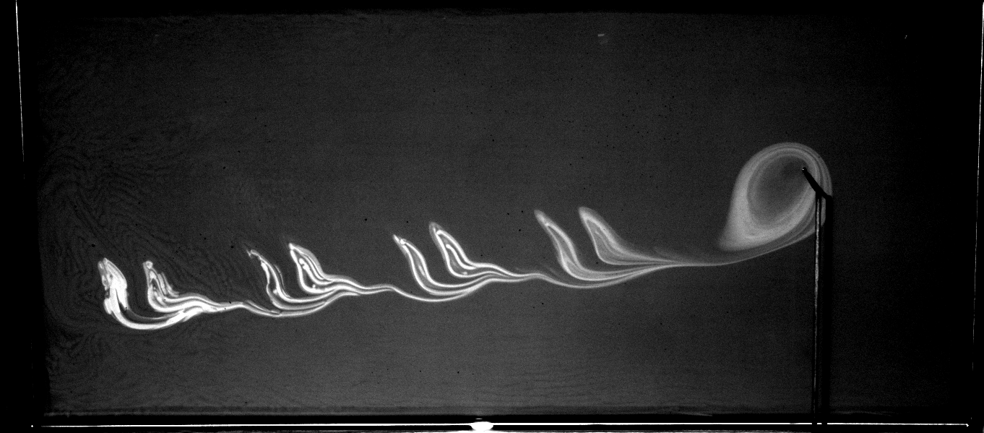
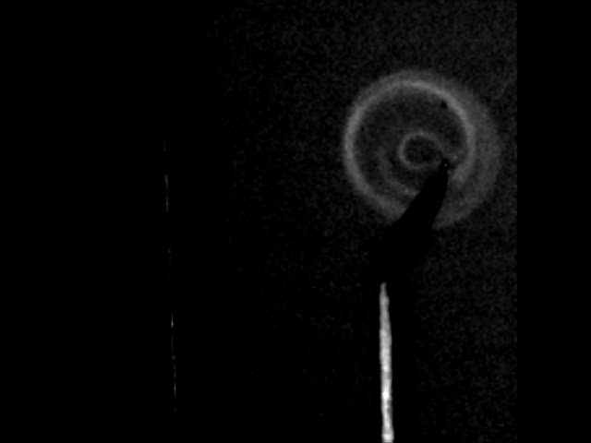
Experimental Studies of reaction front barriers in a single vortex flow
Savannah Gowen, Tom Solomon
Single Vortex with Oscillations
Reaction Subject to Aperiodic Forcing
Sponsored by NSF Grants #PHY-1156964
#DMR-1004744
Characterizing Reaction Barriers in Time Independent and Time Varying Flows

Slide 2
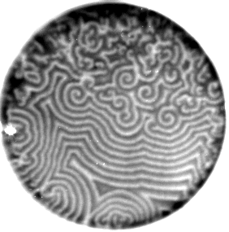
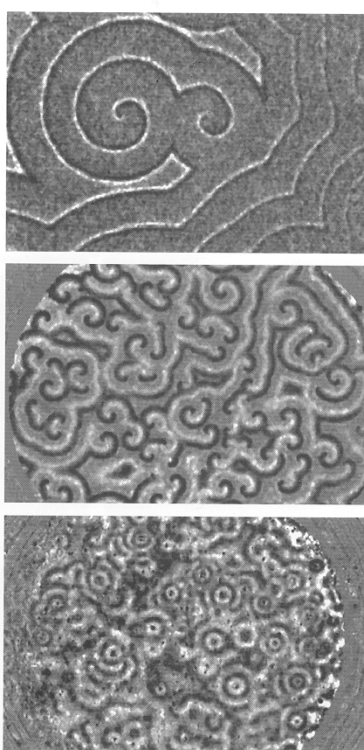
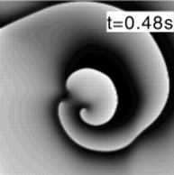
Reactions
Pattern formation due to interaction between reaction and mixing due to molecular diffusion (no fluid flows)
Slime Mold
Culture
Cornelis Weijer (Univ.
Dundee)
Cardiac Tissue
Qu, Weiss and Garfinkel,
A. J. Physiol. Heart Circ.
Physiol 276, H269-H283
(1999)
Belousov-Zhabotinsky (BZ) chemical reaction

Slide 3
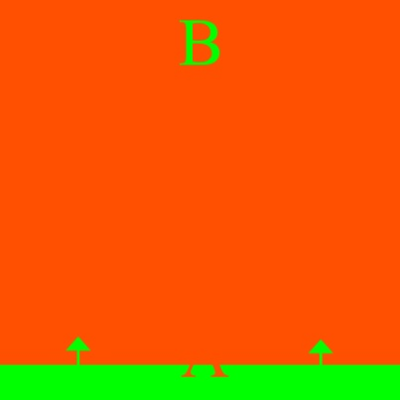
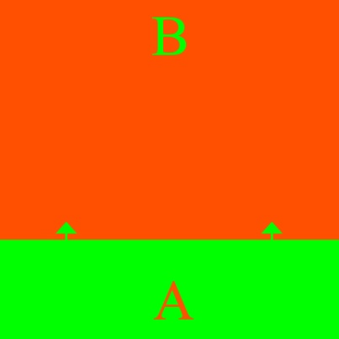
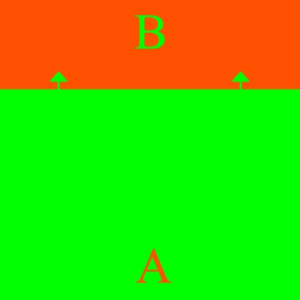

Reaction Front Propagation
  A B
  We can follow the reaction front

Slide 4
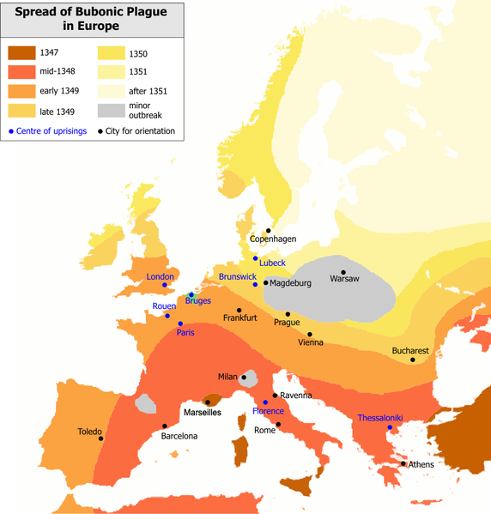
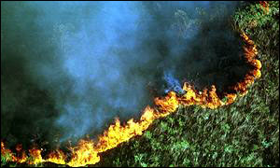
What’s Your Reaction?
Reactions and Front Propagation
  Combustion: forest fires, supernova explosions, fire and gasoline
  Biological: disease spread, predator-prey, embryonic processes
Spread of bubonic plague in Europe
Forest fire in Brazil, image from BBC news, 9/2/1999

Slide 5
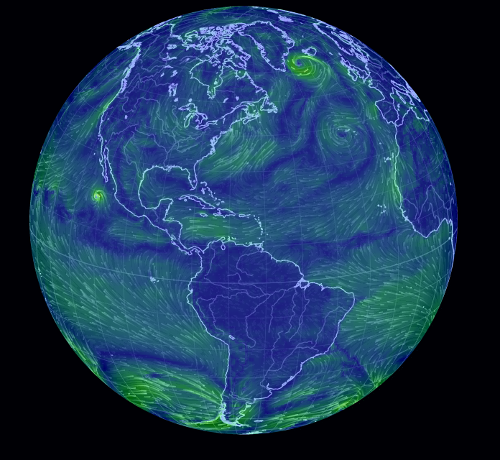
What is Missing?
THE FLOW !
  People move
  Wind
  Ocean Currents
Earth Wind Map from National Weather Services
Question: How Are Reaction Fronts Affected by Laminar Fluid Flows?

Slide 6

Reaction Diffusion
Fisher-Kolomogorov-Petrovskii-Piskunov (FKPP) Theory:
D = molecular diffusivity,
τ = reaction time

Slide 7
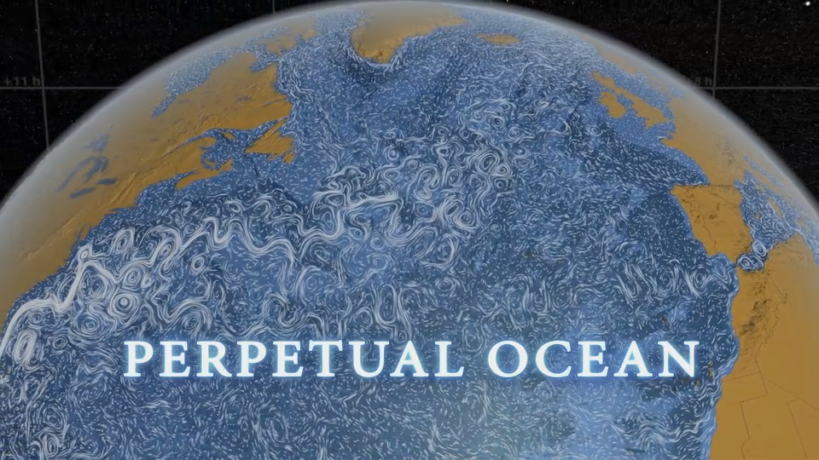
Go With The Flow: The Vortex
Defining Terms:
  Advection
  Laminar
The Vortex
  Agulhas Rings
“Perpetual Ocean” ocean current data compiled by NASA

Slide 8
How can we characterize front propagation in an advection-reaction diffusion system?
Key: BARRIERS!

Slide 9
Barriers
Past Experiments: Vortex chain, ordered array of vortices, disordered array of vortices…

Slide 10
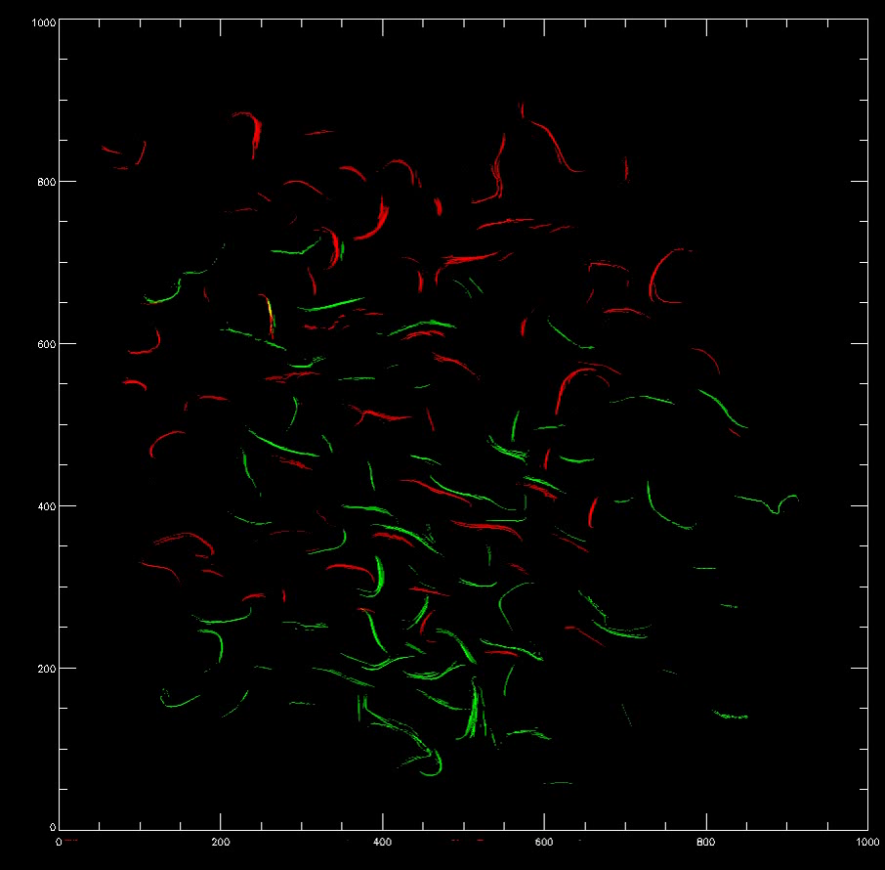
Barriers
Past Experiments: Vortex chain, ordered array of vortices, disordered array of vortices…

Slide 11
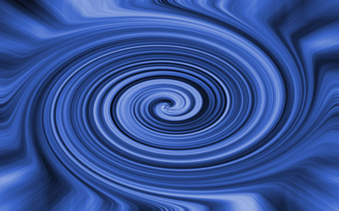
The Single Vortex Experiment
Simplify: One Vortex
  Clearer picture of barriers

Slide 12
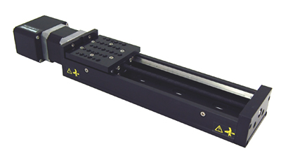
Experimental Setup
Belousov-Zhabotinsky Reaction
X and Y Translation Stages
BIG Honkin’ Magnet
  2.5 “diameter cylinder or 4X4” square
Rectangular Box
View from above:
Stage 1
Stage 2

Slide 13
Experimental Setup
I
Magnetohydrodynamic forcing; radial current interacts with strong magnetic field from large magnet.
Electrode and magnet translate together, causing vortex to move through fluid.
Two perpendicular translation stages – full motion possible in x-y plane.

Slide 14
Experimental Setup
I
Magnetohydrodynamic forcing; radial current interacts with strong magnetic field from large magnet.
Electrode and magnet translate together, causing vortex to move through fluid.
Two perpendicular translation stages – full motion possible in x-y plane.

Slide 15
Experimental Setup
I
Magnetohydrodynamic forcing; radial current interacts with strong magnetic field from large magnet.
Electrode and magnet translate together, causing vortex to move through fluid.
Two perpendicular translation stages – full motion possible in x-y plane.

Slide 16
Experimental Setup
I
Magnetohydrodynamic forcing; radial current interacts with strong magnetic field from large magnet.
Electrode and magnet translate together, causing vortex to move through fluid.
Two perpendicular translation stages – full motion possible in x-y plane.

Slide 17
Experimental Setup
I
Magnetohydrodynamic forcing; radial current interacts with strong magnetic field from large magnet.
Electrode and magnet translate together, causing vortex to move through fluid.
Two perpendicular translation stages – full motion possible in x-y plane.

Slide 18
Experimental Setup
I
Magnetohydrodynamic forcing; radial current interacts with strong magnetic field from large magnet.
Electrode and magnet translate together, causing vortex to move through fluid.
Two perpendicular translation stages – full motion possible in x-y plane.

Slide 19
Experimental Setup
I
Magnetohydrodynamic forcing; radial current interacts with strong magnetic field from large magnet.
Electrode and magnet translate together, causing vortex to move through fluid.
Two perpendicular translation stages – full motion possible in x-y plane.

Slide 20
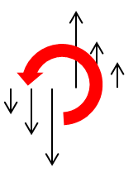

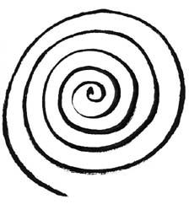
Particle Tracking
Theory requires velocity field
Particle tracking in different box locations
Fitting Data
4
5
1
Sample Velocity Field for the Single Vortex
2
3

Slide 21
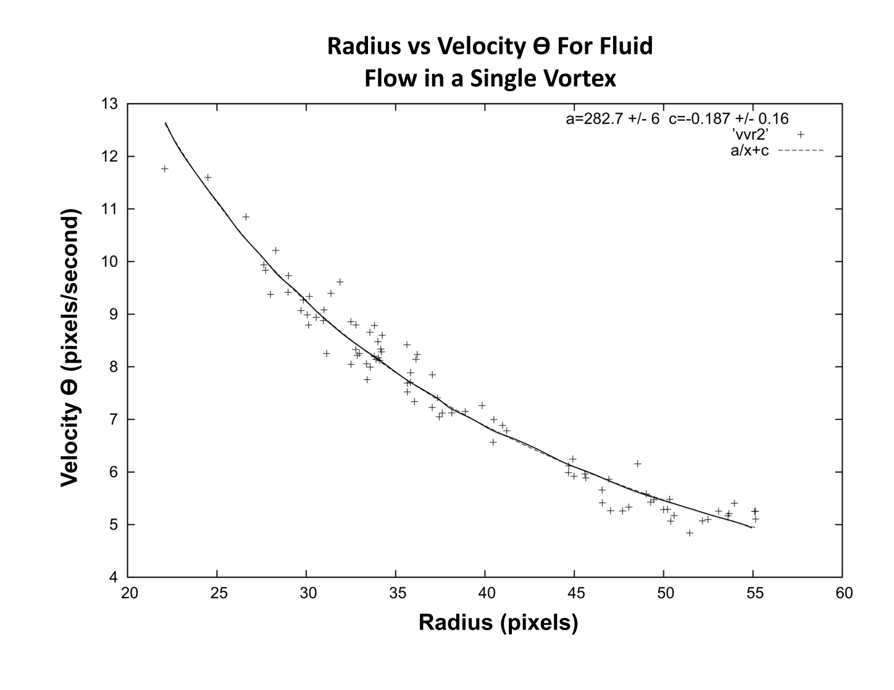
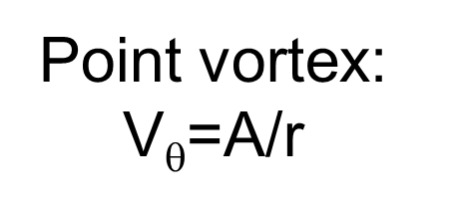
Confirms Velocity Field:

Slide 22

Time Independent
Imposed Wind, same as translation

Slide 23
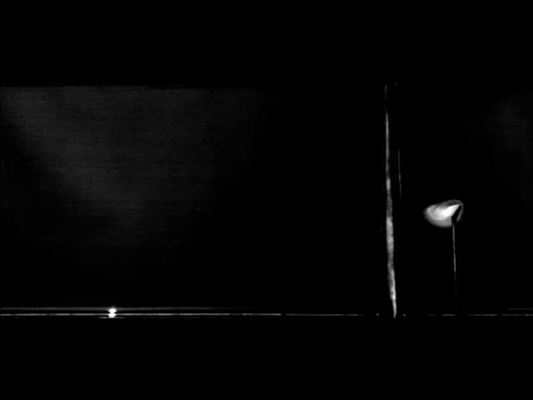
Time Independent
Movie in reference frame of vortex

Slide 24
Passive Invariant Manifolds
Classifying mixing barriers
Fixed point
  Velocity (u)=0
+
=
Fixed Point
V Wind

Slide 25
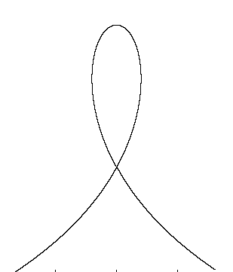
Passive Invariant Manifolds:
Time-Independent Flow
Passive Invariant Manifold: Put a tracer close to the fixed point and integrate forward in time
Homoclinic Manifold:
MANIFOLDS ARE BARRIERS

Slide 26
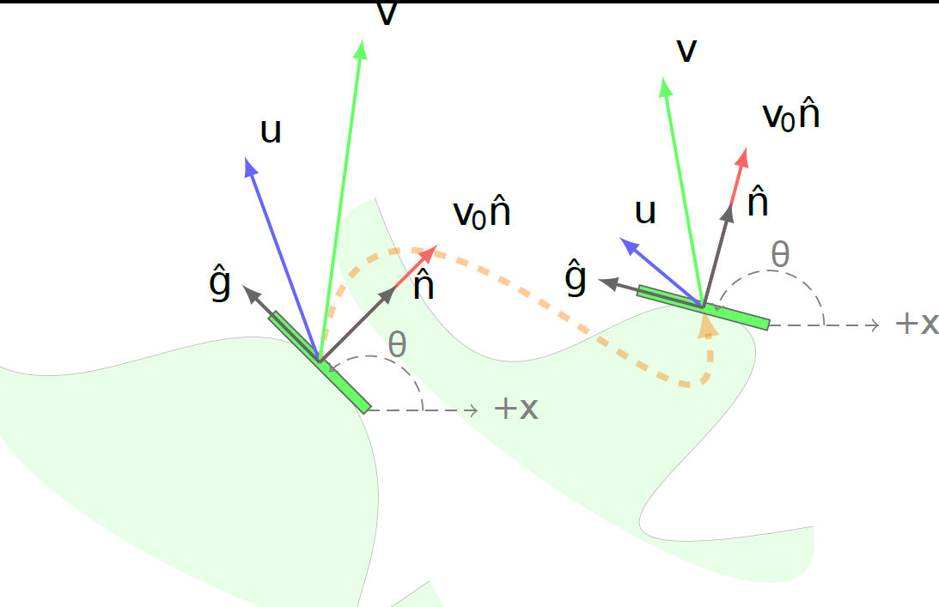
Burning Invariant Manifold (BIM)Theory
Approach: model the evolution of the front
→ 3 variables (x,y,θ) that describe a piece of the front

Slide 27
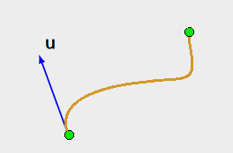
Advection Reaction Diffusion
Mahoney, Bargteil, Kingsbury, Mitchell, and Solomon. EPL (2012)
u: flow velocity
v_{o}: reaction front speed in absence of flow
θ: local angle of front

Slide 28
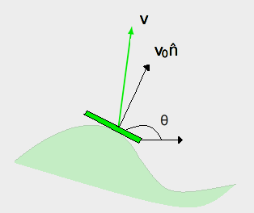
Advection Reaction Diffusion
Mahoney, Bargteil, Kingsbury, Mitchell, and Solomon. EPL (2012)
u: flow velocity
v_{o}: reaction front speed in absence of flow
θ: local angle of front

Slide 29
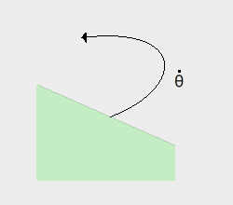
Advection Reaction Diffusion
Mahoney, Bargteil, Kingsbury, Mitchell, and Solomon. EPL (2012)
u: flow velocity
v_{o}: reaction front speed in absence of flow
θ: local angle of front

Slide 30
Burning Invariant Manifold (BIM)Theory
Approach: model the evolution of the front
→ 3 variables (x,y,θ) that describe a piece of the front

Slide 31
Burning Invariant Manifolds
Burning Fixed Points
Burning Invariant Manifolds: Put a large group of tracers close to the burning fixed point and integrate forward in time.

Slide 32
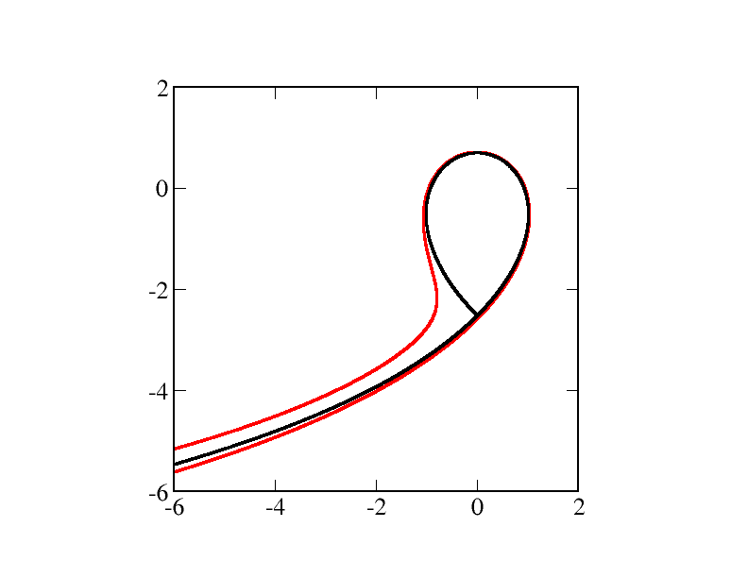
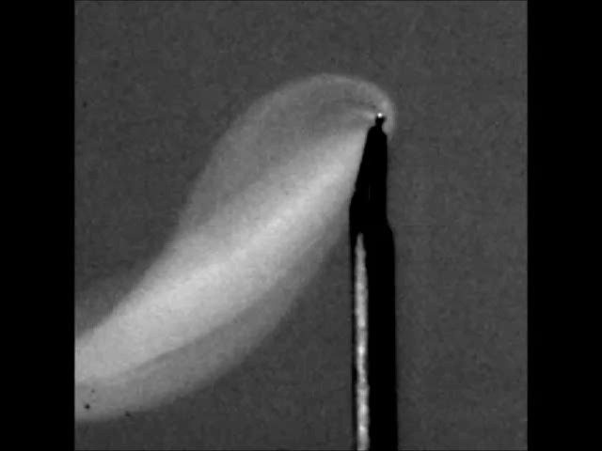
Burning Invariant Manifolds:
Time Independent Flow
Expected Barriers:
Experimental Barriers

Slide 33
Time Dependent
Time Periodic Oscillations

Slide 34



Characterizing Advection Strength
A ratio of the characteristic velocity of the flow over the reaction diffusion velocity
Advection processes are more prominent.
Reaction-diffusion is dominant.

Slide 35
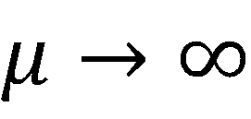
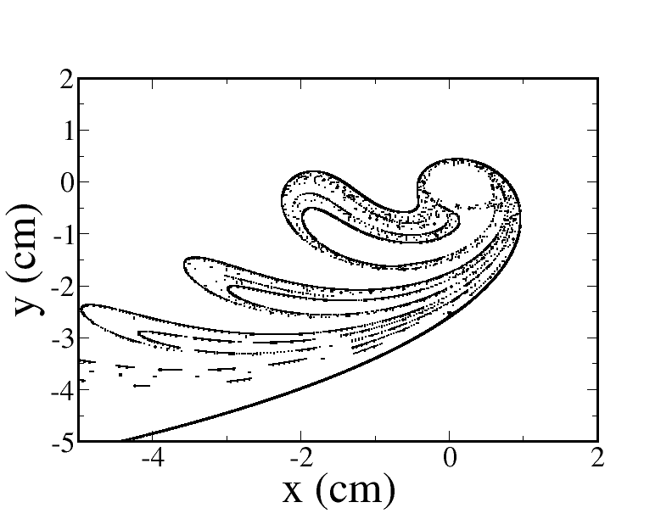

Slide 36

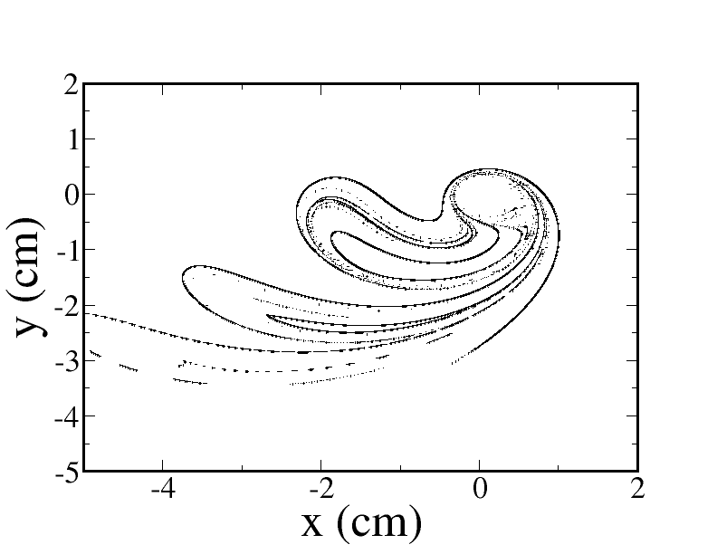
=36

Slide 37
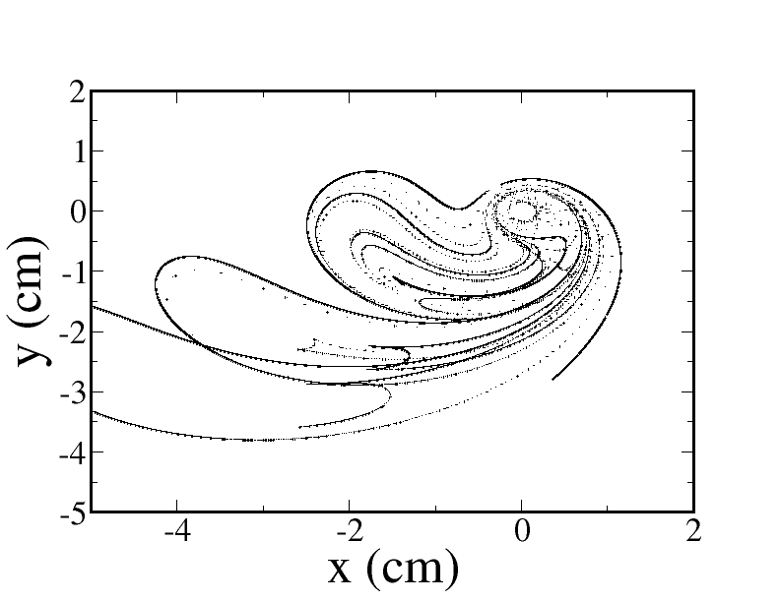
=18.2

Slide 38
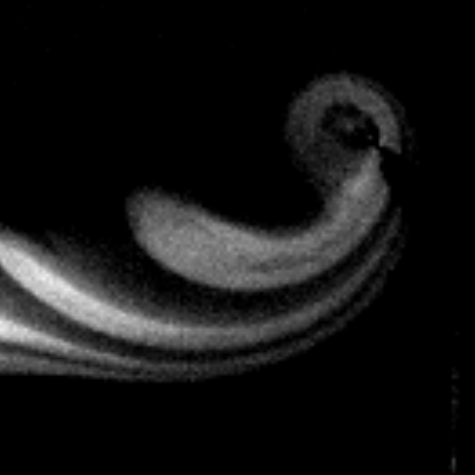
=72

Slide 39
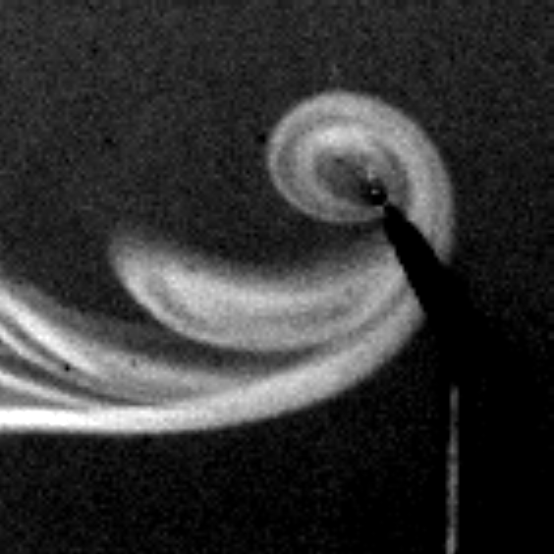
=36

Slide 40
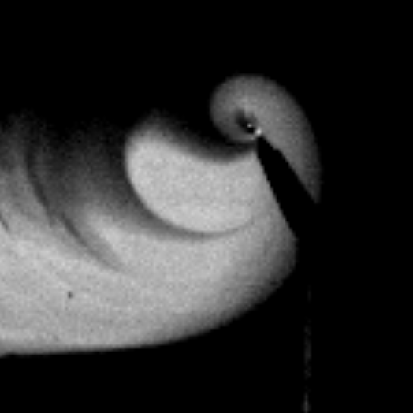
=18.2

Slide 41
Conclusions and Continuing Work
It certainly seems that the BIM theory reflects the reaction front barriers that we are seeing experimentally.
  Extract images at the same phase to compare BIMs
Cover more parameter space and look at different trigger locations
Extending the theory into the aperiodic regime?

Slide 42
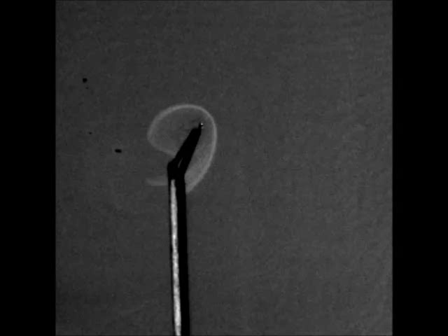
Continuing Work: Aperiodic Motion

Slide 43
Acknowledgments
Jack and Moises
Sandy
Bucknell University Department of Physics and Astronomy
NSF #PHY-1156964 #DMR-1004744
Mount Holyoke College

