Slide 1
Introduction to CPU Scheduling
Notice: The slides for this lecture have been largely based on those from the course text Operating Systems Concepts, 9th ed., by Silberschatz, Galvin, and Gagne. Many, if not all, the illustrations contained in this presentation come from this source. Revised by X.M. from notes by Perrone.

Slide 2
Basic Concepts
P₀
P₁
CPU
P₂
P₃
P₄

Slide 3
Basic Concepts
P₀
P₁
CPU
P₂
P₃
P₄

Slide 4
Basic Concepts
P₀
P₁
CPU
P₃
P₂
P₄

Slide 5
Basic Concepts
P₀
CPU
P₁
P₃
P₂
P₄

Slide 6
Basic Concepts
P₀
CPU
P₄
P₁
P₃
P₂

Slide 7
Basic Concepts
CPU
P₀
P₄
P₁
P₃
P₂
Questions:
When does a process start competing for the CPU?
How is the queue of ready processes organized?
How much time does the system allow a process to use the CPU?
Does the system allow for priorities and preemption?
What does it mean to maximize the system’s performance?

Slide 8
Basic Concepts
You want to maximize CPU utilization through the use of multiprogramming.
Each process repeatedly goes through cycles that alternate CPU execution (a CPU burst) and I/O wait (an I/O wait).
Empirical evidence indicates that CPU-burst lengths have a distribution such that there is a large number of short bursts and a small number of long bursts.

Slide 9
Alternating Sequence of CPU And I/O Bursts

Slide 10
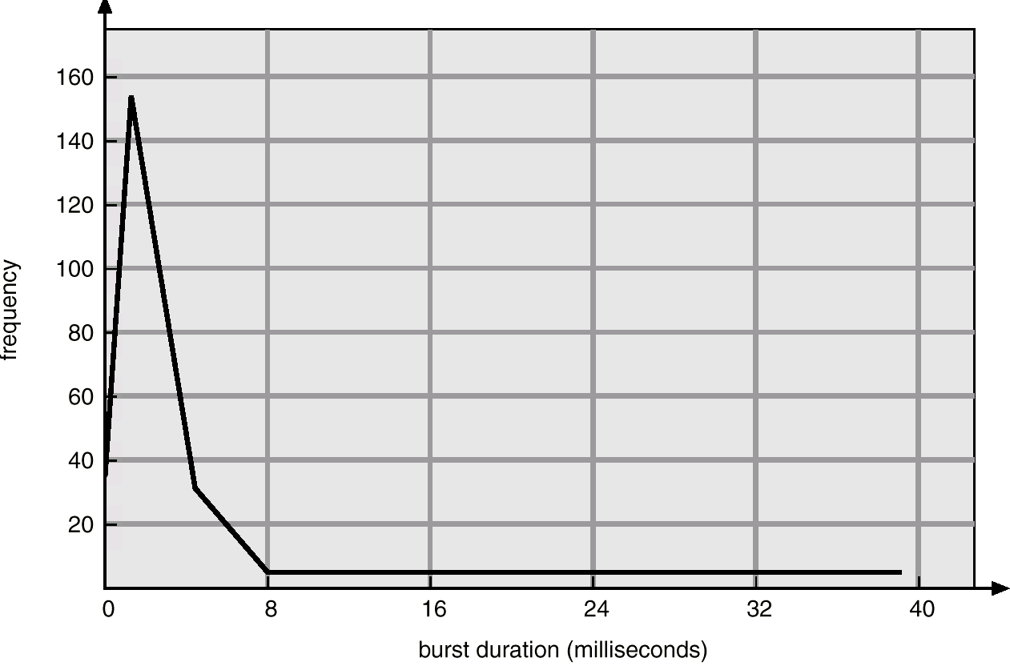
Histogram of CPU-burst Times

Slide 11
CPU Scheduler
AKA short-term scheduler.
Selects from among the processes in memory that are ready to execute, and allocates the CPU to one of them.
CPU scheduling decisions may take place when a process:
1. Switches from running to waiting state (e.g., request I/O)
2. Switches from running to ready state (e.g., time slice expires)
3. Switches from waiting to ready (e.g., completed I/O)
4. Terminates.
Question: Where does the system keep the processes that are ready to execute?

Slide 12
Preemptive Scheduling
In cooperative or nonpreemptive scheduling, when a process takes the CPU, it keeps it until the process either enters waiting state or terminates.
In preemptive scheduling, a process holding the CPU may be forced to give up the CPU. Preemption causes context-switches, which introduce overhead. Preemption also calls for care when a process that loses the CPU is accessing data shared with another process or kernel data structures.

Slide 13
Dispatcher
The dispatcher module in OS gives control of the CPU to the process selected by the short-term scheduler; this involves:
switching context,
switching to user mode,
jumping to the proper location in the user program to restart that program.
The dispatch latency is the time it takes for the dispatcher to stop one process and start another running.

Slide 14
How Do They Work Together? A Big Picture
User actions
OS actions
Time line
init
start shell program for user
…
interrupt handler
read myprog from disk
start myprog on cpu
…
interrupt handler
suspend myprog, do i/o
interrupt handler
resume myprog
User logs in the system
interrupt!
[user@me]$ myprog <ret>
jump start
load $t, a
load $s, b
add $x, $t, $s
print stdout $x
sub $s, 1
store $s, x
store $t, y
I/O trap!
myprog taken
off CPU
i/o cmplt, intrpt

Slide 15
Scheduling Criteria
These are performance metrics such as:
CPU utilization – high is good; the system works best when the CPU is kept as busy as possible.
Throughput – the number of processes that complete their execution per time unit.
Turnaround time – amount of time to execute a particular process.
Waiting time – amount of time a process has been waiting in the ready queue.
Response time – amount of time it takes from when a request was submitted until the first response is produced, not output (for time-sharing environment).
It makes sense to look at averages of these metrics.

Slide 16
Optimizing Performance
Maximize CPU utilization.
Maximize throughput.
Minimize turnaround time.
Minimize waiting time.
Minimize response time.

