Slide 1
CSCI315 – Operating Systems Design Department of Computer Science Bucknell University
Introduction
Ch 1
This set of notes is based on notes from the textbook authors, as well as L. Felipe Perrone and other instructors.
Xiannong Meng, Fall 2020.

Slide 2
What is an Operating System?

Slide 3
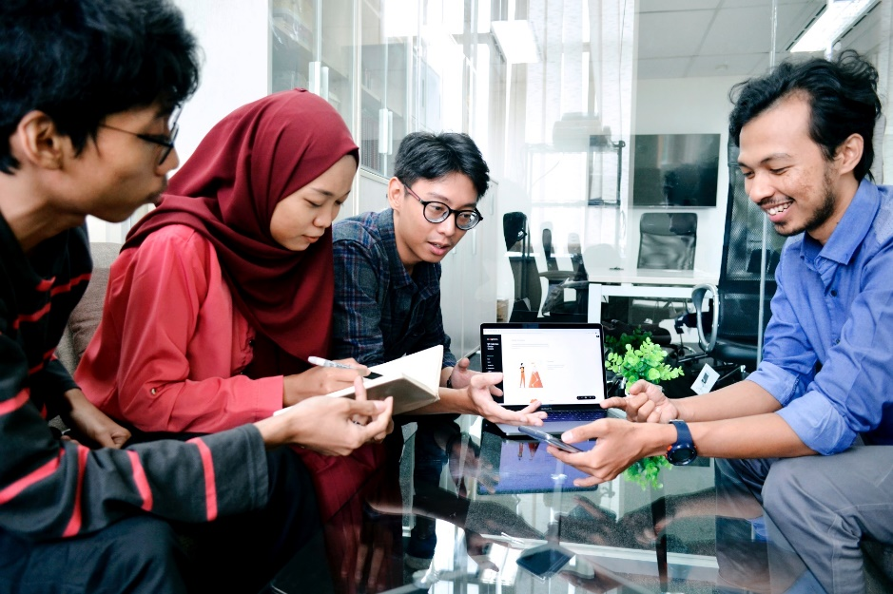
What happens when we ask a computing device such as laptop or smartphone to do something for us?
Photo by UX Indonesia on Unsplash

Slide 4
You type a command such as “gcc -o hello hello.c” or you click a button such as “send.”
The following will be done by the computer (roughly). Take the “gcc” command above as an example.
Read and interpret your command.
Read your hello.c file from the disk into memory.
Compile your program into object code.
Link your object code with appropriate libraries.
Generate and save the executable, which is a file, back to the disk.
Now imagine 30 or so other students are doing exactly the same thing as you are in a lab setting.
How a single computer such as linuxremote.bucknell.edu handle this?

Slide 5
What does an operating system do
Operating systems such as Linux, Windows, MacOS, Android work with a collection of systems and applications software such as gcc, browsers, text editors, Word, and many, many others to provide the users with an effective and useful computing environment to accomplish user tasks.
Operating systems are themselves a piece of software that interacts among the hardware, the applications software, and the users.
They are a resource manager that allocate resources such as memory, disk, and CPU time to applications.

Slide 6
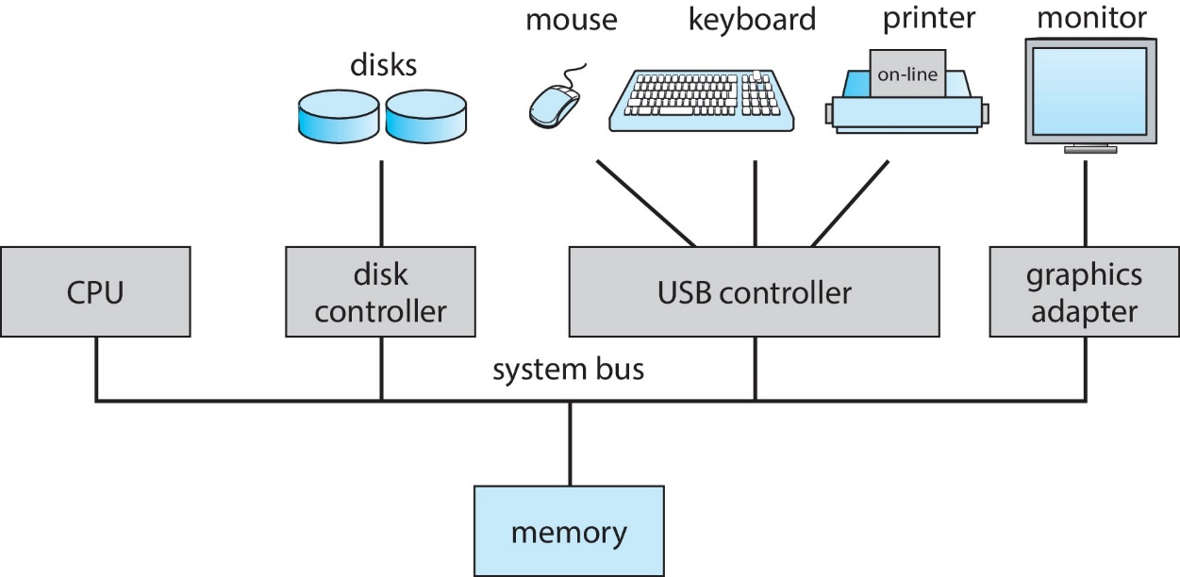
A Modern Computer System
The blocks shown are hardware components. Software runs on these components.

Slide 7
Computer System Components
1. Hardware – provides basic computing resources (CPU, memory, I/O or Input and Output devices).
2. Operating system – controls and coordinates the use of the hardware among the various application programs for different users.
3. Applications programs – define the ways in which the system resources are used to complete the computing tasks of the users (compilers, database systems, video games, business programs).
4. Users (people, machines, other computers).

Slide 8
Macroscopic Abstract View of the Computer System
Application Programs
Operating System
Hardware

Slide 9
What does an Operating System do?
A "program" that acts as an intermediary between a user of a computer and the computer hardware.
Manage resources in the computer system
Control the execution of programs

Slide 10
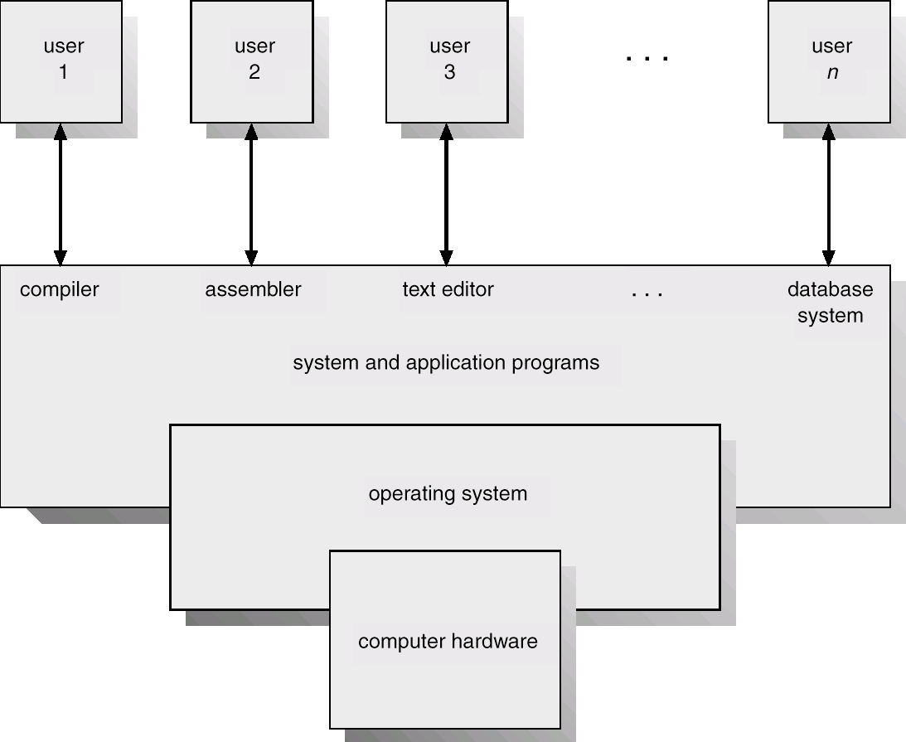
Abstract View of System Components

Slide 11
Operating System Definitions
An operating system can be defined in any of the three ways.
Resource allocator – manages and allocates resources.
Control program – controls the execution of user programs and operations of I/O devices.
Kernel – the one program “running” at all times (all else being application programs).

Slide 12
Operating systems evolution

Slide 13
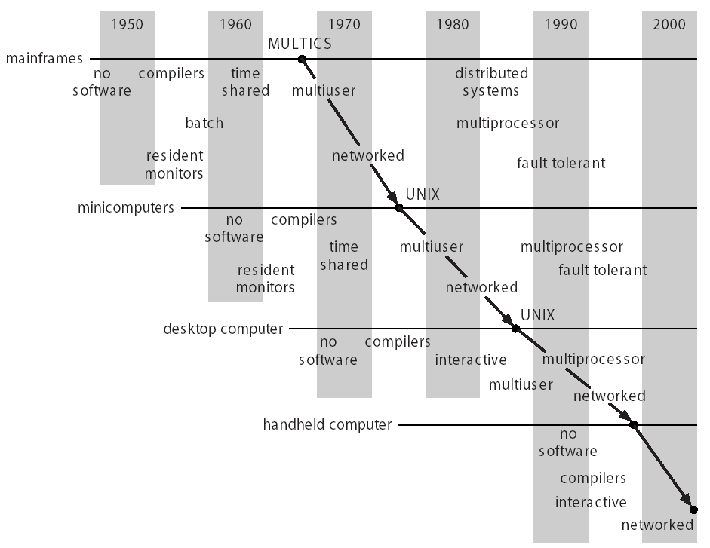
OS Evolution Timeline

Slide 14
Mainframes
Centralized computing;
Users submit jobs through “batched” system;
Multiple jobs take turns to run – the operating system decides which one to run at what time;
No direct user interaction.

Slide 15
Time-Sharing Systems and Interactive Computing
The CPU is multiplexed among all (usually many) jobs that “time share” the computer.
Computing jobs may be swapped in and out between memory and disk.
Interactive communication between the user and the system is provided:
When the operating system finishes the execution of one command, it seeks the next “control statement” from the user’s keyboard
Interactive communication must be available for users to access data and code. (Another way to communicate with the system is through “batch” jobs.)

Slide 16
Desktop Systems
Personal computers – computer system dedicated to a single user.
I/O devices – keyboards, mice, display screens, small printers.
User convenience and responsiveness.
Technology adopted from larger operating system:
Often individuals have the sole use of the computer and do not need advanced CPU utilization of protection features.
May run several different types of operating systems (Windows, MacOS, UNIX, Linux).

Slide 17
PC Motherboard

Slide 18
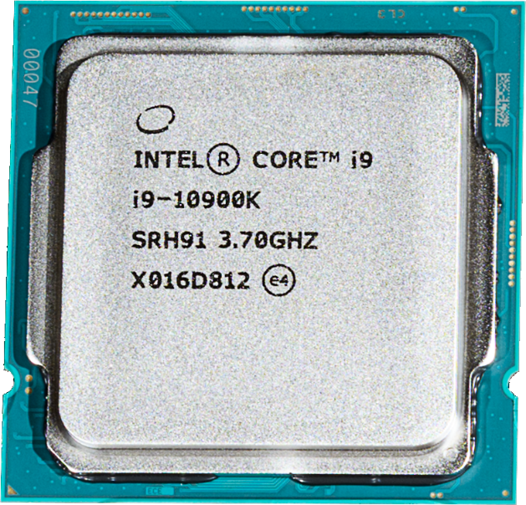
Intel Core i9 Processor (CPU)
https://en.wikipedia.org/wiki/File:Intel_Core_i9-10900K.png

Slide 19
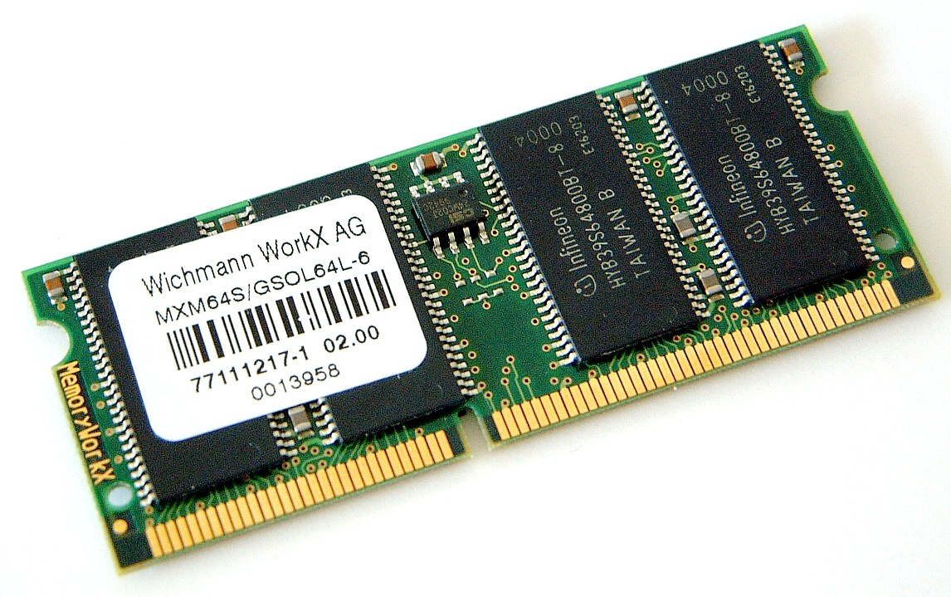
SDRAM Board Example
https://commons.wikimedia.org/wiki/File:SODIMM_64MB_SDRAM.JPG

Slide 20
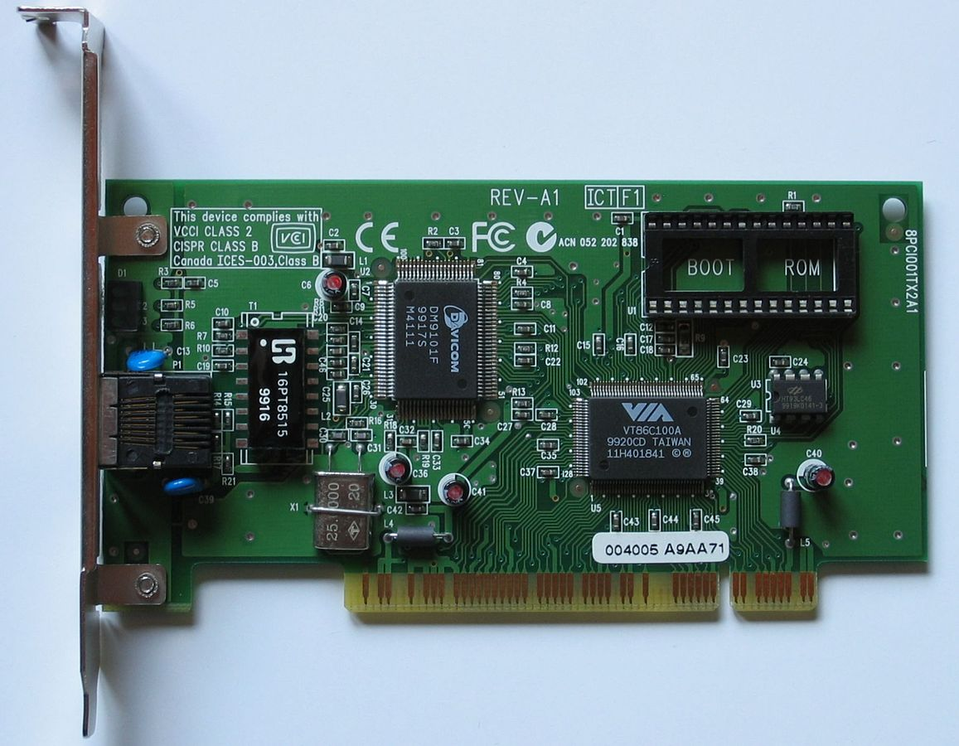
PCI Board Example: Fast Ethernet
https://commons.wikimedia.org/wiki/File:Fast_Ethernet_PCI_Network_Interface_Card_SN5100TX_(VIA_VT86C100A).jpg

Slide 21
Parallel Systems
Systems with more than one CPU in close communication (a.k.a. multiprocessor systems), or more than one core on a single processor, a.k.a. multi-core systems.
Tightly coupled system – processors share memory and a clock; communicate through the shared memory.
Advantages of parallel system:
Increased throughput
Economical
Increased reliability (in some cases)
graceful degradation
fail-soft systems

Slide 22
Symmetric Multiprocessor Architecture
...
CPU
CPU
CPU
System bus
Memory

Slide 23
Distributed or Networked Systems
Distribute the computation among several physical processors.
Loosely coupled system – each processor has its own local memory; processors communicate with one another through various communications medium, such as high-speed buses or internet.
Advantages of distributed systems:
Resources Sharing;
Computation speed up – load sharing;
Reliability;
Communications.
In the lab work we do, you will experiment with this model (client and server)

Slide 24
Networked Systems Architecture (client-server model)
...
Client computer
Client computer
Client computer
Internet
or local network
Server computer

Slide 25
Clustered Systems
Like multiprocessor systems, but multiple systems working together
Usually sharing disk storage via a storage-area network (SAN)
Provides a high-availability service which survives failures
Asymmetric clustering has one machine in hot-standby mode
Symmetric clustering has multiple nodes running applications, monitoring each other
Some clusters are for high-performance computing (HPC)
Applications must be written to use parallelization
Our Linux systems such as linuxremote can be considered as an example of clustered system.

Slide 26
Real-Time Systems
Often used as a control device in a dedicated application such as controlling scientific experiments, medical imaging systems, industrial control systems, and some display systems.
Well-defined fixed-time constraints.
For example, a computing system that controls the launch and flight of a space-craft.

Slide 27
Embedded Systems
Appliances, smart sensors, digital control systems.
Issues:
Limited memory;
Slower processors;
Small display screens (if any).
For example, our classroom temperature control system.

