Slide 1
CSCI315 – Operating Systems Design Department of Computer Science Bucknell University
Operating Systems Services and I/O
Ch 2.1-2.4, 12.1-12.3
This set of notes is based on notes from the textbook authors, as well as L. Felipe Perrone and other instructors.
Xiannong Meng, Fall 2020.

Slide 2
Services Provided by OS (users 1 of 2)
Provide users with direct services
User interfaces: command line, GUI
Program execution: running programs
I/O: printing, viewing screen, issuing commands
File operations: creating and maintaining files on disks

Slide 3
Services Provided by OS (users 2 of 2)
Provide users with direct services (cont.)
Process communication: user programs can talk to each other
Error detecting and handling: notifying users with program errors, not bringing down the system

Slide 4
Services Provided by OS (systems)
Services needed by the system
Resource management: allocating CPU time, memory, storage for all programs, including user programs
Logging: keeping track of the resource usage and error status
Protection and security: making sure the programs access only the authorized resources

Slide 5
Input and output

Slide 6
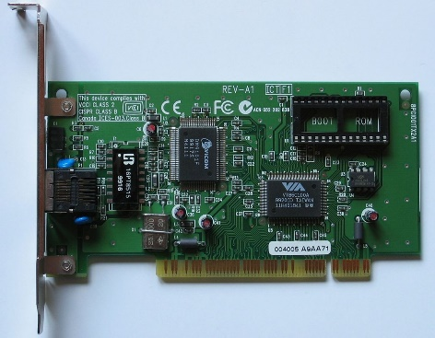
Computing System Input and Output
Assumptions:
Wired network card controller
I/O devices and the CPU can execute concurrently.
Each device controller is in charge of a particular device type.
Each device controller has a local buffer – memory on board.
There must be some mechanism to move data between main memory and local buffers.
I/O operations move data between the device and a controller’s local buffer.
There must be some mechanism for the CPU to learn that an I/O operation has completed.

Slide 7
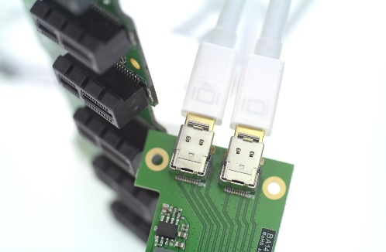
Commonly Used Terms
Two USB ports
Controller: A piece of hardware along with the software that works between the hardware device and the CPU
Device driver: The program (software) that operates or controls a device for the computer system
Port: The connection point for device
Bus: Wires that the data and commands travel through
Polling: The operating system periodically checks the status of an I/O device
Interrupt: The I/O device in operation sends signal to the operating system when I/O is ready or needed

Slide 8
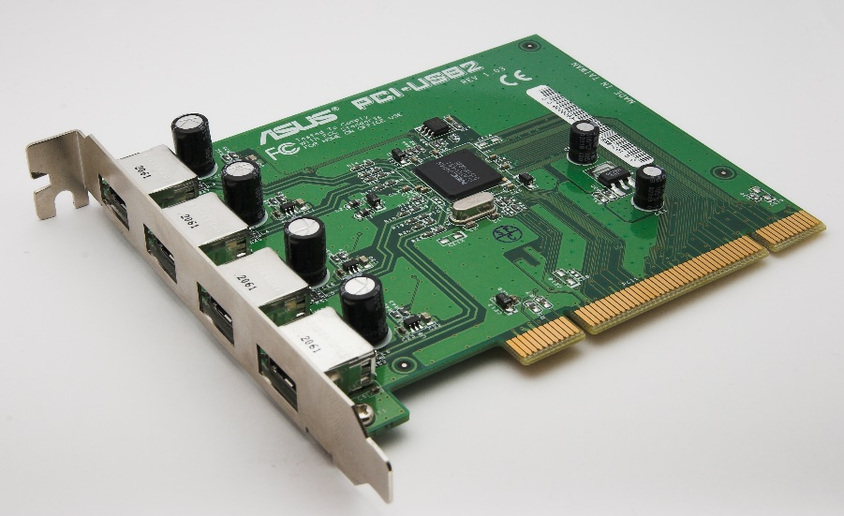
An Example of Controller
We’ve seen the Fast Ethernet controller in last lecture. Here is another one: a controller for USB ports
Connectors to bus
USB ports
https://commons.wikimedia.org/wiki/File:USB2-PCI_Card.jpg

Slide 9
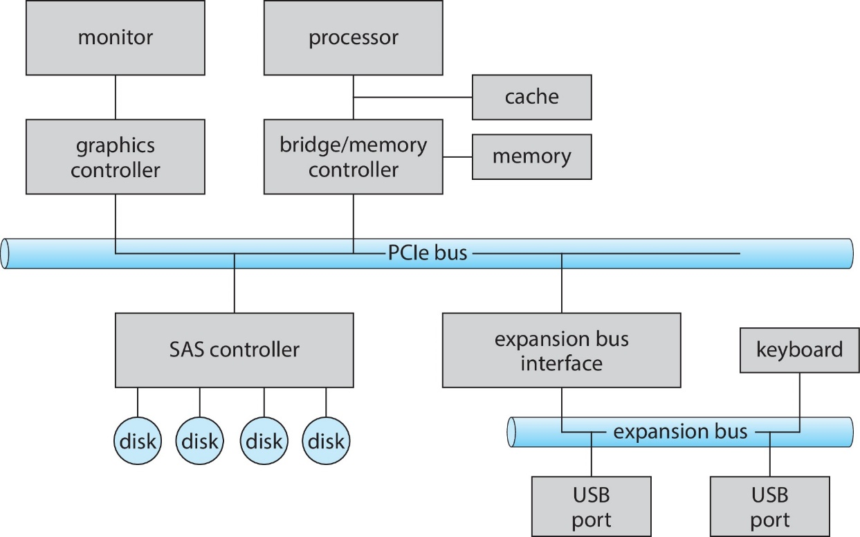
A Typical PC Bus Structure

Slide 10
I/O Option 1: Polling
initiate I/O
ask device if data is ready
data is ready
end I/O
data is not ready
wait some time
The Simpsons:
https://www.youtube.com/watch?v=18AzodTPG5U

Slide 11
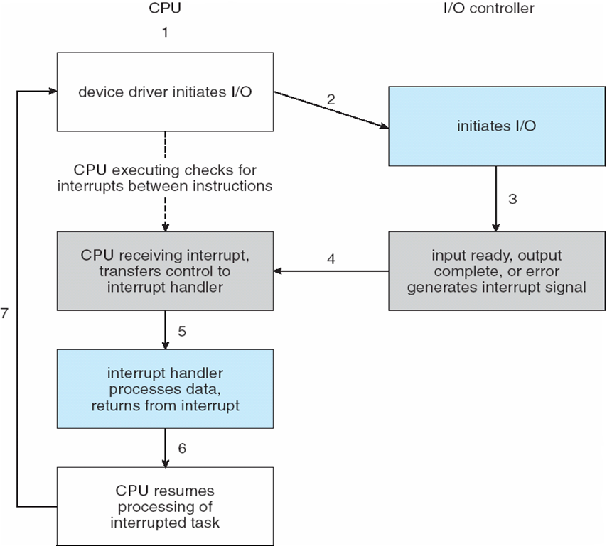
I/O Option 2: Interrupt

Slide 12
Direct Memory Access (1)
Used to avoid programmed I/O (one byte at a time) for large data movement
Requires DMA controller
Bypasses CPU to transfer data directly between I/O device and memory

Slide 13
Direct Memory Access (2)
OS sends the request to DMA controller. The request (command block) includes
Source and destination addresses
Read or write mode
Count of bytes
Writes location of command block to DMA controller
DMA controller gains control of the bus and starts data transfer
When done, interrupts to signal completion

Slide 14
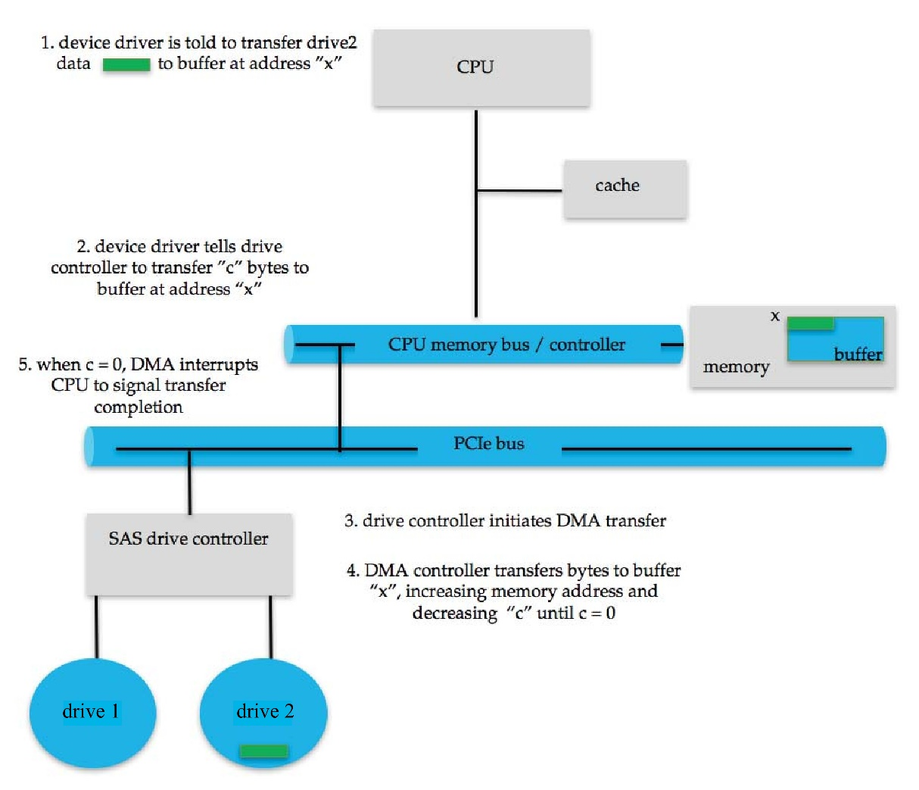
Six Steps in DMA Transfer
destination
source

Slide 15
Hardware Support for the OS
Two classes of instructions: one class for everyone to use, others with privileged use (for the OS kernel).
Need to be able to switch between user mode and kernel mode.
To switch to kernel mode, you need to trap to the kernel.

