Slide 1
CSCI315 – Operating Systems Design Department of Computer Science Bucknell University
Booting an Operating System
External reading
This set of notes is based on notes from the textbook authors, as well as L. Felipe Perrone and other instructors.
Xiannong Meng, Fall 2020.

Slide 2
Steps in Booting an OS (1)
Power on
The BIOS (Basic I/O System) does the following
Power On Self Test (POST) to check all hardware
Find out the “booting drive” name
It is configurable through BIOS, e.g., USB, CD-ROM, hard-disk …
Read and execute the program at the boot sector from the booting drive (a 512 byte program)
This program is usually called the bootstrap program.
It is written in assembly. (why?)

Slide 3
Steps in Booting an OS (2)
The bootstrap program does a number of things
Set up registers so that memory can be separated into segments such as code, data, heap, and stack.
Initialize register values so that proper memory addresses can be computed.
Set up the partition table for the booting device.
Read the rest of the operating system program into memory from the booting device and start running the operating system.

Slide 4
Examining Two Bootstrap Examples
Let’s look at two simple, working, but incomplete bootstrap examples.
“boot_demo.asm” which does nothing at the end of the startup.
“hello_world_bootable_mem_mapped.asm” which prints a “hello world” message through a memory-mapped buffer.

Slide 5
Executing the Examples
These programs can run on a real x86 machine or on an emulator.
We’ll run them on an emulator, bochs. The following are the screenshots of these two programs in execution.
Read the “readme.txt” and “Makefile” in the directory of http://www.eg.bucknell.edu/~cs315/F2020/meng/code/boot for details.

Slide 6
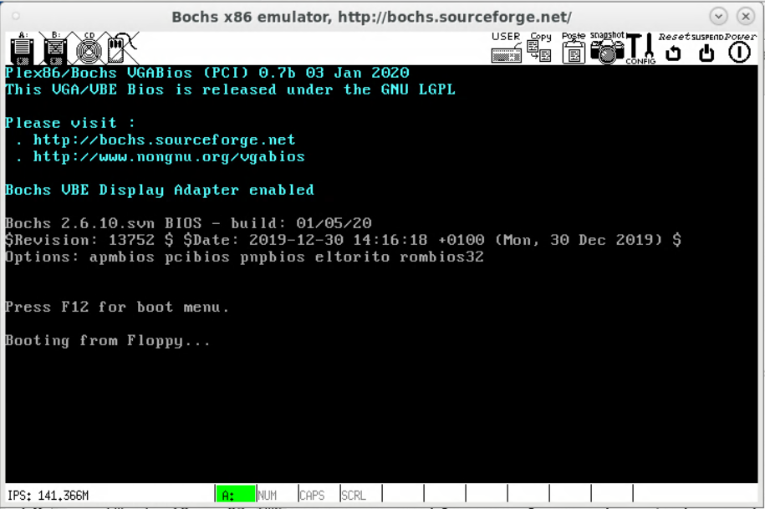
“boot_demo” that does nothing
http://www.eg.bucknell.edu/~cs315/F2020/meng/code/boot/boot_demo.asm
https://www.cs.bham.ac.uk/~exr/lectures/opsys/10_11/lectures/os-dev.pdf

Slide 7
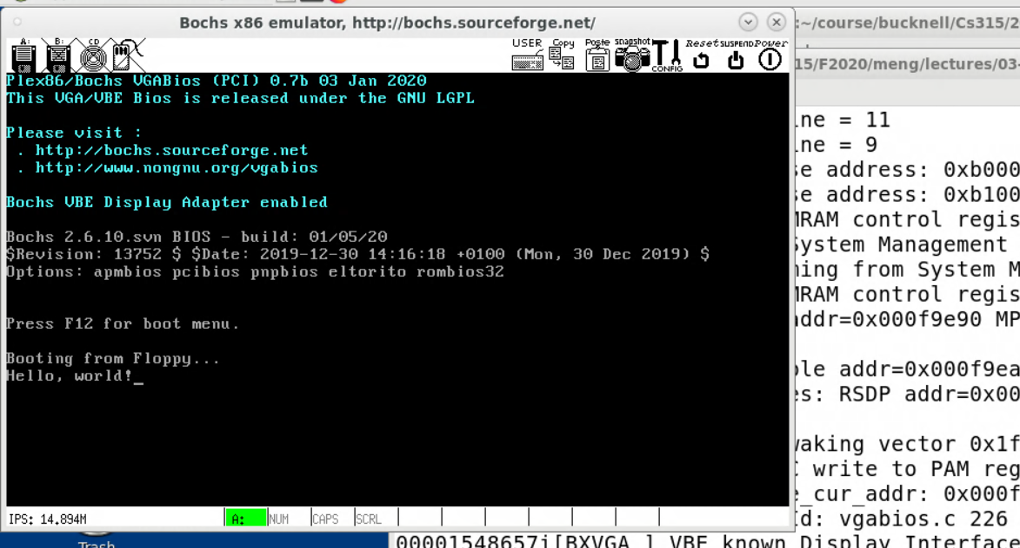
“hello_world_bootable”
Printed by the bootstrap program
http://www.eg.bucknell.edu/~cs315/F2020/meng/code/boot/hello_world_bootable.asm
Original from: https://thiscouldbebetter.wordpress.com/2011/03/15/creating-a-bootable-program-in-assembly-language/

Slide 8
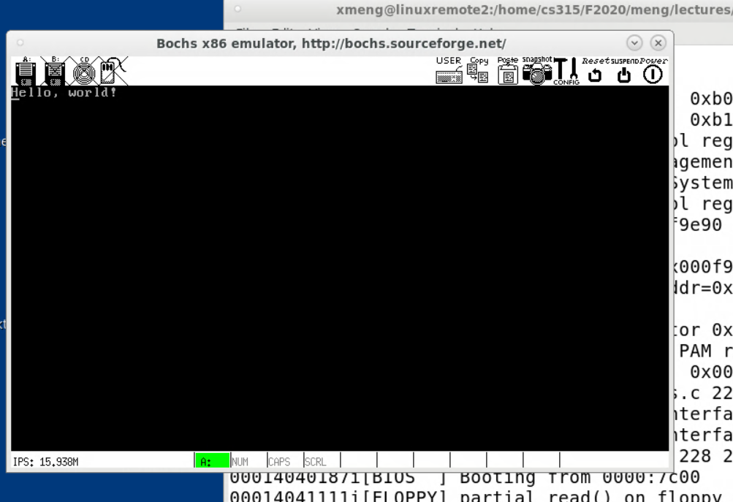
“hello_world_mem_mapped”
Printed by our bootstrap program, screen cleared.
http://www.eg.bucknell.edu/~cs315/F2020/meng/code/boot/hello_world_bootable_mem_mapped.asm
Original from: https://thiscouldbebetter.wordpress.com/2011/03/17/displaying-text-in-assembly-without-interrupts/

Slide 9
Four Key Features
The program must reside at the boot sector of the booting device.
The size of the program must be 512 bytes.
The 511th byte must have the value of 0x55 and 512th bytes 0xAA.
The program must be in an infinite loop.

Slide 10
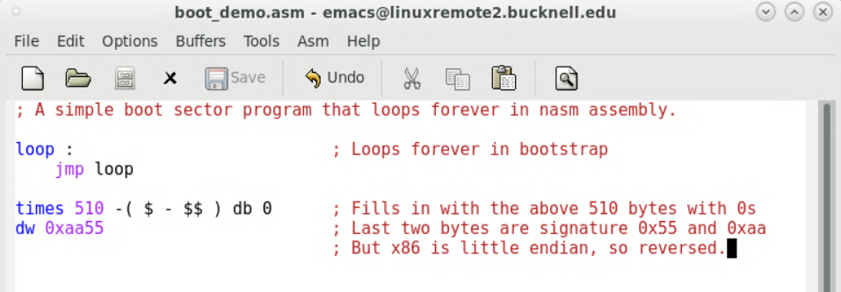
Simplest Bootstrap Program
boot_demo.asm

Slide 11
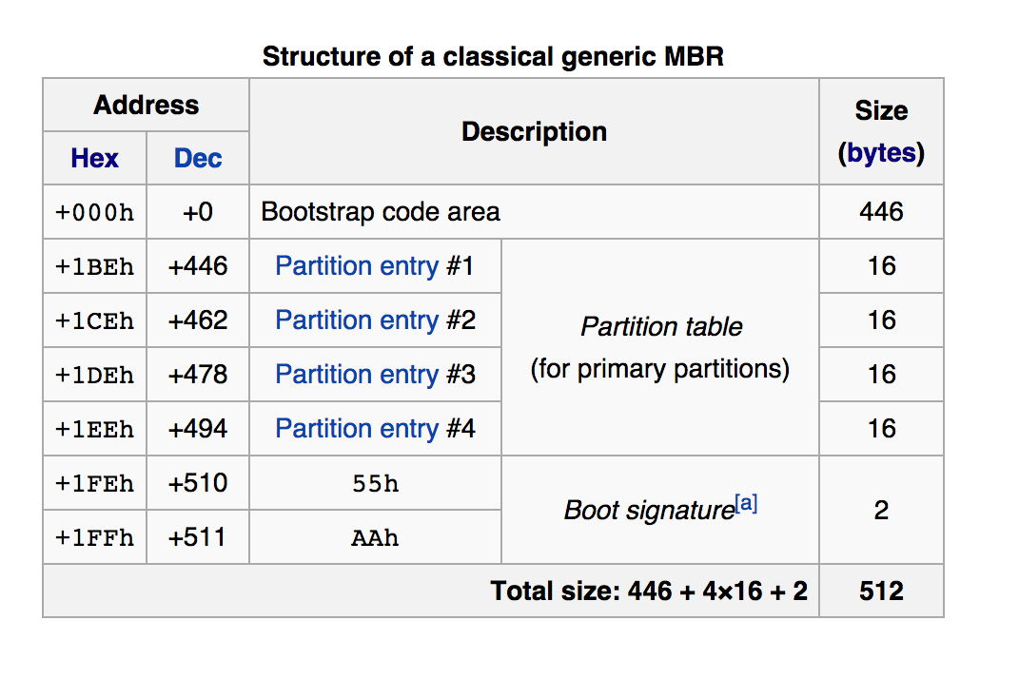
Logic Structure of Boot Loader
code size
total size
MBR: Master Boot Record

Slide 12
Partition Table Entry
Each of the four partition table entry is a 16-byte value, indicating how the device (disk) is partitioned.
https://en.wikipedia.org/wiki/Master_boot_record#PTE

Slide 13
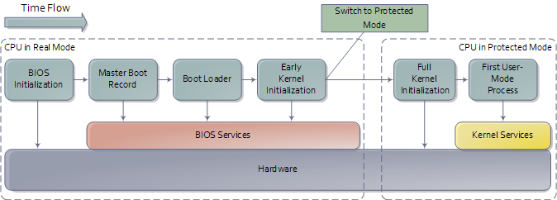
Booting up the OS
BIOS is firmware (flash memory). Power on self tests (POST) check if machine is in shape to run.
Every bootable disk has an MBR, which contains a bootstrap program and a partition table. Each partition has a boot sector with the boot loader.
Source: http://duartes.org/gustavo/blog/post/how-computers-boot-up/

