Slide 1
CSCI315 – Operating Systems Design Department of Computer Science Bucknell University
Processes: Concepts and their Creation
This set of notes is based on notes from the textbook authors, as well as L. Felipe Perrone, Joshua Stough, and other instructors.
Xiannong Meng, Fall 2020.
Ch 3

Slide 2
We discuss the basic concept and creation of a process first, other topics later to fit the lab schedule.

Slide 3
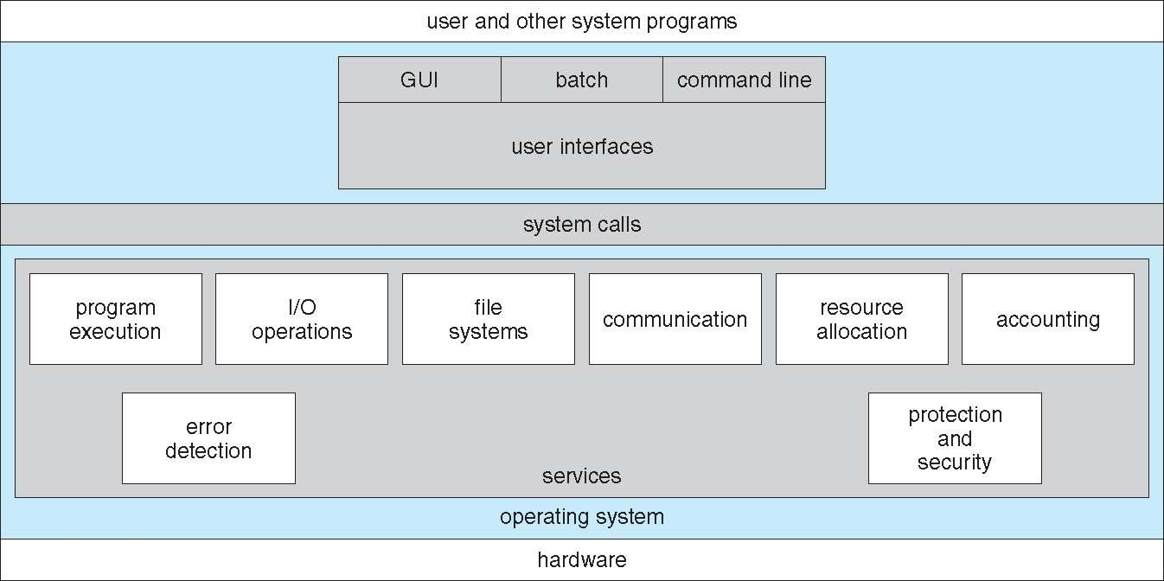
OS Services
The entire blue area is operating system.

Slide 4
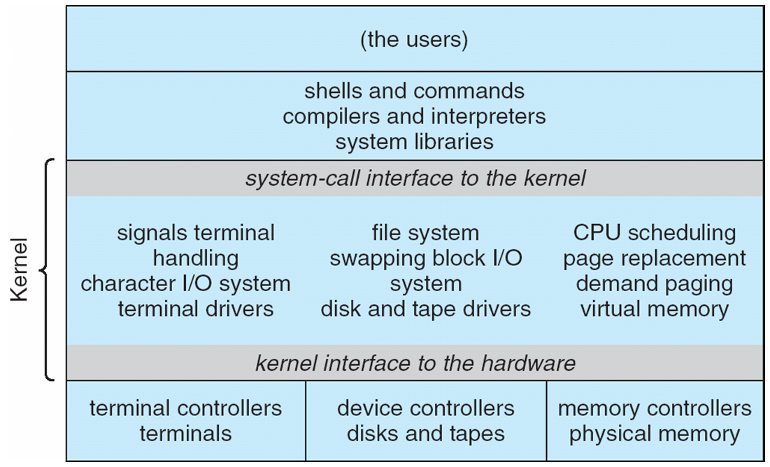
Unix Structure

Slide 5
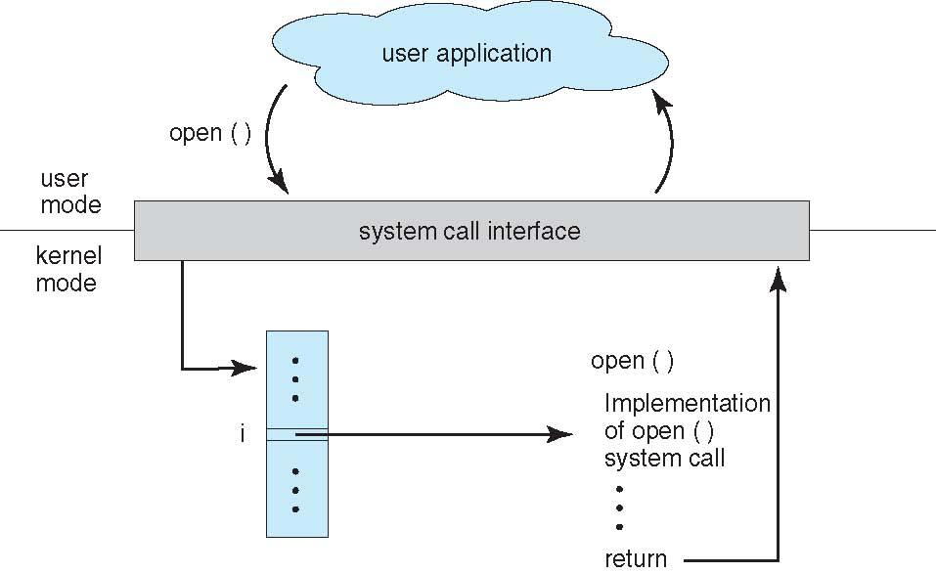
System Calls and the OS
Take the “open()” call as an example.
$ man 2 open

Slide 6
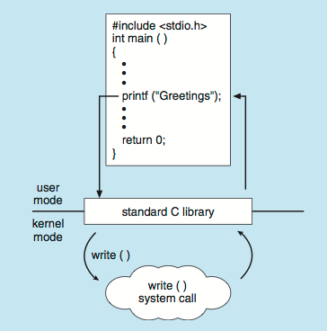
System Calls and Libraries
“printf()” is a C library function.
$ man 3 printf

Slide 7
Process Concept
Process – a program in execution; the code in a process executes sequentially.
A process includes:
program counter,
code,
stack,
heap,
data section.
stack
heap
Memory
Map
data
program counter
code

Slide 8
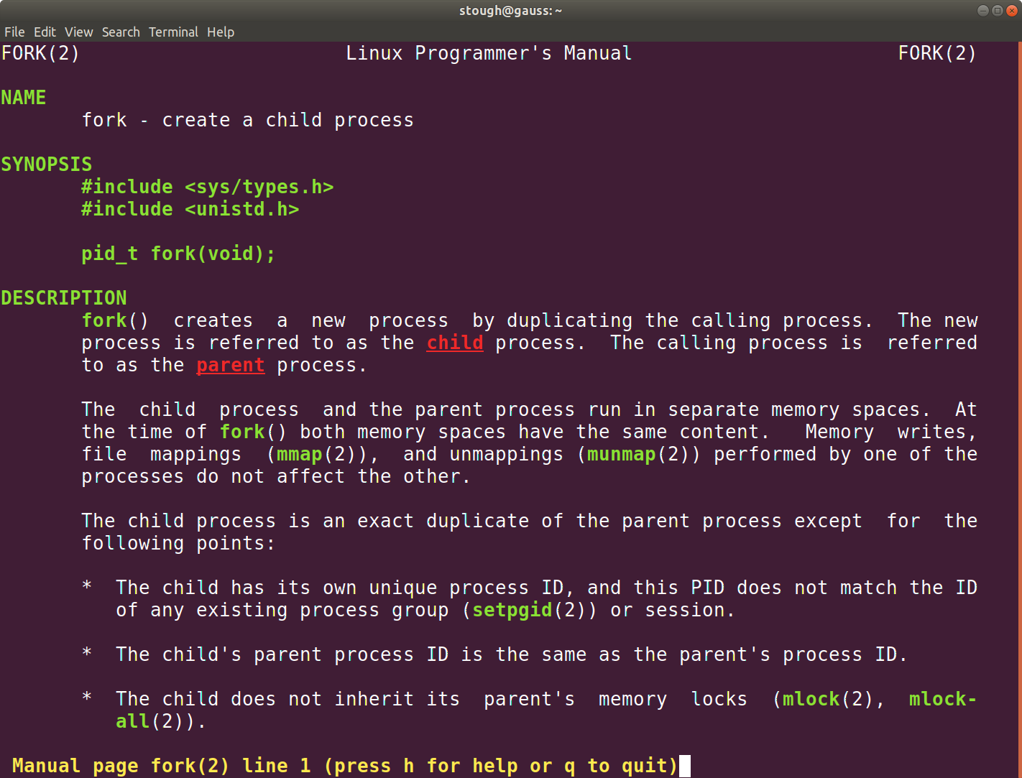
All processes in Unix are created through fork()

Slide 9
Forking
(yeah, it’s a thing, a Unix thing)
Flow of execution
Location
where fork()
is called.
fork();

Slide 10
Forking
(yeah, it’s a thing, a Unix thing)
parent process
Note that the child process and the parent process are identical at the moment of calling fork(). They differ when execution starts.
Location
where fork()
is called.
child process
fork();
fork();
Location
where fork()
is called.

Slide 11
Forking
(what that return value is for)
parent
int pid;
Location
where fork()
is called.
pid = fork();

Slide 12
Forking
(what that return value is for)
parent
int pid;
child
pid = fork();
int pid;
what’s the value of pid?
pid = fork();
what’s the value of pid?

Slide 13
Using fork safely
int pid;
…
pid = fork();
if (0 != pid) {
// code of the parent
…
} else {
// code of the child
…
}
…

Slide 14
Using fork safely
int pid;
…
pid = fork();
if (0 != pid) {
// code of parent P
…
} else {
// code of child C
…
}
…
P
C

Slide 15
Using fork safely
int pid1, pid2;
pid1 = fork();
if (0 != pid1) {
// code of parent P
…
} else {
pid2 = fork();
// code of child C1
if (0 != pid2) {
// more code of child C1, parent of C2
…
} else {
// code of child C2
…
}
P
C₁
C₂

Slide 16
Using fork even more safely
int pid;
pid = fork();
if (-1 == pid) {
// error handling
…
} else if (0 != pid) {
// code of parent P
…
} else {
// code of child C
…
}
P
C

Slide 17
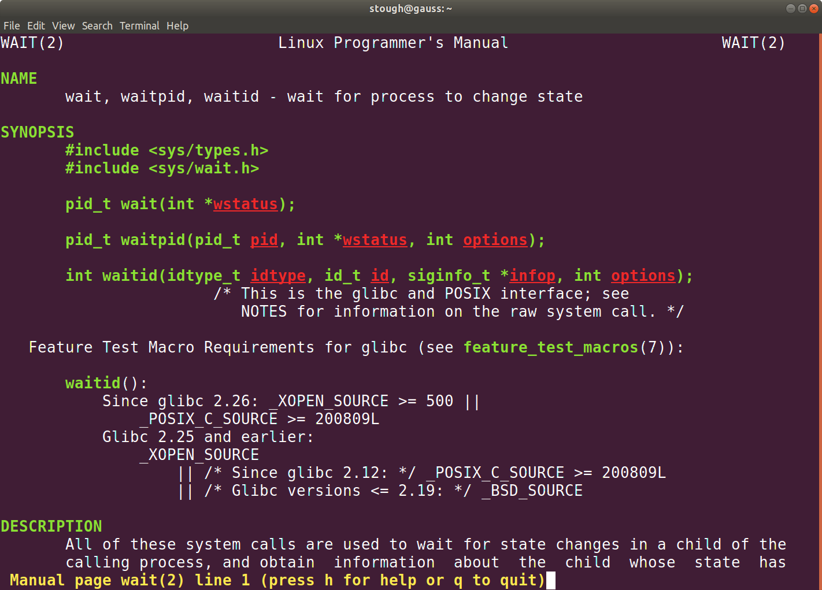
Joining processes in Unix

Slide 18
Waiting
(the inverse of forking)
parent
int s;
child
wait(&s);
int s;
exit(0);

Slide 19
Waiting
(the inverse of forking)
parent
int s;
parent waits
child
wait(&s);
int s;
child executes
exit(0);

Slide 20
Waiting
(the inverse of forking)
parent
int s;
parent waits
child
wait(&s);
int s;
child completed
exit(0);

Slide 21
Waiting
(the inverse of forking)
parent
int s;
parent continues
wait(&s);

