Slide 1
CSCI315 – Operating Systems Design Department of Computer Science Bucknell University
Structure of Processes
This set of notes is based on notes from the textbook authors, as well as L. Felipe Perrone, Joshua Stough, and other instructors.
Xiannong Meng, Fall 2020.
Ch 3

Slide 2
We discuss process structures here. The topic of process creation was discussed first to fit the lab schedule.

Slide 3
What is a process?
A process is a program in execution.
It is a dynamic element, while program (code) is static.
A process contains code, data, heap, and stack segments. In particular, A process has a program counter that indicates which line of code is to be executed next.
All these information needs to be stored and updated while the process is executing.

Slide 4
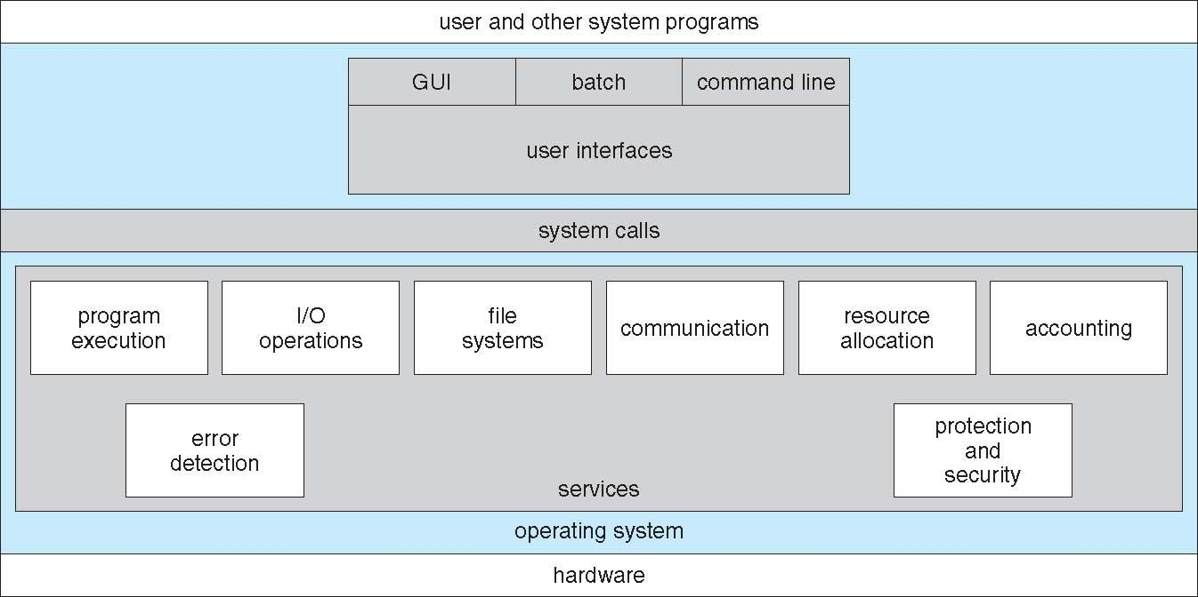
OS Services

Slide 5
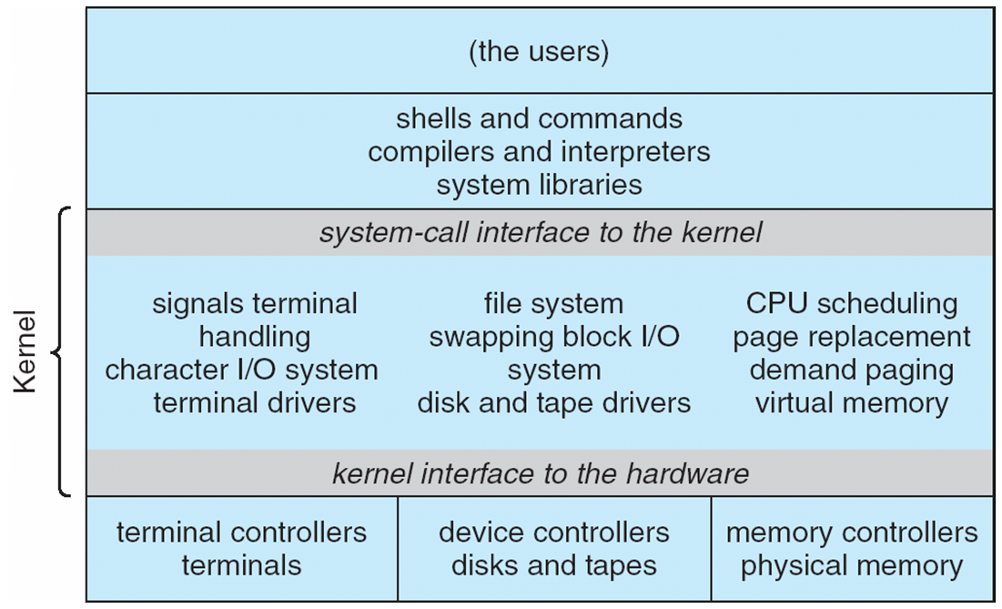
Unix Structure

Slide 6
Linux Process Control Commands
ps(1)
top(1)
htop(1)
pstree(1)
kill(1)

Slide 7
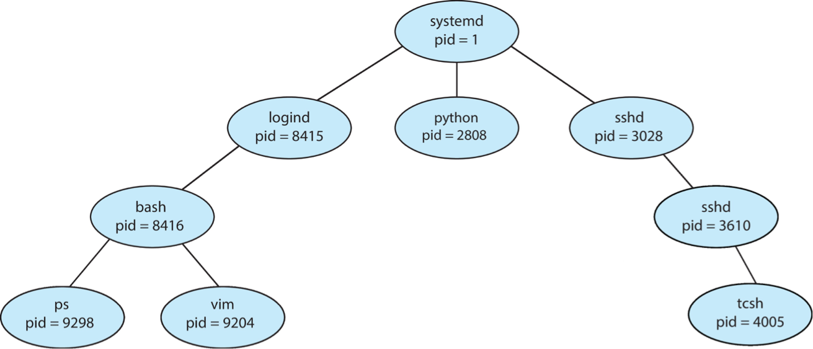
Sample Processes in Linux
This group of processes may belong to User A.
User B

Slide 8
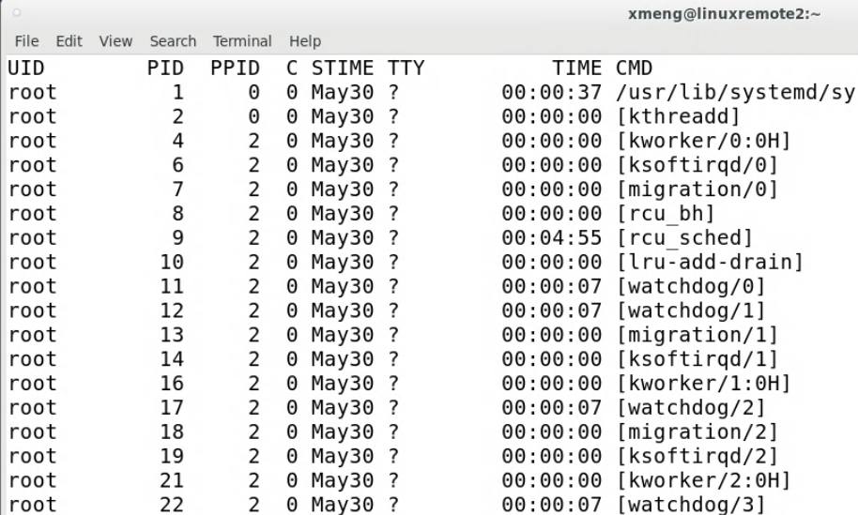
Find out processes on Linux
Try the command ps -aef | less
User ID
CPU time
Process ID
Command that started the process
Parent process ID

Slide 9
What about process 0?
The processes in the table on the previous page starts at Process 1, what about Process 0?
The operating system kernel identifies each process by its process identifier. Process 0 is a special process that is created when the system boots; after forking a child process (process 1), process 0 becomes the swapper process (sometimes also known as the "idle task").
https://en.wikipedia.org/wiki/Parent_process

Slide 10
Process Control Block (PCB)
A data structure that maintains process information.
OS bookkeeping information associated with each process:
Process ID
Process state,
Program counter,
CPU registers,
CPU scheduling information,
Memory-management information,
Accounting information,
I/O status information,
process id
process state
program counter
registers
memory limits
list of open files

Slide 11
How Does PCB Look Like in C?
PCB is a very complicated data structure.
Take a look at this file and search for the key word task_struct
https://elixir.bootlin.com/linux/latest/source/include/linux/sched.h
The PCBs of all current processes form a doubly linked list (hint, hint, hint) maintained by the OS for their management.

Slide 12
A Portion of a PCB (task_struct)
pid_t pid; /* process identifier */
long state; /* state of the process */
unsigned int time_slice /* scheduling information */
struct task struct *parent; /* process’s parent */
struct list head children; /* process’s children */
struct files struct *files; /* list of open files */
struct mm_struct *mm; /* address space of this process*/
…

Slide 13
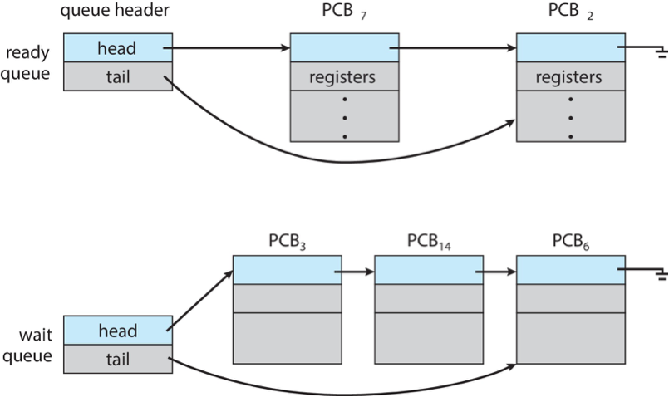
Processes and OS Queues

