Slide 1
CSCI315 – Operating Systems Design Department of Computer Science Bucknell University
Processes Life Cycle
This set of notes is based on notes from the textbook authors, as well as L. Felipe Perrone, Joshua Stough, and other instructors.
Xiannong Meng, Fall 2020.
Ch 3

Slide 2
Process State
As a process executes, it changes its state:
new: The process is being created.
running: Instructions are being executed.
waiting: The process is waiting for some event to occur.
ready: The process is waiting to be assigned to a processor.
terminated: The process has finished execution.

Slide 3
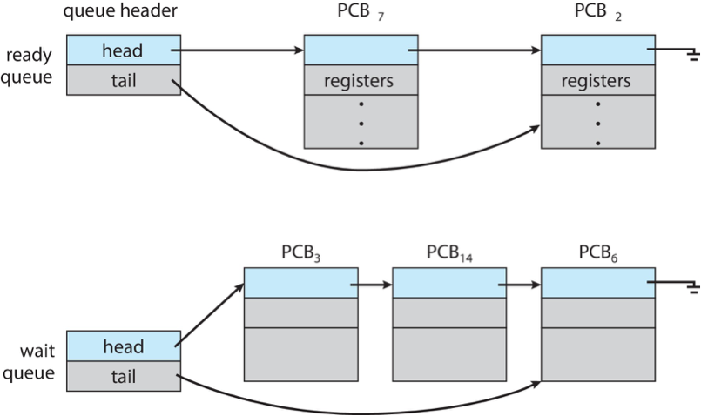
Processes and OS Queues
A process is represented by its PCB in the OS software.

Slide 4
Process State Transition Diagram
admitted
scheduler dispatch
terminated
new
exit
ready
running
interrupt
I/O or event wait
I/O or event completion
waiting

Slide 5
Process Scheduling Queues
Waiting queue – set of processes waiting for service from an I/O device. Waiting queues may contain processes that are sleeping, waiting for their turns to be brought into main memory from secondary memory. Waiting queues sometimes are also called device queues.
Ready queue – set of all processes residing in main memory, ready to execute.
Processes migrate between various queues.

Slide 6
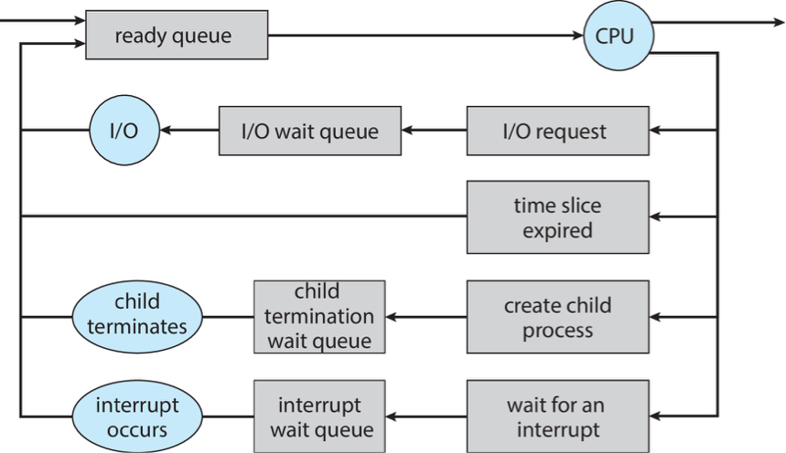
Process Scheduling
admitted
exit
life cycle

Slide 7
Processes and OS Queues

Slide 8
Scheduling
Long-term scheduler is invoked very infrequently (seconds, minutes) ⇒ (may be slow; controls the degree of multiprogramming)
Short-term scheduler is invoked very frequently (milliseconds) ⇒ (must be fast)
Processes can be described as either:
Operating system may schedule to have a good mix of processes running concurrently.
We will discuss various CPU scheduling policies in a later chapter.
I/O-bound process – spends more time doing I/O than computations, many short CPU bursts
CPU-bound process – spends more time doing computations; few very long CPU bursts

Slide 9
Context Switch
When CPU switches to another process to run, the system must save the state (context) of the current process and load the saved state for the new process.
The state of a process is described by the values in its PCB, e.g., the register values, the program counter, the opened files…
Context-switch time is overhead; the system does no useful work while switching.
The “context” is the state of the process.
Time needed depends on hardware support.

Slide 10
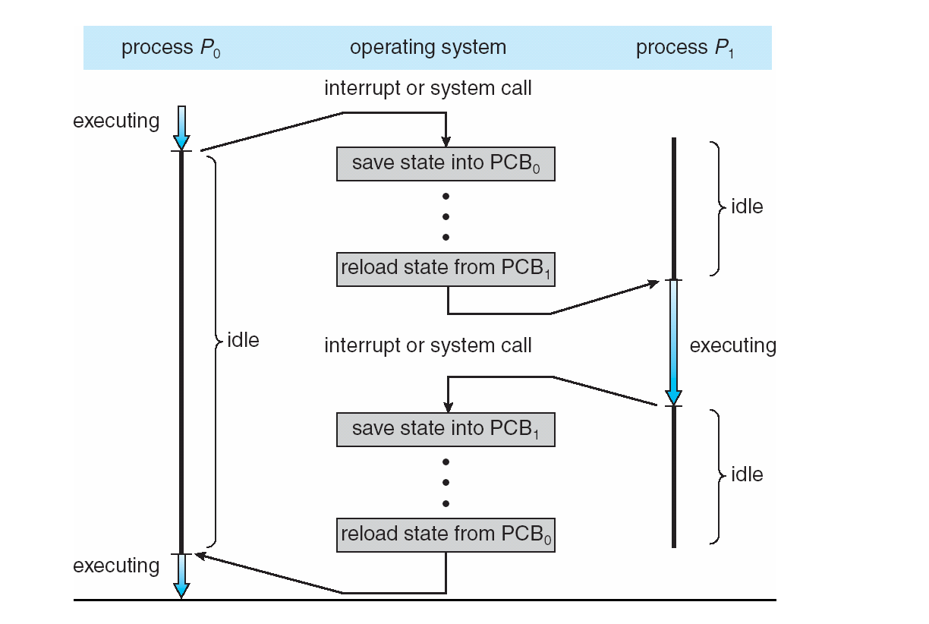
CPU Switching Among Processes

Slide 11
Process Creation (review)
Parent process create children processes, which, in turn can create other processes, forming a tree of processes.
Resource sharing:
Parent and children share all resources,
Children share subset of parent’s resources,
Parent and child share no resources.
Execution:
Parent and children execute concurrently,
Parent may wait until children terminate.

Slide 12
Process Creation (Cont.)
Address space:
Child has duplicate of parent’s address space, or
Child can have a program loaded onto it.
UNIX examples:
fork system call creates new process and returns with a pid (0 in child, > 0 in the parent),
exec system call can be used after a fork to replace the process’ memory space with a new program.

Slide 13
Process Termination
Process executes last statement and asks the operating system to terminate it (exit (3))
Output data from child to parent (via wait (2))
Process’ resources are deallocated by operating system
Parent may terminate execution of children processes (kill (2)) if:
Child has exceeded allocated resources,
Task assigned to child is no longer required,
If parent is exiting (some operating systems do not allow child to continue if its parent terminates)
All children terminated - cascading termination

Slide 14
OS Operations
Interrupt driven by hardware
Software error or request creates exception or trap
Division by zero, request for operating system service
Other process problems include infinite loop, processes modifying each other or the operating system
Dual-mode operation allows OS to protect itself and other system components
User mode and kernel mode
Mode bit managed by OS
Provides ability to distinguish when system is running user code or kernel code
Some instructions designated as privileged, only executable in kernel mode
System call changes mode to kernel, return from call resets it to user mode
Increasingly CPUs support multi-mode operations, i.e., virtual machine manager (VMM) mode for guest VMs

Slide 15
User and Kernel Modes
Two classes of instructions: one class for anyone to use, user mode, others with privileged use (for the OS kernel)
Need to be able to switch between user mode and kernel mode.
If a user runs a privileged instruction, an exception is raised.
To switch to kernel mode, you need to trap, e.g., fork() to the kernel.

Slide 16
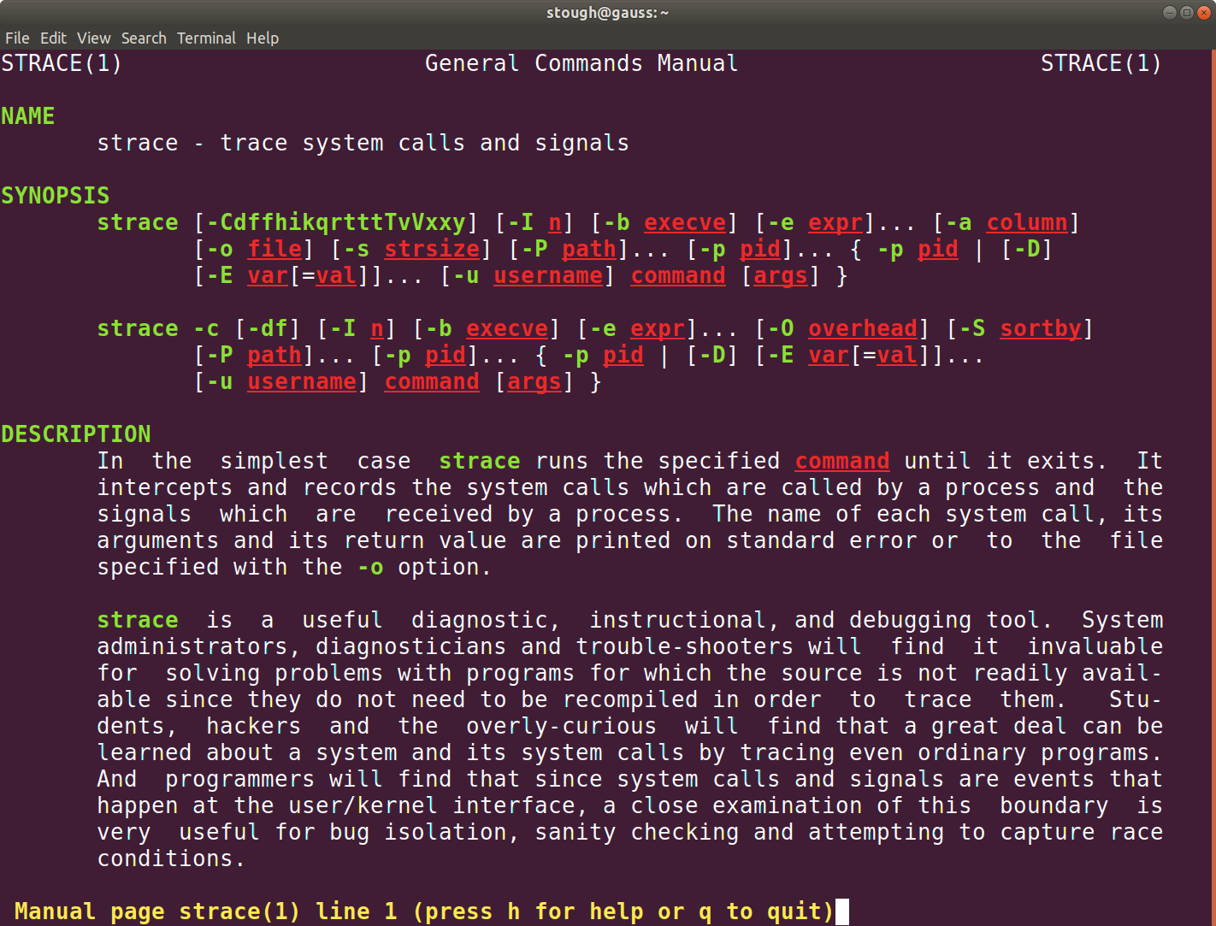
Linux command strace

