Slide 1
CSCI315 – Operating Systems Design Department of Computer Science Bucknell University
Inter-Process Communications: Unix Pipes
This set of notes is based on notes from the textbook authors, as well as L. Felipe Perrone, Joshua Stough, and other instructors.
Xiannong Meng, Fall 2020.
Ch 3.7.4

Slide 2
Interprocess Communication (IPC)
Mechanism for processes to communicate and to synchronize their actions
Message system – processes communicate with each other through messages without resorting to shared variables
IPC facility provides two operations:
send(message) – message size fixed or variable
receive(message)
If processes P and Q wish to communicate, they need to:
establish a communication link between them
exchange messages via send/receive

Slide 3
Implementation Questions
How are links established?
Can a link be associated with more than two processes?
How many links can there be between every pair of communicating processes?
What is the capacity of a link?
Is the size of a message that the link can accommodate fixed or variable?
Is a link unidirectional or bi-directional?
We will examine one implementation first, Unix Pipes.

Slide 4
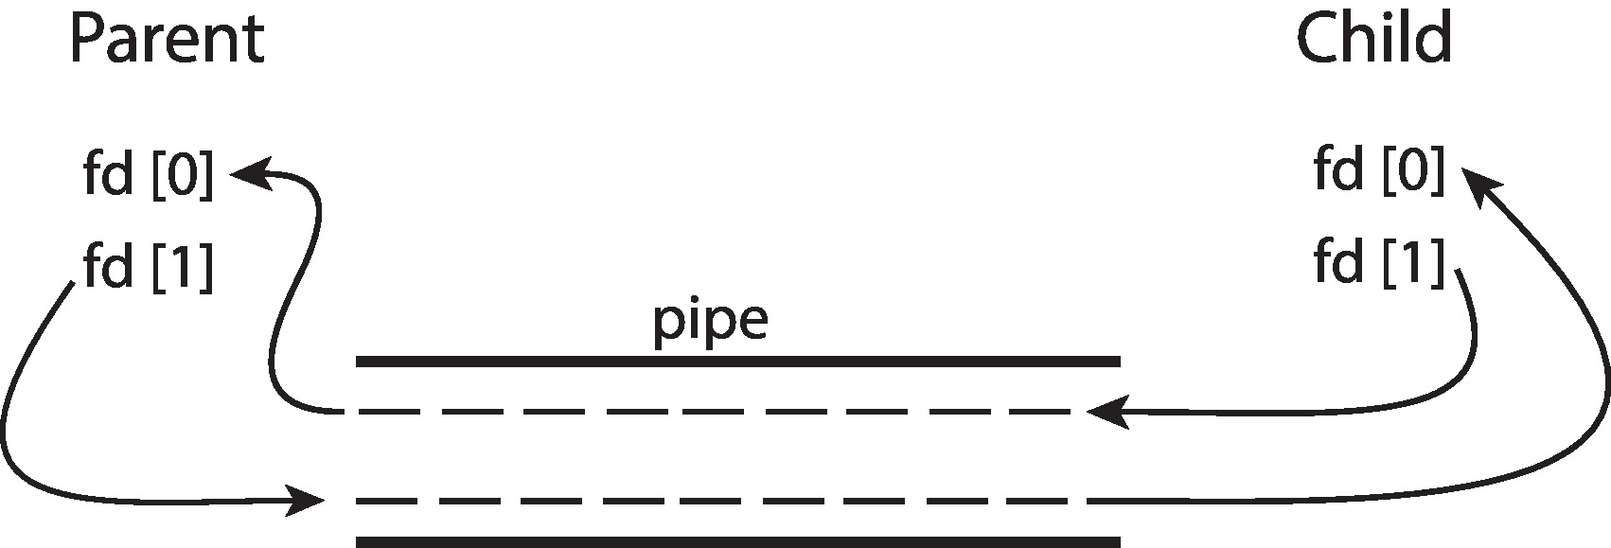
Unix pipe(2)
Point to point
Unidirectional
Reliable delivery
Stream of bytes
FIFO
For processes related by birth (same machine)
Virtually identical to reading and writing to a file (low level file I/O)

Slide 5
Unix pipe(2)
In a process P0
int p2c[2];
int pipe_ret;
pid_t pid;
IDs for open
files
stdin
0
P0
stdout
1
stderr
2
Before creating a child with whom it will communicate, the parent creates a pipe through system call pipe().

Slide 6
Unix pipe(2)
pipe_ret = pipe(p2c);
if (pipe_ret == -1) // error
...
open
files
stdin
0
P0
p2c[0]
stdout
1
p2c[1]
stderr
2
p2c[0]
3
p2c is int array of 2. If call to pipe(2) succeeds, the p2c values should be 3 and 4, continuing from the existing open file IDs.
p2c[1]
4

Slide 7
Unix pipe(2)
pid = fork();
if (pid < 0) // error
...
open
files
stdin
0
P0
p2c[0]
stdout
1
p2c[1]
stderr
2
p2c[0]
3
Then… it creates child P1 with fork
p2c[1]
4

Slide 8
Unix pipe(2)
else if (pid > 0) {
// P0
} else { // child
// P1
}
p2c int array
p2c int array
P0
p2c[0]
P1
p2c[0]
p2c[1]
p2c[1]
P1’s local copy with values inherited from P0

Slide 9
Unix pipe(2)
Unix pipes are unidirectional!
P0
p2c[0]
p2c[0]
P1
p2c[1]
p2c[1]
P0 closes the read end of the pipe (index 0)
P1 closes the write end of the pipe (index 1)

Slide 10
Unix pipe(2)
P0
p2c[0]
p2c[0]
P1
p2c[1]
p2c[1]
P0 closes the read end of the pipe (index 0)
P1 closes the write end of the pipe (index 1)

Slide 11
Unix pipe(2)
P0
p2c[0]
p2c[0]
P1
p2c[1]
p2c[1]
P0 writes to file descriptor p2c[1]
P1 reads from file descriptor p2c[0]
write(p2c[1], buf, size);
read(p2c[0], buf, size);
If P1 needs to write to P0, they have to use the other pair p2c[0] for P1 and p2c[1] for P0.

Slide 12
Synchronization
Message passing may be either blocking or non-blocking.
Blocking is considered synchronous:
Blocking send has the sender blocked until the message is received.
Blocking receive has the receiver blocked until a message is available.
Non-blocking is considered asynchronous
Non-blocking send has the sender send the message and continue.
Non-blocking receive has the receiver receive a valid message or null.

Slide 13
Buffering
Queue of messages attached to the link; implemented in one of three ways:
1. Zero capacity – 0 messages Sender must wait for receiver (rendezvous).
2. Bounded capacity – finite length of n messages. Sender must wait if buffer is full.
3. Unbounded capacity – infinite length. Sender never waits.

Slide 14
Many IPC Mechanisms
File
Pipe
Named pipe
Shared memory
Message passing
Mailbox
Remote procedure calls
Sockets (TCP, datagram)
What are the properties of each?
What are the advantages and disadvantages of each?
How do you select one to use?

Slide 15
IPC Properties
Buffering
Capacity
Synchronization
Service model
Shared memory
Direct or indirect

