Slide 1
CSCI315 – Operating Systems Design Department of Computer Science Bucknell University
Threads, Multi-threads, and Processes
This set of notes is based on notes from the textbook authors, as well as L. Felipe Perrone, Joshua Stough, and other instructors.
Xiannong Meng, Fall 2020.
Ch 4.1 – 4.4

Slide 2
Now that we have seen how pthreads work in the Linux system, let’s look back at the bigger picture of threads and their relation with processes.

Slide 3
Some Common Questions
Pthread is a specification that meets the POSIX (Portable Operating Systems Interface) standard.
How a thread library is implemented varies and we don’t need to worry about it at this level, though we will discuss some high level concepts.
There are other popular thread libraries, e.g., Windows Threads and Java Threads.
Kernel threads vs user threads.
A kernel thread is managed by the OS directly, a user thread is managed by a user program (e.g., in a library).
The pthread library we use on the Linux system is a collection of API; each pthread is a kernel thread.
https://stackoverflow.com/questions/8639150/is-pthread-library-actually-a-user-thread-solution

Slide 4
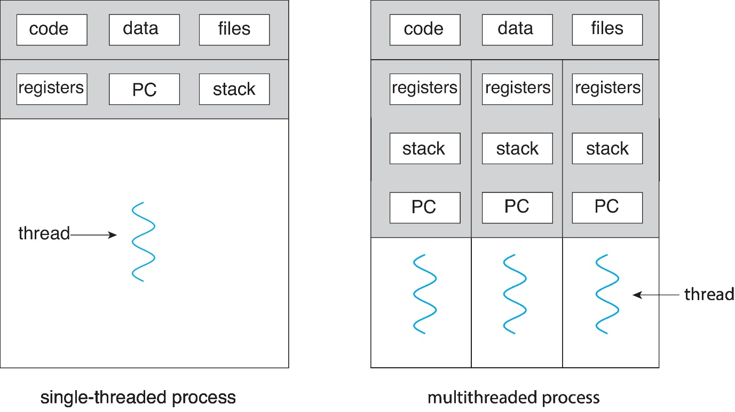
Processes and Threads
Shared among threads
Thread independent

Slide 5
Advantages of Threading
Responsiveness: multiple threads can be executed in parallel (in multi-core machines)
Resource sharing: multiple threads have access to the same data, sharing made easier
Economy: the overhead in creating and managing threads is smaller
Scalability: more processors (or cores), more threads running in parallel

Slide 6
Challenges in Parallel and Multithreaded Programming
Identifying tasks
Load balance
Data splitting
Data dependency
Testing and debugging

Slide 7
Multithreading Models

Slide 8
User threads
Managed by a user library
Runs at user level
Kernel threads
Managed directly by the operating system, thus called “kernel threads”

Slide 9
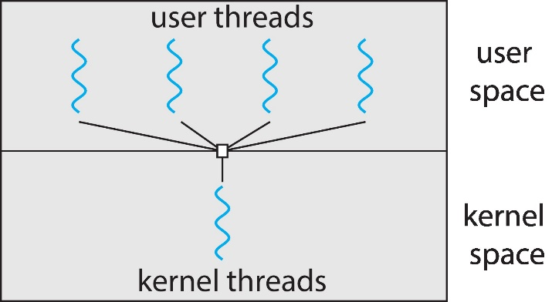
Many-to-One
Many user-level threads mapped to single kernel thread
One user thread blocking causes all to block
Multiple threads may not run in parallel on multi-core system because only one may be in kernel at a time
Few systems currently use this model
Examples:
Solaris Green Threads
GNU Portable Threads

Slide 10
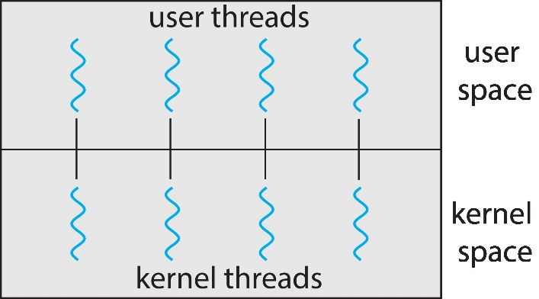
One-to-One
Each user-level thread maps to kernel thread
Creating a user-level thread creates a kernel thread
More concurrency than many-to-one
Number of threads per process sometimes restricted due to overhead, imagining that your program tries to create 100s of threads…
Examples
Windows
Linux

Slide 11
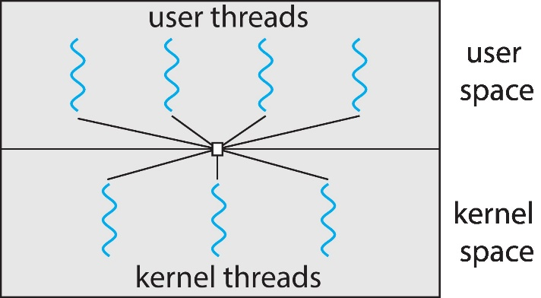
Many-to-Many Model
Allows many user level threads to be mapped to many kernel threads
Allows the operating system to create a sufficient number of kernel threads
Windows with the ThreadFiber package
Otherwise not very common
https://docs.microsoft.com/en-us/windows/win32/procthread/fibers

Slide 12
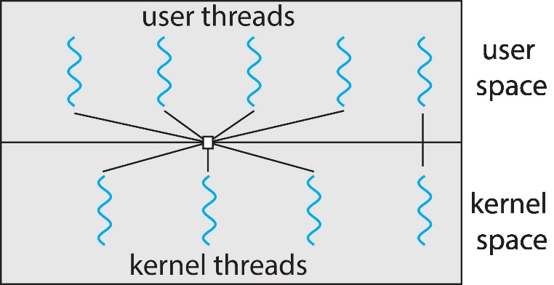
Two-level Model
Similar to M:M, except that it allows a user thread to be bound to kernel thread

Slide 13
Shared Memory Model
Thread
1
Stack
Thread
2
Stack
Thread
n
Stack
...
Heap
Data
Text
All threads have access to the same global, shared memory
Threads also have their own private data (how?)
Programmers are responsible for protecting globally shared data

Slide 14
Thread Safeness
Thread
1
Thread
2
Thread
n
...
Library Storage

Slide 15
Thread Safeness
Thread
1
Thread
2
Thread
n
...
Library function (not thread-safe):
returns pointer to library storage
Library Storage
Thread 1 result

Slide 16
Thread Safeness
Thread
1
Thread
2
Thread
n
...
Library function
(not thread-safe)
Library Storage
Thread 2 result Thread 1 result

Slide 17
Thread Safeness
Thread
1
Thread
2
Thread
n
...
Uses pointer to get to results;
doesn’t see what it expected
Library Storage
Thread 2 result

Slide 18
Remember this example …
#define NUM_THREADS 5000 // everything else is the same
[xmeng@polaris thread]$ ./trd-share
main() reporting that all 5000 threads have terminated
v should be 5000, it is 4998
[xmeng@polaris thread]$
Who stole the two counts from me?!!

Slide 19
Implicit Threads - OpenMP
sum = 0;
for (auto i = 0; i < 100; i++){
sum += a[i]
}
sum = 0;
#pragma omp parallel for shared(sum, a) reduction(+: sum)
for (auto i = 0; i < 100; i++) {
sum += a[i]
}
sumloc_1 = a[0] + ⋯ + a[33]
sumloc_2 = a[34] + ⋯ + a[66]
sumloc_3 = a[67] + ⋯ + a[99]
sum = sumloc_1 + sumloc_2 + sumloc_3
http://jakascorner.com/blog/2016/06/omp-for-reduction.html

Slide 20
A Simple Example
/* To compile, enter:
* gcc -fopenmp openmp.c -o openmp
*/
#include <omp.h>
#include <stdio.h>
int main(int argc, char *argv[]){
/* sequential code */
printf(“I am in a sequential area 1\n”);
#pragma omp parallel
{
printf("I am a parallel region\n");
}
/* sequential code */
printf(“I am in a sequential area 2\n”);
return 0;
}
http://www.eg.bucknell.edu/~cs315/F2020/meng/code/thread/openmp.c

Slide 21
Execution Result
Running the program with 4 threads
[xmeng@polaris thread]$ ./openmp
I am a parallel region
I am a parallel region
I am a parallel region
I am a parallel region
[xmeng@polaris thread]$
The number of threads in OpenMP can be set, either through the call to omp_set_threads()or through the setting of environment variable export OMP_NUM_THREADS=val The default is 16.

Slide 22
A Example with Shared Data
http://www.eg.bucknell.edu/~cs315/F2020/meng/code/thread/openmp-m.c
/* To compile, enter: gcc -fopenmp openmp-m.c -o oenmp-m */
#include <omp.h>
#include <stdio.h>
int main(int argc, char *argv[]){
/* sequential code */
int v = 0; int tid; int nthreads;
#pragma omp parallel shared(v, nthreads) private(tid)
{
tid = omp_get_thread_num();
if (tid == 0) {
nthreads = omp_get_num_threads();
printf("Number of threads = %d\n", nthreads);
}
#pragma omp critical (addv)
{
v ++;
}
printf("I am a parallel region (thread id == %d)\n", tid);
}
/* sequential code */
printf("value of v = %d\n", v);
return 0;
}

Slide 23
Execution Result
Running the program with 4 threads
[xmeng@polaris thread]$ ./openmp-m
I am a parallel region (thread id == 2)
I am a parallel region (thread id == 1)
Number of threads = 4
I am a parallel region (thread id == 0)
I am a parallel region (thread id == 3)
value of v = 4
[xmeng@polaris thread]$
Thread 0 printed this line
The last part of the sequential code printed this line

