Slide 1
CSCI315 – Operating Systems Design Department of Computer Science Bucknell University
Examples of Thread and Process
This set of notes is based on notes from the textbook authors, as well as L. Felipe Perrone, Joshua Stough, and other instructors.
Xiannong Meng, Fall 2020.

Slide 2
Examples of Thread and Process
There are many advantages (or motivations) to use the thread architecture.
One of them is to have a server process, in which each thread can serve one task.
We’ll examine a couple such examples in this section.

Slide 3
Multithreaded Server Architecture
request (1)
client
server

Slide 4
Multithreaded Server Architecture
thread(1)
request (1)
client
server
create new thread to
service request

Slide 5
Multithreaded Server Architecture
thread(1)
client
server
resume
listening for
new requests

Slide 6
Multithreaded Server Architecture
thread(1)
request (2)
client
server

Slide 7
Multithreaded Server Architecture
thread(1)
request (2)
client
server
thread(2)
create new thread to
service request

Slide 8
Multithreaded Server Architecture
thread(1)
client
server
thread(2)
resume
listening for
new requests
Each of these threads can serve a request. These requests can be of the same type, or they can be different.

Slide 9
Multithread Server Example
A server is a program that can provide some kind of services to clients.
Assume we have a server that can provide two simple services, time and rwho.
The time service sends the local time to the client.
The rwho service accepts a user name from the client and searches for it to see if they are online. The server returns the search result.

Slide 10
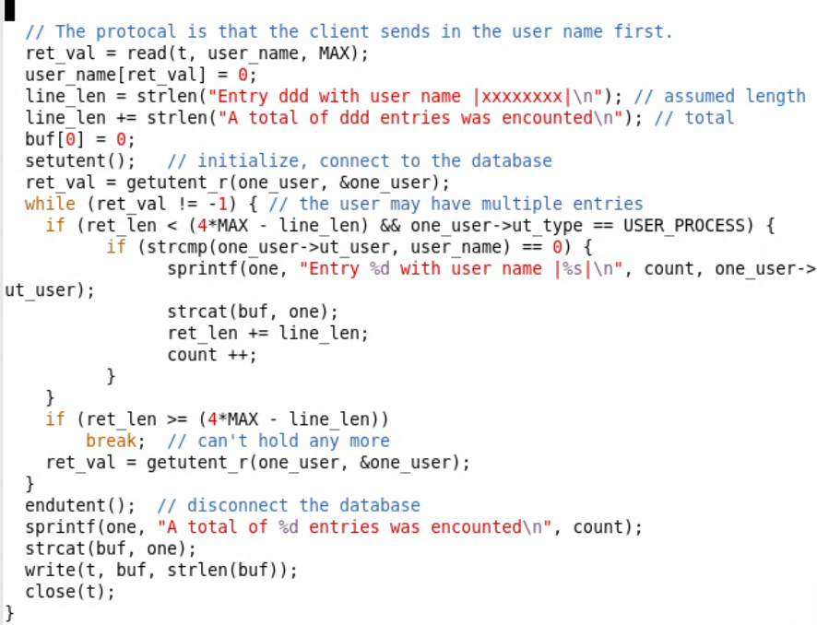
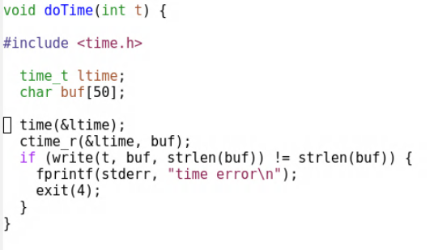
Services Provided
The complete time service
Key part of the rwho service
http://www.eg.bucknell.edu/~cs315/F2020/meng/code/rwho-time/

Slide 11
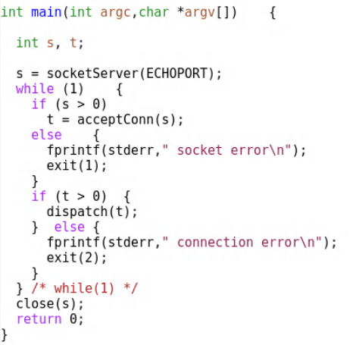
A Single Thread Server
One service at a time, the next service will have to wait until the previous one completes.

Slide 12
Single Service Screenshot
We requested “rwho” first. The “time” request will not get serviced until the “rwho” service is completed.

Slide 13
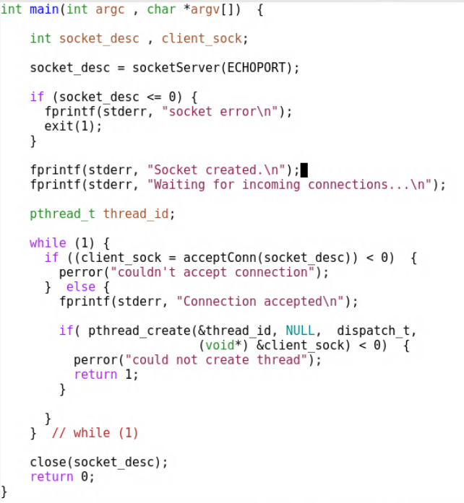
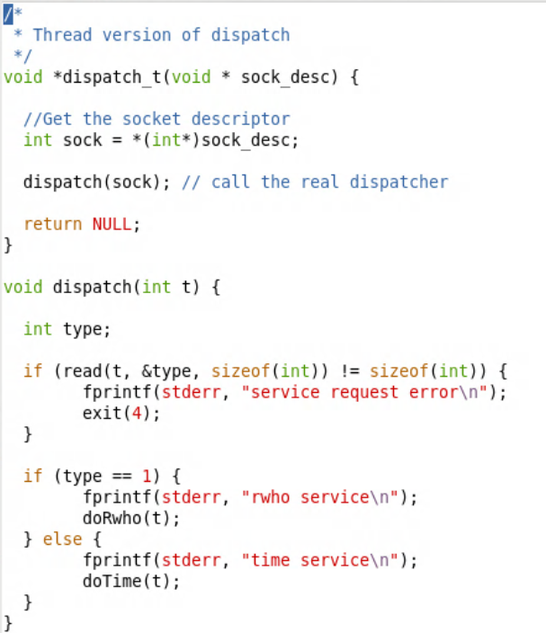
Multithread Server
Threaded dispatcher determining service type
Multi-threaded server with parameter

Slide 14
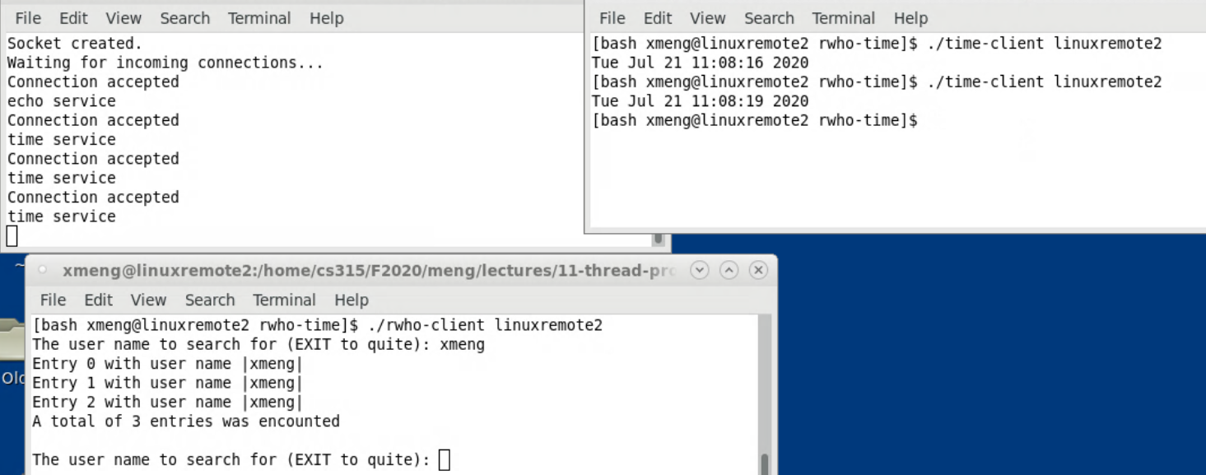
Multithread Server Screenshot
We requested “rwho” first. The “time” request can be serviced at the same time. Any number of these services can be requested and will be serviced simultaneously.

Slide 15
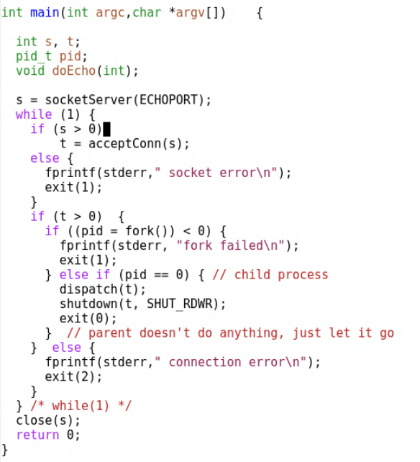
Multi-process Server
We can use fork() to create one process for each request.
The complete source code not shown because it is a part of the lab.

Slide 16
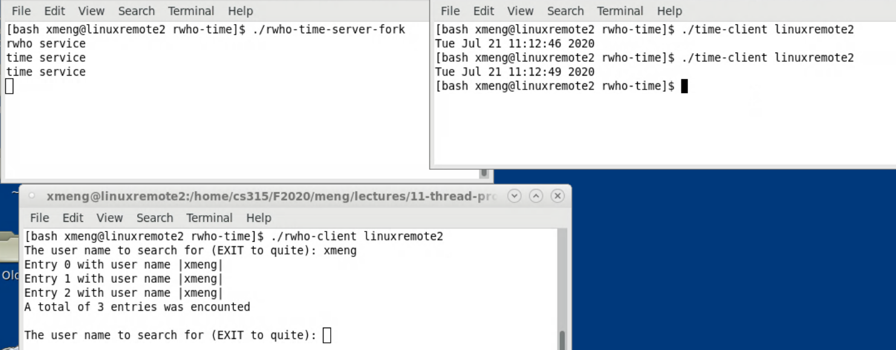
Multi-process Server Screenshot
We requested “rwho” first. The “time” request can be serviced at the same time. Any number of these services can be requested and will be serviced simultaneously. The effect is similar to multi-threaded service, except now processes are used.

