Slide 1
CSCI315 – Operating Systems Design Department of Computer Science Bucknell University
Process Synchronization Introduction
Ch 6.1-6.3
This set of notes is based on notes from the textbook authors, as well as L. Felipe Perrone, Joshua Stough, and other instructors.
Xiannong Meng, Fall 2020.

Slide 2
Two Examples
Multiple threads increment a shared variable leading to incorrect results (
http://www.eg.bucknell.edu/~cs315/F2020/meng/code/synch/trd-share.c
Multiple threads share a string buffer (read/write) leading to incorrect results (consuming items not in the order of producing)
http://www.eg.bucknell.edu/~cs315/F2020/meng/code/synch/consumer-producer-wosynch.c

Slide 3
Process Synchronization
Processes work together to solve problems.
They need to coordinate with each other in order to accomplish a task.
Without coordination, things can go wrong as we saw in the last two examples. Many other scenarios lead to similar problems.

Slide 4
Race Condition
A race condition is where the outcome of the execution depends on the particular order in which the threads^{[note]} access the shared data.
Note: in this context, we will use the term process and thread interchangeably.
We have seen this phenomenon in our thread discussion
[xmeng@polaris thread]$ ./trd-share
main() reporting that all 5000 threads have terminated
v should be 5000, it is 4998
[xmeng@polaris thread]$

Slide 5
The Synchronization Problem
Concurrent access to shared data may result in data inconsistency.
Maintaining data consistency requires mechanisms to ensure the “orderly” execution of cooperating processes.

Slide 6
Producer-Consumer Race Condition
The Producer does:
while (1) {
while (count == BUFFER_SIZE)
; // buffer full, wait
// produce an item and put in buffer at “in”
buffer[in] = make_item();
in = (in + 1) % BUFFER_SIZE;
counter++;
}
Page 256 of textbook, 10th edition

Slide 7
Producer-Consumer Race Condition
The Consumer does:
while (1) {
while (count == 0)
; // buffer empty, wait
item = buffer[out];
out = (out + 1) % BUFFER_SIZE;
counter--;
// consume the item
}
Page 256 of textbook, 10th edition

Slide 8
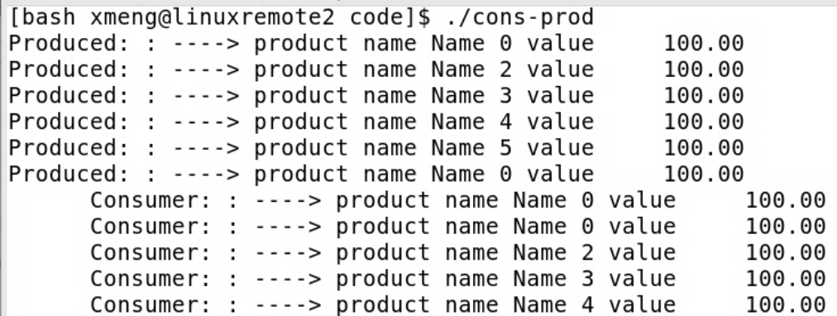
Consumer-Producer Race Condition
Incorrect result …

Slide 9
Producer-Consumer Race Condition
count++ (in producer) could be implemented as lw t0, 0(s0) # load memory content at s0 to t0
addi t0, t0, 1 # increment t0 by 1
sw t0, 0(s0) # store content in t0 to memory at s0
count-- (in consumer) could be implemented as lw t1, 0(s0) # load memory content at s0 to t1
subi t1, t1, 1 # decrement t1 by 1
sw t1, 0(s0) # store content in t1 to memory at s0
Consider this execution interleaving when count == 5:
Step 0: producer execute lw t0, 0(s0) # t0 == 5 Step 1: producer execute addi t0, t0, 1 # t0 == 6 Step 2: consumer execute lw t1, 0(s0) # t1 == 5 Step 3: consumer execute subi t1, t1, 1 # t1 == 4 Step 4: producer execute sw t0, 0(s0) # count == 6 Step 5: consumer execute sw t1, 0(s0) # count == 4, incorrect!

Slide 10
The Critical-Section Problem
It turns out that the consumer-producer problem is one particular problem in a general category of problems called the critical-section problem:
A collection of collaborating processes, each of which has a segment of code (critical section) that accesses some common data. To ensure the correctness of the result, only one process can enter its critical section to access the shared data at any time.
The critical-section problem is to design a protocol that ensures the correctness of the result under such a condition.

Slide 11
The Critical-Section Problem Solution Requirements
Mutual Exclusion - If process P_{i} is executing in its critical section, then no other processes can be executing in their critical sections.
Progress - If no process is executing in its critical section and there exist some processes that wish to enter their critical section, then the selection of the processes that will enter the critical section next cannot be postponed indefinitely.
3. Bounded Waiting - A bound must exist on the number of times that other processes are allowed to enter their critical sections after a process has made a request to enter its critical section and before that request is granted. (Assume that each process executes at a nonzero speed. No assumption concerning relative speed of the N processes.)

Slide 12
Typical Process P_{i}
do {
entry section
critical section
exit section
remainder section
} while (TRUE);

Slide 13
OpenMP Code Example
int main(int argc, char *argv[]) {
/* sequential code */
int v = 0;
#pragma omp parallel shared(v) {
#pragma omp critical (addv) {
v ++;
}
printf("I am a parallel region\n");
}
/* sequential code */
printf("value of v = %d\n", v);
return 0;
}

Slide 14
How To Synchronize Processes?
OpenMP provides a nice solution for programmers.
But how are they implemented? How do we approach a synchronization problem in general?
There could be hardware solution to this problem as well. We are concentrating on software solutions for now.

Slide 15
Peterson’s Solution for a 2-process case
Shared
variables
do {
flag[i] = TRUE;
turn = j;
while (flag[j] && turn == j);
critical section
flag[i] = FALSE;
remainder section
} while (TRUE);
int turn;
boolean flag[2];

Slide 16
Peterson’s Solution Process 0
Shared
variables
do {
flag[0] = TRUE;
turn = 1;
while (flag[1] && turn == 1);
critical section
flag[0] = FALSE;
remainder section
} while (TRUE);
int turn;
boolean flag[2];

Slide 17
Peterson’s Solution Process 1
Shared
variables
do {
flag[1] = TRUE;
turn = 0;
while (flag[0] && turn == 0);
critical section
flag[1] = FALSE;
remainder section
} while (TRUE);
int turn;
boolean flag[2];

Slide 18
Limitation to Peterson’s Solution
Strict order of execution
Variable updates (turn and flag) could still be problematic

