Slide 1
CSCI315 – Operating Systems Design Department of Computer Science Bucknell University
Synchronization Tools: semaphores
Ch 6.6
This set of notes is based on notes from the textbook authors, as well as L. Felipe Perrone, Joshua Stough, and other instructors.
Xiannong Meng, Fall 2020.

Slide 2
Issue With the Lock Solution
While locks (and other hardware-based solutions we discussed in last segment) do well to ensure the exclusive access to shared data, the solution is simplistic.
It may result in “busy waiting,” not a good use of resources.
It is possible that the waiting time is not bounded as we cannot control the order with locks.

Slide 3
Semaphores
Semaphore – an abstract data type consisting of two parts, a counter and a queue, working together to provide atomic operations
Counting semaphore – the counter value is unlimited
Binary semaphore – the counter can only be 0 or 1; it can be simpler to implement (also known as mutex locks).
Provides mutual exclusion:
semaphore S(1); // initialized to 1
wait(S); // or acquire(S) or P(S)
criticalSection();
signal(S); // or release(S) or V(P)

Slide 4
Semaphore Implementation
typedef struct {
int value;
struct process_t *list;
} semaphore;
It looks like a normal C variable, except that operations on semaphores are atomic, to ensure the integrity of the value.

Slide 5
Semaphore Implementation
wait(semaphore *S) {
S->value--;
if (S->value < 0) {
add the process to S->list;
sleep(); // or wait()
}
}
These two operations have to be atomic!
signal(semaphore *S) {
S->value++;
if (S->value <= 0) {
remove a process P from S->list;
wakeup(P); // or signal()
}
}
Here wait() is also known as the P operation, and signal() as V. These are Dutch words were given by Dijkstra, a world-renowned Dutch-native computer scientist, who invented the notion.
https://en.wikipedia.org/wiki/Semaphore_(programming)#Operation_names

Slide 6
The Bounded-Buffer Problem
Binary semaphore
int n;
mutex access;
semaphore empty;
semaphore full;
init(&access,1);
init(&empty,n);
init(&full,0);
Counting semaphore
access
producer
consumer
shared buffer capacity n items
Why do we initialize access to be 1?
Why empty be n?
Why full be zero?

Slide 7
The Bounded-Buffer Problem
do {// produce item and save
wait(&empty);
wait(&access);
// add item and save
signal(&access);
signal(&full);
} while (true);
Producer
producer
buffer
consumer

Slide 8
The Bounded-Buffer Problem
do {// produce item and save
wait(&empty);
wait(&access);
// add item and save
signal(&access);
signal(&full);
} while (true);
critical section
producer
buffer
consumer

Slide 9
The Bounded-Buffer Problem
do {
wait(&full);
wait(&access);
// remove item and save
signal(&access);
signal(&empty);
// consume save item
} while (true);
Consumer
producer
buffer
consumer

Slide 10
The Bounded-Buffer Problem
do { wait(&full);
wait(&access);
// remove item and save
signal(&access);
signal(&empty);
// consume save item
} while (true);
Critical Section
producer
buffer
consumer

Slide 11
Monitor
Semaphores are low-level synchronization resources.
A programmer’s honest mistake can compromise the entire system (well, that is almost always true). We should want a solution that reduces the risk.
The monitor is one such data type:
monitor mName {
// declare shared variables
procedure P1 (…) {
…
}
procedure Pn (…) {
…
}
init code (…) {
….
}
}
A procedure can access only local variables defined within the monitor.
There cannot be concurrent access to procedures within the monitor (only one process/thread can be active in the monitor at any given time).
Condition variables: queues are associated with variables. Primitives for synchronization are wait and signal.

Slide 12
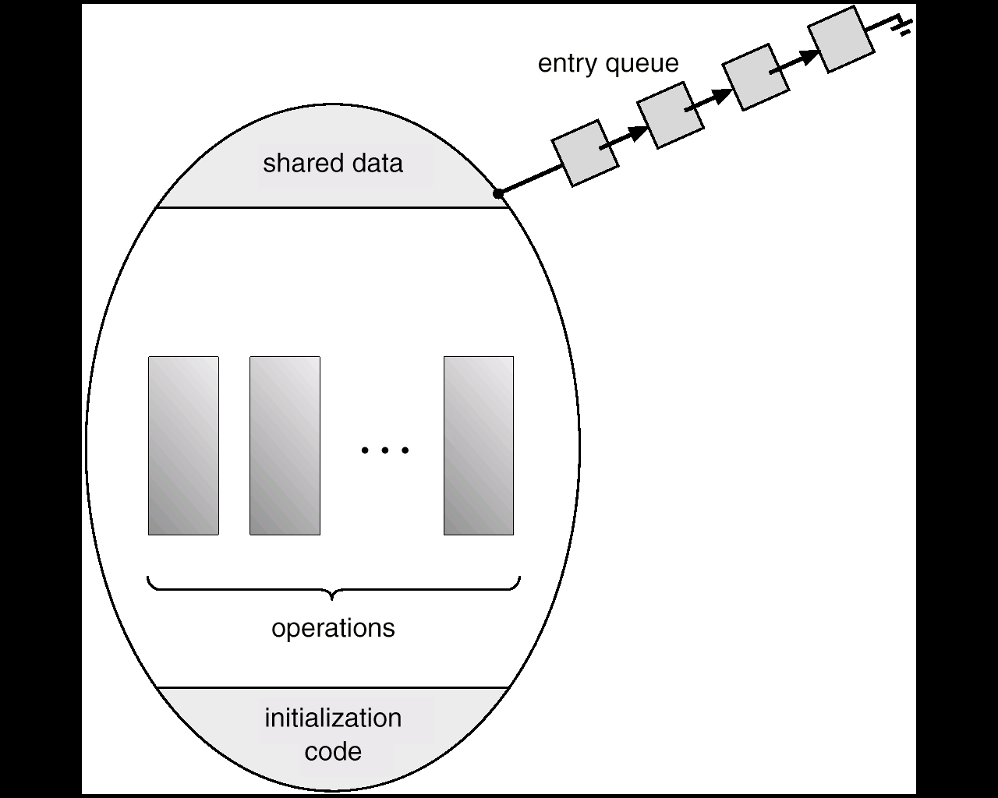
Monitor

Slide 13
Deadlock and Starvation
Deadlock – two or more processes are waiting indefinitely for an event that can be caused by only one of the waiting processes.
Let S and Q be two semaphores initialized to 1. The processes P₀ and P₁ are likely deadlocked.
P₀ P₁
acquire(S); acquire(Q);
acquire(Q); acquire(S);
. .
. .
. .
release(S); release(Q);
release(Q); release(S);
Starvation – indefinite blocking. A process may never be removed from the semaphore queue in which it is suspended.

Slide 14
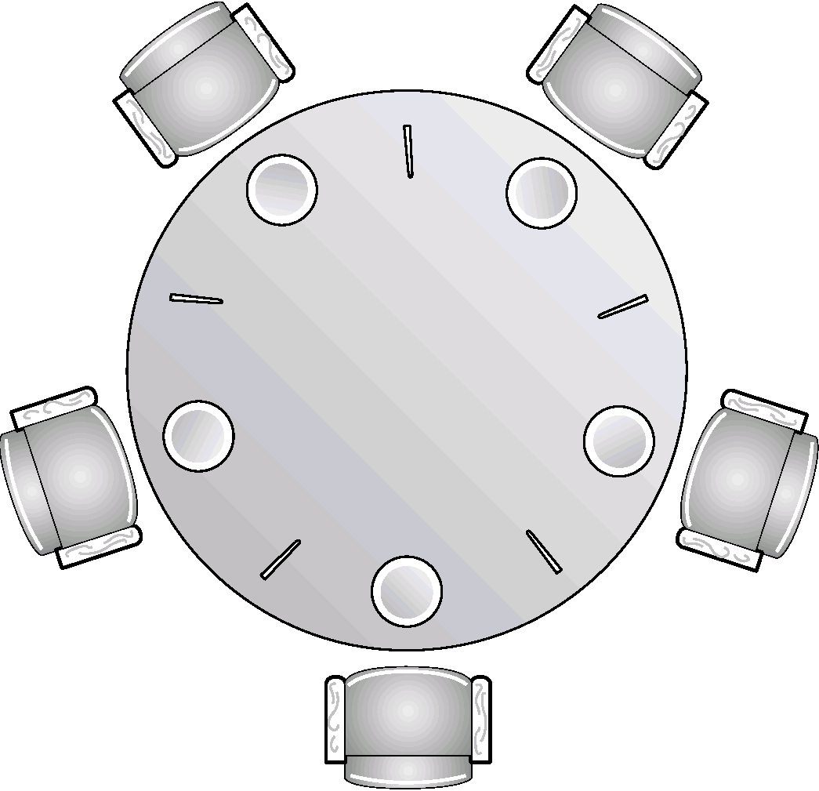
The Dining-Philosophers Problem
N philosophers sit with N chopsticks. Anyone who wants to eat will need both chopsticks. They can only grab one chopstick at a time.
If one is able to get both chopsticks, they will eat. Otherwise, they wait for the chopsticks, or they are in a thinking state (idle).

Slide 15
The Dining-Philosophers Problem
thinking
hungry
eating
State diagram for a philosopher.
We will use the colors to indicate the state of a philosopher.

Slide 16
The Dining-Philosophers Problem

Slide 17
The Dining-Philosophers Problem

Slide 18
The Dining-Philosophers Problem

Slide 19
The Dining-Philosophers Problem

Slide 20
The Dining-Philosophers Problem

Slide 21
The Dining-Philosophers Problem

Slide 22
Limit to Concurrency
What is the maximum number of philosophers that can be eating at any point in time?

Slide 23
Philosopher’s Behavior
Grab chopstick on left
Grab chopstick on right
Eat
Put down chopstick on right
Put down chopstick on left
How well does this work?

Slide 24
The Dining-Philosophers Problem

Slide 25
The Dining-Philosophers Problem
Question: How many philosophers can eat at once? How can we generalize this answer for n philosophers and n chopsticks?
Question: What happens if the programmer initializes the semaphores incorrectly? (Say, two semaphores start out a zero instead of one.)
Question: How can we formulate a solution to the problem so that there is no deadlock or starvation?

Slide 26
Fig 7.7 - monitor solution
monitor DiningPhilosophers {
enum {THINKING, HUNGRY, EATING} state [5] ;
condition self [5];
void pickup (int i) {
state[i] = HUNGRY;
test(i);
if (state[i] != EATING)
self[i].wait();
} // end of pickup()
void putdown (int i) {
state[i] = THINKING;
test((i + 4) % 5); // signal left and right
test((i + 1) % 5);
} // end of putdown()
void test (int i) {
if ((state[(i + 4) % 5] != EATING) &&
(state[i] == HUNGRY) &&
(state[(i + 1) % 5] != EATING) ) {
state[i] = EATING ;
self[i].signal () ;
}
} // end of test()
void initialization_code() {
for (int i = 0; i < 5; i++)
state[i] = THINKING;
} // end of initialization()
} // end of monitor()

Slide 27
Sleeping Barber
https://images.app.goo.gl/HDrPq9ePwpJPS2NM7

Slide 28
Sleeping Barber
https://images.app.goo.gl/Ad9YXi2GxnDGvUr98

