Slide 1
CSCI315 – Operating Systems Design Department of Computer Science Bucknell University
Introduction to CPU Scheduling
Ch 5.1-5.2
This set of notes is based on notes from the textbook authors, as well as L. Felipe Perrone, Joshua Stough, and other instructors.
Xiannong Meng, Fall 2020.

Slide 2
What is CPU scheduling?
CPU scheduling is a mechanism by the operating system to manage processes¹ to maximize CPU utilization and to minimize user waiting time.
The goals of scheduling may be in conflict, e.g., CPU utilization and user waiting time. Comprises may be needed.
CPU scheduling involves algorithm, implementation, and evaluation criteria.
1. Again, here we use processes, threads, or tasks interchangeably.

Slide 3
Why CPU scheduling?
There are many processes active at any moment on a computer. The operating system has to decide to which process to assign CPU, for how long, and how to arrange competing processes.
Try the “top” command at the Linux command line. (See next slide.)

Slide 4
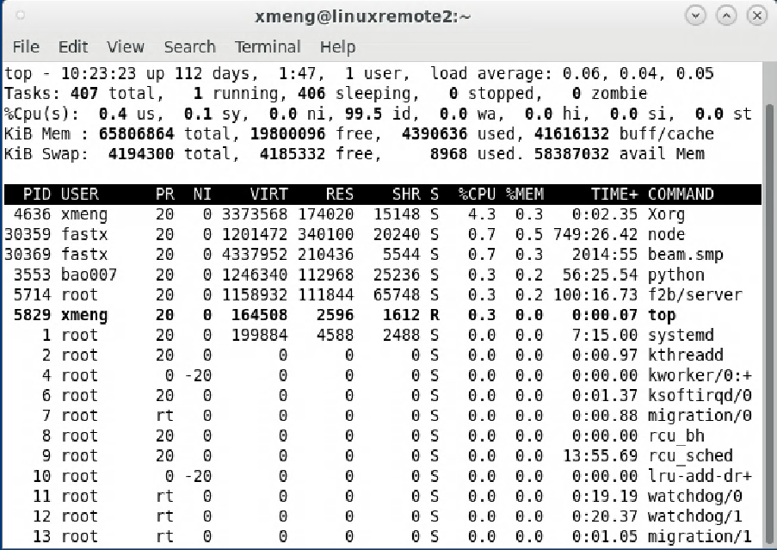
Example of showing live processes
407 live processes
1 running, 406 sleeping
Linux command showing this result

Slide 5
Basic Concepts
P₀
P₁
CPU
P₂
P₃
P₄

Slide 6
Basic Concepts
P₀
P₁
CPU
P₂
P₃
P₄

Slide 7
Basic Concepts
P₀
P₁
CPU
P₃
P₂
P₄

Slide 8
Basic Concepts
P₀
CPU
P₁
P₃
P₂
P₄

Slide 9
Basic Concepts
P₀
CPU
P₄
P₁
P₃
P₂

Slide 10
Basic Concepts
CPU
P₀
P₄
P₁
P₃
P₂
Questions:
When does a process start competing for the CPU?
How is the queue of ready processes organized?
How much time does the system allow a process to use the CPU?
Does the system allow for priorities and preemption?
What does it mean to maximize the system’s performance?

Slide 11
Basic Concepts
You want to maximize CPU utilization through the use of multiprogramming.
utilization: percentage of time the CPU is busy
multiprogramming: allowing multiple processes to be live in the system at the same time
Each process repeatedly goes through cycles that alternate CPU execution (a CPU burst) and I/O wait (an I/O wait).
See the notes on process life cycle in Chapter 3
Empirical evidence indicates that CPU-burst lengths have a distribution such that there is a large number of short bursts and a small number of long bursts.

Slide 12
Alternating Sequence of CPU And I/O Bursts
Sequence of instructions of a sample process.

Slide 13
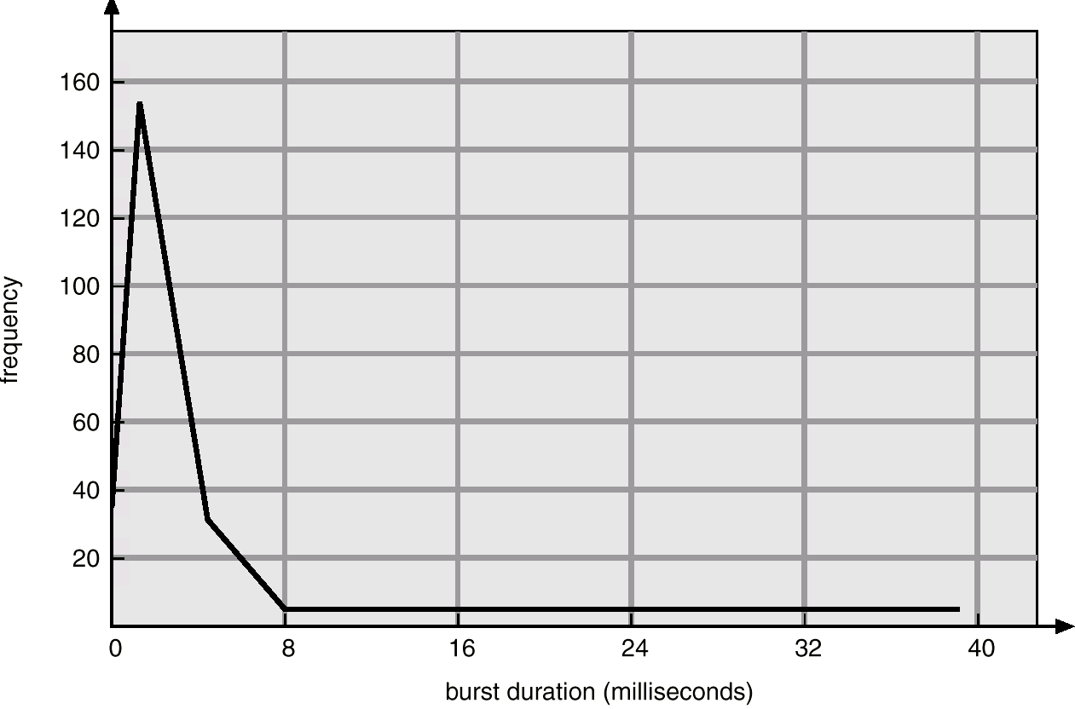
Histogram of CPU-burst Times
This diagram indicates that this process has large number of small CPU bursts of length less than 8 ms, relatively few long CPU bursts that are greater than 8 ms.

Slide 14
CPU Scheduler
A.K.A. short-term scheduler.
Selects from among the processes in memory that are ready to execute, and allocates the CPU to one of them.
CPU scheduling decisions may take place when a process:
1. Switches from running to waiting state (e.g., request I/O)
2. Switches from running to ready state (e.g., time slice expires)
3. Switches from waiting to ready (e.g., completed I/O)
4. Terminates.
Question: Where does the system keep the processes that are ready to execute?

Slide 15
Preemptive Scheduling
In cooperative or non-preemptive scheduling, when taking over the CPU, the process keeps it until the process either enters waiting state or terminates.
In preemptive scheduling, a process holding the CPU may be forced to give up the CPU. Preemption causes context-switches, which introduce overhead. Preemption also calls for care of data shared with another process or kernel data structures when a process loses the CPU.

Slide 16
Dispatcher
The dispatcher module in OS gives control of the CPU to the process selected by the short-term scheduler; this involves:
switching context,
switching to user mode,
jumping to the proper location in the selected process to restart that program.
The dispatch latency is the time it takes for the dispatcher to stop one process and start another.

Slide 17
How Do They Work Together? --- A Big Picture
User actions
OS actions
Time line
init
start shell program for user
…
interrupt handler
read myprog from disk
start myprog on cpu
…
interrupt handler
suspend myprog, do i/o
interrupt handler
resume myprog
User logs in the system
interrupt!
[user@me]$ myprog <ret>
jump start
load $t, a
load $s, b
add $x, $t, $s
print stdout $x
sub $s, 1
store $s, x
store $t, y
I/O trap!
myprog taken
off CPU
i/o cmplt, intrpt

Slide 18
Scheduling Criteria
These are performance metrics such as:
CPU utilization – percentage of time the CPU is busy
Throughput – the number of processes that complete their execution per time unit.
Turnaround time – amount of time to complete a particular process, including waiting and execution.
Waiting time – amount of time a process has been waiting in the ready queue.
Response time – amount of time it takes from when a request was submitted until the first response is received, not output (for time-sharing environment).
These metrics may conflict with each other. It makes sense to look at averages of these metrics.

Slide 19
Optimizing Performance
Maximize CPU utilization.
Maximize throughput.
Minimize turnaround time.
Minimize waiting time.
Minimize response time.

