Slide 1
CSCI315 – Operating Systems Design Department of Computer Science Bucknell University
CPU Scheduling Algorithms
Ch 5.3
This set of notes is based on notes from the textbook authors, as well as L. Felipe Perrone, Joshua Stough, and other instructors.
Xiannong Meng, Fall 2020.

Slide 2
CPU Scheduling Algorithms
In last segment, we discussed the basic idea of CPU scheduling.
We’d like to arrange the execution of processes to gain maximum performance.
maximum throughput, utilization
minimum waiting time, turn-around time, response time …
In this segment, we will look at some algorithms aiming to achieve these goals.

Slide 3
First-Come, First-Served (FCFS)
Process Burst Time
P₁ 24
P₂ 3
P₃ 3
Suppose that the processes arrive in the order: P₁ , P₂ , P₃ The Gantt Chart for the schedule is:
Waiting time for P₁ = 0; P₂ = 24; P₃ = 27
Average waiting time: (0 + 24 + 27)/3 = 17
P₁
P₂
P₃
0
24
27
30

Slide 4
Issues with FCFS
Suppose that the processes arrive in the order
P₂ , P₃ , P₁
The Gantt chart for the schedule is:
Waiting time for P₁ = 6; P₂ = 0; P₃ = 3
Average waiting time: (6 + 0 + 3)/3 = 3
Much better than previous case.
Convoy effect: all process are stuck waiting until a long process terminates.
P₂
P₃
P₁
0
3
6
30

Slide 5
Shortest-Job-First (SJF)
Associate with each process the length of its next CPU burst. Use these lengths to schedule the process with the shortest time.
Two schemes:
Non-preemptive – once CPU given to a process it cannot be preempted until completing its CPU burst.
Preemptive – if a new process arrives with CPU burst length less than remaining time of current executing process, preempt. This scheme is know as the Shortest-Remaining-Time-First (SRTF).
SJF is optimal – gives minimum average waiting time for a given set of processes.
Question: Is this practical? How can one determine the length of a CPU-burst?

Slide 6
Non-Preemptive SJF
Process Arrival Time Burst Time
P₁ 0 7
P₂ 2 4
P₃ 4 1
P₄ 5 4
SJF (non-preemptive)
Average waiting time = (0 + 6 + 3 + 7)/4 = 4
P₁
P₃
P₂
P₄
0
3
7
8
12
16

Slide 7
Preemptive SJF
Process Arrival Time Burst Time
P₁ 0 7
P₂ 2 4
P₃ 4 1
P₄ 5 4
SJF (preemptive)
Average waiting time = (9 + 1 + 0 +2)/4 = 3
P₁
P₂
P₃
P₂
P₄
P₁
0
2
4
5
7
11
16

Slide 8
Determining Length of Next CPU-Burst
We can only estimate the length.
This can be done by using the length of previous CPU bursts, using exponential averaging:
$$τ_{n+1}=α t_{n}+\left(1−α\right)τ_{n}$$
$$\text{1. }t_{n}=\text{actual} \text{lenght} \text{of} n^{th} \text{CPU} \text{burst} \\ \text{2. }τ_{n}= \text{predicted} \text{value} \text{for} \text{the} \text{CPU} \text{burst} \text{at} \text{time} n \\ \text{3. 0}≤α≤1 \\ \text{4. }\text{The} \text{effect} \text{of} \text{the} \text{value} \text{of} α?$$

Slide 9
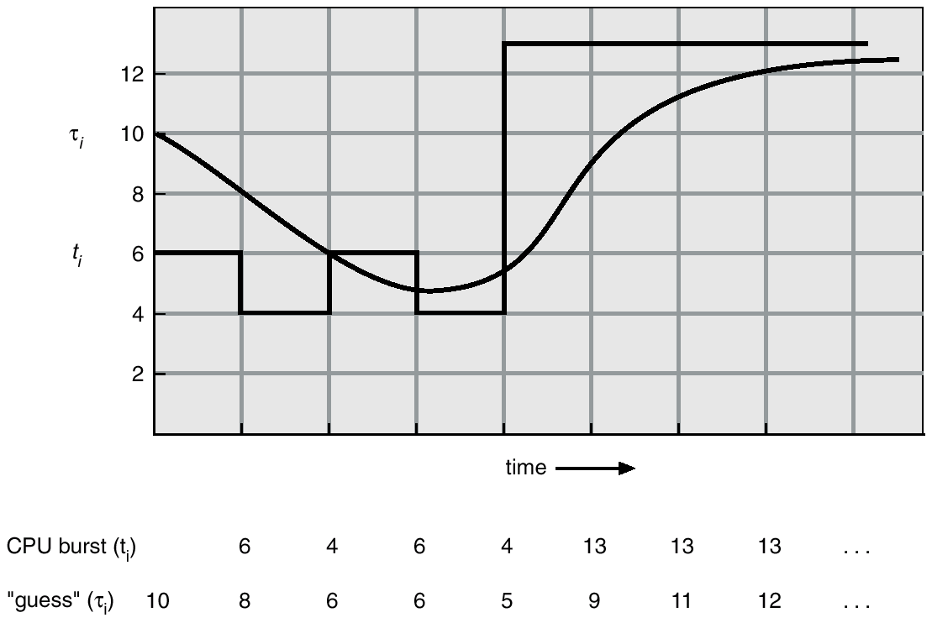
Prediction of the Length of the Next CPU-Burst
The graph is shown when α is 0.5

Slide 10
Example
Given the actual (measured) CPU bursts are 6, 4, 6, 4, 13, 13, 13, and the initial estimate of τ is 10 as in previous slide, show the first three predictions when α takes the value of
0.2
0.7
When α is 0.2, estimates are 9.2, 8.16, 7.73
When α is 0.7, estimates are 7.2, 4.96, 5.69
See an example computation on next slide

Slide 11
Example Computation
$$τ_{n+1}=α t_{n}+\left(1−α\right)τ_{n}$$
t_{i} = 6, 4, 6, 4, 13, 13, 13 --- these are measured time
τ₀ = 10, α = 0.2, t₀ = 6
τ₁ = 0.2*6 + 0.8*10 = 9.2
τ₂ = 0.2*4 + 0.8*9.2 = 8.16
τ₃ = 0.2*6 + 0.8*8.16 = 7.73

Slide 12
Priority Scheduling
A priority number (integer) is associated with each process.
The CPU is allocated to the process with the highest priority (typically, smallest integer ≡ highest priority)
Preemptive
Non-preemptive
SJF is a priority scheduling where priority is the predicted next CPU-burst time.
Problem: Starvation – low priority processes may never execute.
Solution: Aging – as time progresses increase the priority of the process.

Slide 13
Process Priority in Linux
Priority scheduling is commonly used in production OSes such as Linux
In Linux, the priority values range from 1 (most favorite) to 99 (least favorite)
Try ps -l command on a Linux terminal
Default priority of a user process is 80.
We can run a CPU intensive job and use the nice command to set its priority, or renice command to change its priority. (Range of renice is 0 to 20.)
https://study.com/academy/lesson/process-priorities-in-linux-definition-modification.html

Slide 14
To check priority levels
Use Linux command chrt to check levels of priority.

Slide 15
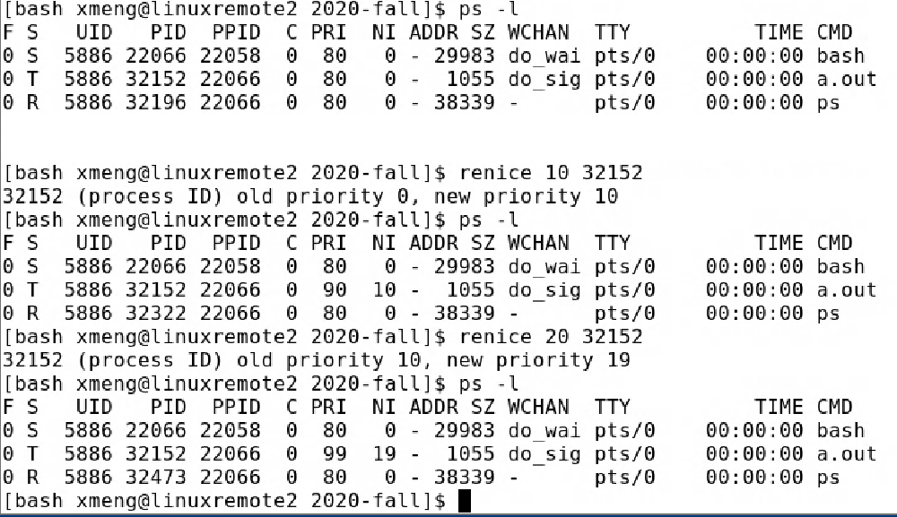
default priority (80)
lower the priority by 10
new priority (90)
try to lower it by another 20
you can’t do, minimum is 99

Slide 16
Round Robin (RR)
Each process gets a small unit of CPU time (time quantum), usually 10-100 milliseconds. After this time has elapsed, the process is preempted and added to the end of the ready queue.
If there are n processes in the ready queue and the time quantum is q, then each process gets 1/n of the CPU time in chunks of at most q time units at once. No process waits more than (n-1)q time units.

Slide 17
RR with Time Quantum = 20
Process Burst Time
P₁ 53
P₂ 17
P₃ 68
P₄ 24
The Gantt chart is: Typically, higher average turnaround than SJF, but better response.
P₁
P₂
P₃
P₄
P₁
P₃
P₄
P₁
P₃
P₃
0
20
37
57
77
97
117
121
134
154
162

Slide 18
Time Quantum and Context Switch Time
Question: What influences the choice of value for the quantum?

Slide 19
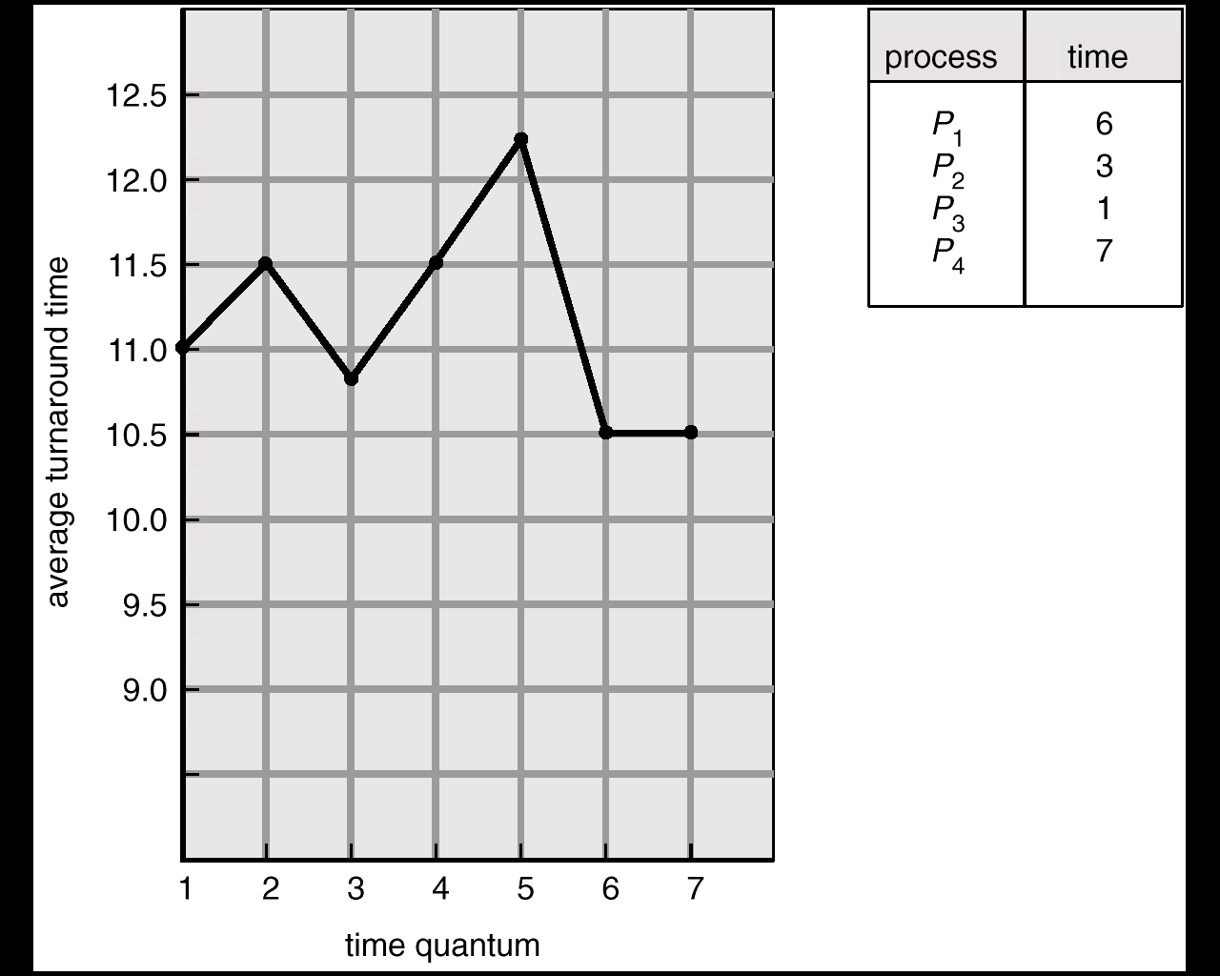
Turnaround Time Varies with the Time Quantum

Slide 20
Performance of RR
Effects of the quantum length q:
q large ⇒ FIFO.
q small ⇒ q must be large with respect to context switch, otherwise overhead is too high.
If q is extremely small, and we ignore the context switch cost, the result is processor sharing.

Slide 21
Multilevel Queue
Ready queue is partitioned into separate queues:
foreground (interactive)
background (batch)
Each queue has its own scheduling algorithm.
foreground: RR
background: FCFS
Scheduling must be done between the queues:
Fixed priority scheduling; (i.e., serve all from foreground then from background). Possibility of starvation.
Time slice – each queue gets a certain amount of CPU time which it can schedule amongst its processes; i.e., 80% to foreground in RR.
20% to background in FCFS .

Slide 22
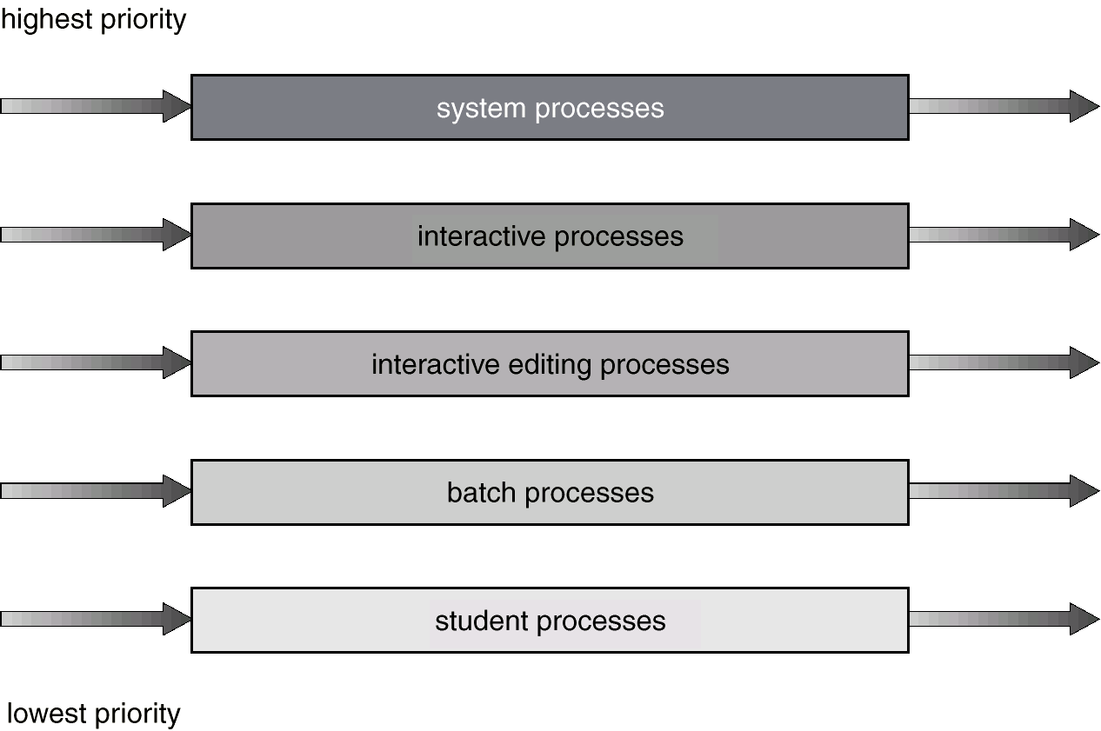
Multilevel Queue Scheduling

Slide 23
Multilevel Feedback Queue
A process can move between the various queues; aging can be implemented this way.
Multilevel-feedback-queue scheduler defined by the following parameters:
number of queues,
scheduling algorithms for each queue,
method used to determine when to upgrade a process,
method used to determine when to demote a process,
method used to determine which queue a process will enter when that process needs service.

Slide 24
Example of Multilevel Feedback Queue
Three queues:
Q₀ – time quantum 8 milliseconds (most favorite queue)
Q₁ – time quantum 16 milliseconds
Q₂ – FCFS (least favorite queue)
Scheduling
A new job enters queue Q₀ which is served FCFS. When it gains CPU, job receives 8 milliseconds. If it does not finish in 8 milliseconds, job is moved to queue Q₁.
At Q₁ job is again served FCFS and receives 16 additional milliseconds. If it still does not complete, it is preempted and moved to queue Q₂.

Slide 25
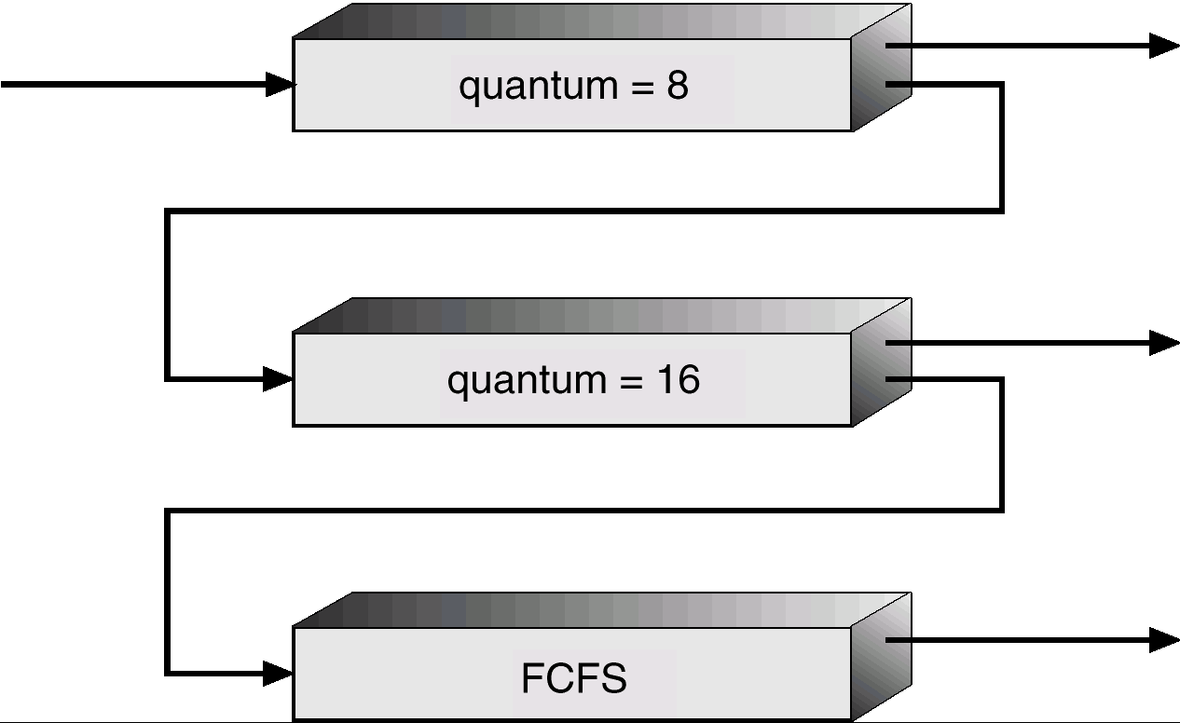
Multilevel Feedback Queues

