Slide 1
CSCI315 – Operating Systems Design
Department of Computer Science
Bucknell University
Multi-Processor Scheduling and
Real-Time Scheduling
Ch 5.5, 5.6
This set of notes is based on notes from the textbook authors, as well as L. Felipe Perrone, Joshua Stough, and other instructors.
Xiannong Meng, Fall 2020.

Slide 2
Multiple-Processor Scheduling
CPU scheduling more complex when multiple CPUs are available
Multiprocessor may be any one of the following architectures:
  Multicore CPUs
  Multithreaded cores
  NUMA (Non-uniform memory access) systems
  Heterogeneous multiprocessing

Slide 3
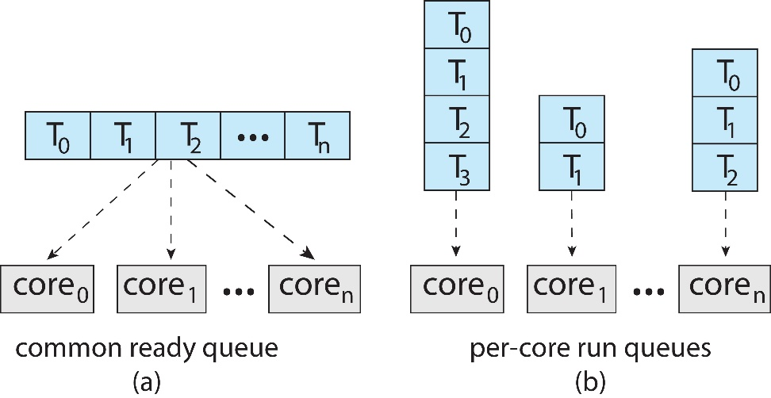
Multiple-Processor Scheduling
Symmetric multiprocessing (SMP) is where each processor is self scheduling.
All threads may be in a common ready queue (a)
Each processor may have its own private queue of threads (b)

Slide 4
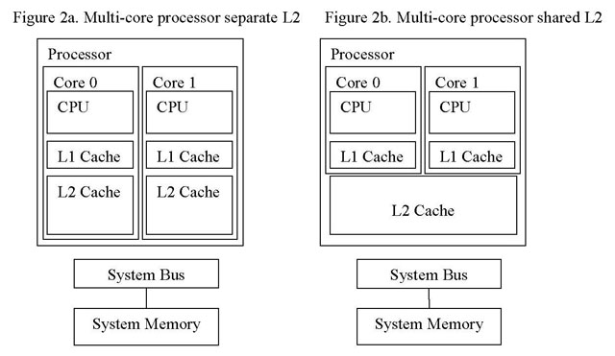
Multi-core Processor Architecture
https://www.drdobbs.com/development-and-optimization-techniques/212600040

Slide 5
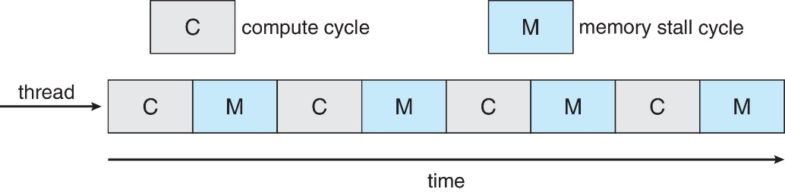
Multicore Processors
Recent trend to place multiple processor cores on same physical chip
Faster and consumes less power
Multiple threads per core also growing
  Takes advantage of memory stall to make progress on another thread while memory retrieve happens

Slide 6
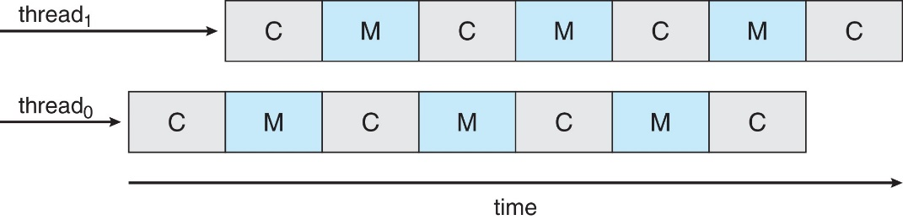
Multithreaded Multicore System
Each core has > 1 hardware threads.
If one thread has a memory stall, switch to another thread!

Slide 7
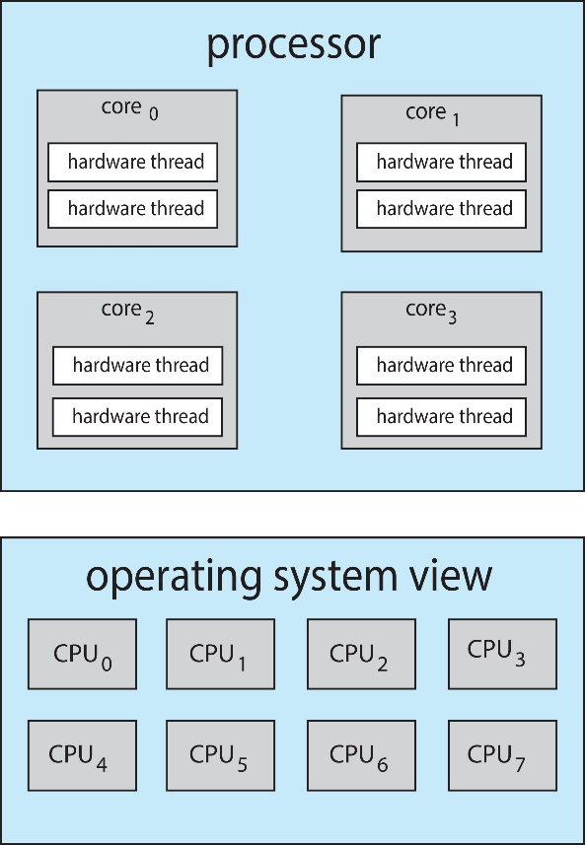
Multithreaded Multicore System
Chip-multithreading (CMT) assigns each core multiple hardware threads. (Intel refers to this as hyperthreading.)
On a quad-core system with 2 hardware threads per core, the operating system sees 8 logical processors.

Slide 8
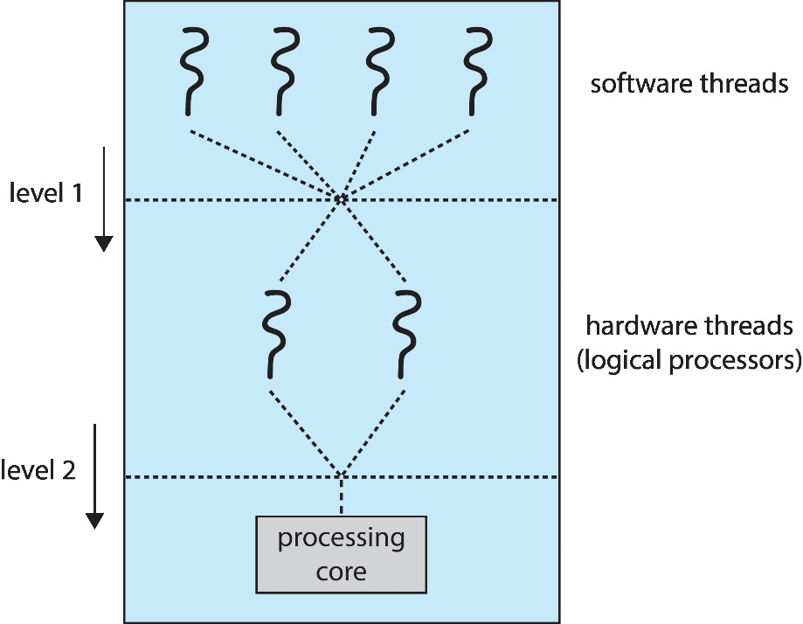
Multithreaded Multicore System
Two levels of scheduling:
  The operating system deciding which software thread to run on a logical CPU
  How each core decides which hardware thread to run on the physical core.

Slide 9
Multiple-Processor Scheduling – Load Balancing
If SMP, need to keep all CPUs loaded for efficiency
Load balancing attempts to keep workload evenly distributed
Push migration – periodic task checks load on each processor, and if found pushes task from overloaded CPU to other CPUs
Pull migration – idle processors pulls waiting task from busy processor

Slide 10
Multiple-Processor Scheduling – Processor Affinity
When a thread has been running on one processor, the cache contents of that processor stores the memory accesses by that thread.
We refer to this as a thread having affinity for a processor (i.e., “processor affinity”)
Load balancing may affect processor affinity as a thread may be moved from one processor to another to balance loads, yet that thread loses the contents of what it had in the cache of the processor it was moved off of.
Soft affinity – the operating system attempts to keep a thread running on the same processor, but no guarantees.
Hard affinity – allows a process to specify a set of processors it may run on.

Slide 11
NUMA and CPU Scheduling
If the operating system is NUMA-aware, it will assign memory closes to the CPU the thread is running on.
NUMA: Non-uniform memory access (time)

Slide 12
Real-Time CPU Scheduling
Can present obvious challenges
Soft real-time systems – Critical real-time tasks have the highest priority, but no guarantee as to when tasks will be scheduled
Hard real-time systems – task must be serviced by its deadline

Slide 13
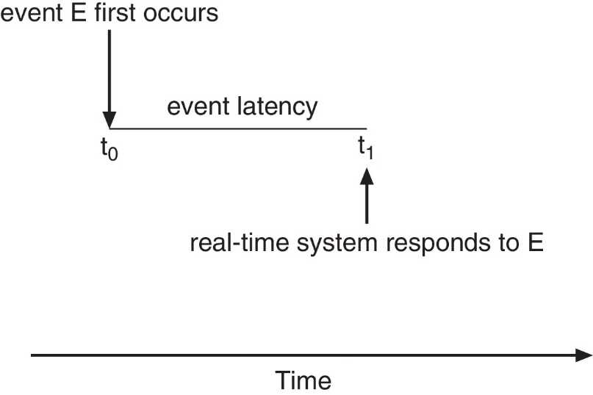
Real-Time CPU Scheduling
Event latency – the amount of time that elapses from when an event occurs to when it is serviced.
Two types of latencies affect performance
  Interrupt latency – time from arrival of interrupt to start of routine that services interrupt
  Dispatch latency – time for schedule to take current process off CPU and switch to another

Slide 14
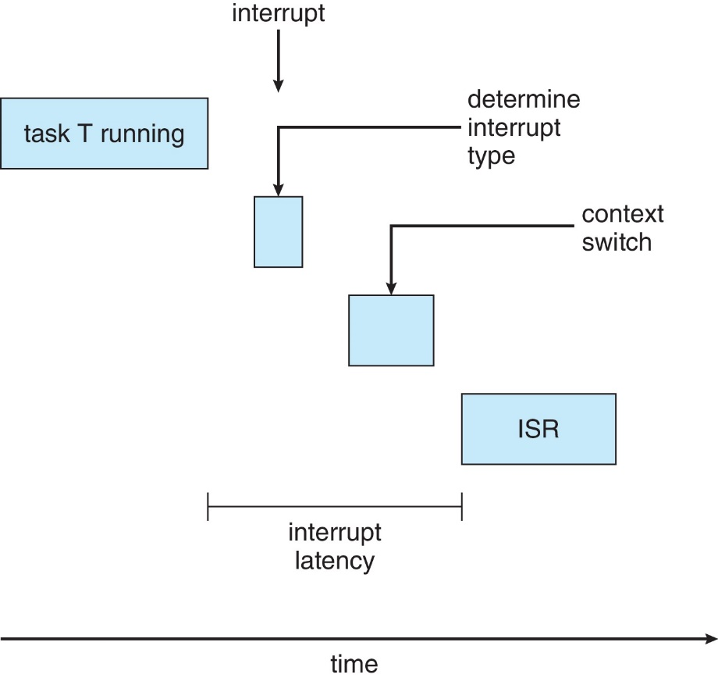
Interrupt Latency
ISR: Interrupt service routine

Slide 15
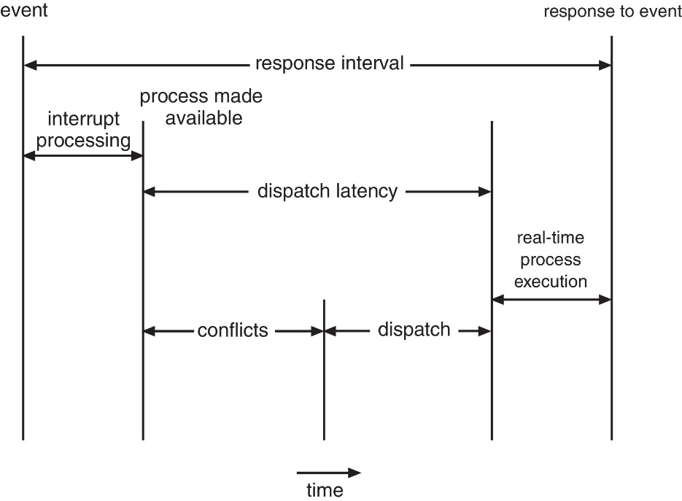
Dispatch Latency
Conflict phase of dispatch latency:
  Preemption of any process running in kernel mode
  Release by low-priority process of resources needed by high-priority processes

Slide 16
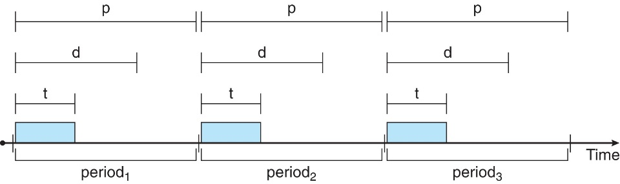
Priority-based Scheduling
For real-time scheduling, scheduler must support preemptive, priority-based scheduling
  But only guarantees soft real-time
For hard real-time must also provide ability to meet deadlines
Processes have new characteristics: periodic ones require CPU at constant intervals
  Has processing time t, deadline d, period p
  0 ≤ t ≤ d ≤ p
  Rate of periodic task is 1/p

Slide 17
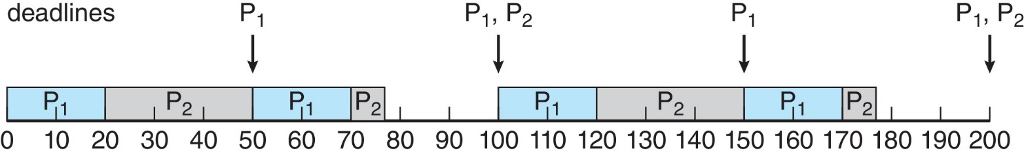
Rate Monotonic Scheduling
A priority is assigned based on the inverse of its period
Shorter periods = higher priority;
Longer periods = lower priority
P₁ is assigned a higher priority than P₂.

Slide 18
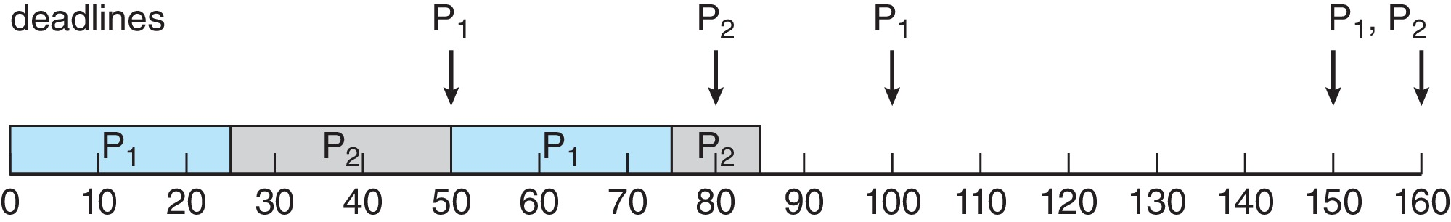
Missed Deadlines with Rate Monotonic Scheduling
Process P₂ misses finishing its deadline at time 80
The figure illustrates the idea

Slide 19
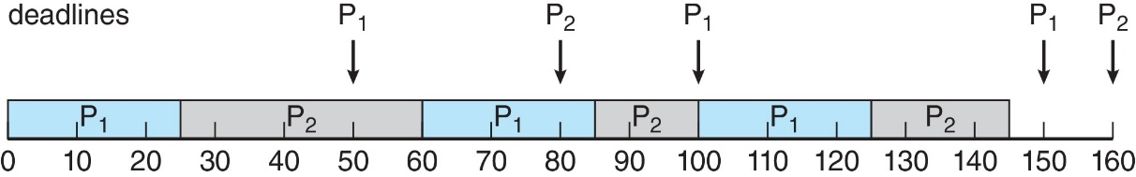
Earliest Deadline First Scheduling (EDF)
Priorities are assigned according to deadlines:
  The earlier the deadline, the higher the priority
  The later the deadline, the lower the priority
The figure illustrates the idea

Slide 20
Proportional Share Scheduling
T shares are allocated among all processes in the system
An application receives N shares where N < T
This ensures each application will receive N / T of the total processor time

