Slide 1
CSCI315 – Operating Systems Design Department of Computer Science Bucknell University
Introduction to Deadlock
Ch 8.1 – 8.3
This set of notes is based on notes from the textbook authors, as well as L. Felipe Perrone, Joshua Stough, and other instructors.
Xiannong Meng, Fall 2020.

Slide 2
Potential Deadlock Example
/* thread one runs in this function */
void *do_work_one(void *param) {
pthread_mutex_lock(&first_mutex);
pthread_mutex_lock(&second_mutex);
/** * Do some work */ pthread_mutex_unlock(&second_mutex);
pthread_mutex_unlock(&first_mutex);
pthread_exit(0);
}
/* thread two runs in this function */
void *do_work_two(void *param) {
pthread_mutex_lock(&second_mutex);
pthread_mutex_lock(&first_mutex);
/** * Do some work */ pthread_mutex_unlock(&first_mutex);
pthread_mutex_unlock(&second_mutex);
pthread_exit(0);
}
Why “potential”?
The code may not cause
deadlock if one thread
grabs both locks before the
other.
If both threads hold on the
one lock before trying
the second lock, a deadlock
is ensured.
http://www.eg.bucknell.edu/~cs315/F2020/meng/code/deadlock/deadlock.c

Slide 3
Deadlock for Two Processes
P1 requests M2
while holding M1
P2 requests M1
while holding M2
P1
P2
mutex1
mutex2

Slide 4
Deadlock: Bridge Crossing Example
Traffic only in one direction at a time.
Each section of a bridge can be viewed as a resource.
If a deadlock occurs, it can be resolved if one car backs up (preempt resources and rollback).
Several cars may have to be backed up if a deadlock occurs.

Slide 5
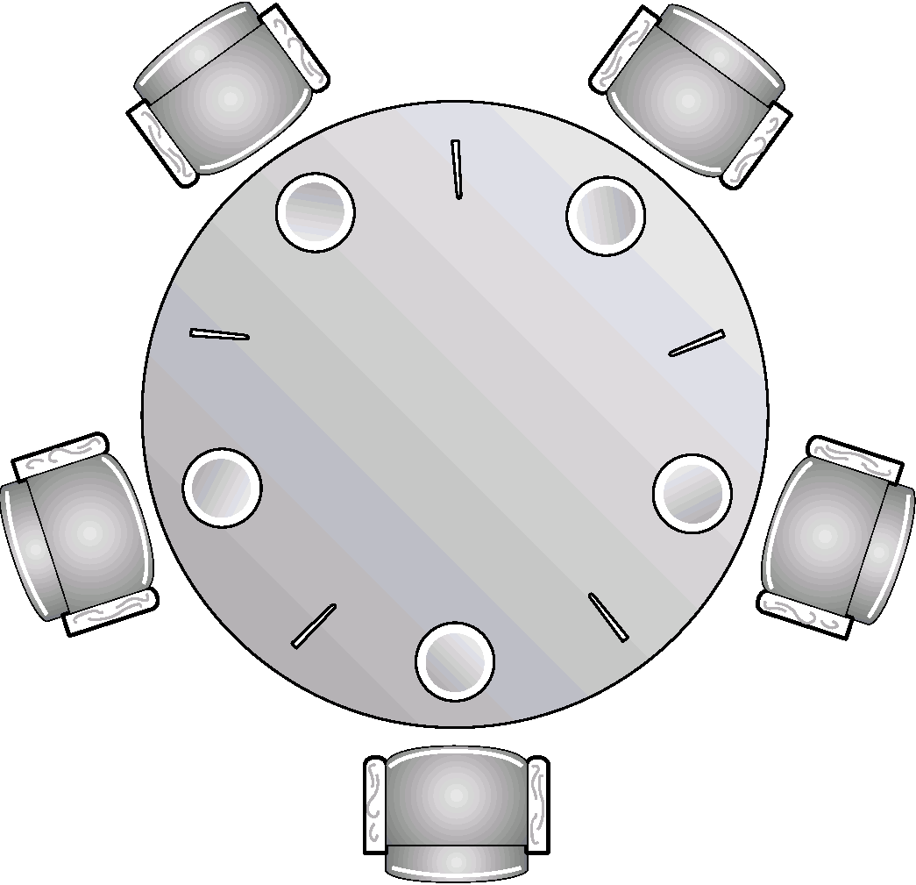
Deadlock: Dining-Philosophers Example
All philosophers start out hungry and that they all pick up their left chopstick at the same time.
When a philosopher manages to get a chopstick, it is not released until a second chopstick is acquired and the philosopher has eaten his share.
Question: Why did deadlock happen? Enumerate all the conditions that have to be satisfied for deadlock to occur.
Question: What can be done to guarantee that deadlock won’t happen?

Slide 6
Traffic Deadlock

Slide 7
Concepts to discuss
Deadlock
Livelock
Spinlock vs. Blocking

Slide 8
A System Model
Resource types R₁, R₂, . . ., R_{m}
CPU cycles, memory space, I/O devices
Each resource type R_{i} has W_{i} instances.
Each process utilizes a resource as follows:
request
use
release

Slide 9
Deadlock Characterization
Deadlock can arise if four conditions hold simultaneously:
Mutual exclusion: only one process at a time can use a resource.
Hold and wait: a process holding at least one resource is waiting to acquire additional resources held by other processes.
No preemption: a resource can be released only voluntarily by the process holding it, after that process has completed its task.
Circular wait: there exists a set {P₀, P₁, …, P₀} of waiting processes such that P₀ is waiting for a resource that is held by P₁, P₁ is waiting for a resource that is held by
P₂, …, P_{n–1} is waiting for a resource that is held by P_{n}, and P_{n} is waiting for a resource that is held by P₀.

Slide 10
Resource Allocation Graph
Graph: G=(V,E)
The nodes in V can be of two types (partitions):
P = {P₁, P₂, …, P_{n}}, the set consisting of all the processes in the system.
R = {R₁, R₂, …, R_{m}}, the set consisting of all resource types in the system.
Request edge – directed edge P₁ → R_{j}
Assignment edge – directed edge R_{j} → P_{i}

Slide 11
Resource Allocation Graph
Process
Resource Type with 4 instances
P_{i} requests instance of R_{j}
P_{i} is holding an instance of R_{j}
P_{i}
R_{j}
P_{i}
R_{j}

Slide 12
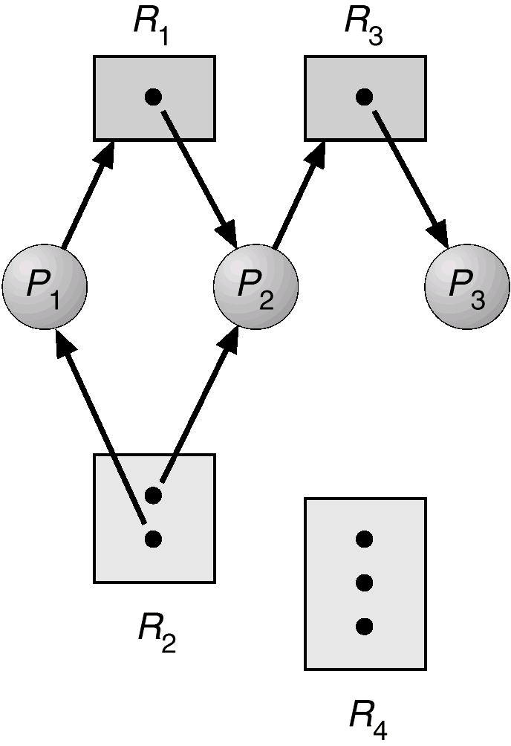
Example of a Resource Allocation Graph

Slide 13
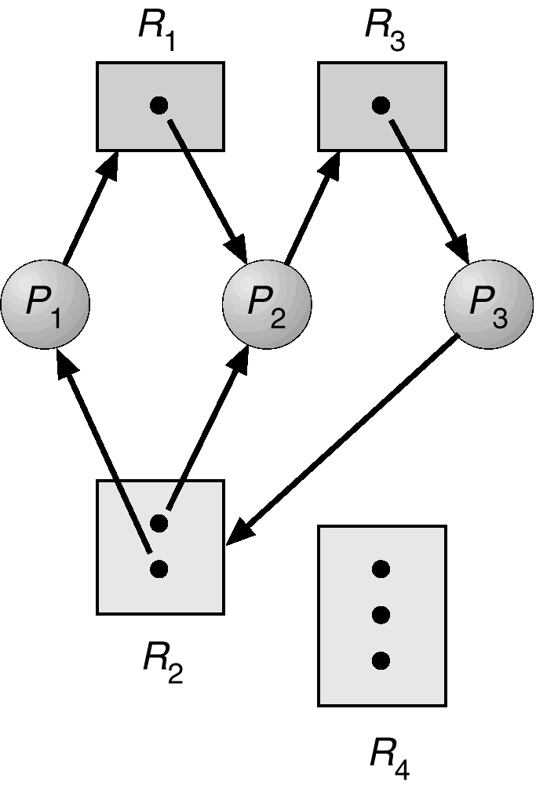
Resource Allocation Graph With A Deadlock

Slide 14
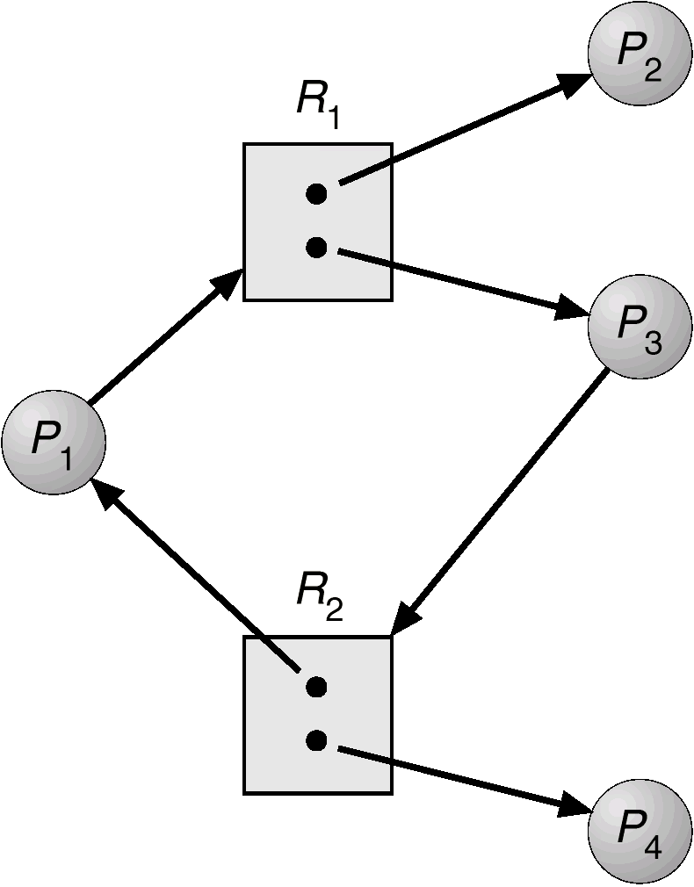
Resource Allocation Graph With A Cycle But No Deadlock

Slide 15
Resource Allocation Graph Example 1

Slide 16
Resource Allocation Graph Example 2

Slide 17
Basic Facts
If graph contains no cycles ⇒ no deadlock.
If graph contains a cycle ⇒
if only one instance per resource type, then deadlock.
if several instances per resource type, possibility of deadlock.

