Slide 1
CSCI315 – Operating Systems Design Department of Computer Science Bucknell University
Introduction to Memory Management
Memory Labs Overview
Ch 9.1-9.2
This set of notes is based on notes from the textbook authors, as well as L. Felipe Perrone, Joshua Stough, and other instructors.
Xiannong Meng, Fall 2020.

Slide 2
Background
Source programs such as a C program must be compiled and linked with library to form an executable.
An executable program must be brought from disk into memory and placed within a process for it to be run.
Waiting queue – collection of processes on the disk that are waiting to be brought into memory to run the program.

Slide 3
Logical View of Memory
We learned from CSCI 206, memory can be viewed as an array of words, each with its address.
Addresses can be in bytes or words.
n-1
memory
……
8
4
0
byte addresses

Slide 4
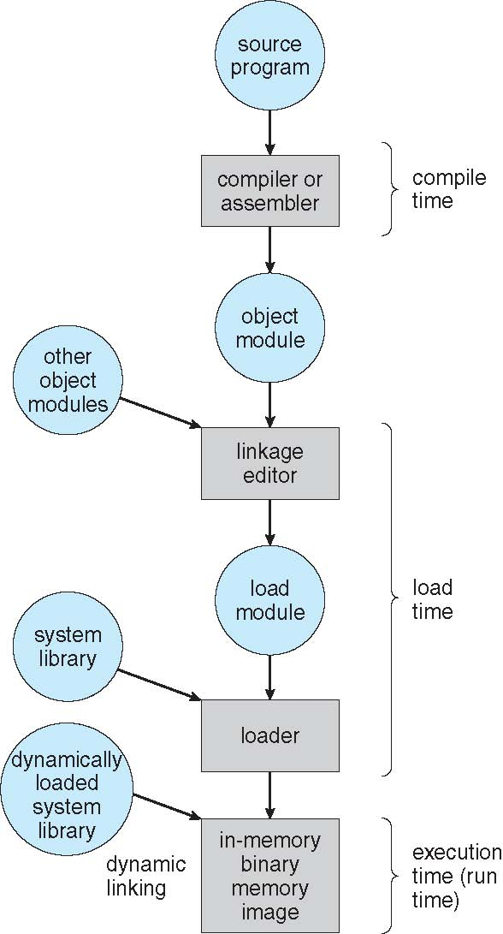
Processing of a User Program

Slide 5
Binding of Instructions and Data to Memory
Address binding of instructions and data to memory addresses can happen at three different stages:
Compile time: If memory location known a priori, absolute code can be generated; must recompile code if starting location changes.
Load time: Must generate relocatable code if memory location is not known at compile time.
Execution time: Binding delayed until run time if the process can be moved during its execution from one memory segment to another. Need hardware support for address maps (e.g., base and limit registers).

Slide 6
Logical vs. Physical Address Space
The concept of a logical address space that is bound to a separate physical address space is central to proper memory management.
Logical address – generated by the CPU; also referred to as virtual address.
Physical address – address seen by the memory unit.
Logical addresses must be mapped onto physical addresses when the program is loaded into memory for execution.

Slide 7
Memory-Management Unit (MMU)
Hardware device that maps virtual to physical address.
In MMU scheme, the value in the relocation register is added to every address generated by a user process at the time it is sent to memory.
The user program deals with logical addresses; it never sees the real physical addresses.

Slide 8
Contiguous Allocation
Main memory usually is in two partitions:
Resident operating system, usually held in low memory with interrupt vector.
User processes then held in high memory.
Single-partition allocation
Relocation-register scheme used to protect user processes from each other, and from changing operating-system code and data.
Relocation-register contains value of smallest physical address; limit register contains range of logical addresses – each logical address must be less than the limit register.

Slide 9
Contiguous Allocation
Multiple-partition allocation
Hole – block of available memory; holes of various size are scattered throughout memory.
When a process arrives, it is allocated memory from a hole large enough to accommodate it.
Operating system maintains information about: a) allocated partitions b) free partitions (hole)
OS
OS
OS
OS
process 5
process 5
process 5
process 5
process 9
process 9
process 8
process 10
process 2
process 2
process 2
process 2

Slide 10
Dynamic Storage-Allocation Problem
How to satisfy a request of size n from a list of free holes.
First-fit: Allocate the first hole that is big enough.
Best-fit: Allocate the smallest hole that is big enough; must search entire list, unless ordered by size. Produces the smallest leftover hole.
Worst-fit: Allocate the largest hole; must also search entire list. Produces the largest leftover hole.
First-fit and best-fit better than worst-fit in terms of speed and storage utilization.

Slide 11
Sidebar:
The Memory Labs

Slide 12
A Custom Memory Allocator
M - 1
void *allocate (int size);
M bytes
(contiguous)
void deallocate (void *p);
0

Slide 13
free list
the M bytes are obtained through malloc()
M is the size of the initial free block
data points to the first available address
head
tail
M - 1
prev
next
M
Initial State
data
NULL
NULL
0
M bytes
(contiguous)
allocated list
head
tail
NULL
0

Slide 14
free
ptr1 = allocate(100);
head
tail
M-1
prev
next
M-100
data
NULL
NULL
M-100
100
allocated
head
tail
prev
next
100
100
99
data
0
NULL
NULL
0

Slide 15
free
ptr2 = allocate(50);
head
tail
M-1
prev
next
M-150
data
NULL
NULL
150
M-150
allocated
head
tail
next
150
prev
100
50
next
149
prev
50
data
data
99
NULL
NULL
100
0
100
0

Slide 16
free
head
tail
ptr3 = allocate(200);
M-1
prev
next
M-350
data
NULL
NULL
350
M-350
allocated
350
head
tail
349
200
next
next
prev
100
50
200
next
149
prev
prev
50
data
data
data
NULL
99
NULL
100
0
100
150
0

Slide 17
free
deallocate(ptr2);
head
tail
M-1
prev
next
M-350
50
next
prev
data
data
NULL
NULL
350
100
M-350
allocated
head
349
tail
200
next
prev
100
200
next
prev
149
50
data
data
NULL
99
NULL
100
0
150
0

Slide 18
ptr4 = allocate(40);
M-1
First-fit
Best-fit
Worst-fit
M-350
349
200
200
200
149
50
99
100
100
100
0

Slide 19
End of Sidebar

