Slide 1
CSCI315 – Operating Systems Design
Department of Computer Science
Bucknell University
Memory Management
Contiguous Allocation and Introduction to Paging
Ch 9.2-9.3
This set of notes is based on notes from the textbook authors, as well as L. Felipe Perrone, Joshua Stough, and other instructors.
Xiannong Meng, Fall 2020.

Slide 2
Contiguous Allocation
Multiple-partition allocation: Programs are put into various parts of the memory. But each program occupies a contiguous part of the memory.
OS
OS
OS
OS
process 5
process 5
process 5
process 5
process 9
process 9
process 8
process 10
process 2
process 2
process 2
process 2

Slide 3
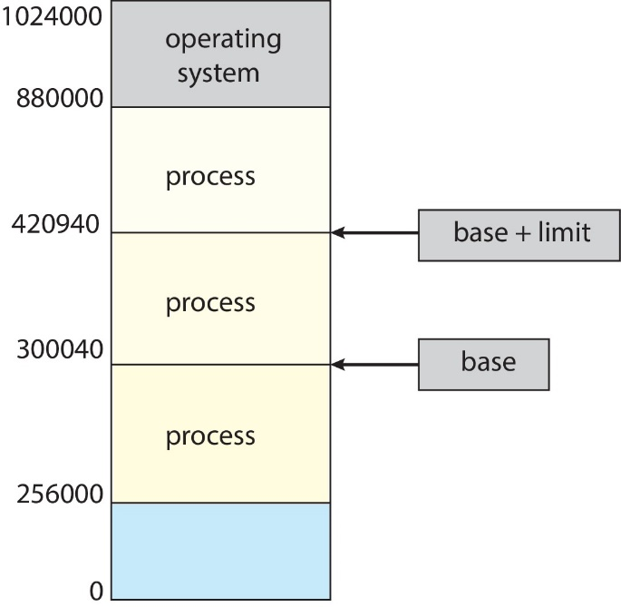
Protection
Need to censure that a process can access only access those addresses in it address space.
We can provide this protection by using a pair of base and limit registers define the logical address space of a process.

Slide 4
Dynamic relocation using a relocation register
relocation
register
14000
logical
address
physical
address
CPU
+
memory
346
14346
MMU
This is an example of how to convert a logical address to a physical one.

Slide 5
Hardware Support for Relocation and Limit Registers
CPU must check every memory access generated in user mode to be sure it is between base and limit for that user.
limit
register
relocation
register
logical
address
physical
address
yes
CPU
<
+
memory
no
Logical address ranges from 0 to n-1, so the condition logical address < limit guarantees validity of the address
trap;
addressing error

Slide 6
Dynamic Loading
Routine is not loaded until it is called.
Better memory-space utilization; unused routine is never loaded.
Useful when large amounts of code are needed to handle infrequently occurring cases.
No special support from the operating system is required implemented through program design.

Slide 7
Dynamic Linking
Linking postponed until execution time.
Small piece of code, stub, used to locate the appropriate memory-resident library routine.
Stub replaces itself with the address of the routine, and executes the routine.
Operating system needed to check if routine is in process’s memory address space.
Dynamic linking is particularly useful for libraries.

Slide 8
Fragmentation
External Fragmentation – total memory space exists to satisfy a request, but it is not contiguous
Internal Fragmentation – allocated memory may be slightly larger than requested memory; this size difference is memory internal to a partition, but not being used
First fit analysis reveals that given N blocks allocated, 0.5 N blocks lost to fragmentation
  50-percent rule: “1/3 may be unusable”

Slide 9
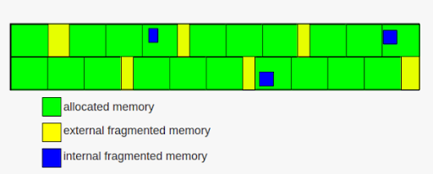
External and Internal Fragmentation
https://images.app.goo.gl/ghC55ZDKDBXLFHMH6
http://www.differencebetween.net/technology/difference-between-internal-fragmentation-and-external-fragmentation/

Slide 10
Fragmentation (Cont.)
Reduce external fragmentation by compaction
  Shuffle memory contents to place all free memory together in one large block
  Compaction is possible only if relocation is dynamic, and is done at execution time
  I/O problem
    Latch job in memory while it is involved in I/O
    Do I/O only into OS buffers
Now consider that backing store (e.g., hard disks) has same fragmentation problems

Slide 11
Paging
Physical address space of a process can be noncontiguous; process is allocated physical memory whenever the latter is available
  Avoids external fragmentation
Divide physical memory into fixed-sized blocks called frames
  Size is power of 2, between 512 bytes and 16 Mbytes
Divide logical memory into blocks of same size called pages
Keep track of all free frames
To run a program of size N pages, need to find N free frames and load program
Set up a page table to translate logical to physical addresses

Slide 12
Address Translation Scheme
Address generated by CPU is divided into:
  Page number (p) – used as an index into a page table which contains base address of each page in physical memory
  Page offset (d) – combined with base address to define the physical memory address that is sent to the memory unit
  For given logical address space 2^{m} and page size 2^{n} assuming the address has m bits.

Slide 13
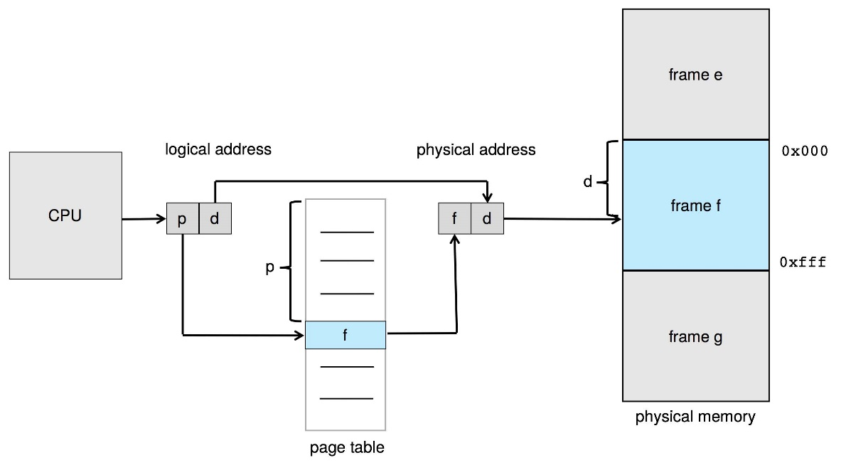
Paging Hardware

Slide 14
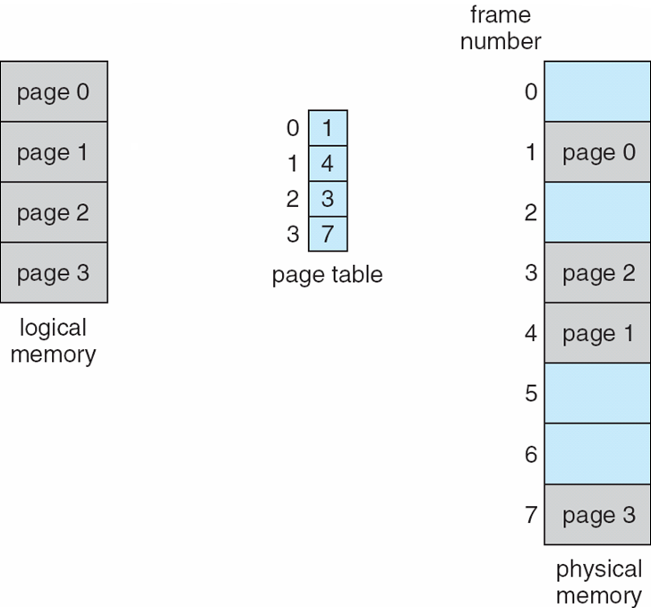
Paging Model of Logical and Physical Memory

Slide 15
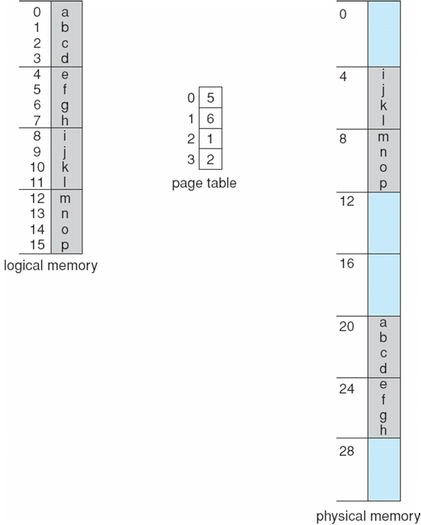
Paging Example
Logical address: n = 2 and m = 4. Using a page size of 4 bytes and a physical memory of 32 bytes (8 pages)

Slide 16
Paging – Example of internal fragmentation
Page size = 2,048 bytes
Process size = 72,766 bytes
35 pages + 1,086 bytes
Internal fragmentation of 2,048 - 1,086 = 962 bytes
Worst case fragmentation = 1 frame – 1 byte
On average fragmentation = 1 / 2 frame size
So small frame sizes desirable?
But each page table entry takes memory to track
Page sizes growing over time with larger memory capacity
  Solaris supports two page sizes – 8 KB and 4 MB

Slide 17
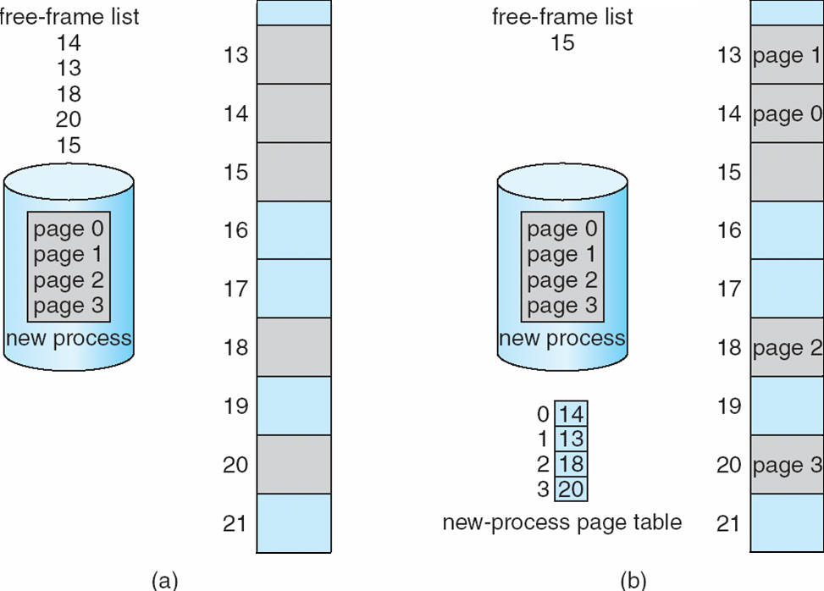
Free Frames
Before allocation
After allocation

Slide 18
Implementation of Page Table
Page table is kept in main memory
  Page-table base register (PTBR) points to the page table
  Page-table length register (PTLR) indicates size of the page table
In this scheme every data/instruction access requires two memory accesses
  One for the page table and one for the data / instruction
The two-memory access problem can be solved by the use of a special fast-lookup hardware cache called translation look-aside buffers (TLBs) (also called associative memory).

Slide 19
Translation Look-Aside Buffer
Some TLBs store address-space identifiers (ASIDs) in each TLB entry – uniquely identifies each process to provide address-space protection for that process
  Otherwise need to flush at every context switch
TLBs typically small (64 to 1,024 entries)
On a TLB miss, value is loaded from memory into the TLB for faster access next time
  Replacement policies must be considered
  Some entries can be wired down for permanent fast access

Slide 20
Hardware
Associative memory – parallel search
Address translation (p, d)
  If p is in associative register, retrieve the frame # f from TLB
  Otherwise get frame # from page table in memory

Slide 21
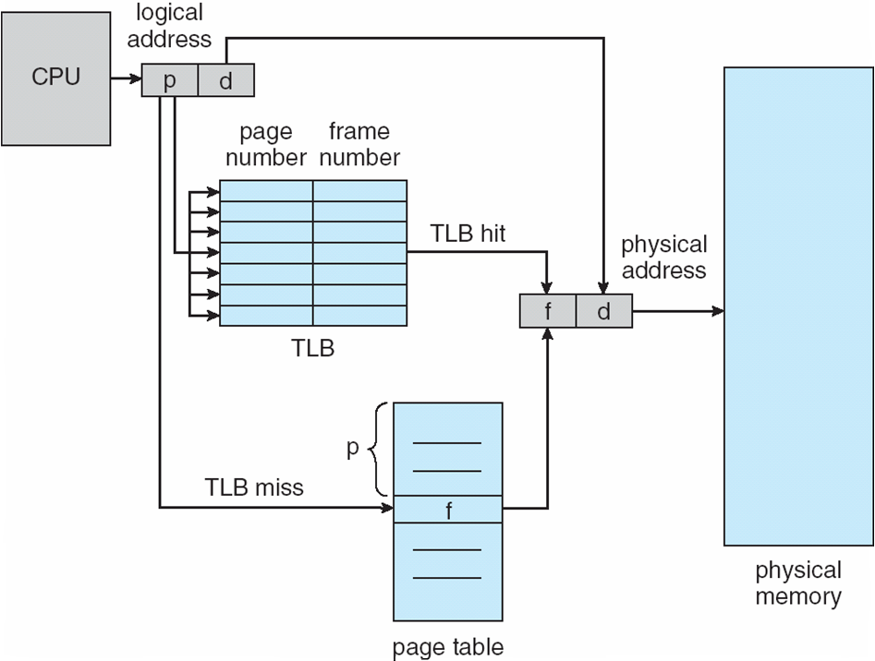
Paging Hardware With TLB

