Slide 1
CSCI315 – Operating Systems Design Department of Computer Science Bucknell University
Memory Management: Paging 2
Ch 9.4 – 9.5
This set of notes is based on notes from the textbook authors, as well as L. Felipe Perrone, Joshua Stough, and other instructors.
Xiannong Meng, Fall 2020.

Slide 2
Memory Protection
Memory protection implemented by associating protection bits with each frame.
Valid-invalid bit attached to each entry in the page table:
“valid” indicates that the associated page is in the process’ logical address space, and is thus a legal page.
“invalid” indicates that the page is not in the process’ logical address space.

Slide 3
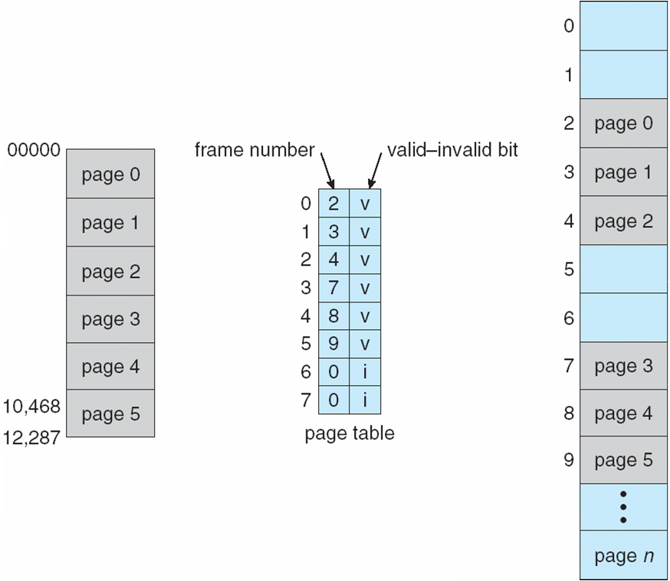
Valid Bit
1 bit value

Slide 4
Effective Access Time
Associative Lookup = ε time unit (e.g., nanosecond)
Assume memory cycle time is t nanosecond
Hit ratio – percentage of times that a page number is found in the associative registers; ratio related to number of associative registers.
Hit ratio = α
Effective Access Time (EAT)
EAT = (t + ε) α + (2t + ε)(1 – α)
why 2?

Slide 5
Effective Access Time
Effective Access Time (EAT)
EAT = (t + ε) α + (2t + ε)(1 – α)
First access to memory is to load the page table entry when it is not in the TLB (cache). The second access actually reads the data or instruction from the memory.
why 2?

Slide 6
Effective Access Time Example
Effective Access Time (EAT)
EAT = (t + ε) α + (2t + ε)(1 – α)
Assume α = 0.8 (80 percent hit ratio for PTL entries)
ε = 1 ns, t = 20 ns
EAT = (20+1)*0.80 + (2*20 +1)*0.20 = 25 ns
If α = 0.99, EAT = (20+1)*0.99 + (2*20 +1)*0.01 = 21.2 ns

Slide 7
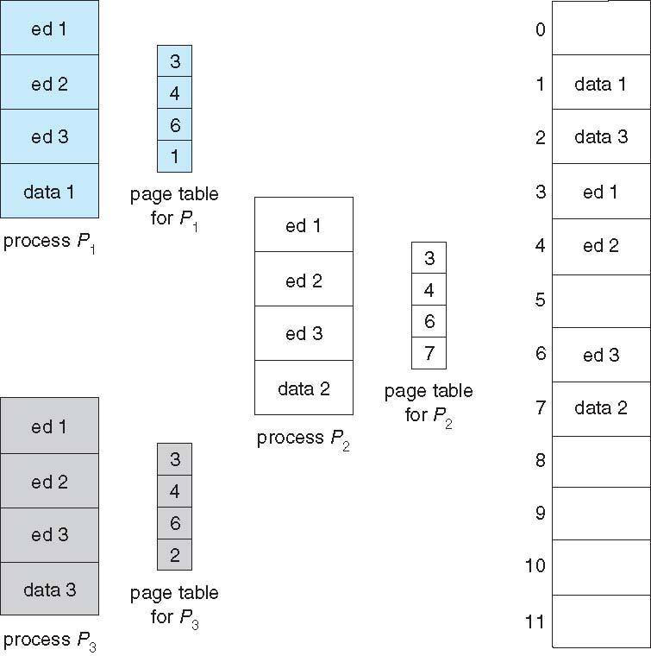
Added Benefit: shared pages

Slide 8
Shared Pages
Shared code
One copy of read-only (reentrant) code shared among processes (i.e., text editors, compilers, window systems).
Shared code must appear in same location in the logical address space of all processes.
Private code and data
Each process keeps a separate copy of the code and data.
The pages for the private code and data can appear anywhere in the logical address space.

Slide 9
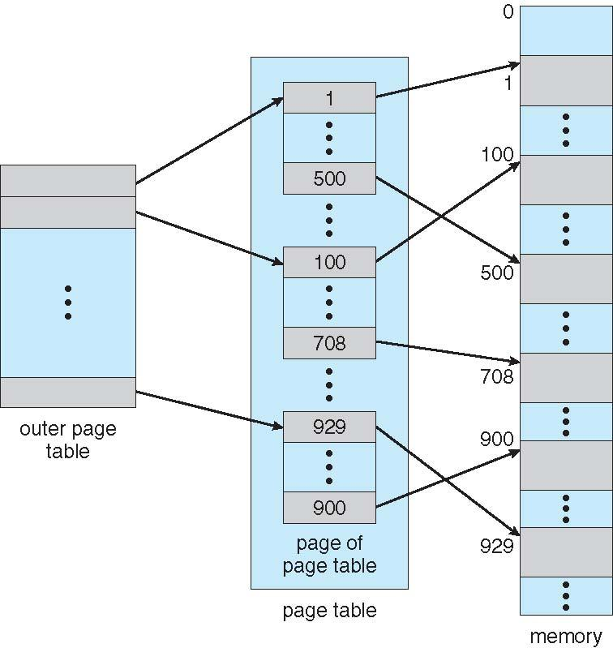
Large Page Table?
Break up the logical address space into multiple page tables
A simple technique is a two-level page table
The page table is broken into pages
page number: P₁ + P₂ bits
n bits
P₁
P₂
page offset
L bits

Slide 10
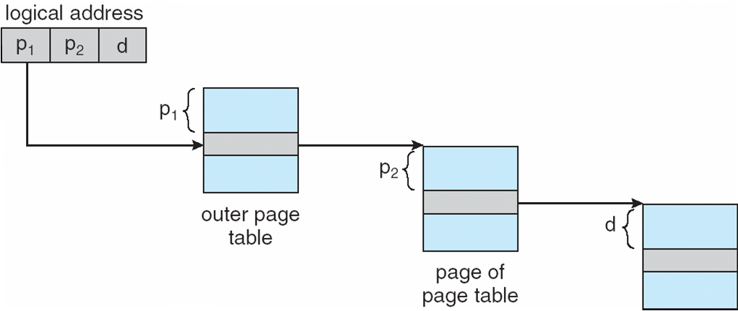
Address Translation
aggregates all the pages that together make up the page table

Slide 11
Two-Level Paging Example
A logical address (on 32-bit machine with 4K page size) is divided into:
a page number consisting of 20 bits.
a page offset consisting of 12 bits.
Since the page table is paged, the page number is further divided into:
a 10-bit page number.
a 10-bit page offset.
Thus, a logical address is as follows: where p₁ is an index into the outer page table, and p₂ is the displacement within the page of the outer page table.
page number
page offset
p₁
p₂
d
10
10
12

