Slide 1
CSCI315 – Operating Systems Design
Department of Computer Science
Bucknell University
Paging: Other Issues and Examples
Ch 9.5-9.7
This set of notes is based on notes from the textbook authors, as well as L. Felipe Perrone, Joshua Stough, and other instructors.
Xiannong Meng, Fall 2020.

Slide 2
Hashed Page Tables
Common in address spaces > 32 bits
The virtual page number is hashed into a page table
  This page table contains a chain of elements hashing to the same location
Each element contains (1) the virtual page number (2) the value of the mapped page frame (3) a pointer to the next element
Virtual page numbers are compared in this chain searching for a match
  If a match is found, the corresponding physical frame is extracted

Slide 3
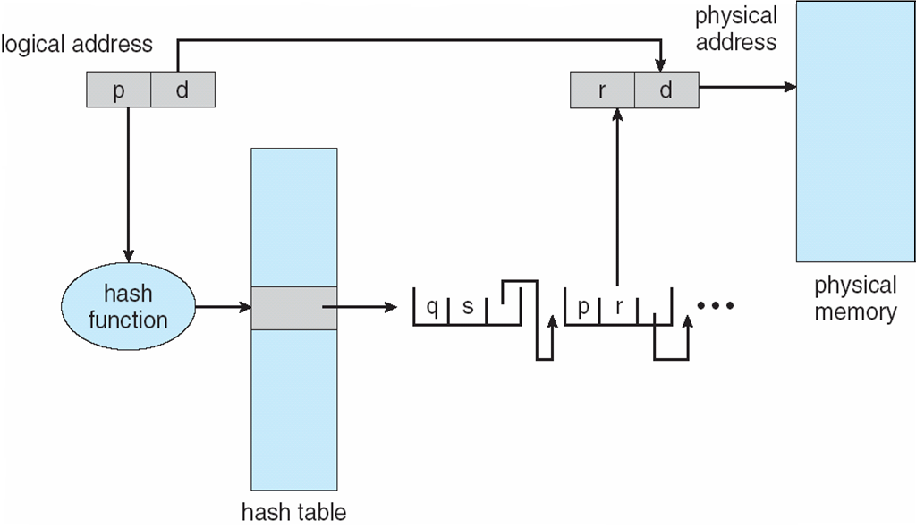
Hashed Page Table

Slide 4
Clustered Page Tables
Variation for 64-bit addresses is clustered page tables
  Similar to hashed but each entry refers to several pages (such as 16) rather than 1
  Especially useful for sparse address spaces (where memory references are non-contiguous and scattered)

Slide 5
Inverted Page Table
Rather than each process having a page table and keeping track of all possible logical pages, track all physical pages
One entry for each real page (frame) of memory
Entry consists of the virtual address of the page stored in that real memory location, with information about the process that owns that page
Decreases memory needed to store each page table, but increases time needed to search the table when a page reference occurs
Use hash table to limit the search to one — or at most a few — page-table entries
  TLB can accelerate access
But how to implement shared memory?
  One mapping of a virtual address to the shared physical address

Slide 6
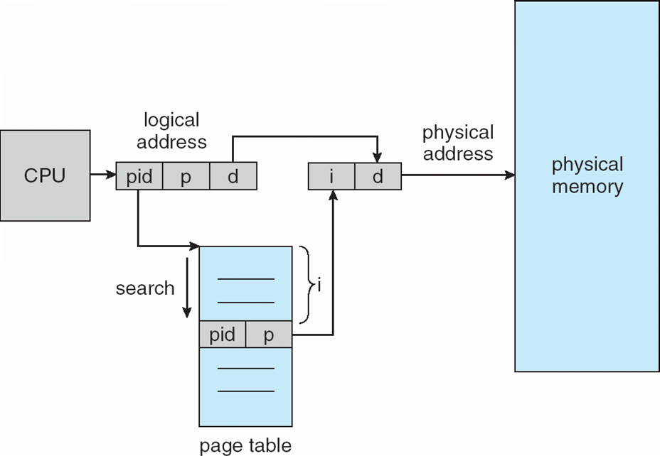
Inverted Page Table Architecture

Slide 7
Swapping
A process can be swapped temporarily out of memory to a backing store, and then brought back into memory for continued execution
  Total physical memory space of processes can exceed physical memory
Backing store – fast disk large enough to accommodate copies of all memory images for all users; must provide direct access to these memory images
Roll out, roll in – swapping variant used for priority-based scheduling algorithms; lower-priority process is swapped out so higher-priority process can be loaded and executed
Major part of swap time is transfer time; total transfer time is directly proportional to the amount of memory swapped
System maintains a ready queue of ready-to-run processes which have memory images on disk

Slide 8
Swapping (Cont.)
Does the swapped out process need to swap back in to same physical addresses?
Depends on address binding method
  Plus consider pending I/O to / from process memory space
Modified versions of swapping are found on many systems (i.e., UNIX, Linux, and Windows)
  Swapping normally disabled
  Started if more than threshold amount of memory allocated
  Disabled again once memory demand reduced below threshold

Slide 9
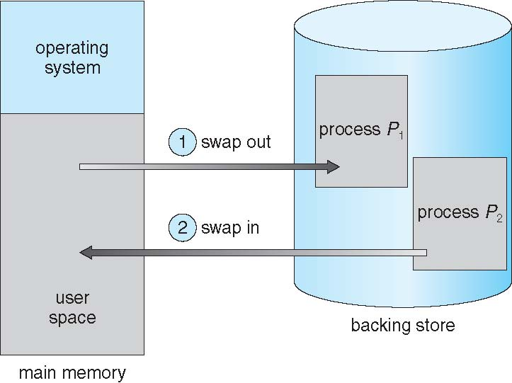
Schematic View of Swapping

Slide 10
Context Switch Time including Swapping
If next processes to be put on CPU is not in memory, need to swap out a process and swap in target process
Context switch time can then be very high
100MB process swapping to hard disk with transfer rate of 50MB/sec
  Swap out time of 2000 ms
  Plus swap in of same sized process
  Total context switch swapping component time of 4000ms (4 seconds)
Time can be reduced if reducing the size of memory swapped – by knowing how much memory really being used.

Slide 11
Context Switch Time and Swapping (Cont.)
Other constraints on swapping
  Pending I/O – can’t swap out as I/O would occur to wrong process
Standard swapping not used in modern operating systems
  But modified version common
    Swap only when free memory extremely low

Slide 12
Swapping on Mobile Systems
Not typically supported
Mobil OSes are more flash memory based
  Small amount of space
  Limited number of write cycles
  Poor throughput between flash memory and CPU on mobile platform
Instead use other methods to free memory if low
  iOS asks apps to voluntarily relinquish allocated memory
    Read-only data thrown out and reloaded from flash if needed
    Failure to free can result in termination
  Android terminates apps if low free memory, but first writes application state to flash for fast restart
  Both OSes support swapping paging as shown next

Slide 13
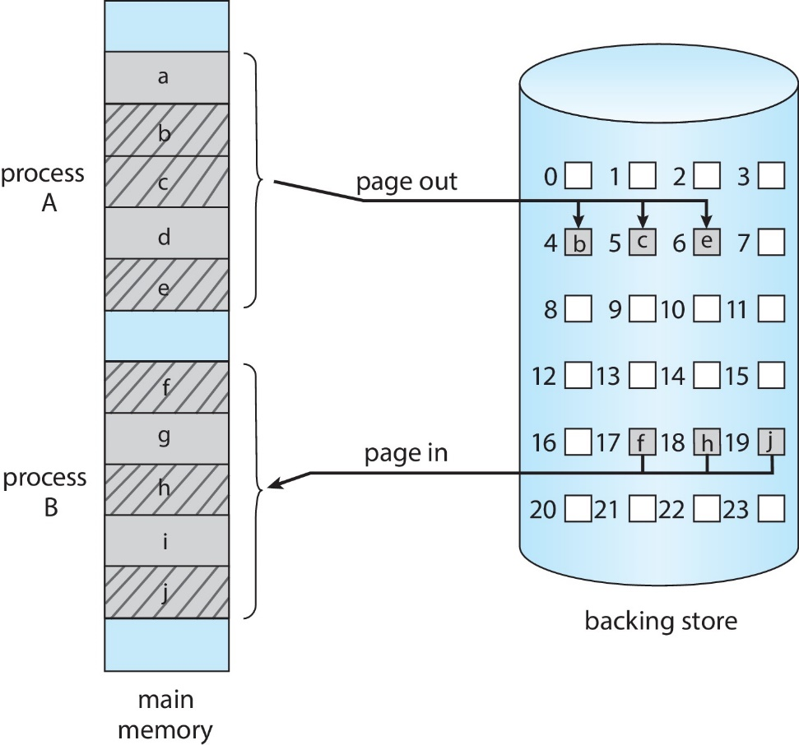
Swapping with Paging
swapping pages as necessary, rather than the entire process

Slide 14
Example: The Intel 32 and 64-bit Architectures
Dominant industry chips
Pentium CPUs are 32-bit and called IA-32 architecture
Current Intel CPUs are 64-bit and called IA-64 architecture
Many variations in the chips, cover the main ideas here

Slide 15
Example: The Intel IA-32 Architecture
Supports both segmentation and segmentation with paging
  Each segment can be 4 GB (max for 32 bits)
  Up to 16 K segments per process
  Divided into two partitions
    First partition of up to 8 K segments are private to process (kept in local descriptor table (LDT))
    Second partition of up to 8K segments shared among all processes (kept in global descriptor table (GDT))

Slide 16

Example: The Intel IA-32 Architecture (Cont.)
CPU generates logical address, a selector and an offset.
  Selector given to segmentation unit
    Which produces linear addresses
    s: segment number
    g: whether the segment is in the GDT or LDT
    p: protection information

Slide 17
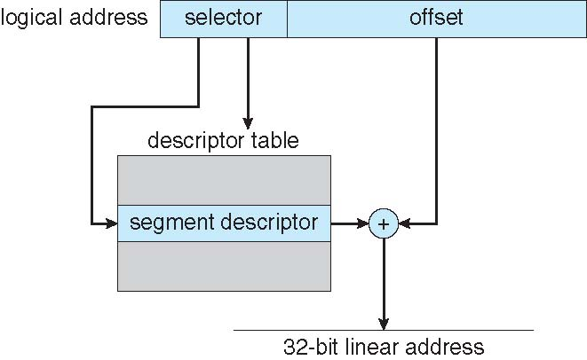
Intel IA-32 Segmentation
16 bit
16 bit

Slide 18
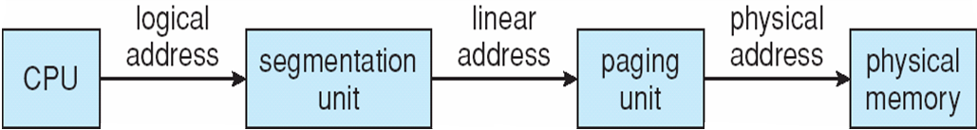
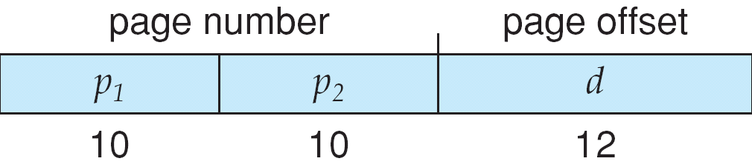
Logical to Physical Address Translation in IA-32
IA-32 allows a page size either 4 KB or 4 MB. For a 4 KB page, 2-level paging is used. Example shown on the right.
12 bit for 4 KB

Slide 19
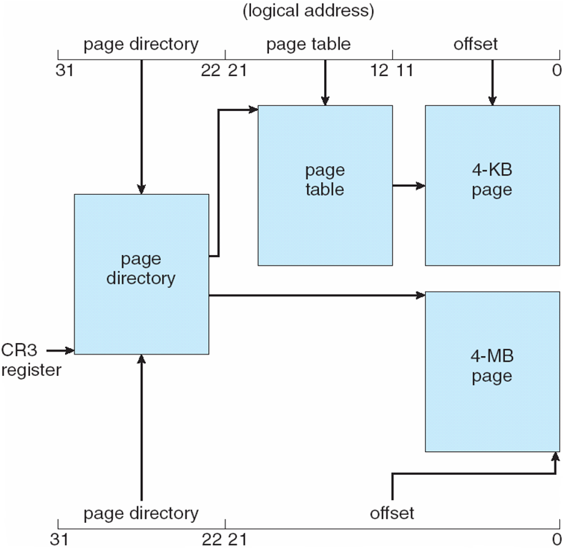
Intel IA-32 Paging Architecture
Two-level paging system in IA-32.
10-bit page directory
10-bit page table

Slide 20
Intel IA-32 Page Address Extensions
32-bit address limits led Intel to create page address extension (PAE), allowing 32-bit apps access to more than 4GB of memory space
  Paging went to a 3-level scheme
  Top two bits refer to a page directory pointer table
  Page-directory and page-table entries moved to 64-bits in size
  Net effect is increasing address space to 36 bits – 64GB of physical memory

Slide 21
Intel x86-64
Current generation Intel x86 architecture
64 bits is ginormous (> 16 exabytes)
In practice only implement 48 bit addressing
  Page sizes of 4 KB, 2 MB, 1 GB
  Four levels of paging hierarchy
Can also use PAE so virtual addresses are 48 bits and physical addresses are 52 bits

Slide 22
Example: ARM Architecture
Dominant mobile platform chip (Apple iOS and Google Android devices for example)
Modern, energy efficient, 32-bit CPU
4 KB and 16 KB pages
1 MB and 16 MB pages (termed sections)
One-level paging for sections, two-level for smaller pages
Two levels of TLBs
  Outer level has two micro TLBs (one data, one instruction)
  Inner is single main TLB
  First inner is checked, on miss outers are checked, and on miss page table walk performed by CPU

