Slide 1
CSCI315 – Operating Systems Design Department of Computer Science Bucknell University
Introduction to Virtual Memory
Ch 10.1 – 10.2
This set of notes is based on notes from the textbook authors, as well as L. Felipe Perrone, Joshua Stough, and other instructors.
Xiannong Meng, Fall 2020.

Slide 2
Problems with Memory System
The total memory needed by running processes may exceed the amount of physical memory.
In one example we saw, there were 400+ processes active at one time on linuxremote.
At the same time, only about 10 percent of the code is really needed (executed) in a program life time, according to the 90/10 rule.
https://softwareengineering.stackexchange.com/questions/334528/what-is-the-meaning-of-the-90-10-rule-of-program-optimization

Slide 3
Solutions?
We keep only the active part of the programs in memory as needed.
Other less active part of the programs are stored on secondary storage. They are brought into the memory only when being called.
Doing so maximizes the number of programs (processes) can be in memory at any time.
Virtual memory is one such solution.

Slide 4
Virtual Memory
Virtual memory – separation of user logical memory from physical memory.
Only part of the program needs to be in memory for execution.
Logical address space can therefore be much larger than physical address space.
Allows address spaces to be shared by several processes.
Allows for more efficient process creation.
Virtual memory can be implemented via:
Demand paging
Demand segmentation

Slide 5
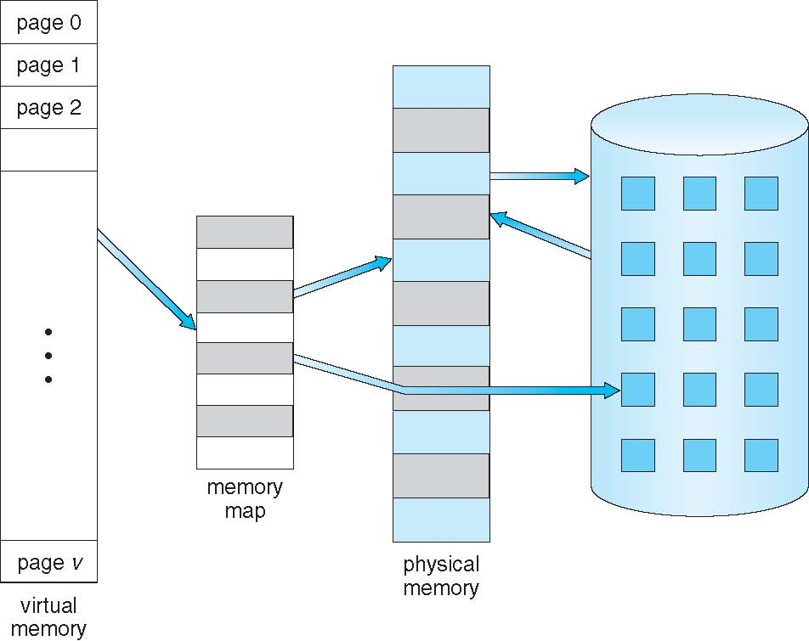
Virtual Memory That is Larger Than Physical Memory

Slide 6
Demand Paging
Bring a page into memory only when it is needed.
Less I/O needed.
Less memory needed.
Faster response.
More users.
When a page is needed (there is a reference to it):
invalid reference ⇒ abort.
not-in-memory ⇒ bring it into to memory.
Lazy swapper – never swap a page into memory unless page will be needed.

Slide 7
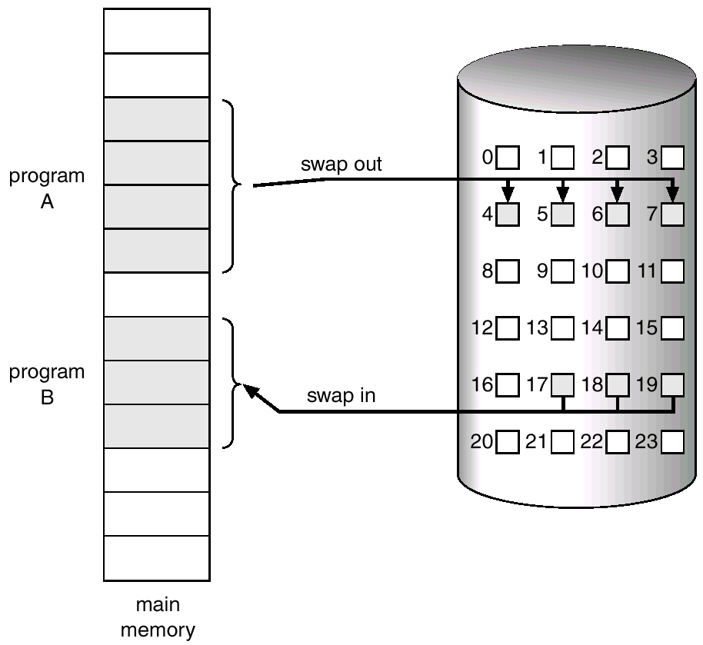
Mapping of a Paged Memory to Contiguous Disk Space

Slide 8
Valid-Invalid Bit
With each page table entry a valid bit is associated (1 ⇒ in-memory, 0 ⇒ not-in-memory)
Initially valid bit is set to 0 on all entries.
During address translation, if valid bit in page table entry is 0 ⇒ page fault.
Example of a page table snapshot ⇒
Frame #
valid
1
1
1
1
0

0
0
sample page table

Slide 9
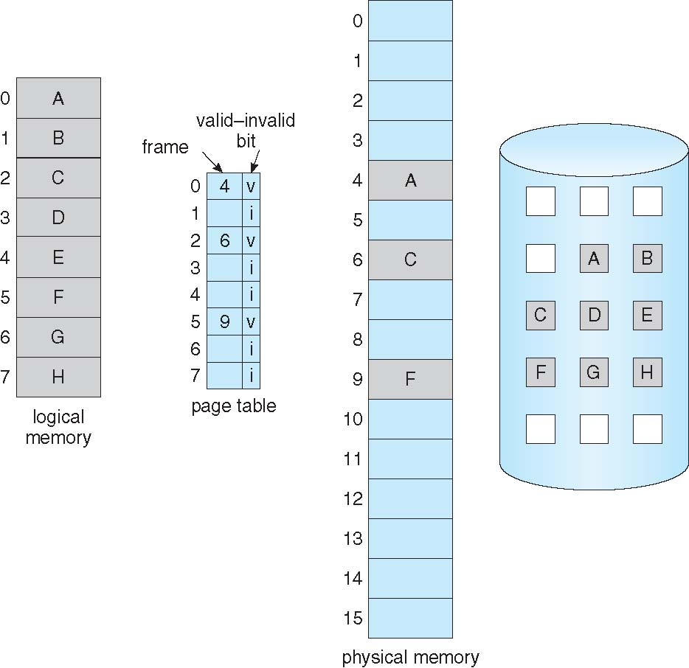
Page Table When Some Pages Are Not in Main Memory

Slide 10
Page Fault and Its Handling
For any reference to a page, the very first reference will trap to OS ⇒ page fault.
OS looks at page table and page limit table to decide:
If it was an invalid reference (address out of bound) ⇒ abort.
If it was a reference to a page that is not in memory, continue.
Get an empty frame from the free-list.
Bring the page content from disk into frame.
Update the page table and make valid bit = 1.
Restart the instruction that caused the page fault.

Slide 11
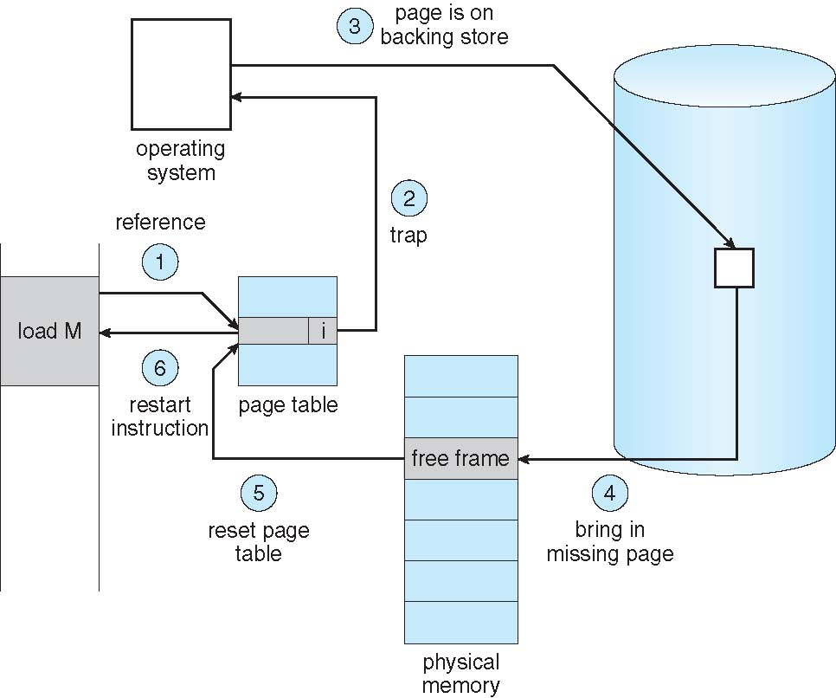
Steps in Handling a Page Fault

Slide 12
No free frame: now what?
Page replacement: Are all those pages in memory being referenced? Choose one to swap back out to disk and make room to load a new page.
Algorithm: How you choose a victim.
Performance: Want an algorithm that will result in minimum number of page faults.
Side effect: The same page may be brought in and out of memory several times.

Slide 13
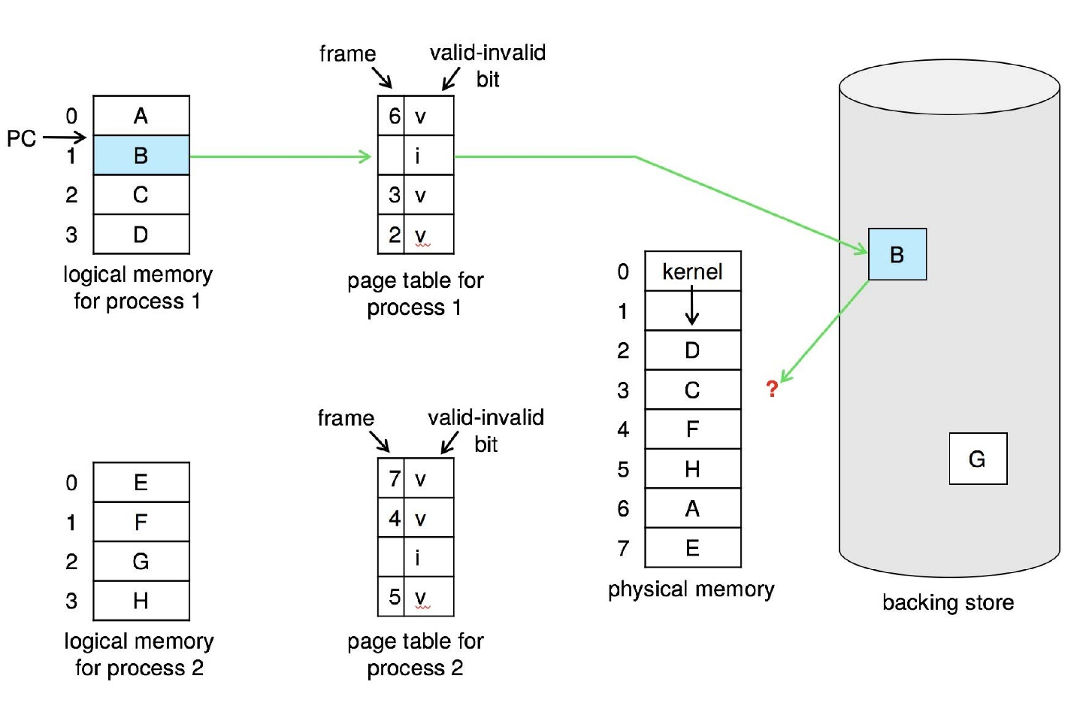
Need For Page Replacement

Slide 14
Basic Page Replacement
Find the location of the desired page on disk
Find a free frame: - If there is a free frame, use it - If there is no free frame, use a page replacement algorithm to select a victim frame - Write victim frame to disk if dirty
Bring the desired page into the (newly) free frame; update the page and frame tables
Continue the process by restarting the instruction that caused the trap
Note now potentially 2 page transfers for page fault – increasing EAT

Slide 15
Page Replacement
Prevent over-allocation of memory by modifying page-fault service routine to include page replacement.
Use modify (dirty) bit to reduce overhead of page transfers – only modified pages are written to disk.
Page replacement completes separation between logical memory and physical memory – large virtual memory can be provided on a smaller physical memory.

Slide 16
Aspects of Demand Paging
Extreme case – start process with no pages in memory
OS sets instruction pointer to first instruction of process, non-memory-resident -> page fault
And for every other process pages on first access
Pure demand paging
Actually, a given instruction could access multiple pages -> multiple page faults
Consider fetch and decode of instruction which adds 2 numbers (add $a, $b, $c) from memory and stores result back to memory
Pain decreased because of locality of reference
Peter Denning’s Work Set Model (more later)

Slide 17
Hardware Support for Demand Paging
Hardware support needed for demand paging
Page table with valid / invalid bit
Secondary memory (swap device with swap space)
Instruction restart
add $s1, $t1, $t2 # easy
mov +4($sp), $t0 # challenge, side effect

Slide 18
Performance of Demand Paging
Page Fault Rate: 0 ≤ p ≤ 1.0
if p = 0 no page faults.
if p = 1, every reference is a fault.
Effective Access Time (EAT):
EAT = [(1 – p) (memory access)] + [p (page fault overhead)]
where:
page fault overhead = [swap page out ] + [swap page in]
+ [restart overhead]

Slide 19
Demand Paging Example
Memory access time = 200 nanoseconds
Average page-fault service time = 8 milliseconds
EAT = (1 – p) x 200 + p (8 milliseconds)
= (1 – p) x 200 + p x 8,000,000
= 200 + p x 7,999,800
If one access out of 1,000 causes a page fault (p = 0.001), then
EAT = 8.2 microseconds.
This is a slowdown by a factor of 40!! (in comparison to 200 ns memory time)
If want performance degradation < 10 percent
220 > 200 + 7,999,800 x p 20 > 7,999,800 x p
p < .0000025
< one page fault in every 400,000 memory accesses

Slide 20
Improve Performance
Swap space I/O faster than file system I/O even if on the same device
Swap allocated in larger chunks, less management needed than file system
Copy entire process image to swap space at process load time
Then page in and out of swap space
Used in older BSD Unix
Demand page in from program binary on disk, but discard rather than paging out when freeing frame
Used in Solaris and current BSD
Still need to write to swap space
Pages not associated with a file (like stack and heap) – anonymous memory
Pages modified in memory but not yet written back to the file system
Mobile systems
Typically don’t support swapping
Instead, demand page from file system and reclaim read-only pages (such as code)

Slide 21
Copy-on-Write
Copy-on-Write (COW) allows both parent and child processes to initially share the same pages in memory
If either process modifies a shared page, only then is the page copied
COW allows more efficient process creation as only modified pages are copied
In general, free pages are allocated from a pool of zero-fill-on-demand pages
Pool should always have free frames for fast demand page execution
Don’t want to have to free a frame as well as other processing on page fault
Why zero-out a page before allocating it?
vfork() variation on fork() system call has parent suspend and child using copy-on-write address space of parent
Designed to have child call exec()
Very efficient

