Slide 1
CSCI315 – Operating Systems Design Department of Computer Science Bucknell University
Page Replacement Algorithms - 1
Ch 10.4
This set of notes is based on notes from the textbook authors, as well as L. Felipe Perrone, Joshua Stough, and other instructors.
Xiannong Meng, Fall 2020.

Slide 2
The Need To Replace A Page
When a page is referenced by a process, it is possible that the needed page is not in memory, resulting in a page fault.
The missing page needs to be brought into the memory.
What if there is no free memory frame for the needed page?
We need to remove an existing page to make space for the new page!

Slide 3
Basic Page Replacement
Find the location of the desired page on disk.
Find a free frame: - If there is a free frame, use it. - If there is no free frame, use a page replacement algorithm to select a victim frame.
Read the desired page into the (newly) free frame. Update the page and frame tables.
Restart the process.

Slide 4
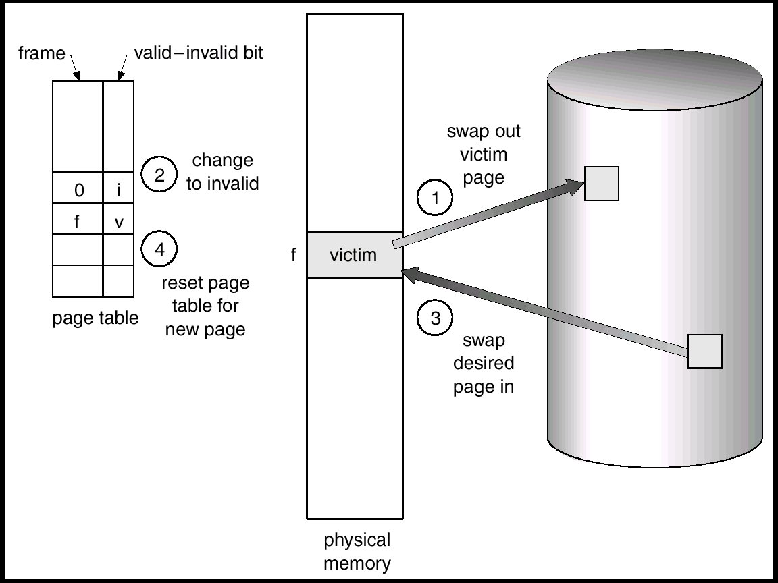
Page Replacement
victim page
victim frame

Slide 5
Page Replacement Algorithms
Goal: Produce a low page-fault rate.
Evaluate algorithm by running it on a particular string of memory references (reference string) and computing the number of page faults on that string.
The reference string is produced by tracing a real program or by some stochastic model. We look at every address produced and strip off the page offset, leaving only the page number. For instance:
1, 2, 3, 4, 1, 2, 5, 1, 2, 3, 4, 5

Slide 6
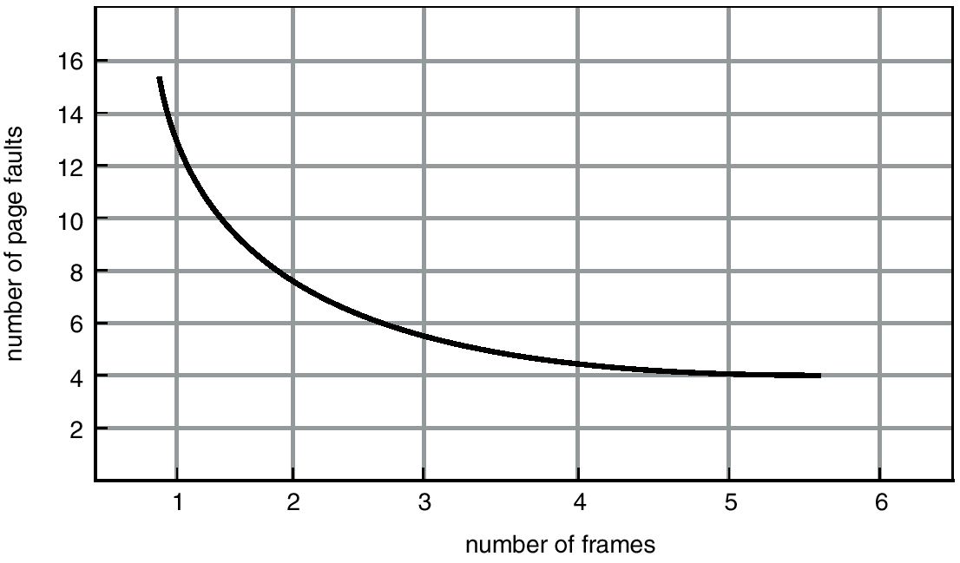
Graph of Page Faults vs The Number of Frames

Slide 7
FIFO Page Replacement
Reference string: 1, 2, 3, 4, 1, 2, 5, 1, 2, 3, 4, 5.
3 frames
4 frames FIFO Replacement ⇒ Belady’s Anomaly: more frames, more page faults, in this case.
1
1
4
5
2
2
1
3
9 page faults
3
3
2
4
1
1
5
4
2
2
1
5
10 page faults
3
3
2
4
4
3

Slide 8
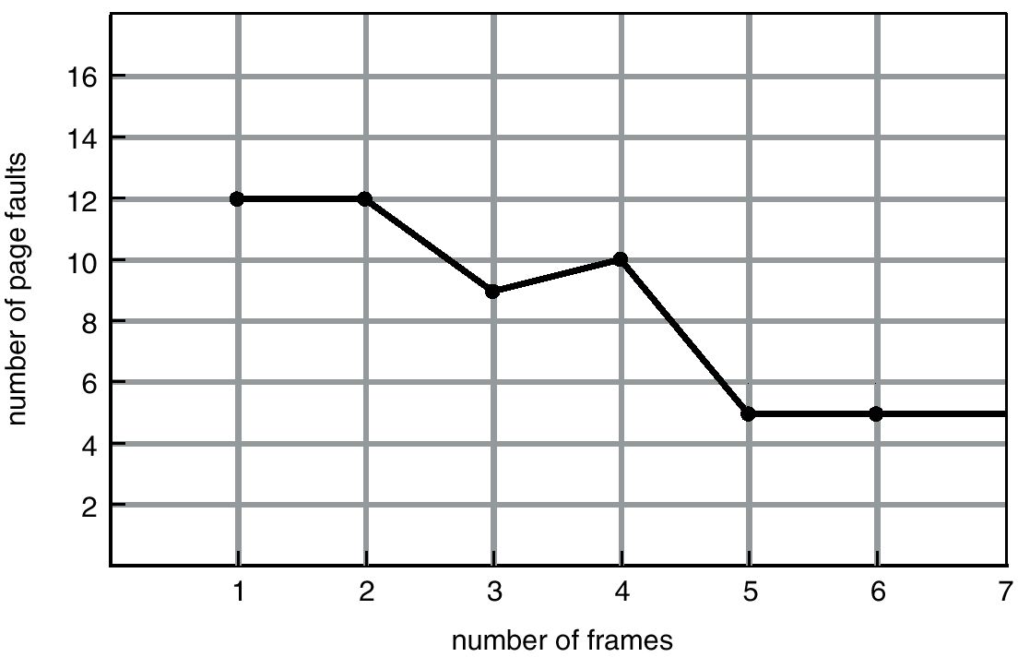
FIFO (Belady’s Anomaly)

Slide 9
Optimal Algorithm
Replace the page that will not be used for the longest period of time.
4 frames example: 1, 2, 3, 4, 1, 2, 5, 1, 2, 3, 4, 5 Used for measuring how well your algorithm performs.
How can you know what the future references will be?
1
4
2
6 page faults
3
4
5

Slide 10
Another FIFO Page Replacement Example
FIFO: 15 page faults

Slide 11
Optimal Page Replacement
Optimal: 9 page faults with the same reference string

Slide 12
Optimal not Practical!
Optimal page replace algorithm works great, except it is not practical!
Compare to optimal CPU scheduling algorithm (Shortest-Remaining-Time-First)
We will try to approximate the optimal algorithm
In CPU scheduling, we try to predict the next CPU burst length and use it to approximate the SJF
In page replacement, we use LRU (Least Recently Used) to approximate the optimal algorithm

Slide 13
LRU Algorithm
Reference string: 1, 2, 3, 4, 1, 2, 5, 1, 2, 3, 4, 5 It works great!
But, how do we implement the LRU algorithm? (more later.)
1
5
2
Optimal: 6 page faults
LRU: 8 page faults
3
5
4
4
3

Slide 14
LRU Page Replacement
Optimal: 9 page faults
LRU: 12 page faults

Slide 15
LRU Algorithm (Cont.)
Stack implementation – keep a stack of page numbers in a double link form:
Page referenced:
move it to the top
requires 6 pointers to be changed
No search for replacement.

Slide 16
LRU and Belady’s Anomaly
LRU does not suffer from Belady’s Anomaly (OPT doesn’t either).
It has been shown that algorithms in a class called stack algorithms can never exhibit Belady’s Anomaly.
A stack algorithm is one for which the set of pages in memory for n frames is a subset of the pages that could be in memory for n+1 frames.

Slide 17
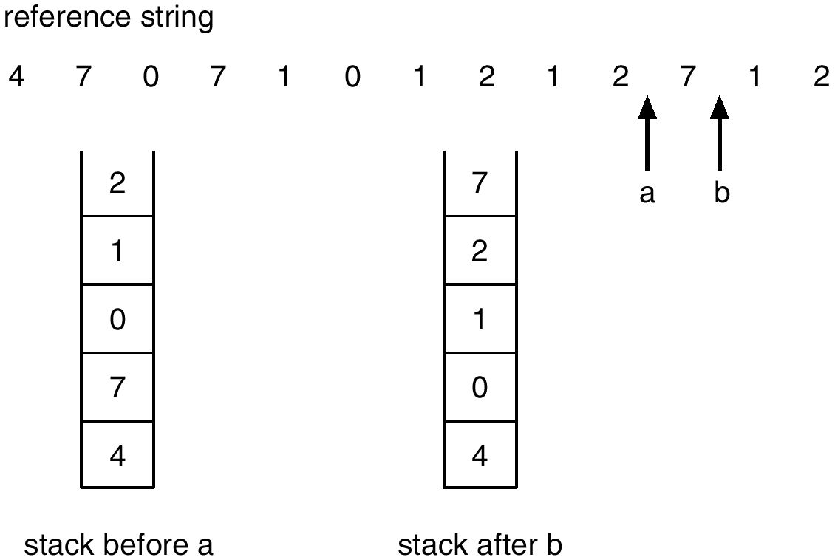
Use Stack to Record The Most Recent Page References

