Slide 1
CSCI315 – Operating Systems Design Department of Computer Science Bucknell University
Page Replacement Algorithms – 2
The Working Set Model
Ch 10.4-10.5
This set of notes is based on notes from the textbook authors, as well as L. Felipe Perrone, Joshua Stough, and other instructors.
Xiannong Meng, Fall 2020.

Slide 2
LRU Approximation Algorithms
Reference bit
With each page associate a bit, initially = 0
When page is referenced bit set to 1.
Replace the one which is 0 (if one exists). We do not know the order, however.
Additional reference bits (e.g., 8 bits)
Every time a page is referenced
Shift the reference bits to the right by 1
Place the reference bit (1 if being visited, 0 otherwise) into the high order bit of the reference bits
The page with the lowest reference bits value is the one that is Least Recently Used, thus to be replaced
E.g., the page with ref bits 11000100 is more recently used than the page with ref bits 01110111

Slide 3
LRU Approximation Algorithms
Second Chance
If we consider the number of reference history bits to be zero, only using the reference bit itself, we have the Second Chance (a.k.a. Clock) algorithm
Need a pointer (clock handle) to point the next victim.
At each clock interruption, we check the reference bit for the victim.
If the victim page has reference bit = 1, then:
set reference bit 0.
leave this page in memory.
Else if the page reference bit is 0, this page can be replaced.

Slide 4
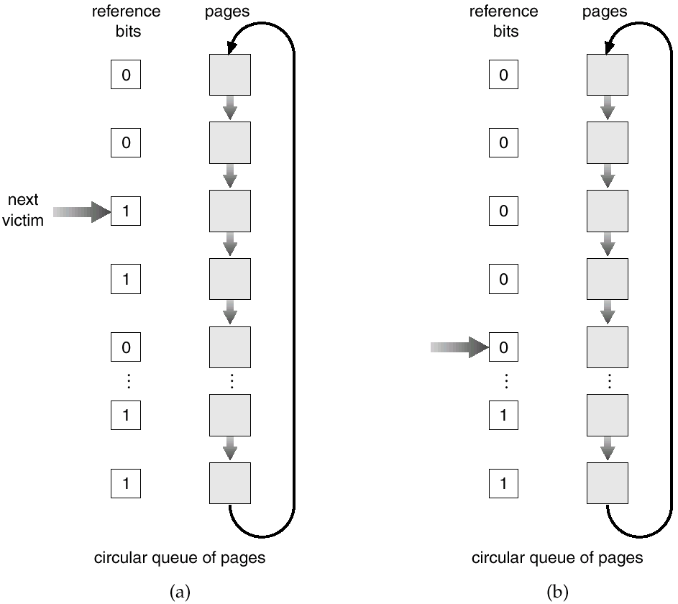
Second-Chance (Clock) Page-Replacement Algorithm

Slide 5
Counting Algorithms
Keep a counter of the number of references that have been made to each page.
LFU Algorithm: replaces page with smallest count.
MFU Algorithm: based on the argument that the page with the smallest count was probably just brought in and has yet to be used.

Slide 6
Allocation of Frames
Each process needs a minimum number of pages.
There are two major allocation schemes:
fixed allocation
priority allocation

Slide 7
Fixed Allocation
Equal allocation – e.g., if 100 frames and 5 processes, give each 20 pages.
Proportional allocation – Allocate according to the size of process.

Slide 8
Priority Allocation
Use a proportional allocation scheme using priorities rather than size.
If process P_{i} generates a page fault,
select for replacement one of its frames.
select for replacement a frame from a process with lower priority number.

Slide 9
Global vs. Local Allocation
Global replacement – process selects a replacement frame from the set of all frames; one process can take a frame from another.
Local replacement – each process selects from only its own set of allocated frames.

Slide 10
Thrashing
If a process does not have “enough” pages, the page-fault rate is very high. This leads to:
Low CPU utilization.
Operating system thinks that it needs to increase the degree of multiprogramming.
Another process added to the system.
Thrashing ≡ a process is busy swapping pages in and out.

Slide 11
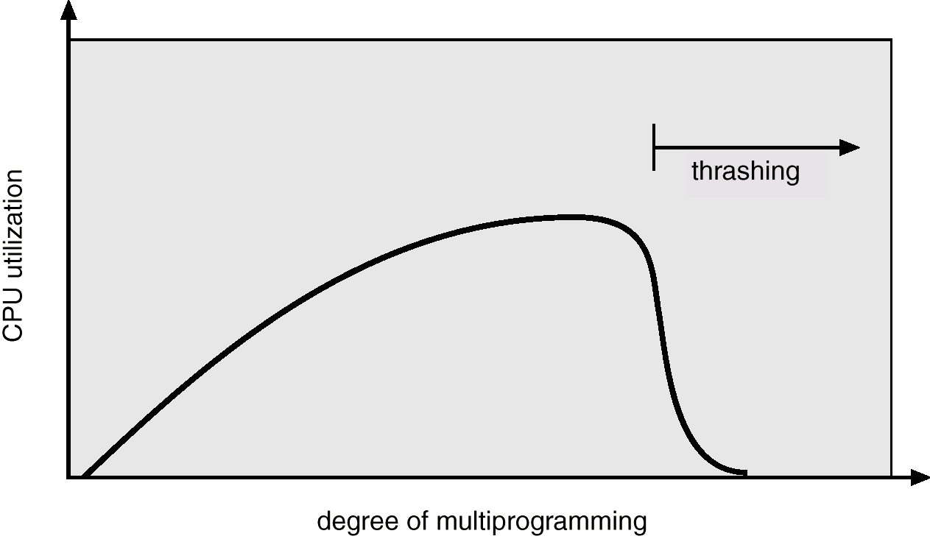
Thrashing
Why does paging work? Locality model
Process migrates from one locality to another.
Localities may overlap.
Why does thrashing occur? Σ size of locality > total memory size

Slide 12
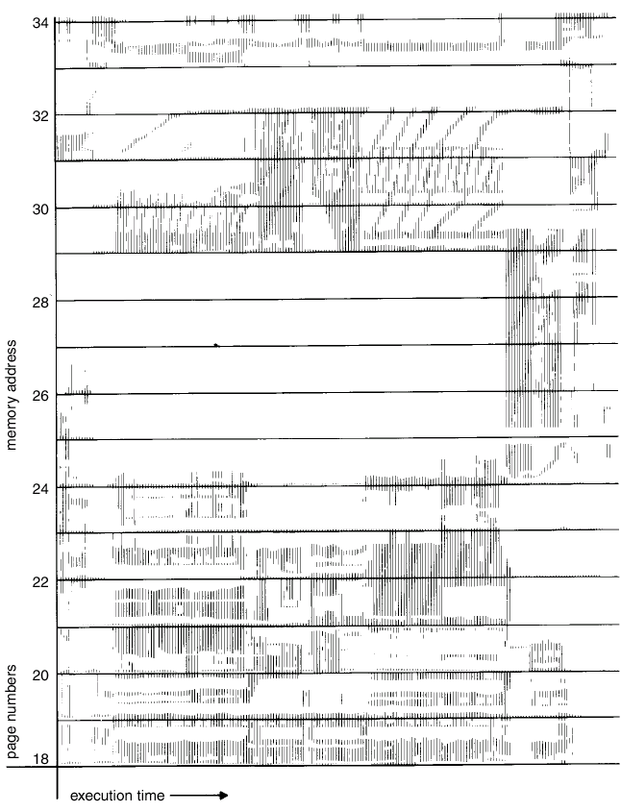
Locality in Memory-Reference Pattern

Slide 13
Working-Set Model
Δ ≡ working-set window ≡ a fixed number of page references.
WSS_{i} (working set of Process P_{i}) = total number of pages referenced in the most recent Δ (varies in time)
if Δ too small will not encompass entire locality.
if Δ too large will encompass several localities.
if Δ = ∞ ⇒ will encompass entire program.
D = Σ WSS_{i} ≡ total demand frames
if D > m ⇒ Thrashing
Policy if D > m, then suspend one of the processes.

Slide 14
Working-set model

Slide 15
Keeping Track of the Working Set
Approximate with interval timer + a reference bit
Example: Δ = 10,000
Timer interrupts after every 5000 time units.
Keep in memory 2 bits for each page.
Whenever a timer interrupts copy and sets the values of all reference bits to 0.
If one of the bits in memory = 1 ⇒ page in working set.
Why is this not completely accurate?
Improvement = 10 bits and interrupt every 1000 time units.

Slide 16
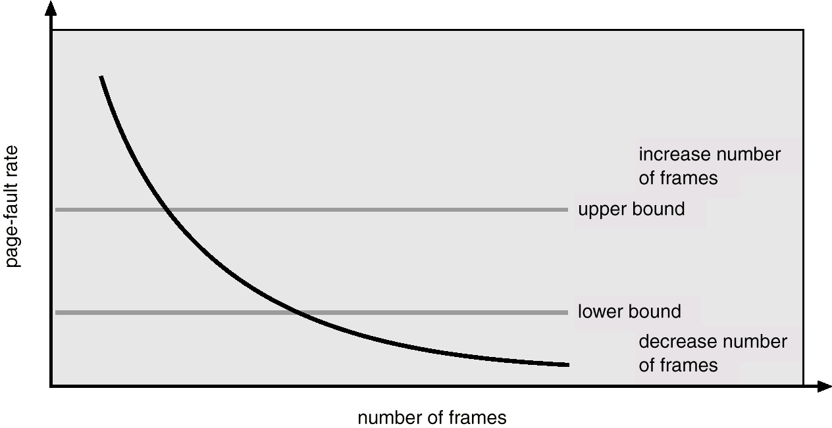
Page-Fault Frequency Scheme
Establish “acceptable” page-fault rate.
If actual rate too low, process loses frame.
If actual rate too high, process gains frame.

Slide 17
Memory-mapped Files
Memory mapping a file can be accomplished by mapping a disk block to one or more pages in memory.
A page-sized portion of the file is read from the file system into a physical page. Subsequent read() and write() operations are handled as memory (not disk) accesses.
Writing to the file in memory is not necessarily synchronous to the file on disk. The file can be committed back to disk when it’s closed.

Slide 18
Memory-mapped Files
3
1
6
1
2
2
3
3
4
1
4
5
5
5
6
6
4
process A
virtual memory
2
process B
virtual memory
1 | 2 | 3 | 4 | 5 | 6
disk file

Slide 19
Prepaging
Prepaging: In order to avoid the initial number of page faults, the system can bring into memory all the pages that will be needed all at once.
This can also be applied when a swapped-out process is restarted. The smart thing to do is to remember the working set of the process.
One question that arises is whether all the pages brought in will actually be used…
Is the cost of prepaging less than the cost of servicing each individual page fault?

