Slide 1
CSCI315 – Operating Systems Design
Department of Computer Science
Bucknell University
Other Issues in Virtual Memory
Ch 10.5, 10.8. 10.9
This set of notes is based on notes from the textbook authors, as well as L. Felipe Perrone, Joshua Stough, and other instructors.
Xiannong Meng, Fall 2020.

Slide 2
Overview
Major and minor page faults
Reclaiming free memory
Virtual memory for kernel process(es)

Slide 3
Major and Minor Page Faults
A page fault occurs when a page needed by a process does not have a valid mapping in its page table (valid bit == 0).
However, the needed frame might be actually in memory! It may just not be mapped to the process.
If the frame needed is NOT in memory, we call this fault a major page fault – the frame has to be loaded from disk.
If the frame needed is in memory, we call this fault a minor page fault – the mapping can be established without a disk I/O.

Slide 4
Reasons for Minor Page Fault
There are two reasons for minor page fault to occur.
  A process may reference a shared page that is in memory, but not mapped to the current process.
  A frame has been moved to the free list by the memory management system. (We’ll discuss the issue of reclaiming free frames later.)
In either case, all the MMU needs to do is to update the page table reference, much less expensive than reading the frame from disk.

Slide 5
Observing Major and Minor Faults
In Linux, one can view the number of major and minor page faults using the ps (process status) command.
ps -eo min_flt,maj_flt,cmd
There is no space in min_flt,maj_flt,cmd
The command means “show all processes with minor and major page faults caused by all commands.”

Slide 6
Sample Output
From our Linuxremote1, the following are some sample output.
MINFL MAJFL CMD
4618573 3819 /usr/sbin/sshd –D
1068498 1206 /usr/lib/systemd/systemd-logind
17611 2312 /sbin/auditd
1851 0 vim
Some notes:
Because large number of processes are running, you’d use grep command to extract the output, e.g.,
ps –eo min_flt,maj_flt,cmd | grep “sshd –D”
Why the number of major fault for “vim” is zero?

Slide 7
Reclaiming Free Memory
The issue of reclaiming free memory:
  If we wait until a major page fault, it is too costly!
  The MMU tries to avoid as much as possible any major faults. One practical solution is to reclaim free memory when possible.
In a global page-replacement policy, the MMU periodically reclaims free frames from all processes under certain given condition(s).

Slide 8
Reclaiming Pages
A strategy to implement global page-replacement policy
  All memory requests are serviced by the global free-frame list.
  Rather than waiting for the free list to drop to zero before we begin selecting pages for replacement, page replacement is triggered when the list falls below a certain threshold.
This strategy attempts to ensure there is always sufficient free memory to satisfy new requests.

Slide 9
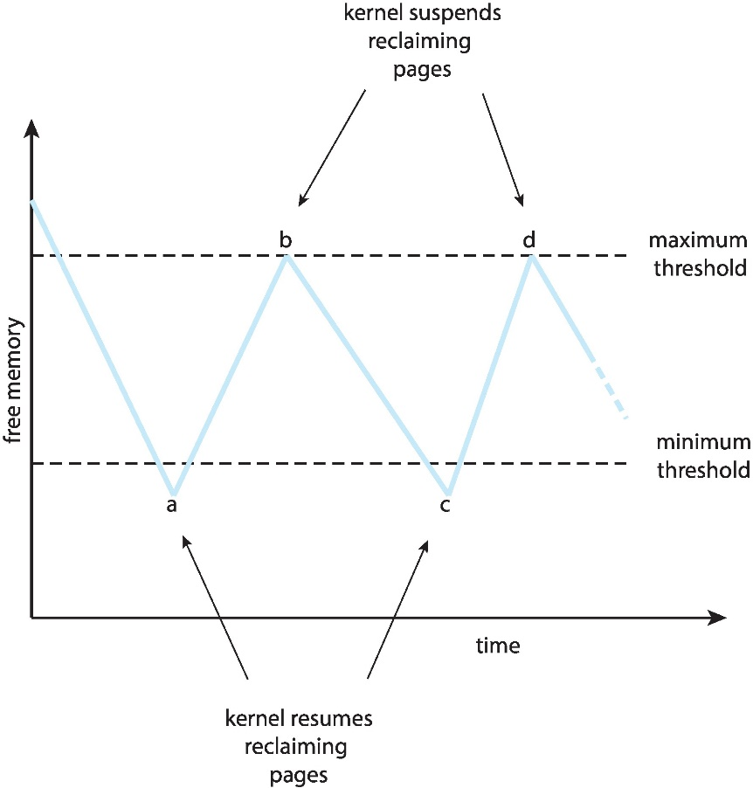
Reclaiming Pages Example

Slide 10
Allocating Kernel Memory
Algorithms so far are applied to user processes. Kernel processes need special consideration.
Often allocated from a separate free-memory pool
  Kernel requests memory for structures of varying sizes
  Some kernel memory needs to be contiguous
    i.e., for device I/O

Slide 11
Buddy System
Allocates memory from fixed-size segment consisting of physically-contiguous pages
Memory allocated using power-of-2 allocator
  Satisfies requests in units sized as power of 2
  Request rounded up to next highest power of 2
  When smaller allocation needed than is available, current chunk split into two buddies of next-lower power of 2
    Continue until appropriate sized chunk available

Slide 12
Buddy System Example
For example, assume 256KB chunk available, kernel requests 21KB
  Split into A_{L} _{and} A_{R} of 128KB each
    One further divided into B_{L} and B_{R} of 64KB
      One further into C_{L} and C_{R} of 32KB each – one used to satisfy the given request
Advantage – quickly coalesce unused chunks into larger chunk
Disadvantage - fragmentation

Slide 13
Buddy System Allocator

Slide 14
Slab Allocator
Alternate strategy
Slab is one or more physically contiguous pages
Cache consists of one or more slabs
Single cache for each unique kernel data structure
  Each cache filled with objects – instantiations of the data structure
When cache created, filled with objects marked as free
When structures stored, objects marked as used
If slab is full of used objects, next object allocated from empty slab
  If no empty slabs, new slab allocated
Benefits include no fragmentation, fast memory request satisfaction

Slide 15
Slab Allocation

Slide 16
Slab Allocator in Linux
For example process descriptor is of type struct task_struct
Approx 1.7KB of memory
New task -> allocate new struct from cache
  Will use existing free struct task_struct
Slab can be in three possible states
  Full – all used
  Empty – all free
  Partial – mix of free and used
Upon request, slab allocator
  Uses free struct in partial slab
  If none, takes one from empty slab
  If no empty slab, create new empty

Slide 17
Slab Allocator in Linux (Cont.)
Slab started in Solaris, now wide-spread for both kernel mode and user memory in various OSes
Linux 2.2 had SLAB, now has both SLOB and SLUB allocators
  SLOB for systems with limited memory
    Simple List Of Blocks – maintains 3 list objects for small, medium, large objects
  SLUB is performance-optimized SLAB removes per-CPU queues, metadata stored in page structure
    SLUB: Unqueued SLAB allocator
https://events.static.linuxfound.org/sites/events/files/slides/slaballocators.pdf
https://lwn.net/Articles/229096/

