Slide 1
CSCI315 – Operating Systems Design
Department of Computer Science
Bucknell University
Other Issues in Virtual Memory
System Examples
Ch 10.9,10.10
This set of notes is based on notes from the textbook authors, as well as L. Felipe Perrone, Joshua Stough, and other instructors.
Xiannong Meng, Fall 2020.

Slide 2
Overview
Other issues:
  Prepaging
  Page size
  TLB reach
  I/O interlock and page locking
Examples: Linux, Windows, Solaris

Slide 3
Prepaging
To reduce the large number of page faults that occurs at process startup
Prepage all or some of the pages a process will need, before they are referenced
But if prepaged pages are unused, I/O and memory was wasted
Assume s pages are prepaged and α percent of the pages are used
  Is cost of s * α save pages faults > or < than the cost of prepaging s * (1- α) unnecessary pages?
  α near zero ⇒ prepaging loses

Slide 4
Page Size
Sometimes OS designers have a choice
  Especially if running on custom-built CPU
Page size selection must take into consideration:
  Fragmentation
  Page table size
  Resolution
  I/O overhead
  Number of page faults
  Locality
  TLB size and effectiveness
Always power of 2, usually in the range 2¹² (4,096 bytes) to 2²² (4,194,304 bytes)
On average, growing over time

Slide 5
TLB Reach
TLB Reach - The amount of memory accessible from the TLB
TLB Reach = (TLB Size) X (Page Size)
Ideally, the working set of each process is stored in the TLB
  Otherwise there is a high degree of page faults
Increase the Page Size
  This may lead to an increase in fragmentation as not all applications require a large page size
Provide Multiple Page Sizes
  This allows applications that require larger page sizes the opportunity to use them without an increase in fragmentation

Slide 6
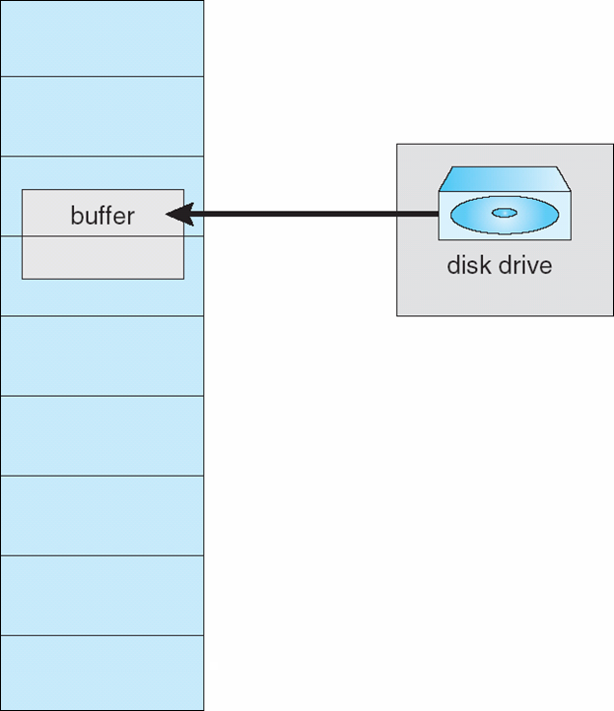
I/O interlock
I/O Interlock – Pages must sometimes be locked into memory
Consider I/O - Pages that are used for copying a file from a device must be locked from being selected for eviction by a page replacement algorithm
Pinning of pages to lock into memory

Slide 7
Virtual memory system examples

Slide 8
Linux
Use demanding paging, allocating pages from a list of free frames.
Employ a global page-replacement policy similar to LRU-approximation clock algorithm.
Maintain two types of page lists: an active list containing pages that are in use, and an inactive list containing pages that have not been used recently and are eligible to be reclaimed.

Slide 9
Maintaining the Two Lists
Each page has an accessed bit that is set whenever the page is referenced.
When a page is first allocated, its access bit is set, the page is added to the rear of the active_list.
Whenever a page is referenced, its access bit is set, the page is moved to the rear of the active_list.
Periodically the access bit of pages in the active_list are reset.
Over time, the least recently used pages will be at the front of the active_list.
When the reclaiming algorithm is run, some pages are moved from the front of the active_list to the rear of the inactive_list.
Note that the use and the meaning of “front” and “rear” in these two lists.
See an illustration on next slide.

Slide 10
Active and Inactive Lists
referenced
new page
rear
front
Active_list
front
rear
Inactive_list

Slide 11
Linux Virtual Memory References
Some relevant references
  Better active/inactive list balancing https://lwn.net/Articles/495543/
  Understanding memory information on Linux systems https://linux-audit.com/understanding-memory-information-on-linux-systems/
  Page Frame Reclamation https://www.kernel.org/doc/gorman/html/understand/understand013.html

Slide 12
Windows
Uses demand paging with clustering. Clustering brings in pages surrounding the faulting page
Processes are assigned working set minimum and working set maximum
Working set minimum is the minimum number of pages the process is guaranteed to have in memory
A process may be assigned as many pages up to its working set maximum
When the amount of free memory in the system falls below a threshold, automatic working set trimming is performed to restore the amount of free memory
Working set trimming removes pages from processes that have pages in excess of their working set minimum

Slide 13
Solaris
Maintains a list of free pages to assign faulting processes
lotsfree – threshold parameter (amount of free memory) to begin scanning at a slow rate (high threshold)
desfree – desired amount of free frames (mid point)
minfree – threshold parameter to begin swapping (low threshold of free frames)
Paging is performed by the pageout process
pageout scans pages using modified clock algorithm
scanrate is the rate at which pages are scanned. This ranges from slowscan to fastscan
pageout is called more frequently depending upon the amount of free memory available
Priority paging gives priority to process code pages

Slide 14
Solaris 2 Page Scanner
Solaris page reclaiming

