Slide 1
CSCI315 – Operating Systems Design Department of Computer Science Bucknell University
Introduction to File Systems
Ch 13.1-13.2
This set of notes is based on notes from the textbook authors, as well as L. Felipe Perrone, Joshua Stough, and other instructors.
Xiannong Meng, Fall 2020.

Slide 2
File System Topics
File Concept
Access Methods
Directory Structure
File System Mounting
File Sharing
Protection
File System Implementation
File System Internals

Slide 3
File Concept
A file is a named collection of related information recorded on secondary storage.
“Contiguous” logical address space.
A collection of bytes, of which the meaning is interpreted by the applications.
File types:
Data
Programs (source code and executable)
Files are objects with attributes and operations

Slide 4
Types of File Structures
None: just a sequence of words or bytes, such as files on Linux
Simple record structure such as database files:
Lines,
Fixed length,
Variable length.
Complex Structures:
Formatted document,
Relocatable load file.
Can simulate last two with first method by inserting appropriate control characters.
Who decides:
Operating systems,
Programs.

Slide 5
File Attributes
Name – only information kept in human-readable form.
Type – needed for systems that support different types.
Location – pointer to file location on device.
Size – current file size.
Protection – controls who can do reading, writing, executing.
Time, date, and user identification – data for protection, security, and usage monitoring.
Information about files is kept in the directory structure, which is maintained on the disk by the operating system.

Slide 6
File Operations
Create – create a new file
Write – write some data into an existing file
Read – read some data from an existing file
Seek – move the read/write point to a specific position
Delete – remove the file from the file system
Truncate – remove a portion of data, keep current attributes
Open – open an existing file, get it ready for operations
Close – close an existing file, no further operations can be applied to a closed file

Slide 7
File Operation Example in C
#include <stdio.h>
#include <stdlib.h>
int main() {
FILE * fp;
char ch;
fp = fopen(“hello.txt", "r"); /* open file ‘hello.txt' for read */
if (!fp) {
fprintf(stderr, "error in opening file\n");
exit(2);
}
fscanf(fp, "%c", &ch);
while (!feof(fp)) { /* if not end of the file, continue */
/* reading and printing one char at a time */
printf("%c", ch);
fscanf(fp, "%c", &ch);
}
fclose(fp);
return 0;
}
[xmeng@linuxremote1 files]$ cat hello.txt
Hello World!
How are you?
[xmeng@linuxremote1 files]$ gcc file-basics.c
[xmeng@linuxremote1 files]$ ./a.out
Hello World!
How are you?
[xmeng@linuxremote1 files]$
http://www.eg.bucknell.edu/~cs315/
F2020/meng/code/files/file-basics.c

Slide 8
Use System Calls
/* only the essential part is listed */
int main() {
int fp;
char ch;
int bytes_read = 0;
fp = open("hello.txt", O_RDONLY);
/* error check removed for presentation … */
bytes_read = read(fp, &ch, sizeof(ch));
while (bytes_read > 0) {
printf("%c", (char)ch);
bytes_read = read(fp, &ch, sizeof(ch));
}
}
[xmeng@linuxremote1 files]$ cat hello.txt
Hello World!
How are you?
[xmeng@linuxremote1 files]$ gcc file-syscalls.c
[xmeng@linuxremote1 files]$ ./a.out
Hello World!
How are you?
[xmeng@linuxremote1 files]$
http://www.eg.bucknell.edu/~cs315/F2020/meng/code/files/file-syscalls.c

Slide 9
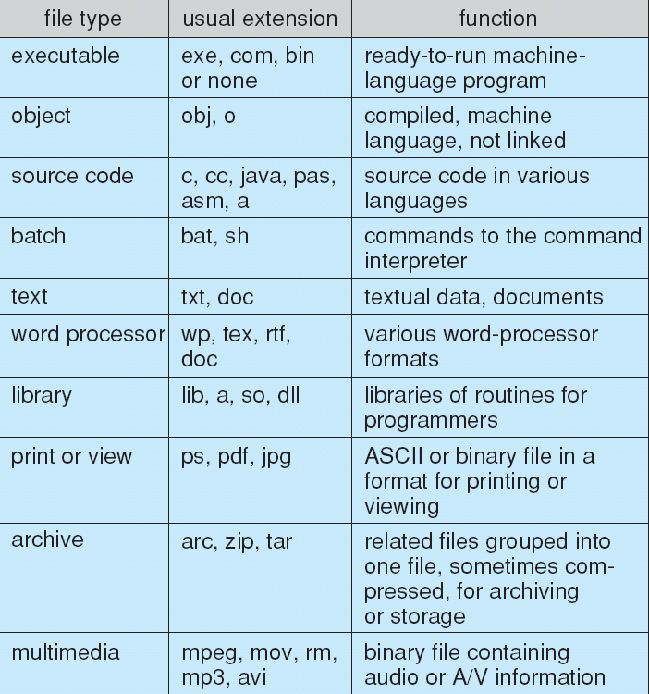
File Types: Name and Extension

Slide 10
Linux Files
Linux files are just a sequence of bytes, regardless of the types.
Here are two examples of files, one is a text and the other is an image. (See next slide for details.)
“hello.txt” is a text file with 26 characters (bytes) in it.
“base-small.png” is a small random image file (a small blue square) of 125 bytes in size.

Slide 11
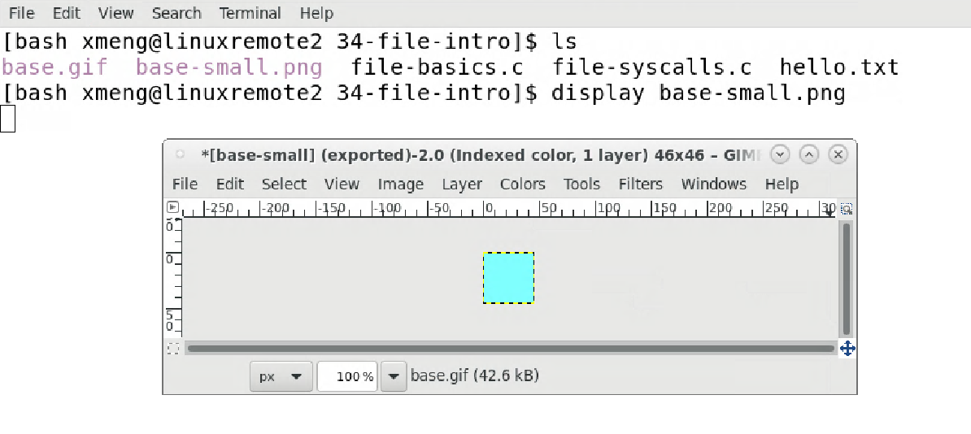
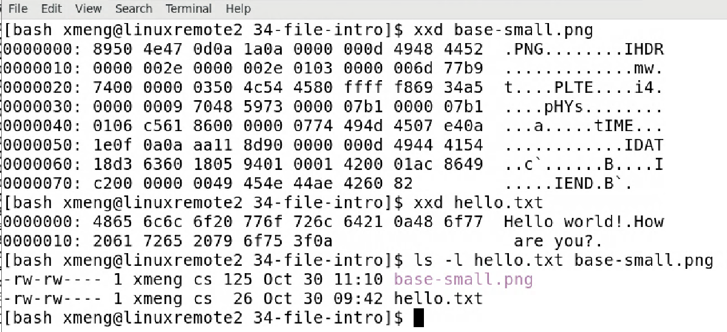
Linux Files – Sequence of Bytes
how the image “base-small.png” looks
byte content of “base-small.png” (125 bytes)
logical addresses of the file content
byte content of “hello.txt” (26 bytes)
size of the files

Slide 12
Access Methods
Sequential Access read next
write next
reset
Direct Access read n
write n
position to n
read next
write next
rewrite n
n = relative block number

Slide 13
Sequential-access File
Where does the term “rewind” come from?
It was from tape-based file storage medium in old days!

Slide 14
Sequential Access Files
Because most files are logically organized in sequence, accesses are in sequence.
Linux files can be “directly accessed” through the operation of “lseek()” (see man lseek)

Slide 15
Linux lseek(3) Example
fp = open("hello.txt", O_RDONLY);
lseek(fp, 6, SEEK_SET); // move forward 6 bytes
// "Hello world!" so we should read 'w' now
bytes_read = read(fp, &ch, sizeof(ch));
printf("char read = ['%c']\n", ch);
Only relevant segment is shown here. For the complete program, see
http://www.eg.bucknell.edu/~cs315/F2020/meng/code/files/file-lseek.c

Slide 16
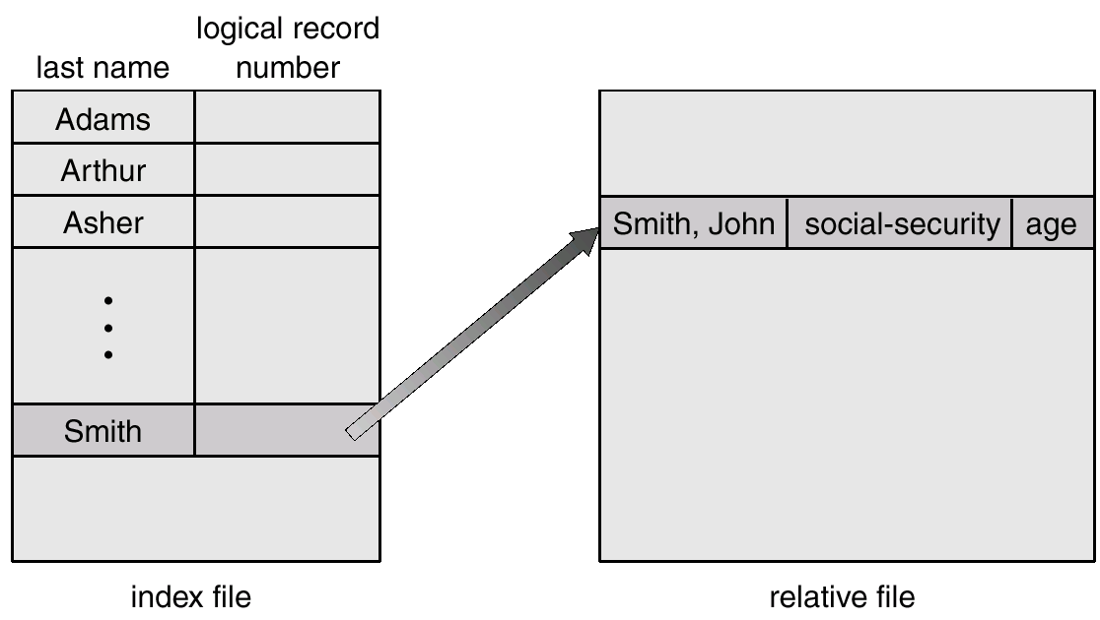
Example of Index and Relative Files

