Slide 1
CSCI315 – Operating Systems Design Department of Computer Science Bucknell University
File Meta Data, Directories
Ch 13.3-13.4
This set of notes is based on notes from the textbook authors, as well as L. Felipe Perrone, Joshua Stough, and other instructors.
Xiannong Meng, Fall 2020.

Slide 2
Directory Structure
Directory: a symbol table that maps file names into directory entries. Each directory entry contains meta-data of the file such as owner name, date, protection.
ping
emacs
ifconfig
mount
fdisk
find
…
…
Both the directory structure and the files reside on disk.
Backups of these two structures are kept on back-up storage.

Slide 3
Linux Directory Entry
One directory entry, a directory consists of a number of these entries.
struct dirent {
ino_t d_ino; /* inode number */
off_t d_off; /* not an offset; see NOTES */
unsigned short d_reclen; /* length of this record */
unsigned char d_type; /* type of file; not supported
by all file system types */
char d_name[256]; /* filename */
};
man 3 readdir

Slide 4
Operations on Directories
Search for a file.
Create a file.
Delete a file.
List a directory.
Rename a file.
Traverse the file system.

Slide 5
Example of Directory Listing
dirp = opendir(dname);
if (dirp != NULL) { // it is a directory
printf("directory : %s\n",dname);
for (dp = readdir(dirp);
NULL != dp;
dp = readdir(dirp)) {
printf("%s\n", dp->d_name);
}
closedir (dirp);
[xmeng@linuxremote1 files]$ gcc list_dir.c
[xmeng@linuxremote1 files]$ ./a.out ../
directory : ../
.
..
thread
sync
process
deadlock
scheduling
memory
files
[xmeng@linuxremote1 files]$ ./a.out ./
directory : ./
.
..
file-test.c
a.out
file-test.c~
list_dir.c
hello.txt
list_dir.c~
[xmeng@linuxremote1 files]$
For the complete program, see
http://www.eg.bucknell.edu/~cs315/
F2020/meng/code/files/list_dir.c

Slide 6
Goals of Directory Logical Organization
Efficiency – locating a file quickly.
Naming – convenient to users.
Two users can have same name for different files.
The same file can have several different names.
Grouping – logical grouping of files by properties, (e.g., all Java programs, all games, …)

Slide 7
Single-Level Directory
A single directory for all users.
Drawbacks:
Naming problem
Grouping problem

Slide 8
Two-Level Directory
A separate directory for each user.
Path name.
Can have the same file name for different user.
Efficient searching.
No grouping capability.

Slide 9
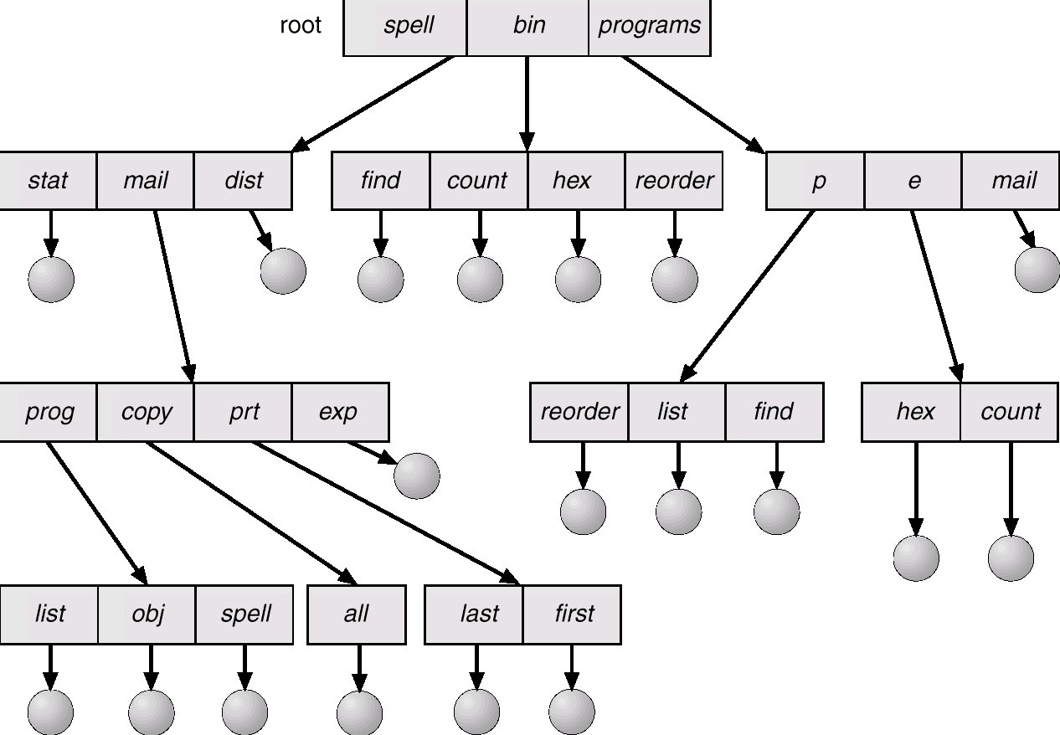
Tree-Structured Directories

Slide 10
Tree-Structured Directories (Cont.)
Efficient searching.
Grouping Capability.
Current directory (working directory):
cd /spell/mail/prog,
type list.

Slide 11
Tree-Structured Directories (Cont.)
Absolute or relative path name.
Creating a new file is done in current directory by default.
Delete a file
rm <file-name>
Creating a new subdirectory is done in current directory.
mkdir <dir-name>
Example: if in current directory /mail
mkdir count
will add count as a subdirectory under mail
mail
prog
copy
prt
exp
count
Deleting “mail” ⇒ deleting the entire subtree rooted by “mail”.

Slide 12
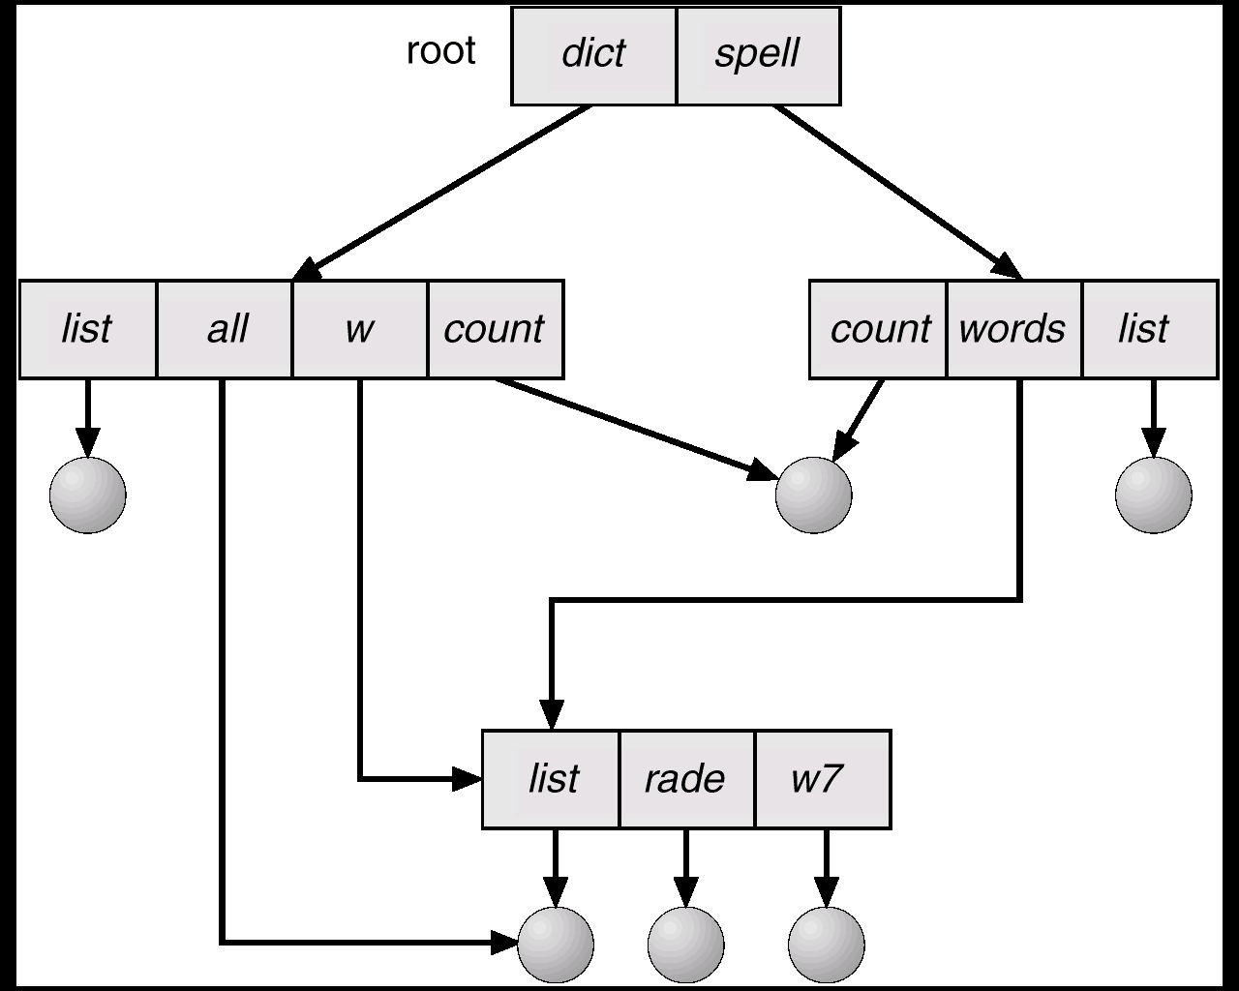
Acyclic-Graph Directories
Have shared subdirectories and files.

Slide 13
Acyclic-Graph Directories (Cont.)
Two different names (aliasing).
If dict deletes list ⇒ dangling pointer.
Solutions:
Backpointers, so we can delete all pointers. Variable size records a problem.
Backpointers using a daisy chain organization.
Entry-hold-count solution.

Slide 14
Acyclic-Graph Directories
Have shared subdirectories and files.
links: soft (symbolic)
hard
Unix: ln (read man page);
need to keep a reference count on each file or directory.

Slide 15
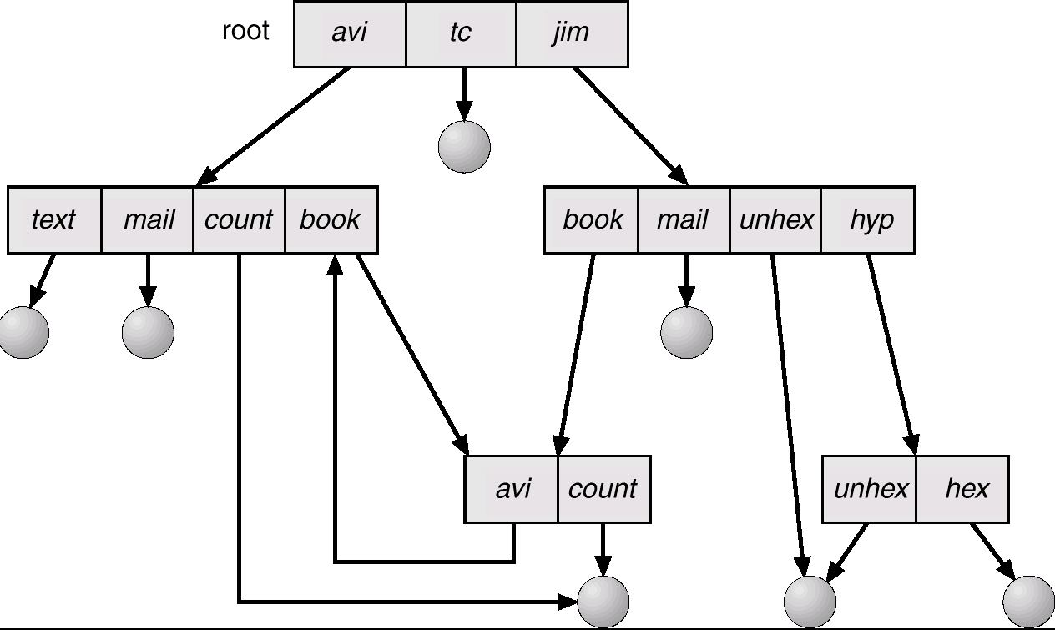
General Graph Directory

Slide 16
General Graph Directory (Cont.)
How do we guarantee no cycles?
Allow only links to file not subdirectories.
Garbage collection.
Every time a new link is added use a cycle detection algorithm to determine whether it is OK.

Slide 17
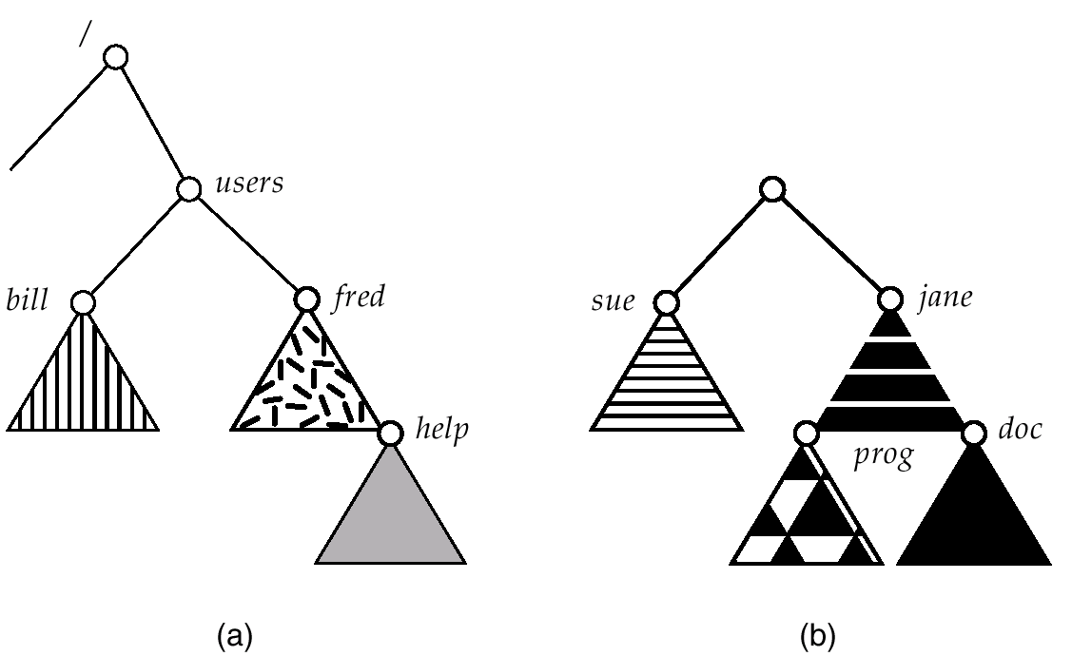
File System Mounting
A file system (partition) must be mounted before it can be accessed. Mounting allows one to attach the file system on one device to the file system on another device.
A unmounted file system needs to be attached to a mount point before it can be accessed.
In our Linux systems, the /home directory is mounted on all Linux computers, including the ones in the labs.
Try the command pwd on any Linux computer, you’d see the same files and directories.
existing
unmounted

Slide 18
File Sharing
Sharing of files on multi-user systems is desirable.
Sharing may be done through a protection scheme.
On distributed systems, files may be shared across a network.
Network File System (NFS) is a common distributed file-sharing method. Our Linux systems use a variation of it.

Slide 19
Protection
File owner/creator should be able to control:
what can be done,
by whom.
Types of access:
Read,
Write,
Execute,
Append,
Delete,
List.
Discretionary Access Control (DAC)

Slide 20
Protection
Mandatory Access Control (MAC):
System policy: files tied to access levels = (public, restricted, confidential, classified, top-secret).
Process also has access level: can read from and write to all files at same level, can only read from files below, can only write to files above.
Role-Based Access Control (RBAC):
System policy: defines “roles” (generalization of the Unix idea of groups).
Roles are associated with access rules to sets of files and devices.
A process can change roles (in a pre-defined set of possibilities) during execution.

Slide 21
Access Lists and Groups
Mode of access: read, write, execute
Three classes of users
RWX
a) owner access 7 ⇒ 1 1 1 RW
b) group access 6 ⇒ 1 1 0
X
c) public access 1 ⇒ 0 0 1
Ask manager to create a group (unique name), say G, and add some users to the group.
For a particular file (say game) or subdirectory, define an appropriate access.
owner
group
public
chmod
761
game
Associate a group with a file: chgrp G game

Slide 22
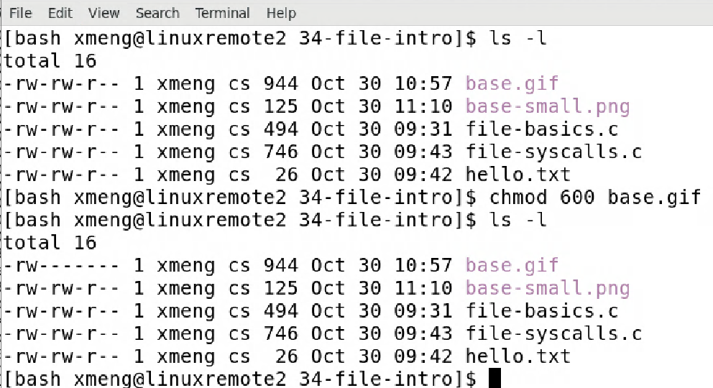
File Protection Example
protection bits 664 or ugo rw,rw,r
u: owner
g: group
o: world
changed so only owner can read/write
6: 110
4: 100
600

Slide 23
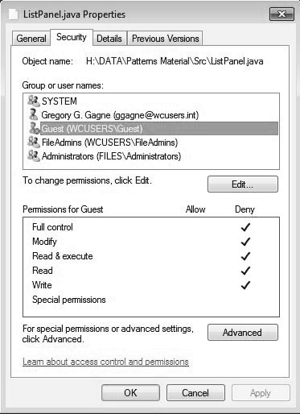
Windows 7 Access-Control List Management

