Slide 1
CSCI315 – Operating Systems Design Department of Computer Science Bucknell University
File System Implementations 1
Ch 14.1-14.3
This set of notes is based on notes from the textbook authors, as well as L. Felipe Perrone, Joshua Stough, and other instructors.
Xiannong Meng, Fall 2020.

Slide 2
File-System Structure
File structure:
Logical storage unit
Collection of related information
File system resides on secondary storage (disks).
File system is organized into layers.

Slide 3
Layered File System

Slide 4
Layered Structure
File system resides on secondary storage (e.g., disks)
Provides user interface to storage
Maps logical files to physical file structures
Provides efficient and convenient access to disk by allowing data to be stored, located retrieved easily

Slide 5
Lower Level Organization
Disk provides in-place rewrite and random access
I/O transfers performed in blocks of sectors (usually 4096 bytes)
/sbin/blockdev --getbsz /dev/sda1
/sbin/dumpe2fs -h /dev/sda1
File control block – storage structure consisting of information about a file, very similar to process control block for processes
Device driver controls the physical device

Slide 6
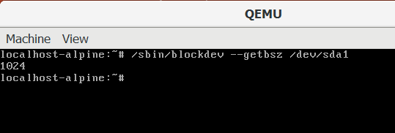
Example of Block Size
The above example shows the block size of 1024 bytes on my QEMU Linux emulator.
I don’t have root access on the school Linux systems so I can’t run the command. But the above example illustrates the block size.

Slide 7
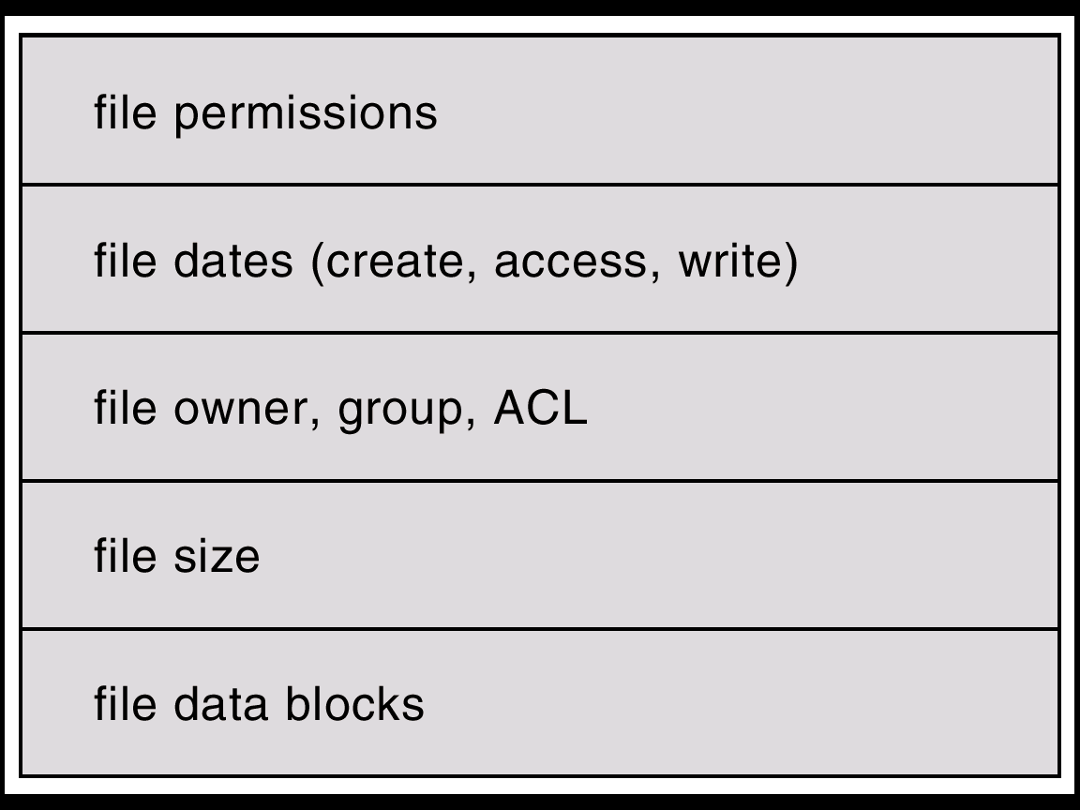
A General File Control Block

Slide 8
inode in Linux/Unix
File control blocks in Linux are called inode (has nothing to do with Apple) meaning index node.
http://www.tldp.org/LDP/tlk/ds/ds.html search for the keyword “inode” to find the inode data structure
Each file in Linux has a unique control block (inode)
“ls -i” shows the inode number of the files
“stat file_name” shows inode number and other information

Slide 9
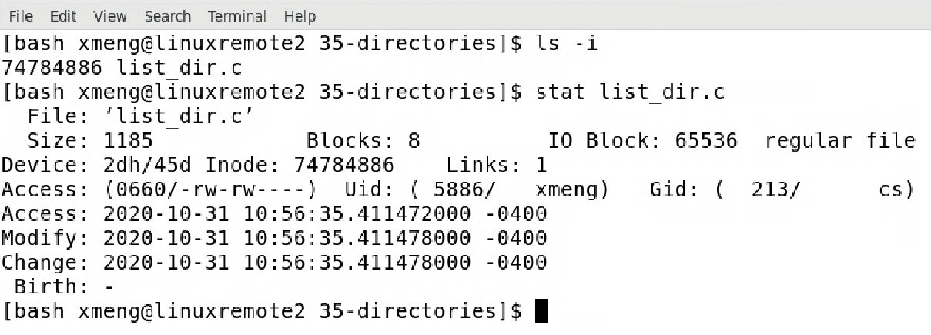
Example of inode Information
list file stats
list inode info

Slide 10
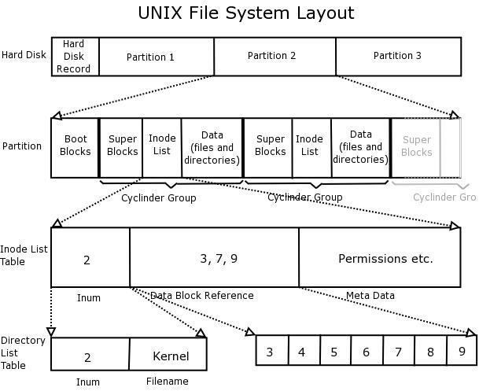
Linux File System Structure
http://www.learnlinux.org.za/courses/build/internals/ch08s04.html

Slide 11
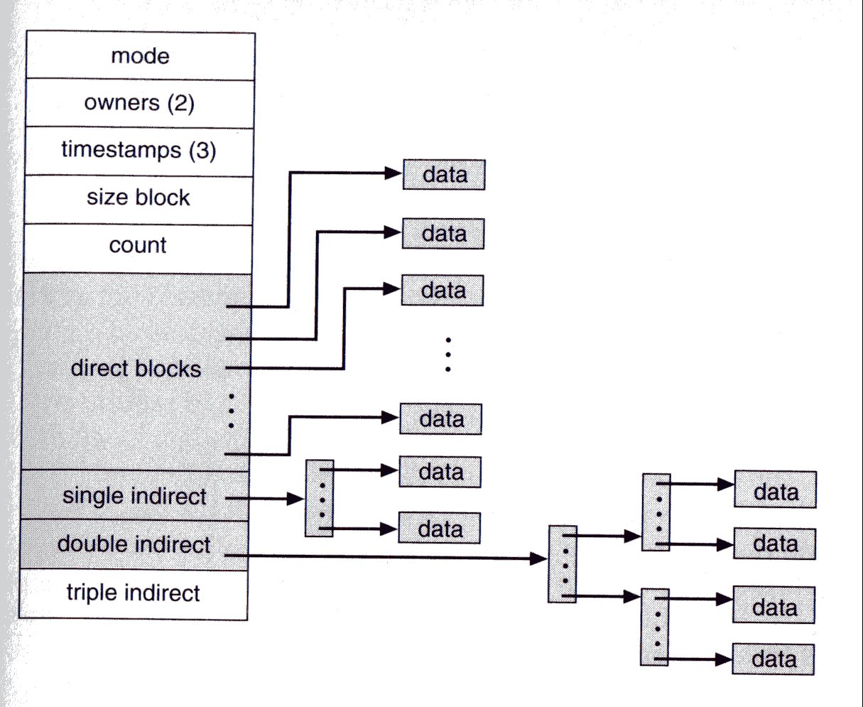
Linux inode Structure
http://www.csie.ntu.edu.tw/~pangfeng/System%20Programming/Lecture_Note_2.htm

Slide 12
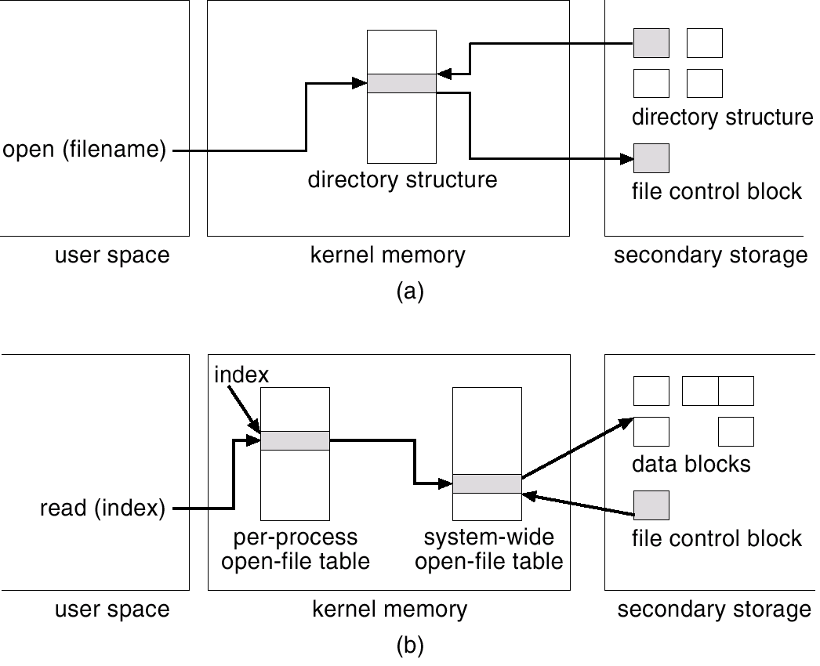
In-Memory File System Structures
file open
file read

