Slide 1
CSCI315 – Operating Systems Design Department of Computer Science Bucknell University
File System Implementation 2
Ch 14.4-14.5
This set of notes is based on notes from the textbook authors, as well as L. Felipe Perrone, Joshua Stough, and other instructors.
Xiannong Meng, Fall 2020.

Slide 2
Review
We discussed the file control block (FCB) in Linux, that is inode.
We also discussed general directory structure in Linux.
Today we will look at some other implementation issues.
Virtual file system, and
File block allocation strategies

Slide 3
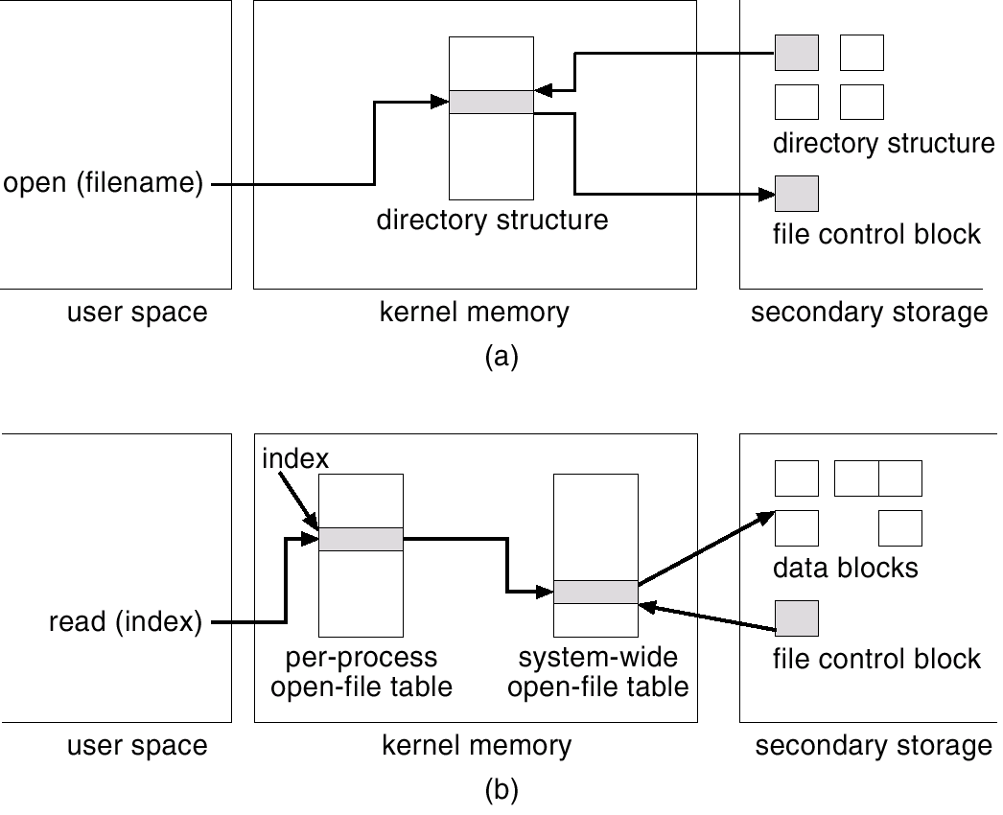
In-Memory File System Structures
file open
file read
Per-process open-file table part of PCB

Slide 4
Directory Implementation
The directory is a symbol table that maps file names to file control block (inode) which has pointers that lead to the blocks comprising a file.
Linear list of file names with pointer to the data blocks:
simple to program, but…
time-consuming to execute.
Hash Table:
decreases directory search time,
collisions – situations where two file names hash to the same location,
fixed size.

Slide 5
An Example
Consider ‘open(“hello.txt”, O_RDONLY)’ in
http://www.eg.bucknell.edu/~cs315/F2020/meng/code/files/file-stream.c
Where does the file “hello.txt” and “file-stream.c” reside?
On any remote school Linux computer!
linuxremote.bucknell.edu
Use “df” to find out (you may have to use “grep” to look for the string ‘cs315’
Implication?
File system has to work with networked files

Slide 6
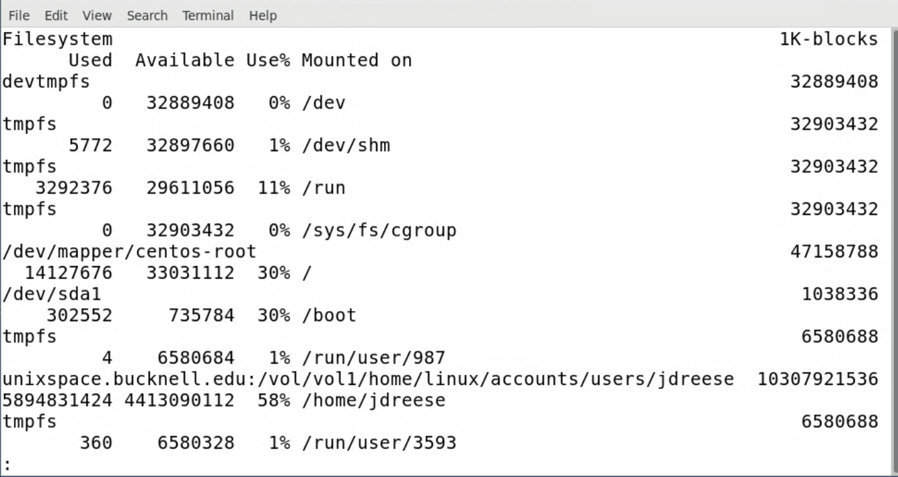
Examples of “df” Results
df | less
on linuxremot
df | grep cs315
on linuxremote

Slide 7
Virtual File Systems
Virtual File Systems (VFS) provide an object-oriented way of implementing file systems.
VFS allows the same system call interface (the API) to be used for different types of file systems.
The API is to the VFS interface, rather than any specific type of file system.

Slide 8
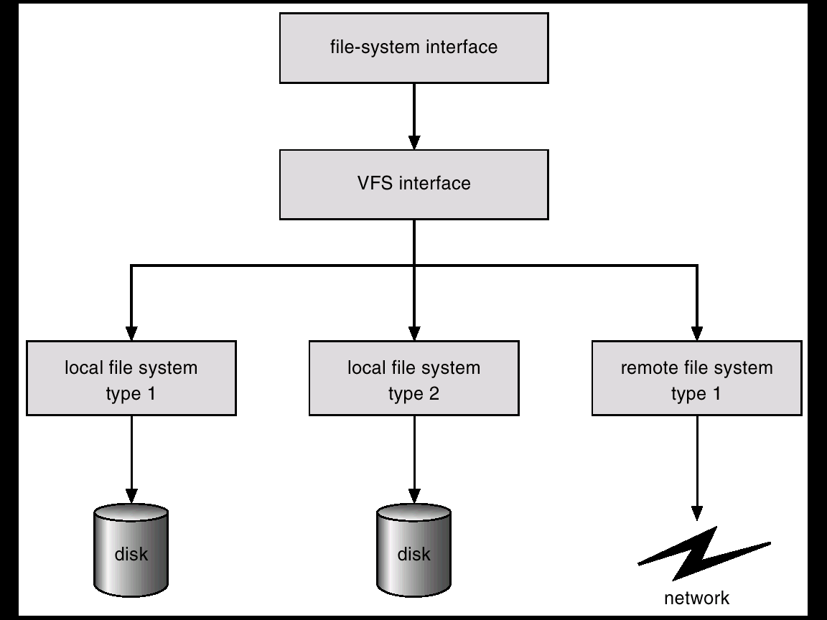
Schematic View of Virtual File System
same API for
all file system
types
ext3
FAT 32
NFS

Slide 9
Virtual File System Implementation
For example, Linux has four file object types:
inode, file, superblock, dentry
VFS defines set of operations on the objects that must be implemented, inode -> vnode
Every object has a pointer to a function table
Function table has addresses of routines to implement that function on that object
For example:
int open() -- Open a file
int close() -- Close an already-open file
ssize t read() -- Read from a file
ssize t write() -- Write to a file
int mmap() -- Memory-map a file
https://unix.stackexchange.com/questions/4402/what-is-a-superblock-inode-dentry-and-a-file

Slide 10
NFS Protocol
Provides a set of remote procedure calls (RPC) for remote file operations.
Early versions of NFS servers are stateless; each request has to provide a full set of arguments; NFS V4 is very different, stateful, supporting many more operations
Modified data must be committed to the server’s disk before results are returned to the client (lose advantages of caching)
The NFS protocol does not provide concurrency-control mechanisms

Slide 11
Three Major Layers of File System Architecture
UNIX file-system interface (based on the open, read, write, and close calls, and file descriptors)
Virtual File System (VFS) layer – distinguishes local files from remote ones, and local files are further distinguished according to their file-system types
The VFS activates file-system-specific operations to handle local requests according to their file-system types
Calls the NFS protocol procedures for remote requests
NFS service layer – bottom layer of the architecture
Implements the NFS protocol

Slide 12
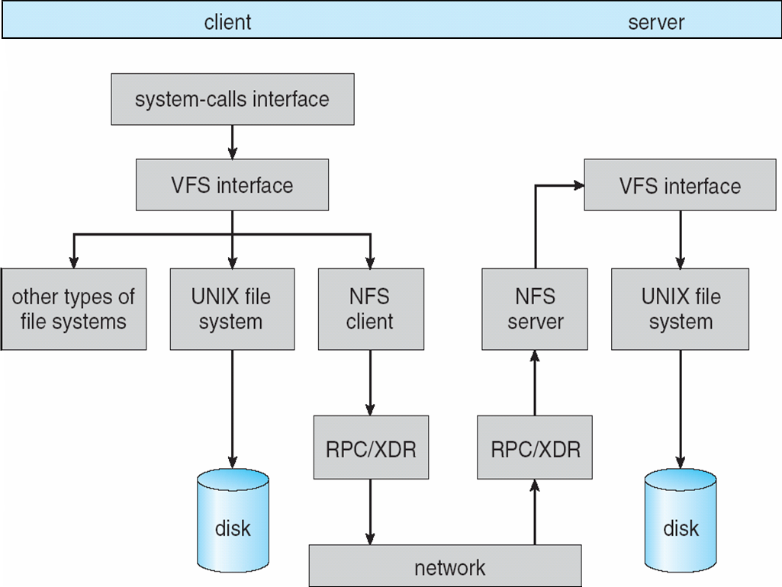
Schematic View of NFS Architecture
Server
Client

Slide 13
Allocation Methods
An allocation method refers to how disk blocks are allocated for files. We’ll discuss three options:
Contiguous allocation,
Linked allocation,
Indexed allocation.

Slide 14
Disk Structure
Points to consider:
Sector sizes (number of bits per sector) are fixed in most disks, which means the data density is lower on outside tracks.
Newer formats, e.g., zone-bit-recording, uses variable size sectors so sectors have similar data density.
direction of rotation
sector
read/write head
direction of movement
The disk rotates at a constant speed. To find a block, the head is moved to the appropriate track, and then the correct sector is found as the disk rotates.
arm
track
Organization of a disk surface

Slide 15
Disk Structure
The disk rotation is given in rotations per minute (RPM).
The time to find a track is proportional to the distance the head must travel.
The average time to find a sector within a track is roughly half the time for a full rotation.
Question: If the time to move from track i to track (i+1) is given by δ, assuming that the disk head is at track 0 (all the way out), could you calculate the time to get to sector 4 in track 5?
direction of rotation
sector
read/write head
direction of movement
arm
track
Organization of a disk surface

Slide 16
Disk Structure
Multi-surface disk
A cylinder is the collection of all the same tracks across all the multiple disk surfaces.
There is a time associated with turning heads on and off so that a different surface can be accessed. We call this overhead the head-switching time.
The time to move the arm to read another cylinder is due to the mechanics of the arm. It is certainly much large than the head-switching time, which is due to electronics only.
Question: How should one organize data across multiple surfaces to minimize access overhead?
direction of rotation
read/write heads
cylinder
arm
direction of movement

Slide 17
A PC Disk Example
https://commons.wikimedia.org/wiki/File:Laptop-hard-drive-exposed.jpg

Slide 18
Contiguous Allocation
Each file occupies a set of contiguous blocks on the disk.
Simple: only starting location (block #) and length (number of blocks) are required.
Suitable for sequential and random access.
Wasteful of space: dynamic storage-allocation problem; external fragmentation.
Files cannot grow unless more space than necessary is allocated when file is created (clearly this strategy can lead to internal fragmentation).

Slide 19
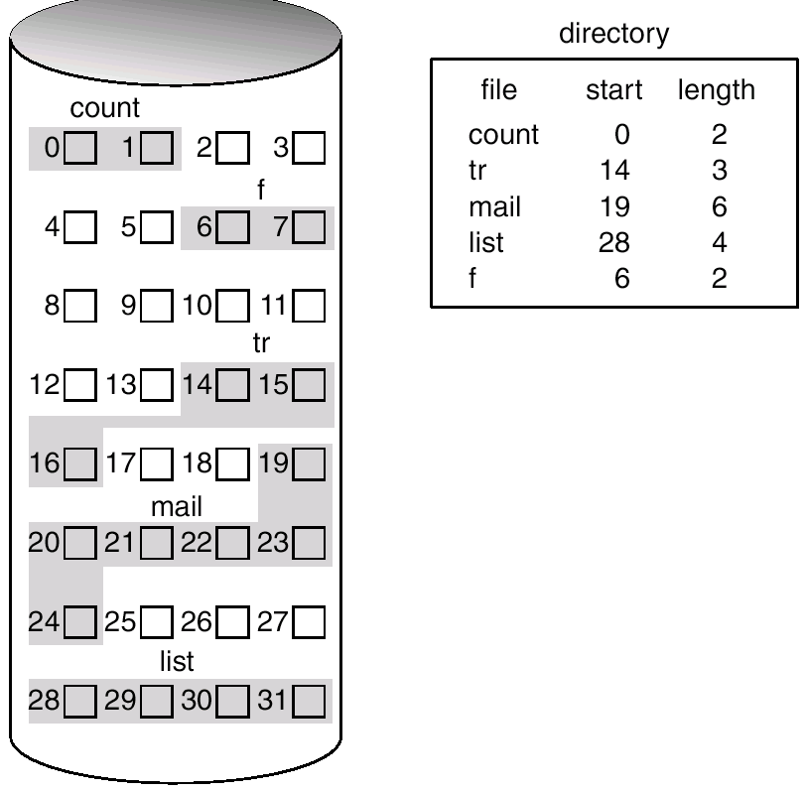
Contiguous Allocation of Disk Space
To deal with the dynamic allocation problem (external fragmentation), the system should periodically compact the disk.
Compaction may take a long time, during which the system is effectively down.
To deal with possibly growing files, one needs to pre-allocate space larger than required at the initial time => this leads to internal fragmentation.

Slide 20
Extent-Based Systems
Many newer file systems (i.e., Veritas File System by HPUX) use a modified contiguous allocation scheme.
Extent-based file systems allocate disk blocks in extents.
An extent is a contiguous set of blocks. Extents are allocated for each file. A file consists of one or more extents.
Extents can be added to an existing file that needs space to grow. A block can be found given by the location of the first block in the file and the block count, plus a link to the first extent.

Slide 21
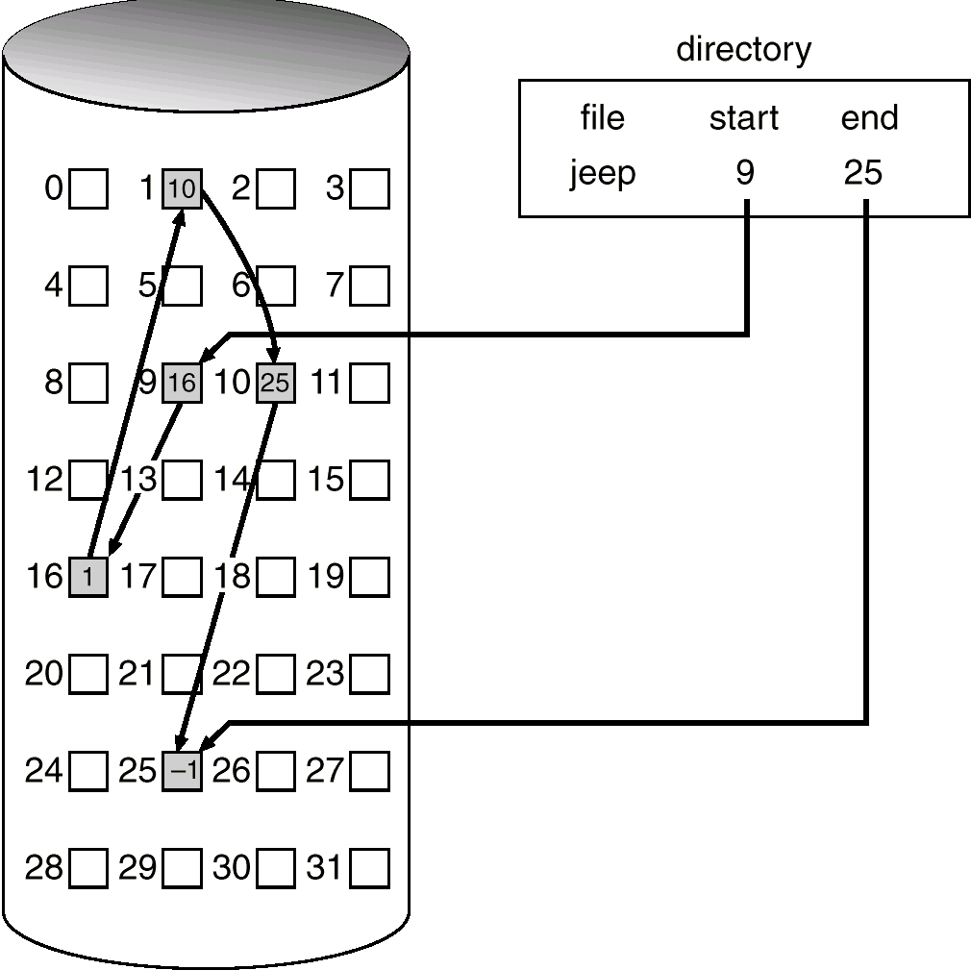
Linked Allocation
Each file is a linked list of disk blocks.
Simple: need only starting address.
Overhead: each block links to the next.
Space cost to store pointer.
Time cost to read one block to find the next.
Internal fragmentation, but not external.
Sequential access comes naturally, random does not.

Slide 22
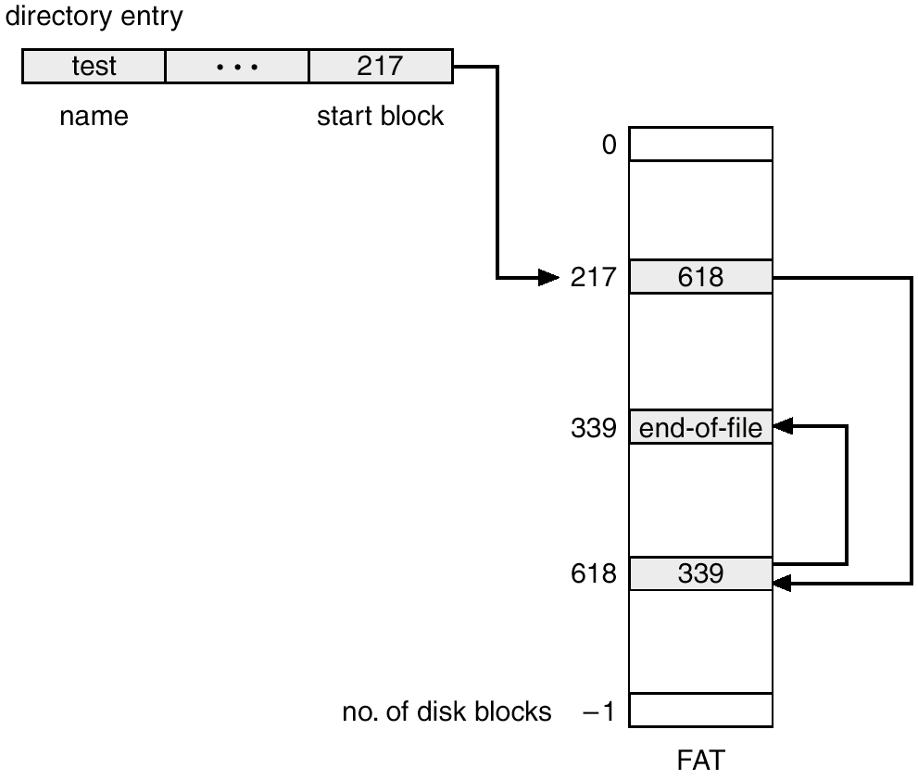
File-Allocation Table (FAT)
Simple and efficient: One entry for each block; indexed by block number. The table is implements the list linking the blocks in a file.
Growing a file is easy: find a free block and link it in.
Random access is easy.
If the FAT is not cached in memory, a considerable number of disk seeks happens.
Used by MS-DOS and OS/2.

Slide 23
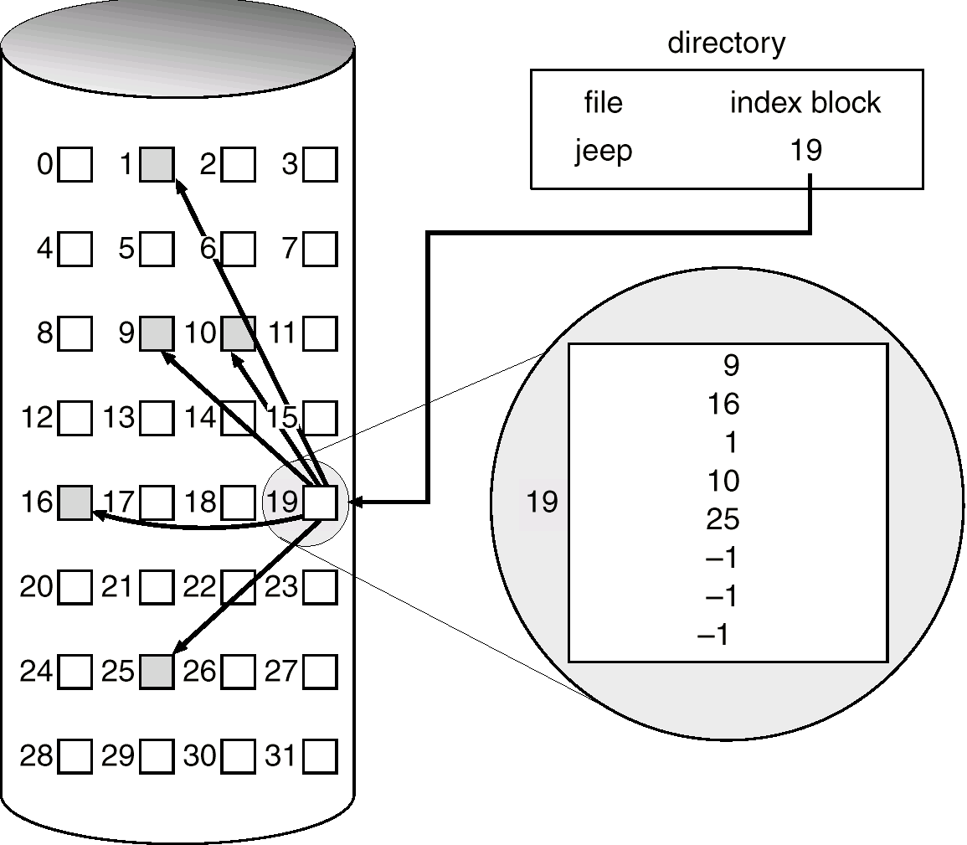
Indexed Allocation
Brings all pointers together into an index block.
One index block per file.
Random access comes easy.
Dynamic access without external fragmentation, but have overhead of index block.
Wasted space: how large should an index block be to minimize the overhead?
linked index blocks
multilevel index
combined scheme

Slide 24
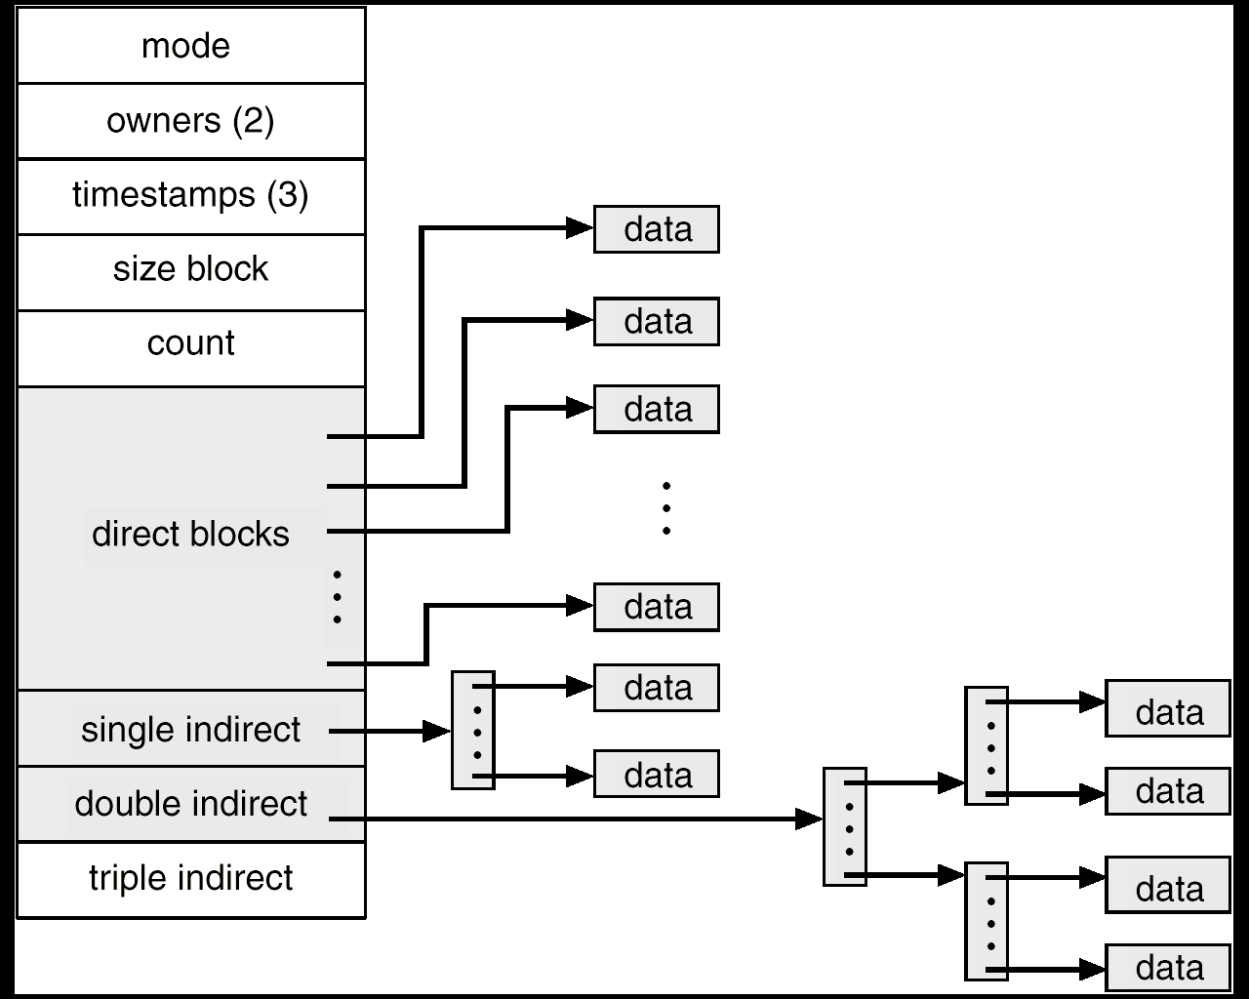
Combined Scheme: UNIX
If file is small enough, use only direct blocks pointers.
If number of blocks in file is greater than the number of direct block pointers, use single, double, or triple indirect.
Additional levels of indirection increase the number of blocks that can be associated with a file.
Index blocks can be cached in memory, like FAT. Access to data blocks, however, may require many disk seeks.

