Slide 1
CSCI315 – Operating Systems Design Department of Computer Science Bucknell University
File System Implementation 3
Ch 14.5-14.6
This set of notes is based on notes from the textbook authors, as well as L. Felipe Perrone, Joshua Stough, and other instructors.
Xiannong Meng, Fall 2020.

Slide 2
Review
We discussed different ways of allocating blocks for file data
contiguous allocation in which data blocks for a file are contiguous
linked allocation in which the data blocks are “chained” together, similar to a linked list
indexed allocation in which one index block points all data blocks
hybrid (or combination) of the above such as what is used in Linux systems.

Slide 3
Performance
Best method depends on file access type
Contiguous great for sequential and random access
Linked good for sequential, not random
Declare access type at creation -> select either contiguous or linked
Indexed more complex
Single block access could require 2 index block reads then data block read
Clustering can help improve throughput, reduce CPU overhead

Slide 4
Performance (Cont.)
Adding instructions to the execution path to save one disk I/O is reasonable because I/O is very costly
Intel Core i7 Extreme Edition 990x (2011) at 3.46Ghz = 159,000 MIPS
http://en.wikipedia.org/wiki/Instructions_per_second
Typical disk drive at 250 I/Os per second
159,000 MIPS / 250 = 630 million instructions during one disk I/O
Fast SSD drives provide 60,000 IOPS
159,000 MIPS / 60,000 = 2.65 millions instructions during one disk I/O

Slide 5
Free-Space Management
File system maintains free-space list to track available blocks/clusters
(Using term “block” for simplicity)
Bit vector or bit map (n blocks)
0
1
2
n-1
…
1 ⇒ block[i] free
0 ⇒ block[i] occupied
bit[i] =

Free block number calculation
(number of bits per word) * (number of 0-value words)
+ offset of first 1 bit
CPUs have instructions to return offset within word of first “1” bit

Slide 6
Free-Space Management (Cont.)
Bit map requires extra space
Example:
block size = 4KB = 2¹² bytes
disk size = 2⁴⁰ bytes (1 terabyte)
n = 2⁴⁰/2¹² = 2²⁸ bits (or 32MB)
if clusters of 4 blocks -> 8MB of memory
Easy to get contiguous files

Slide 7
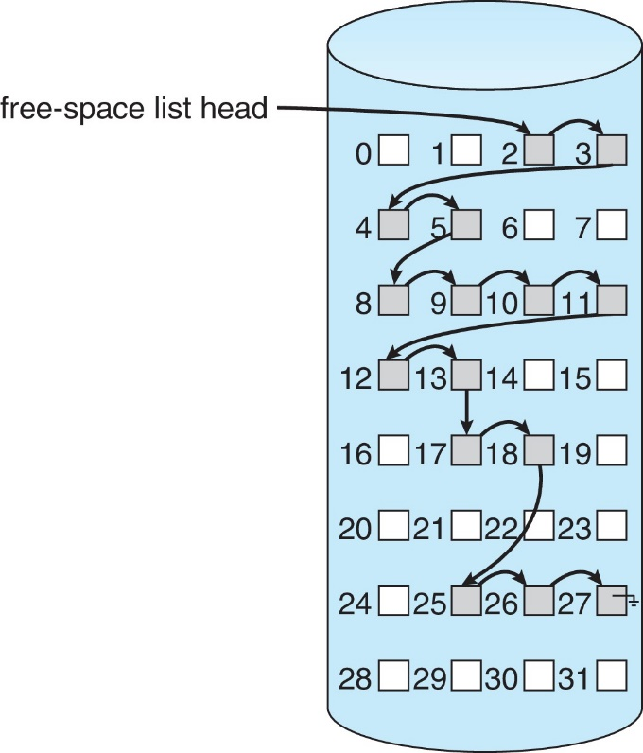
Linked Free Space List on Disk
Linked list (free list)
Cannot get contiguous space easily
No waste of space
No need to traverse the entire list if # free blocks recorded

Slide 8
Free-Space Management (Cont.)
Grouping
Modify linked list to store address of next n-1 free blocks in first free block, plus a pointer to next block that contains free-block-pointers
Counting
Because space is frequently contiguously used and freed, with contiguous-allocation allocation, extents, or clustering
Keep address of first free block and count of following free blocks
Free space list then has entries containing addresses and counts

Slide 9
Free-Space Management (Cont.)
Space Maps
Used in ZFS https://en.wikipedia.org/wiki/ZFS
Consider meta-data I/O on very large file systems
Full data structures like bit maps couldn’t fit in memory -> thousands of I/Os
Divides device space into meta-slab units and manages meta-slabs
Given volume can contain hundreds of meta-slabs
Each meta-slab has associated space map
Uses counting algorithm
But records to log file rather than file system
Log of all block activity, in time order, in counting format
Meta-slab activity -> load space map into memory in balanced-tree structure, indexed by offset
Replay log into that structure
Combine contiguous free blocks into single entry

Slide 10
TRIMing Unused Blocks
HDDS overwrite in place so need only free list
Blocks not treated specially when freed
Keeps its data but without any file pointers to it, until overwritten
Storage devices not allowing overwrite like NVM (non-volatile memory) suffer badly with same algorithm
Must be erased before written, erases made in large chunks (blocks, composed of pages) and are slow
TRIM is a newer mechanism for the file system to inform the NVM storage device that a page is free
Can be garbage collected or if block is free, now block can be erased
https://en.wikipedia.org/wiki/Trim_(computing)

Slide 11
Efficiency and Performance
Efficiency dependent on:
Disk allocation and directory algorithms
Types of data kept in file’s directory entry
Pre-allocation or as-needed allocation of metadata structures
Fixed-size or varying-size data structures

Slide 12
Efficiency and Performance (Cont.)
Performance
Keeping data and metadata close together
Buffer cache – separate section of main memory for frequently used blocks
Synchronous writes sometimes requested by apps or needed by OS
No buffering / caching – writes must hit disk before acknowledgement
Asynchronous writes more common, buffer-able, faster
Free-behind and read-ahead – techniques to optimize sequential access
a) free-behind technique - free the memory of a block as soon as the next block is requested b) read-ahead technique - when a block is requested, read and cache several subsequent disk blocks to make use of spatial locality
http://www.cs.uni.edu/~fienup/courses/copy-of-operating-systems/lecture-notes/notes98f-17.lwp/odyframe.htm

Slide 13
Page Cache
A page cache caches pages rather than disk blocks using virtual memory techniques and addresses
Memory-mapped I/O uses a page cache
Routine I/O through the file system uses the buffer (disk) cache
This leads to the figure on next slide

Slide 14
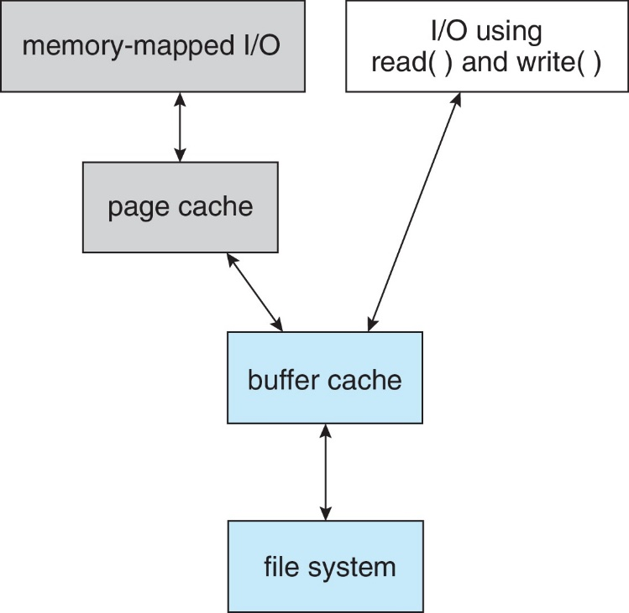
I/O Without a Unified Buffer Cache

Slide 15
Unified Buffer Cache
A unified buffer cache uses the same page cache to cache both memory-mapped pages and ordinary file system I/O to avoid double caching
But which caches get priority, and what replacement algorithms to use?

Slide 16
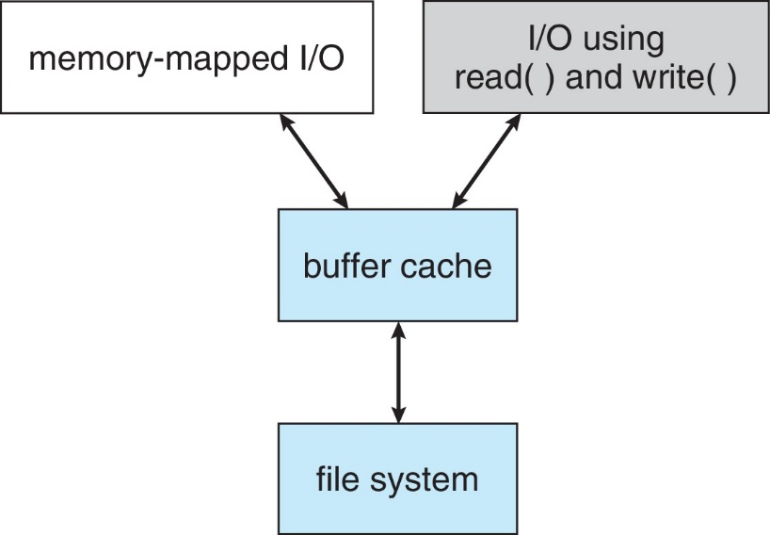
I/O Using a Unified Buffer Cache

