Slide 1
CSCI315 – Operating Systems Design Department of Computer Science Bucknell University
Virtual Machines Examples
Ch 18.7-18.8
This set of notes is based on notes from the textbook authors, as well as L. Felipe Perrone, Joshua Stough, and other instructors.
Xiannong Meng, Fall 2020.

Slide 2
Examples - VMware
VMware Workstation runs on x86, provides VMM for guests
Runs as application on other native, installed host operating system -> Type 2
Lots of guests possible, including Windows, Linux, etc. all runnable concurrently (as resources allow)
Virtualization layer abstracts underlying HW, providing guest with is own virtual CPUs, memory, disk drives, network interfaces, etc.
Physical disks can be provided to guests, or virtual physical disks (just files within host file system)

Slide 3
VMware Workstation Architecture

Slide 4
Examples – Java Virtual Machine
Example of programming-environment virtualization
Very popular language / application environment invented by Sun Microsystems in 1995
Write once, run anywhere
Includes language specification (Java), API library, Java virtual machine (JVM)
Java objects specified by class construct, Java program is one or more objects
Each Java object compiled into architecture-neutral bytecode output (.class) which JVM class loader loads
JVM compiled per architecture, reads bytecode and executes
Includes garbage collection to reclaim memory no longer in use
Made faster by just-in-time (JIT) compiler that turns bytecodes into native code and caches them

Slide 5
The Java Virtual Machine

Slide 6
Virtualization Research
Very popular technology with active research
Driven by uses such as server consolidation
Unikernels, built on library operating systems
Aim to improve efficiency and security
Specialized machine images using one address space, shrinking attack surface and resource footprint of deployed applications
In essence, compile application, libraries called, and used kernel services into single binary that runs in a virtual environment
https://en.wikipedia.org/wiki/Unikernel
http://unikernel.org/

Slide 7
Virtualization Research
Better control of processes available via projects like Quest-V
Real time execution and fault tolerance via virtualization instructions
Partitioning hypervisors partition physical resources amongst guests, fully-committing all resources (rather than overcommitting)
For example a Linux system that lacks real-time capabilities for safety- and security-critical tasks can be extended with a lightweight real-time OS running in its own VM
http://www.cs.bu.edu/fac/richwest/quest.php

Slide 8
Virtualization Research (Cont.)
Separation hypervisors like Quest-V, each task runs in a virtual machine
Hypervisor initializes system and starts tasks but not involved in continuing operation
Each VM has its own resources the task manages
Tasks can be real time and more secure
Other examples are Xtratum, Siemens Jailhouse
Can build chip-level distributed system
Secure shared memory channels implemented via extended page tables for inter-task communication
Project targets include robotics, self-driving cars, Internet of Things

Slide 9
Current Popular List of VM Software (1)
Based on a list by TechRadar (dated 09/24/2020)
1. VMware Workstation Player
2. VirtualBox
3. Parallels Desktop
4. QEMU
5. Citrix Hypervisor
6. Xen Project
7. Microsoft Hyper-V
https://www.techradar.com/best/best-virtual-machine-software

Slide 10
Current Popular List of VM Software (2)
Based on a list by Software Testing Help (dated 10/1/2020)
SolarWinds Virtualization Manager
V2 Cloud
VM Ware Fusion
Parallels Desktop
Oracle Virtualization (a.k.a. Virtual Box)
VM Ware Workstation
QEMU
Virtual PC
Microsoft Hyper-V
Redhat Virtualization
Veertu-for MAC
Apple-Boot Camp
https://www.softwaretestinghelp.com/virtualization-software/

Slide 11
Virtual Machine: QEMU
Here is a running example of VM: QEMU.
hardware emulator of x86 processor
I used it to study the bootstrap programs, which was demonstrated early in the course.
One can specify the disk capacity and memory configuration for each run.
https://www.qemu.org/
https://en.wikipedia.org/wiki/QEMU

Slide 12
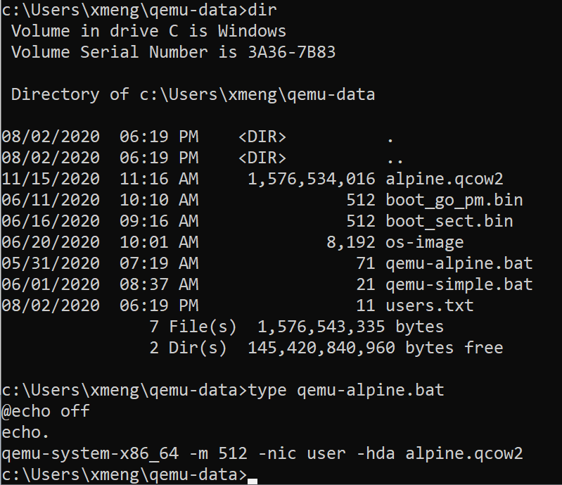
Some Screenshots Running QEMU
QEMU files on my Windows computer. “alphine.qcow2” is a virtual Linux brand OS.
https://alpinelinux.org/

Slide 13
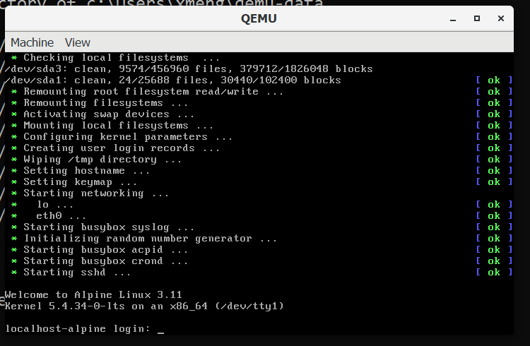
Some Screenshots Running QEMU
booting up Alphine Linux on my Windows computer
under QEMU

Slide 14
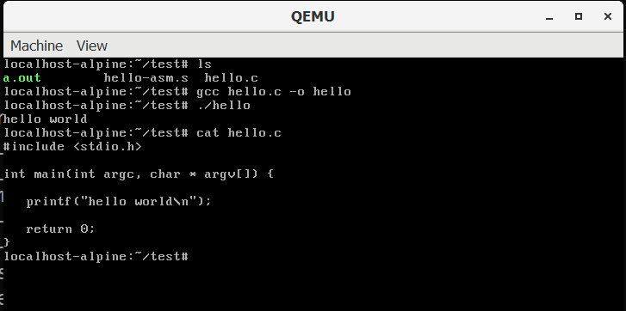
Some Screenshots Running QEMU
compiling and running hello.c

Slide 15
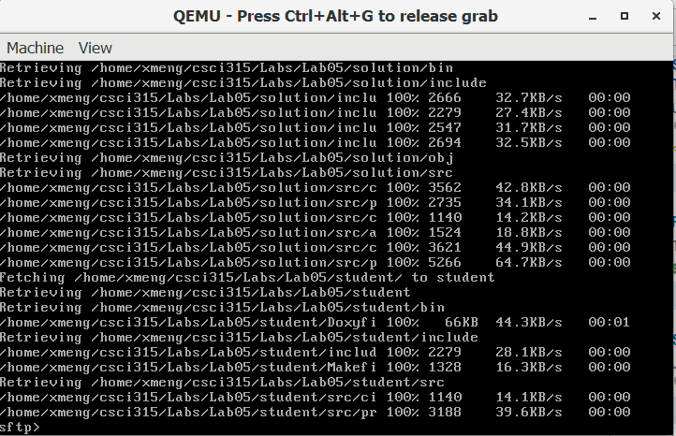
Some Screenshots Running QEMU
retrieving files from linuxremote
sftp user@linuxremote.bucknell.edu
cd csci315/lab05
mget -r *

Slide 16
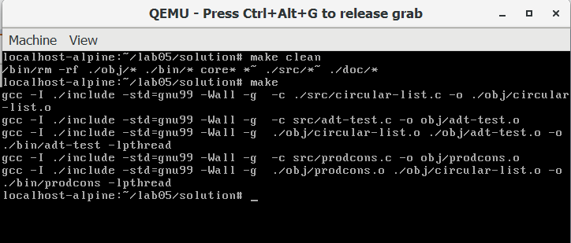
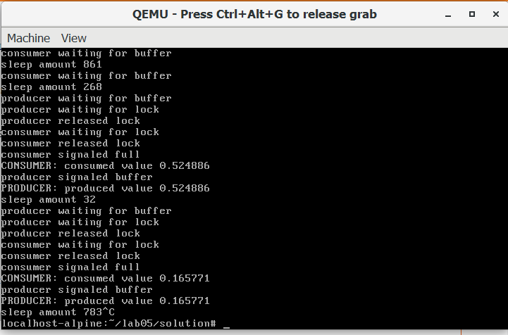
Some Screenshots Running QEMU
compiling lab05 on QEMU
running lab05 on QEMU

