Slide 1
Some highlights from chapter one

Slide 2
Internet structure: network of networks
Tier 1 ISP
Tier 1 ISP
Google
IXP
IXP
IXP
Regional ISP
Regional ISP
access
ISP
access
ISP
access
ISP
access
ISP
access
ISP
access
ISP
access
ISP
access
ISP
at center: small # of well-connected large networks
“tier-1” commercial ISPs (e.g., Level 3, Sprint, AT&T, NTT), national & international coverage
“internet exchange points” (IXPs): meeting points of multiple ISPs
content provider network (e.g, Google): private network that connects it data centers to Internet, often bypassing tier-1, regional ISPs

Slide 3
A closer look at network structure:
network edge:
hosts: clients and servers
servers often in data centers
mobile network
global ISP
access networks, physical media: wired, wireless communication links
home
network
regional ISP
network core:
interconnected routers
network of networks
institutional
network

Slide 4
Two key network-core functions
routing: determines source-destination route taken by packets
routing algorithms
forwarding: move packets from router’s input to appropriate router output
routing algorithm
local forwarding table
header value
output link
0100
0101
0111
1001
3
2
2
1
1
3
2
0111
dest address in arriving
packet’s header

Slide 5
“Real” Internet delays, routes
traceroute: gaia.cs.umass.edu to www.eurecom.fr
Do some traceroutes from exotic
countries at www.traceroute.org
3 delay measurements from
gaia.cs.umass.edu to cs-gw.cs.umass.edu
1 cs-gw (128.119.240.254) 1 ms 1 ms 2 ms
2 border1-rt-fa5-1-0.gw.umass.edu (128.119.3.145) 1 ms 1 ms 2 ms
3 cht-vbns.gw.umass.edu (128.119.3.130) 6 ms 5 ms 5 ms
4 jn1-at1-0-0-19.wor.vbns.net (204.147.132.129) 16 ms 11 ms 13 ms
5 jn1-so7-0-0-0.wae.vbns.net (204.147.136.136) 21 ms 18 ms 18 ms
6 abilene-vbns.abilene.ucaid.edu (198.32.11.9) 22 ms 18 ms 22 ms
7 nycm-wash.abilene.ucaid.edu (198.32.8.46) 22 ms 22 ms 22 ms
8 62.40.103.253 (62.40.103.253) 104 ms 109 ms 106 ms
9 de2-1.de1.de.geant.net (62.40.96.129) 109 ms 102 ms 104 ms
10 de.fr1.fr.geant.net (62.40.96.50) 113 ms 121 ms 114 ms
11 renater-gw.fr1.fr.geant.net (62.40.103.54) 112 ms 114 ms 112 ms
12 nio-n2.cssi.renater.fr (193.51.206.13) 111 ms 114 ms 116 ms
13 nice.cssi.renater.fr (195.220.98.102) 123 ms 125 ms 124 ms
14 r3t2-nice.cssi.renater.fr (195.220.98.110) 126 ms 126 ms 124 ms
15 eurecom-valbonne.r3t2.ft.net (193.48.50.54) 135 ms 128 ms 133 ms
16 194.214.211.25 (194.214.211.25) 126 ms 128 ms 126 ms
17 * * *
18 * * *
19 fantasia.eurecom.fr (193.55.113.142) 132 ms 128 ms 136 ms
trans-oceanic
link
* means no response (probe lost, router not replying)

Slide 6
Packet switching and circuit switching
packet-switching: hosts break application-layer messages into packets
forward packets from one router to the next, across links on path from source to destination
each packet transmitted at full link capacity
circuit-switching: end-end resources allocated to, reserved for “call” between source & destination:
Dedicated resources: no sharing
circuit-like (guaranteed) performance
Circuit segment idle if not used by call (no sharing)
Commonly used in traditional telephone networks
Virtual circuits may be used in modern communications

Slide 7
Network protocols
A network protocol is a set of rules governing the operations of the network.
Internet is in layered architecture, each layer has a set of protocols.
For example: at transport layer, TCP or UDP, at networking layer, IP, at data link layer, Ethernet or WiFi.

Slide 8
Internet protocol stack
application: supporting network applications
FTP, SMTP, HTTP
transport: process-process data transfer
TCP, UDP
network: routing of datagrams from source to destination
IP, routing protocols
link: data transfer between neighboring network elements
Ethernet, 802.11 (WiFi)
physical: bits “on the wire” or “in the air”
application
transport
network
link
physical

Slide 9
Encapsulation
source
message
M
application
transport
network
link
physical
segment
H_{t}
M
H_{t}
datagram
H_{n}
H_{n}
H_{t}
M
frame
H_{l}
H_{n}
H_{t}
M
link
physical
switch
destination
H_{n}
H_{t}
M
network
link
physical
M
application
transport
network
link
physical
H_{l}
H_{n}
H_{t}
M
H_{n}
H_{t}
M
H_{t}
M
H_{n}
H_{t}
M
H_{l}
H_{n}
H_{t}
M
router

Slide 10
FDM versus TDM
Example:
FDM
4 users
frequency
time
TDM
frequency
time
Notes:
Two simple multiple access control techniques.
Each mobile’s share of the bandwidth is divided into portions for the uplink and the downlink. Also, possibly, out of band signaling.
As we will see, used in AMPS, GSM, IS-54/136

Slide 11
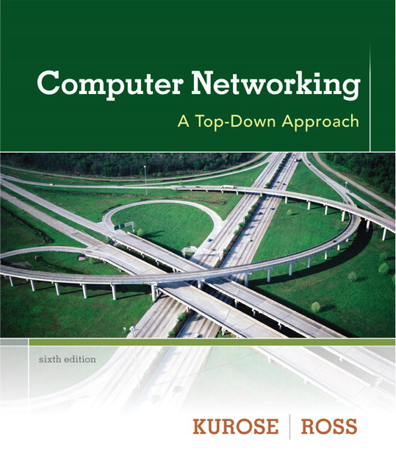
Chapter 2 Application Layer
A note on the use of these ppt slides:
We’re making these slides freely available to all (faculty, students, readers). They’re in PowerPoint form so you see the animations; and can add, modify, and delete slides (including this one) and slide content to suit your needs. They obviously represent a lot of work on our part. In return for use, we only ask the following:
Computer Networking: A Top Down Approach 6th edition Jim Kurose, Keith Ross Addison-Wesley March 2012
If you use these slides (e.g., in a class) that you mention their source (after all, we’d like people to use our book!)
If you post any slides on a www site, that you note that they are adapted from (or perhaps identical to) our slides, and note our copyright of this material.
Thanks and enjoy! JFK/KWR
All material copyright 1996-2012
J.F Kurose and K.W. Ross, All Rights Reserved
The course notes are adapted for Bucknell’s CSCI 363
Xiannong Meng
Spring 2016

Slide 12
Chapter 2: outline
2.1 principles of network applications
2.1.1 client-server model
2.6 P2P applications
2.2 Web and HTTP
2.3 FTP
2.4 electronic mail
SMTP, POP3, IMAP
2.7 socket programming with UDP and TCP
2.5 DNS

Slide 13
Some network apps
e-mail
web
text messaging
remote login
P2P file sharing
multi-user network games
streaming stored video (YouTube, Hulu, Netflix)
voice over IP (e.g., Skype)
real-time video conferencing
social networking
search
…
…

Slide 14
Creating a network app
application
transport
network
data link
physical
write programs that:
run on (different) end systems
communicate over network
e.g., web server software communicates with browser software
no need to write software for network-core devices
network-core devices do not run user applications
applications on end systems allows for rapid app development, propagation
application
transport
network
data link
physical
application
transport
network
data link
physical

Slide 15
Application architectures
possible structure of applications:
client-server
peer-to-peer (P2P)

Slide 16
Client-server architecture
server:
always-on host
wait for requests from clients
permanent IP address
server examples:
www.bucknell.edu, www.google.com
clients:
client initiates the communication
may be intermittently connected, dynamic (or static) IP
do not communicate directly with each other
client/server

Slide 17
P2P architecture
no always-on server
arbitrary end systems directly communicate with each other
peers request service from other peers, provide service in return to other peers
self scalability – new peers bring new service capacity, as well as new service demands
example:
Skype, text message
no server(s) at all?
peer-peer

Slide 18
Processes communicating
process: program running within a host
within same host, two processes communicate using inter-process communication (defined by OS), e.g., pipe()
processes in different hosts communicate by exchanging messages
clients, servers
client process: process that initiates communication
server process: process that waits to be contacted
aside: applications with P2P architectures have client processes & server processes

Slide 19
Sockets
process sends/receives messages to/from its socket
socket analogous to mailbox at your house or LC
sending process puts the message in the mailbox
sending process relies on transport infrastructure between the sending mailbox and receiving mailbox to deliver message to socket at receiving process
application
socket
application
controlled by
app developer
process
process
transport
transport
network
network
controlled
by OS
link
Internet
link
physical
physical

Slide 20
Some client-server examples
Client-server in C
http://www.eg.bucknell.edu/~cs363/2016-spring/code/client-server-c/
Client-server in Python
http://www.eg.bucknell.edu/~cs363/2016-spring/code/client-server-python/
Web client-server in C
http://www.eg.bucknell.edu/~cs363/2016-spring/code/web-client-server-c/

Slide 21
What transport service does an app need?
data integrity
some apps (e.g., file transfer, web transactions) require 100% reliable data transfer
other apps (e.g., audio) can tolerate some loss
throughput
some apps (e.g., multimedia) require minimum amount of throughput to be “effective”
other apps (“elastic apps”) make use of whatever throughput they get
timing
some apps (e.g., Internet telephony, interactive games) require low delay to be “effective”
security
encryption, data integrity, …

Slide 22
Securing TCP
TCP & UDP
no encryption
cleartext passwds sent into socket traverse Internet in cleartext
TLS and SSL
provides encrypted TCP connection
data integrity
end-point authentication
SSL is at app layer
Apps use SSL libraries, which “talk” to TCP
SSL socket API
cleartext passwds sent into socket traverse Internet encrypted
See Chapter 8

