Slide 1
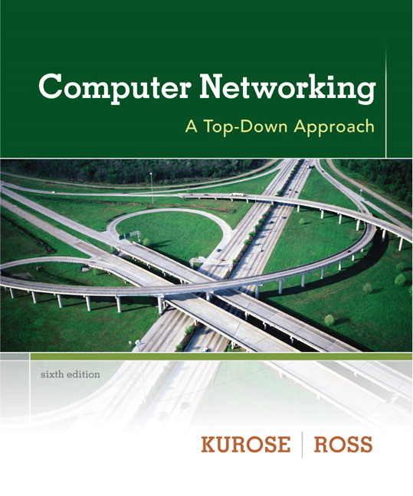

Chapter 2
Application Layer
A note on the use of these ppt slides:
We’re making these slides freely available to all (faculty, students, readers). They’re in PowerPoint form so you see the animations; and can add, modify, and delete slides (including this one) and slide content to suit your needs. They obviously represent a lot of work on our part. In return for use, we only ask the following:
Computer Networking: A Top Down Approach
6th edition
Jim Kurose, Keith Ross
Addison-Wesley
March 2012
If you use these slides (e.g., in a class) that you mention their source (after all, we’d like people to use our book!)
If you post any slides on a www site, that you note that they are adapted from (or perhaps identical to) our slides, and note our copyright of this material.
Thanks and enjoy! JFK/KWR
All material copyright 1996-2012
J.F Kurose and K.W. Ross, All Rights Reserved
The course notes are adapted for Bucknell’s CSCI 363
Xiannong Meng
Spring 2016

Slide 2
Chapter 2: outline
2.1 principles of network applications
  app architectures
  app requirements
2.2 Web and HTTP
2.3 FTP
2.4 electronic mail
  SMTP, POP3, IMAP
2.5 DNS
2.6 P2P applications
2.7 socket programming with UDP and TCP

Slide 3

Socket programming
goal: learn how to build client/server applications that communicate using sockets
socket: door between application process and end-end-transport protocol
application
socket
application
controlled by
app developer
process
process
transport
transport
network
network
controlled
by OS
link
Internet
link
physical
physical

Slide 4
Socket programming
  Two socket types for two transport services:
  UDP: unreliable datagram
  TCP: reliable, byte stream-oriented
  Application Example:
Client reads a line of characters (data) from its keyboard and sends the data to the server.
The server receives the data and converts characters to uppercase.
The server sends the modified data to the client.
The client receives the modified data and displays the line on its screen.

Slide 5
Socket programming with UDP
UDP: no “connection” between client & server
no handshaking before sending data
sender explicitly attaches IP destination address and port # to each packet
rcvr extracts sender IP address and port# from received packet
UDP: transmitted data may be lost or received out-of-order
Application viewpoint:
UDP provides unreliable transfer of groups of bytes (“datagrams”) between client and server

Slide 6
Client/server socket interaction: UDP
server (running on serverIP)
client
create socket:
create socket, port= x:
clientSocket =
socket(AF_INET,SOCK_DGRAM)
serverSocket =
socket(AF_INET,SOCK_DGRAM)
Create datagram with server IP and
port=x; send datagram via
clientSocket
read datagram from
serverSocket
write reply to
serverSocket
specifying
client address,
port number
read datagram from
clientSocket
close
clientSocket
Application 2-6

Slide 7
Example app: UDP client
Python UDPClient
include Python’s socket
library
from socket import *
serverName = ‘hostname’
serverPort = 12000
clientSocket = socket(AF_INET,
SOCK_DGRAM)
message = input(’Input lowercase sentence:’)
clientSocket.sendto(str.encode(message),
(serverName, serverPort))
modifiedMessage, serverAddress =
clientSocket.recvfrom(2048)
print (bytes.decode(modifiedMessage))
clientSocket.close()
create UDP socket for server
get user keyboard
input
Attach server name, port to message; send into socket
read reply characters from
socket into string
print out received string and close socket

Slide 8
Example app: UDP server
Python UDPServer
from socket import *
serverPort = 12000
serverSocket = socket(AF_INET, SOCK_DGRAM)
serverSocket.bind((‘’, serverPort))
print (“The server is ready to receive” )
while 1:
message, clientAddress = serverSocket.recvfrom(2048)
modifiedMessage = message.upper()
serverSocket.sendto(modifiedMessage, clientAddress)
create UDP socket
bind socket to local port number 12000
loop forever
Read from UDP socket into message, getting client’s address (client IP and port)
send upper case string back to this client

Slide 9
UDP server and client in C
Exact the same functionality can be implemented in C.
Since the C language is a more primitive, more complicated code is needed.
See examples/socket.
Basic flow:
  Create a socket
  Associate the server host information with a socket address
  Bind the client socket to a local address
  Send the message to the server (read from client)
  Read the echoed message from the server (send back to the client)

Slide 10
Socket programming with TCP
client must contact server
server process must first be running
server must have created socket (door) that welcomes client’s contact
client contacts server by:
Creating TCP socket, specifying IP address, port number of server process
when client creates socket: client TCP establishes connection to server TCP
when contacted by client, server TCP creates new socket for server process to communicate with that particular client
  allows server to talk with multiple clients
  source port numbers used to distinguish clients (more in Chap 3)
application viewpoint:
TCP provides reliable, in-order
byte-stream transfer (“pipe”)
between client and server

Slide 11
Client/server socket interaction: TCP
server (running on hostid)
client
create socket,
port=x, for incoming request:
serverSocket = socket()
wait for incoming
connection request
TCP
connection setup
create socket,
connect to hostid, port=x
connectionSocket =
serverSocket.accept()
clientSocket = socket()
send request using
clientSocket
read request from
connectionSocket
write reply to
connectionSocket
read reply from
clientSocket
close
connectionSocket
close
clientSocket

Slide 12
Example app: TCP client
Python TCPClient
from socket import *
serverName = ’servername’
serverPort = 12000
clientSocket = socket(AF_INET, SOCK_STREAM)
clientSocket.connect((serverName,serverPort))
sentence = input(‘Input lowercase sentence:’)
clientSocket.send(str.encode(sentence))
modifiedSentence = clientSocket.recv(1024)
print (‘From Server: ’, bytes.decode(modifiedSentence))
clientSocket.close()
create TCP socket for server, remote port 12000
No need to attach server name, port

Slide 13
Example app: TCP server
Python TCPServer
from socket import *
serverPort = 12000
serverSocket = socket(AF_INET,SOCK_STREAM)
serverSocket.bind((‘’,serverPort))
serverSocket.listen(1)
print (‘The server is ready to receive’)
while 1:
connectionSocket, addr = serverSocket.accept()
sentence = connectionSocket.recv(1024)
capitalizedSentence = sentence.upper()
connectionSocket.send(capitalizedSentence)
connectionSocket.close()
create TCP welcoming
socket
server begins listening for incoming TCP requests
loop forever
server waits on accept()
for incoming requests, new socket created on return
read bytes from socket (but not address as in UDP)
close connection to this client (but not welcoming socket)

Slide 14
TCP server and client in C
Exact the same functionality can be implemented in C.
Since the C language is a more primitive, more complicated code is needed.
See examples/socket.
Basic flow:
  Create a socket
  Associate the server host information with a socket address
  Bind the client socket to a local address
  Send the message to the server (read from client)
  Read the echoed message from the server (send back to the client)

