Slide 1
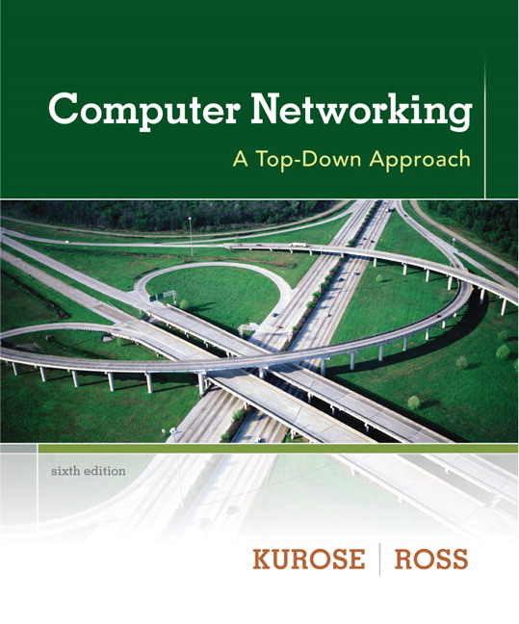

Chapter 3
Transport Layer
A note on the use of these ppt slides:
We’re making these slides freely available to all (faculty, students, readers). They’re in PowerPoint form so you see the animations; and can add, modify, and delete slides (including this one) and slide content to suit your needs. They obviously represent a lot of work on our part. In return for use, we only ask the following:
Computer Networking: A Top Down Approach
6th edition
Jim Kurose, Keith Ross
Addison-Wesley
March 2012
If you use these slides (e.g., in a class) that you mention their source (after all, we’d like people to use our book!)
If you post any slides on a www site, that you note that they are adapted from (or perhaps identical to) our slides, and note our copyright of this material.
Thanks and enjoy! JFK/KWR
All material copyright 1996-2012
J.F Kurose and K.W. Ross, All Rights Reserved
The course notes are adapted for Bucknell’s CSCI 363
Xiannong Meng
Spring 2016

Slide 2
Chapter 3: Transport Layer
our goals:
understand principles behind transport layer services:
  multiplexing, demultiplexing
  reliable data transfer
  flow control
  congestion control
learn about Internet transport layer protocols:
  UDP: connectionless transport
  TCP: connection-oriented reliable transport
  TCP congestion control

Slide 3
review layered architecture

Slide 4

Encapsulation
source
message
M
application
transport
network
link
physical
segment
H_{t}
M
H_{t}
datagram
H_{n}
H_{n}
H_{t}
M
frame
H_{l}
H_{n}
H_{t}
M
link
physical
switch
destination
H_{n}
H_{t}
M
network
link
physical
M
application
transport
network
link
physical
H_{l}
H_{n}
H_{t}
M
H_{n}
H_{t}
M
H_{t}
M
H_{n}
H_{t}
M
H_{l}
H_{n}
H_{t}
M
router

Slide 5
Wireshark
Wireshark is a piece of software that can capture and record network traffic “on the wire.”
It also allows user to examine the traffic in a nice GUI.
We’ll use Wireshark to capture network traffic, and write our own analyzer.
Our analyzer will peer into the layers and examine in detail the information in each captured frame.
Demonstration of Wireshark.

Slide 6
Chapter 3 outline
3.1 transport-layer services
3.2 multiplexing and demultiplexing
3.3 connectionless transport: UDP
3.4 principles of reliable data transfer
3.5 connection-oriented transport: TCP
  segment structure
  reliable data transfer
  flow control
  connection management
3.6 principles of congestion control
3.7 TCP congestion control

Slide 7

















Transport services and protocols
application
transport
network
data link
physical
provide logical communication between app processes running on different hosts
transport protocols run in end systems
  send side: breaks app messages into segments, passes to network layer
  recv side: reassembles segments into messages, passes to app layer
more than one transport protocol available to apps
  Internet: TCP and UDP
logical end-end transport
application
transport
network
data link
physical

Slide 8
Transport vs. network layer
network layer: logical communication between hosts
transport layer: logical communication between processes
  relies on, enhances, network layer services
household analogy:
12 kids in Ann’s house sending letters to 12 kids in Bill’s house:
hosts = houses
processes = kids
app messages = letters in envelopes
transport protocol = Ann’ multiplexing and Bill’ demultiplexing to in-house siblings
network-layer protocol = postal service

Slide 9
Internet transport-layer protocols
reliable, in-order delivery (TCP)
  congestion control
  flow control
  connection setup
unreliable, unordered delivery: UDP
  no-frills extension of “best-effort” IP
services not available:
  delay guarantees
  bandwidth guarantees
application
transport
network
data link
physical
network
data link
physical
network
data link
physical
network
data link
physical
logical end-end transport
network
data link
physical
network
data link
physical
network
data link
physical
network
data link
physical
application
transport
network
data link
physical

Slide 10
Chapter 3 outline
3.1 transport-layer services
3.2 multiplexing and demultiplexing
3.3 connectionless transport: UDP
3.4 principles of reliable data transfer
3.5 connection-oriented transport: TCP
  segment structure
  reliable data transfer
  flow control
  connection management
3.6 principles of congestion control
3.7 TCP congestion control

Slide 11
Multiplexing/demultiplexing
multiplexing at sender:
handle data from multiple
sockets, add transport header (later used for demultiplexing)
demultiplexing at receiver:
use header info to deliver
received segments to correct
socket
application
application
P1
P2
application
socket
P3
transport
P4
process
transport
network
transport
network
link
network
link
physical
link
physical
physical

Slide 12
How demultiplexing works
host receives IP datagrams
  each datagram has source IP address, destination IP address
  each datagram carries one transport-layer segment
  each segment has source, destination port number
host uses IP addresses & port numbers to direct segment to appropriate socket
32 bits
source port #
dest port #
other header fields
application
data
(payload)
TCP/UDP segment format

Slide 13
Connectionless demultiplexing
recall: when creating datagram to send into UDP socket, must specify
  destination IP address
  destination port #
recall: created socket has host-local port #:
udp_sock = socket(AF_INET, SOCK_DGRAM)
udp_sock.sendto(msg,(host,port))
when host receives UDP segment:
  checks destination port # in segment
  directs UDP segment to socket with that port #
IP datagrams with same dest. port #, but different source IP addresses and/or source port numbers will be directed to same socket at dest

Slide 14
Connectionless demux: example
DatagramSocket serverSocket = new DatagramSocket
(6428);
DatagramSocket mySocket2 = new DatagramSocket
(9157);
DatagramSocket mySocket1 = new DatagramSocket (5775);
application
application
P1
application
P3
P4
transport
transport
network
transport
network
link
network
link
physical
link
physical
physical
source port: 6428
dest port: 9157
source port: ?
dest port: ?
source port: 9157
dest port: 6428
source port: ?
dest port: ?

Slide 15
Connection-oriented demux
TCP socket identified by 4-tuple:
  source IP address
  source port number
  dest IP address
  dest port number
demux: receiver uses all four values to direct segment to appropriate socket
server host may support many simultaneous TCP sockets:
  each socket identified by its own 4-tuple
web servers have different sockets for each connecting client
  non-persistent HTTP will have different socket for each request

Slide 16
Connection-oriented demux: example
application
application
P4
P5
P6
application
P3
P2
P3
transport
transport
network
transport
network
link
network
link
physical
link
physical
server: IP address B
physical
host: IP address A
source IP,port: B,80
dest IP,port: A,9157
host: IP address C
source IP,port: C,5775
dest IP,port: B,80
source IP,port: A,9157
dest IP, port: B,80
source IP,port: C,9157
dest IP,port: B,80
three segments, all destined to IP address: B,
dest port: 80 are demultiplexed to different sockets

Slide 17
Connection-oriented demux: example
threaded server
application
application
application
P4
P3
P3
P2
transport
transport
network
transport
network
link
network
link
physical
link
physical
server: IP address B
physical
host: IP address A
source IP,port: B,80
dest IP,port: A,9157
host: IP address C
source IP,port: C,5775
dest IP,port: B,80
source IP,port: A,9157
dest IP, port: B,80
source IP,port: C,9157
dest IP,port: B,80

Slide 18
Chapter 3 outline
3.1 transport-layer services
3.2 multiplexing and demultiplexing
3.3 connectionless transport: UDP
3.4 principles of reliable data transfer
3.5 connection-oriented transport: TCP
  segment structure
  reliable data transfer
  flow control
  connection management
3.6 principles of congestion control
3.7 TCP congestion control

Slide 19
UDP: User Datagram Protocol [RFC 768]
“no frills,” “bare bones” Internet transport protocol
“best effort” service, UDP segments may be:
  lost
  delivered out-of-order to app
connectionless:
  no handshaking between UDP sender, receiver
  each UDP segment handled independently of others
UDP use:
  streaming multimedia apps (loss tolerant, rate sensitive)
  DNS
  SNMP
reliable transfer over UDP:
  add reliability at application layer
  application-specific error recovery!

Slide 20
UDP: segment header
length, in bytes of UDP segment, including header
32 bits
source port #
dest port #
length
checksum
why is there a UDP?
no connection establishment (which can add delay)
simple: no connection state at sender, receiver
small header size
no congestion control: UDP can blast away as fast as desired
application
data
(payload)
UDP segment format

Slide 21
UDP Header File for C/C++
struct udphdr
{
u_int16_t source; /* src port number */
u_int16_t dest; /* dest port number */
u_int16_t len; /* total length in bytes */
u_int16_t check; /* check sum */
};
In the file : /usr/include/netinet/udp.h

Slide 22
UDP checksum
Goal: detect “errors” (e.g., flipped bits) in transmitted segment
sender:
treat segment contents, including header fields, as sequence of 16-bit integers
checksum: addition (one’s complement sum) of segment contents
sender puts checksum value into UDP checksum field
receiver:
compute checksum of received segment
check if computed checksum equals checksum field value:
  NO - error detected
  YES - no error detected. But maybe errors nonetheless? More later ….

Slide 23
Internet checksum: example
example: add two 16-bit integers
1 1 1 1 0 0 1 1 0 0 1 1 0 0 1 1 0
1 1 1 0 1 0 1 0 1 0 1 0 1 0 1 0 1
1 1 0 1 1 1 0 1 1 1 0 1 1 1 0 1 1
1 1 0 1 1 1 0 1 1 1 0 1 1 1 1 0 0
1 0 1 0 0 0 1 0 0 0 1 0 0 0 0 1 1
wraparound
sum
checksum
Note: when adding numbers, a carryout from the most significant bit needs to be added to the result
Notes:
Kurose and Ross forgot to say anything about wrapping the carry and adding it to low order bit

Slide 24
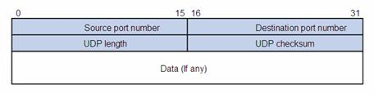
UDP packet format
UDP header:
  http://en.wikipedia.org/wiki/User_Datagram_Protocol
  http://www.ietf.org/rfc/rfc768.txt

Slide 25
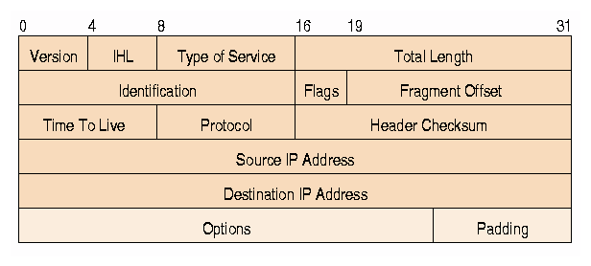
IP packet format
IP header:
  http://en.wikipedia.org/wiki/IPv4
  http://www.ietf.org/rfc/rfc791.txt

Slide 26
UDP Checksum Computation
According to RFC 768, http://www.faqs.org/rfcs/rfc768.html
UDP checksum is computed as follows
  Checksum is the 16-bit one's complement of the one's complement sum of a pseudo header of information from the IP header, the UDP header, and the data, padded with zero octets at the end (if necessary) to make a multiple of two octets.

