Slide 1


Chapter 3
Transport Layer
A note on the use of these ppt slides:
We’re making these slides freely available to all (faculty, students, readers). They’re in PowerPoint form so you see the animations; and can add, modify, and delete slides (including this one) and slide content to suit your needs. They obviously represent a lot of work on our part. In return for use, we only ask the following:
Computer Networking: A Top Down Approach
6th edition
Jim Kurose, Keith Ross
Addison-Wesley
March 2012
If you use these slides (e.g., in a class) that you mention their source (after all, we’d like people to use our book!)
If you post any slides on a www site, that you note that they are adapted from (or perhaps identical to) our slides, and note our copyright of this material.
Thanks and enjoy! JFK/KWR
All material copyright 1996-2012
J.F Kurose and K.W. Ross, All Rights Reserved
The course notes are adapted for Bucknell’s CSCI 363
Xiannong Meng
Spring 2016

Slide 2
Chapter 3 outline
3.1 transport-layer services
3.2 multiplexing and demultiplexing
3.3 connectionless transport: UDP
3.4 principles of reliable data transfer
3.5 connection-oriented transport: TCP
  segment structure
  reliable data transfer
  flow control
  connection management
3.6 principles of congestion control
3.7 TCP congestion control

Slide 3
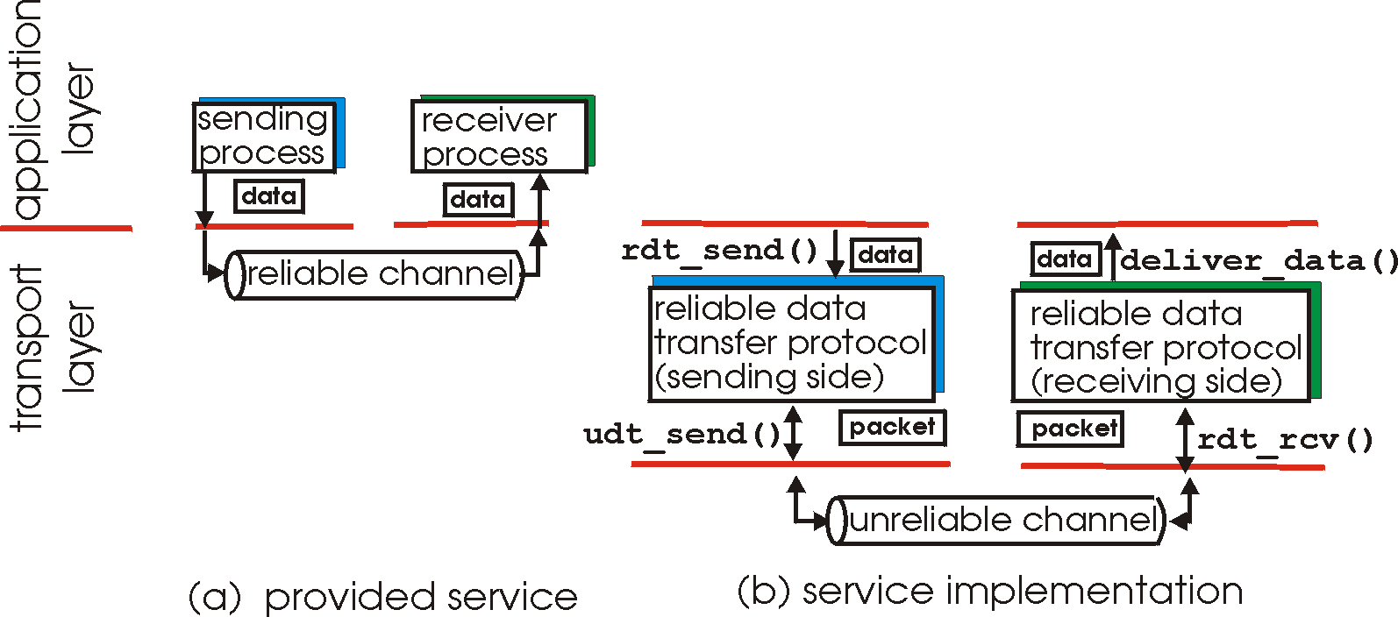
Principles of reliable data transfer
important in application, transport, link layers
  top-10 list of important networking topics!
characteristics of unreliable channel will determine complexity of reliable data transfer protocol (rdt)

Slide 4
Principles of reliable data transfer
important in application, transport, link layers
  top-10 list of important networking topics!
characteristics of unreliable channel will determine complexity of reliable data transfer protocol (rdt)

Slide 5
Principles of reliable data transfer
important in application, transport, link layers
  top-10 list of important networking topics!
characteristics of unreliable channel will determine complexity of reliable data transfer protocol (rdt)

Slide 6
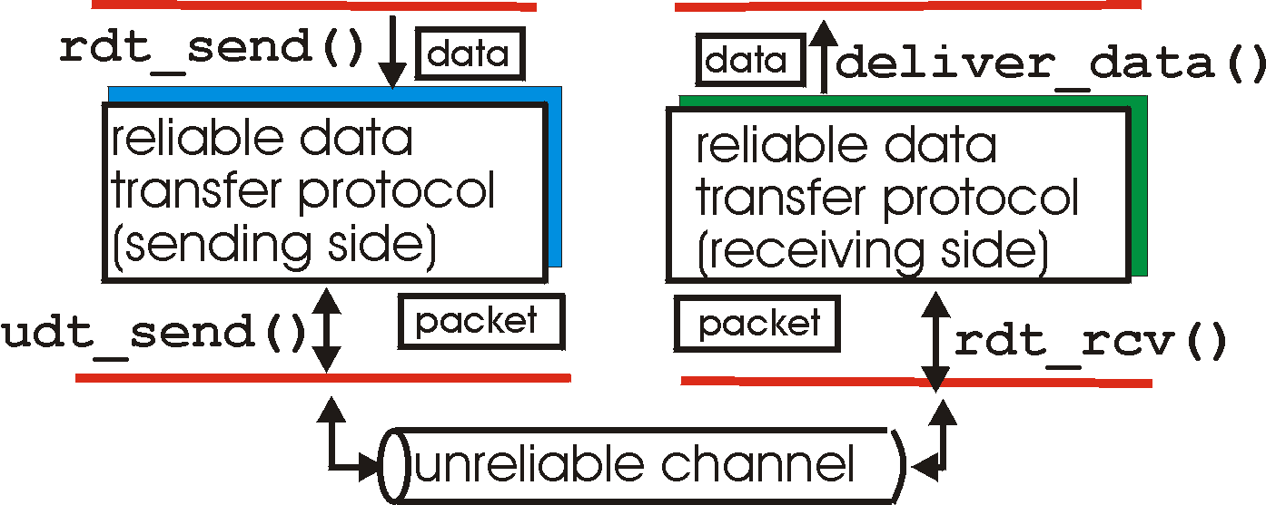
Reliable data transfer: getting started
rdt_send(): called from above, (e.g., by app.). Passed data to
deliver to receiver upper layer
deliver_data(): called by rdt to deliver data to upper
send
side
receive
side
udt_send(): called by rdt,
to transfer packet over
unreliable channel to receiver
rdt_rcv(): called when packet arrives on rcv-side of channel

Slide 7
Reliable data transfer: getting started
We will:
incrementally develop sender, receiver sides of reliable data transfer protocol (rdt)
consider only unidirectional data transfer
  but control info will flow on both directions!
use finite state machines (FSM) to specify behaviors of sender, receiver
event causing state transition
actions taken on state transition
state: when in this “state” next state uniquely determined by next event
state
1
state
2
event
actions

Slide 8
rdt1.0: reliable transfer over a reliable channel
underlying channel perfectly reliable
  no bit errors
  no loss of packets
separate FSMs for sender, receiver:
  sender sends data into underlying channel
  receiver reads data from underlying channel
Wait for call from above
rdt_send(data)
Wait for call from below
rdt_rcv(packet)
extract (packet,data)
deliver_data(data)
packet = make_pkt(data)
udt_send(packet)
sender
receiver

Slide 9
rdt2.0: channel with bit errors
underlying channel may flip bits in packet
  checksum to detect bit errors
the question: how to recover from errors:
  acknowledgements (ACKs): receiver explicitly tells sender that pkt received OK
  negative acknowledgements (NAKs): receiver explicitly tells sender that pkt had errors
  sender retransmits pkt on receipt of NAK
new mechanisms in rdt2.0 (beyond rdt1.0):
  error detection
  receiver feedback: control msgs (ACK,NAK) rcvr->sender
How do humans recover from “errors”
during conversation?

Slide 10
rdt2.0: channel with bit errors
underlying channel may flip bits in packet
  checksum to detect bit errors
the question: how to recover from errors:
  acknowledgements (ACKs): receiver explicitly tells sender that pkt received OK
  negative acknowledgements (NAKs): receiver explicitly tells sender that pkt had errors
  sender retransmits pkt on receipt of NAK
new mechanisms in rdt2.0 (beyond rdt1.0):
  error detection
  feedback: control msgs (ACK,NAK) from receiver to sender

Slide 11
rdt2.0: FSM specification
rdt_send(data)
sndpkt = make_pkt(data, checksum)
udt_send(sndpkt)
receiver
rdt_rcv(rcvpkt) &&
isNAK(rcvpkt)
Wait for call from above
Wait for ACK or NAK
rdt_rcv(rcvpkt) &&
corrupt(rcvpkt)
udt_send(sndpkt)
udt_send(NAK)
rdt_rcv(rcvpkt) && isACK(rcvpkt)
Λ
Wait for call from below
sender
rdt_rcv(rcvpkt) &&
notcorrupt(rcvpkt)
extract(rcvpkt,data)
deliver_data(data)
udt_send(ACK)

Slide 12
rdt2.0: operation with no errors
rdt_send(data)
snkpkt = make_pkt(data, checksum)
udt_send(sndpkt)
rdt_rcv(rcvpkt) &&
isNAK(rcvpkt)
Wait for call from above
Wait for ACK or NAK
rdt_rcv(rcvpkt) &&
corrupt(rcvpkt)
udt_send(sndpkt)
udt_send(NAK)
rdt_rcv(rcvpkt) && isACK(rcvpkt)
Wait for call from below
Λ
rdt_rcv(rcvpkt) &&
notcorrupt(rcvpkt)
extract(rcvpkt,data)
deliver_data(data)
udt_send(ACK)

Slide 13
rdt2.0: error scenario
rdt_send(data)
snkpkt = make_pkt(data, checksum)
udt_send(sndpkt)
rdt_rcv(rcvpkt) &&
isNAK(rcvpkt)
Wait for call from above
Wait for ACK or NAK
rdt_rcv(rcvpkt) &&
corrupt(rcvpkt)
udt_send(sndpkt)
udt_send(NAK)
rdt_rcv(rcvpkt) && isACK(rcvpkt)
Wait for call from below
Λ
rdt_rcv(rcvpkt) &&
notcorrupt(rcvpkt)
extract(rcvpkt,data)
deliver_data(data)
udt_send(ACK)

Slide 14
rdt2.0 has a fatal flaw!
what happens if ACK/NAK corrupted?
sender doesn’t know what happened at receiver!
can’t just retransmit: possible duplicate
handling duplicates:
sender retransmits current pkt if ACK/NAK corrupted
sender adds sequence number to each pkt
receiver discards (doesn’t deliver up) duplicate pkt
stop and wait
sender sends one packet,
then waits for receiver’s
response

