Slide 1
Chapter 3 Transport Layer
A note on the use of these ppt slides:
We’re making these slides freely available to all (faculty, students, readers). They’re in PowerPoint form so you see the animations; and can add, modify, and delete slides (including this one) and slide content to suit your needs. They obviously represent a lot of work on our part. In return for use, we only ask the following:
Computer Networking: A Top Down Approach 6th edition Jim Kurose, Keith Ross Addison-Wesley March 2012
If you use these slides (e.g., in a class) that you mention their source (after all, we’d like people to use our book!)
If you post any slides on a www site, that you note that they are adapted from (or perhaps identical to) our slides, and note our copyright of this material.
Thanks and enjoy! JFK/KWR
All material copyright 1996-2012
J.F Kurose and K.W. Ross, All Rights Reserved
The course notes are adapted for Bucknell’s CSCI 363
Xiannong Meng
Spring 2016

Slide 2
rdt2.2: a NAK-free protocol
same functionality as rdt2.1, using ACKs only
instead of NAK, receiver sends ACK for last pkt received fine
receiver must explicitly include seq # of pkt being ACKed
duplicate ACK at sender results in same action as NAK: retransmit current pkt

Slide 3
rdt2.2: sender, receiver fragments
rdt_send(data)
sndpkt = make_pkt(0, data, checksum)
udt_send(sndpkt)
rdt_rcv(rcvpkt) &&
(corrupt(rcvpkt) ||
isACK(rcvpkt,1) )
Wait for call 0 from above
Wait for ACK
0
udt_send(sndpkt)
sender FSM
fragment
rdt_rcv(rcvpkt)
&& notcorrupt(rcvpkt)
&& isACK(rcvpkt,0)
rdt_rcv(rcvpkt) &&
(corrupt(rcvpkt) ||
has_seq1(rcvpkt))
Λ
Wait for
0 from below
receiver FSM
fragment
sndpkt = make_pkt(ACK1, chksum)
udt_send(sndpkt)
rdt_rcv(rcvpkt) && notcorrupt(rcvpkt)
&& has_seq0(rcvpkt)
extract(rcvpkt,data)
deliver_data(data)
sndpkt = make_pkt(ACK0, chksum)
udt_send(sndpkt)

Slide 4
rdt3.0: channels with errors and loss
new assumption: underlying channel can also lose packets (data, ACKs)
checksum, seq. #, ACKs, retransmissions will be of help … but not enough
approach: sender waits “reasonable” amount of time for ACK
retransmits if no ACK received in this time
if pkt (or ACK) just delayed (not lost):
retransmission will be duplicate, but seq. #’s already handles this
receiver must specify seq # of pkt being ACKed
requires countdown timer

Slide 5
rdt3.0 sender
rdt_send(data)
rdt_rcv(rcvpkt) &&
( corrupt(rcvpkt) ||
isACK(rcvpkt,1) )
sndpkt = make_pkt(0, data, checksum)
udt_send(sndpkt)
start_timer
rdt_rcv(rcvpkt)
Λ
Λ
Wait for
call 0from above
Wait for ACK0
timeout
udt_send(sndpkt)
start_timer
rdt_rcv(rcvpkt)
&& notcorrupt(rcvpkt)
&& isACK(rcvpkt,1)
rdt_rcv(rcvpkt)
&& notcorrupt(rcvpkt)
&& isACK(rcvpkt,0)
stop_timer
stop_timer
Wait for ACK1
Wait for
call 1 from above
timeout
udt_send(sndpkt)
start_timer
rdt_rcv(rcvpkt)
rdt_send(data)
Λ
rdt_rcv(rcvpkt) &&
( corrupt(rcvpkt) ||
isACK(rcvpkt,0) )
sndpkt = make_pkt(1, data, checksum)
udt_send(sndpkt)
start_timer
Λ

Slide 6
rdt3.0 in action
sender
receiver
sender
receiver
send pkt0
pkt0
send pkt0
pkt0
rcv pkt0
rcv pkt0
ack0
send ack0
ack0
send ack0
rcv ack0
rcv ack0
send pkt1
pkt1
send pkt1
pkt1
rcv pkt1
X
ack1
send ack1
loss
rcv ack1
send pkt0
pkt0
rcv pkt0
timeout
resend pkt1
ack0
send ack0
pkt1
rcv pkt1
ack1
send ack1
rcv ack1
send pkt0
pkt0
(a) no loss
rcv pkt0
ack0
send ack0
(b) packet loss

Slide 7
rdt3.0 in action
sender
receiver
sender
receiver
send pkt0
pkt0
send pkt0
pkt0
rcv pkt0
rcv pkt0
ack0
send ack0
send ack0
rcv ack0
ack0
send pkt1
pkt1
rcv ack0
rcv pkt1
send pkt1
pkt1
send ack1
rcv pkt1
ack1
send ack1
ack1
X
loss
timeout
resend pkt1
pkt1
rcv pkt1
timeout
resend pkt1
rcv ack1
pkt1
rcv pkt1
pkt0
(detect duplicate)
send pkt0
send ack1
ack1
(detect duplicate)
ack1
rcv pkt0
rcv ack1
send ack1
rcv ack1
ack0
send ack0
pkt0
send pkt0
pkt0
send pkt0
rcv pkt0
rcv pkt0
ack0
(detect duplicate)
ack0
send ack0
send ack0
(c) ACK loss
(d) premature timeout/ delayed ACK

Slide 8
Performance of rdt3.0
rdt3.0 is correct, but performance stinks
e.g.: 1 Gbps link, 15 ms prop. delay, 8000 bit packet:
L
8000 bits
D_{trans} =
=
=
8 microsecs
R
10⁹ bits/sec
U _{sender}: utilization – fraction of time sender busy sending
if RTT=30 msec, 1KB pkt every 30 msec: 33kB/sec thruput over 1 Gbps link
network protocol limits use of physical resources!

Slide 9
rdt3.0: stop-and-wait operation
sender
receiver
first packet bit transmitted, t = 0
last packet bit transmitted, t = L / R
first packet bit arrives
RTT
last packet bit arrives, send ACK
ACK arrives, send next
packet, t = RTT + L / R

Slide 10
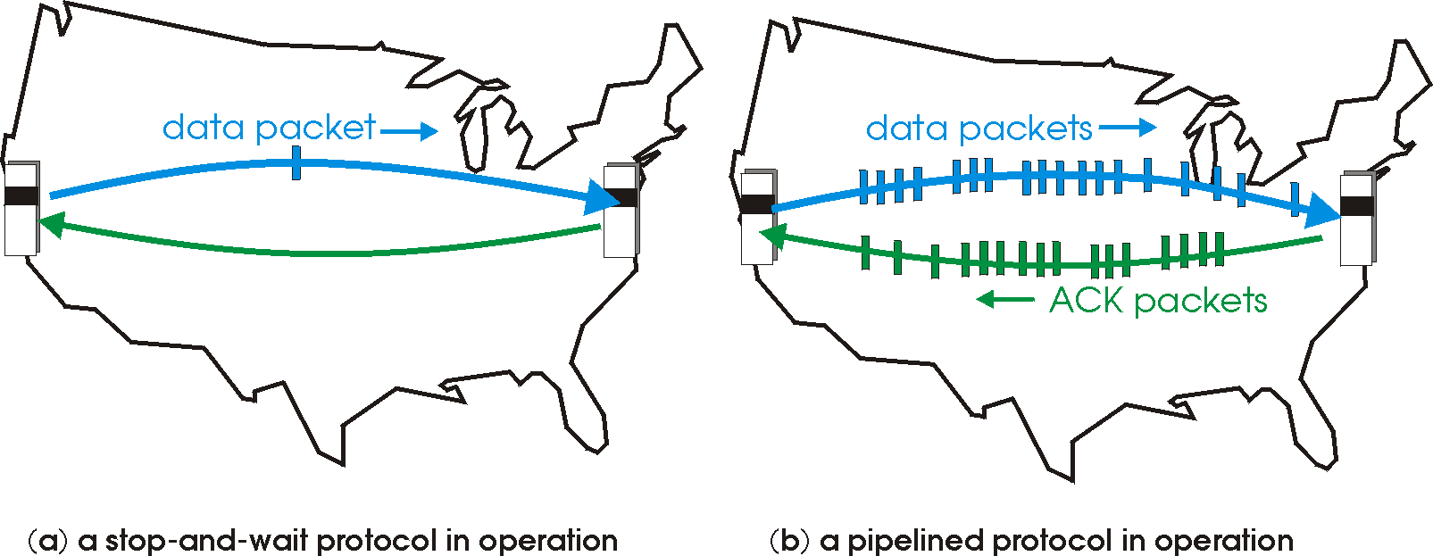
Pipelined protocols
pipelining: sender allows multiple, “in-flight”, yet-to-be-acknowledged pkts
range of sequence numbers must be increased
buffering at sender and/or receiver
two generic forms of pipelined protocols: go-Back-N, selective repeat

Slide 11
Pipelining: increased utilization
sender
receiver
first packet bit transmitted, t = 0
last bit transmitted, t = L / R
first packet bit arrives
RTT
last packet bit arrives, send ACK
last bit of 2nd packet arrives, send ACK
last bit of 3rd packet arrives, send ACK
ACK arrives, send next
packet, t = RTT + L / R
3-packet pipelining increases
utilization by a factor of 3!

Slide 12
Pipelined protocols: overview
Go-back-N (a.k.a. Sliding Window Protocol):
sender can have up to N unacked packets in pipeline
receiver only sends cumulative ack
doesn’t ack packet if there’s a gap
sender has timer for oldest unacked packet
when timer expires, retransmit all unacked packets
Selective Repeat:
sender can have up to N unack’ed packets in pipeline
rcvr sends individual ack for each packet
sender maintains timer for each unacked packet
when timer expires, retransmit only that unacked packet

Slide 13
Go-Back-N: sender
k-bit seq # in pkt header
“window” of up to N, consecutive unack’ed pkts allowed
ACK(n): ACKs all pkts up to, including seq # n - “cumulative ACK”
may receive duplicate ACKs (see receiver)
timer for oldest in-flight pkt
timeout(n): retransmit packet n and all higher seq # pkts in window

Slide 14
GBN: sender extended FSM
rdt_send(data)
if (nextseqnum < base+N) {
sndpkt[nextseqnum] = make_pkt(nextseqnum,data,chksum)
udt_send(sndpkt[nextseqnum])
if (base == nextseqnum)
start_timer
nextseqnum++
}
else
refuse_data(data)
Λ
base=1
nextseqnum=1
timeout
Wait
start_timer
udt_send(sndpkt[base])
udt_send(sndpkt[base+1])
…
udt_send(sndpkt[nextseqnum-1])
rdt_rcv(rcvpkt)
&& corrupt(rcvpkt)
Λ
rdt_rcv(rcvpkt) &&
notcorrupt(rcvpkt)
base = getacknum(rcvpkt)+1
If (base == nextseqnum)
stop_timer
else
start_timer

Slide 15
GBN: receiver extended FSM
default
udt_send(sndpkt)
rdt_rcv(rcvpkt)
&& notcurrupt(rcvpkt)
&& hasseqnum(rcvpkt,expectedseqnum)
Λ
Wait
extract(rcvpkt,data)
deliver_data(data)
sndpkt = make_pkt(expectedseqnum,ACK,chksum)
udt_send(sndpkt)
expectedseqnum++
expectedseqnum=1
sndpkt =
make_pkt(expectedseqnum,ACK,chksum)
ACK-only: always send ACK for correctly-received pkt with highest in-order seq #
may generate duplicate ACKs
need only remember expectedseqnum
out-of-order pkt:
discard (don’t buffer): no receiver buffering!
re-ACK pkt with highest in-order seq #

Slide 16
GBN in action
sender window (N=4)
sender
receiver
0 1 2 3 4 5 6 7 8
send pkt0
send pkt1
send pkt2
send pkt3
(wait)
0 1 2 3 4 5 6 7 8
receive pkt0, send ack0
receive pkt1, send ack1
receive pkt3, discard,
(re)send ack1
0 1 2 3 4 5 6 7 8
X
0 1 2 3 4 5 6 7 8
loss
0 1 2 3 4 5 6 7 8
rcv ack0, send pkt4
rcv ack1, send pkt5
0 1 2 3 4 5 6 7 8
receive pkt4, discard,
(re)send ack1
ignore duplicate ACK
receive pkt5, discard,
(re)send ack1
pkt 2 timeout
0 1 2 3 4 5 6 7 8
send pkt2
send pkt3
send pkt4
send pkt5
0 1 2 3 4 5 6 7 8
0 1 2 3 4 5 6 7 8
rcv pkt2, deliver, send ack2
rcv pkt3, deliver, send ack3
rcv pkt4, deliver, send ack4
rcv pkt5, deliver, send ack5
0 1 2 3 4 5 6 7 8

Slide 17
Selective repeat
receiver individually acknowledges all correctly received pkts
buffers pkts, as needed, for eventual in-order delivery to upper layer
sender only resends pkts for which ACK not received
sender timer for each unACKed pkt
sender window
N consecutive seq #’s
limits seq #s of sent, unACKed pkts

Slide 18
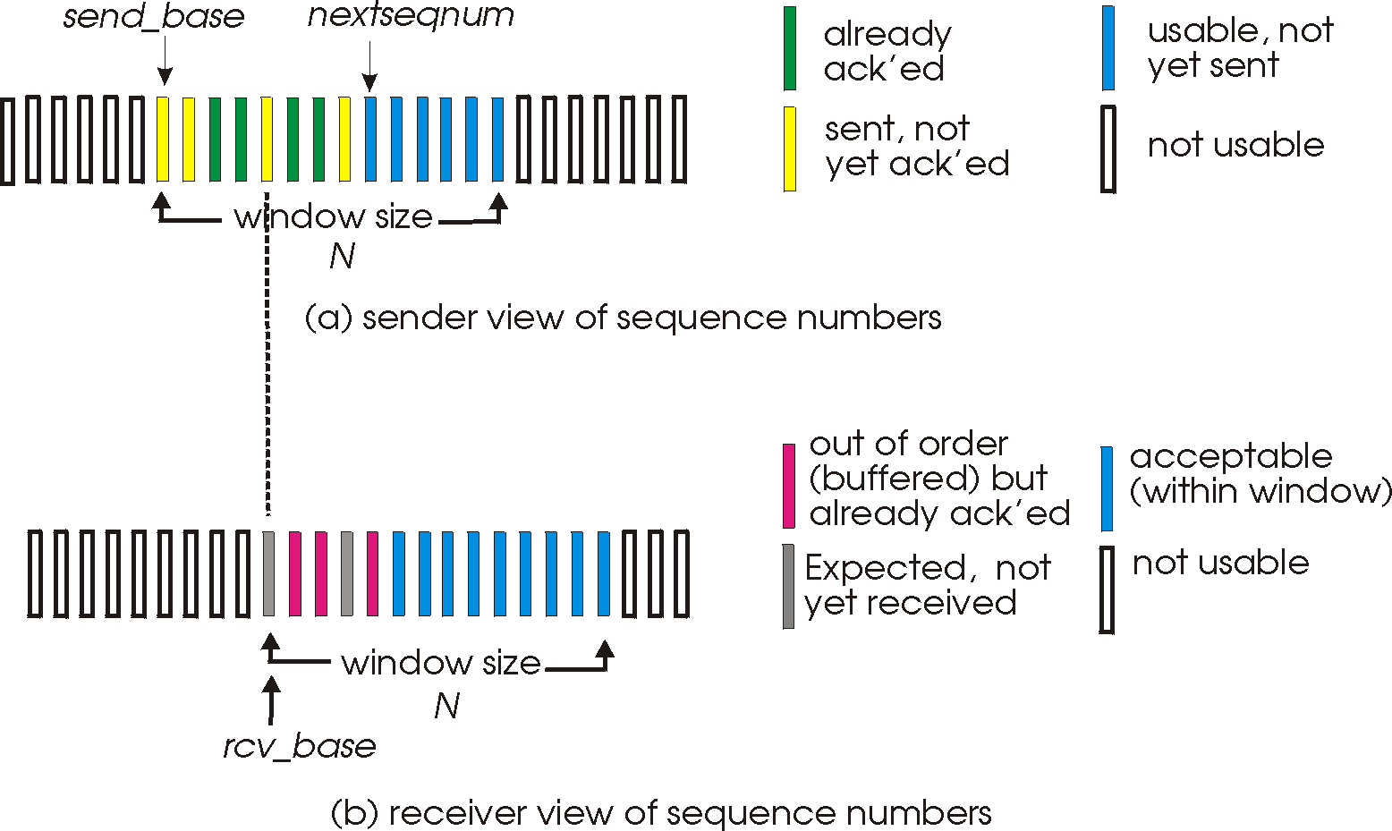
Selective repeat: sender, receiver windows
In sender’s window, there should have been one more “sent” packet at the far right

Slide 19
Selective repeat
sender
receiver
data from above:
if next available seq # in window, send pkt
timeout(n):
resend pkt n, restart timer
ACK(n) in [sendbase,sendbase+N]:
mark pkt n as received
if n smallest unACKed pkt, advance window base to next unACKed seq #
pkt n in [rcvbase, rcvbase+N-1]
send ACK(n)
out-of-order: buffer
in-order: deliver (also deliver buffered, in-order pkts), advance window to next not-yet-received pkt
pkt n in [rcvbase-N,rcvbase-1]
ACK(n)
otherwise:
ignore

Slide 20
Selective repeat in action
sender window (N=4)
sender
receiver
0 1 2 3 4 5 6 7 8
send pkt0
send pkt1
send pkt2
send pkt3
(wait)
0 1 2 3 4 5 6 7 8
receive pkt0, send ack0
receive pkt1, send ack1
receive pkt3, buffer,
send ack3
0 1 2 3 4 5 6 7 8
X
0 1 2 3 4 5 6 7 8
loss
0 1 2 3 4 5 6 7 8
rcv ack0, send pkt4
rcv ack1, send pkt5
0 1 2 3 4 5 6 7 8
receive pkt4, buffer,
send ack4
record ack3 arrived
receive pkt5, buffer,
send ack5
pkt 2 timeout
0 1 2 3 4 5 6 7 8
send pkt2
0 1 2 3 4 5 6 7 8
record ack4 arrived
0 1 2 3 4 5 6 7 8
rcv pkt2; deliver pkt2,
pkt3, pkt4, pkt5; send ack2
record ack4 arrived
0 1 2 3 4 5 6 7 8
Q: what happens when ack2 arrives?

Slide 21
Selective repeat: dilemma
sender window
(after receipt)
receiver window
(after receipt)
0 1 2 3 0 1 2
pkt0
0 1 2 3 0 1 2
pkt1
0 1 2 3 0 1 2
example:
seq #’s: 0, 1, 2, 3
window size=3
0 1 2 3 0 1 2
pkt2
0 1 2 3 0 1 2
0 1 2 3 0 1 2
0 1 2 3 0 1 2
pkt3
X
0 1 2 3 0 1 2
pkt0
will accept packet
with seq number 0
receiver sees no difference in two scenarios!
duplicate data accepted as new in (b)
Q: what relationship between seq # size and window size to avoid problem in (b)?
(a) no problem
receiver can’t see sender side.
receiver behavior identical in both cases!
something’s (very) wrong!
0 1 2 3 0 1 2
pkt0
0 1 2 3 0 1 2
pkt1
0 1 2 3 0 1 2
0 1 2 3 0 1 2
pkt2
0 1 2 3 0 1 2
X
0 1 2 3 0 1 2
X
timeout
retransmit pkt0
X
0 1 2 3 0 1 2
pkt0
will accept packet
with seq number 0
(b) oops!

Slide 22
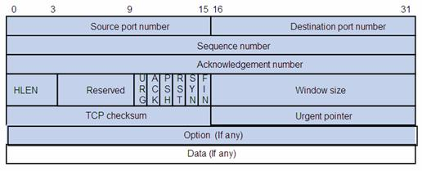
TCP packet format
TCP header:
http://en.wikipedia.org/wiki/Transmission_Control_Protocol
http://www.ietf.org/rfc/rfc793.txt

