Slide 1
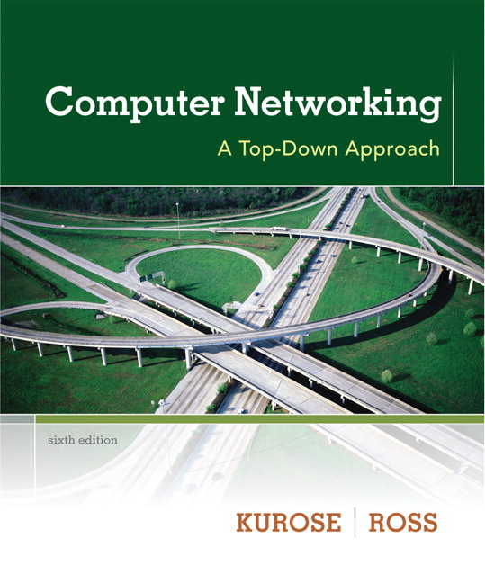
Chapter 3 Transport Layer
A note on the use of these ppt slides:
We’re making these slides freely available to all (faculty, students, readers). They’re in PowerPoint form so you see the animations; and can add, modify, and delete slides (including this one) and slide content to suit your needs. They obviously represent a lot of work on our part. In return for use, we only ask the following:
Computer Networking: A Top Down Approach 6th edition Jim Kurose, Keith Ross Addison-Wesley March 2012
If you use these slides (e.g., in a class) that you mention their source (after all, we’d like people to use our book!)
If you post any slides on a www site, that you note that they are adapted from (or perhaps identical to) our slides, and note our copyright of this material.
Thanks and enjoy! JFK/KWR
All material copyright 1996-2012
J.F Kurose and K.W. Ross, All Rights Reserved
The course notes are adapted for Bucknell’s CSCI 363
Xiannong Meng
Spring 2016

Slide 2
Chapter 3 outline
3.1 transport-layer services
3.2 multiplexing and demultiplexing
3.3 connectionless transport: UDP
3.4 principles of reliable data transfer
3.5 connection-oriented transport: TCP
segment structure
reliable data transfer
flow control
connection management
3.6 principles of congestion control
3.7 TCP congestion control

Slide 3
Principles of congestion control
congestion:
informally: “too many sources sending too much data too fast for network to handle”
different from flow control!
flow control: between hosts
congestion control: hosts and network
manifestations:
lost packets (buffer overflow at routers)
long delays (queueing in router buffers)
a top-10 problem!

Slide 4
Causes/costs of congestion: scenario 1
original data: λ_{in}
throughput: λ_{out}
two senders, two receivers
one router, infinite buffers
output link capacity: R
no retransmission
Host A
unlimited shared output link buffers
Host B
R/2
λ_{out}
delay
λ_{in}
R/2
λ_{in}
R/2
maximum per-connection throughput: R/2
large delays as arrival rate, λ_{in}, approaches capacity

Slide 5
Causes/costs of congestion: scenario 2
one router, finite buffers
sender retransmission of timed-out packet
application-layer input = application-layer output: λ_{in} = λ_{out}
transport-layer input includes retransmissions : λ∗_{in} >= λ_{in}
λ_{in} : original data
λ*_{in}: original data, plus retransmitted data
λ_{out}
Host A
finite shared output link buffers
Host B

Slide 6
Causes/costs of congestion: scenario 2
R/2
idealization: perfect knowledge
sender sends only when router buffers available
λ_{out}
λ_{in}
R/2
λ_{in} : original data
copy
λ'_{in}: original data, plus retransmitted data
λ_{out}
A
free buffer space!
finite shared output link buffers
Host B

Slide 7
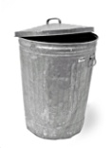
Causes/costs of congestion: scenario 2
Idealization: known loss packets can be lost, dropped at router due to full buffers
sender only resends if packet known to be lost
λ_{in} : original data
copy
λ'_{in}: original data, plus retransmitted data
λ_{out}
A
no buffer space!
Host B

Slide 8
Causes/costs of congestion: scenario 2
Idealization: known loss packets can be lost, dropped at router due to full buffers
sender only resends if packet known to be lost
R/2
when sending at R/2, some packets are retransmissions but asymptotic goodput is still R/2 (why?)
λ_{out}
λ_{in}
R/2
λ_{in} : original data
λ'_{in}: original data, plus retransmitted data
λ_{out}
A
free buffer space!
Host B

Slide 9
Causes/costs of congestion: scenario 2
Realistic: duplicates
packets can be lost, dropped at router due to full buffers
sender times out prematurely, sending two copies, both of which are delivered
R/2
when sending at R/2, some packets are retransmissions including duplicated that are delivered!
λ_{out}
λ_{in}
R/2
λ_{in}
copy
λ'_{in}
λ_{out}
timeout
A
free buffer space!
Host B

Slide 10
Causes/costs of congestion: scenario 2
Realistic: duplicates
packets can be lost, dropped at router due to full buffers
sender times out prematurely, sending two copies, both of which are delivered
R/2
when sending at R/2, some packets are retransmissions including duplicated that are delivered!
λ_{out}
λ_{in}
R/2
“costs” of congestion:
more work (retrans) for given “goodput”
unneeded retransmissions: link carries multiple copies of pkt
decreasing goodput

Slide 11
Causes/costs of congestion: scenario 3
Q: what happens as λ_{in} and λ_{in}’ increase ?
four senders
multihop paths
timeout/retransmit
A: as red λ_{in}’ increases, all arriving blue pkts at upper queue are dropped, blue throughput g 0
Host A
λ_{in} : original data
λ_{out}
Host B
λ'_{in}: original data, plus retransmitted data
finite shared output link buffers
Host D
Host C

Slide 12
Causes/costs of congestion: scenario 3
C/2
λ_{out}
λ_{in}’
C/2
another “cost” of congestion:
when packet dropped, any “upstream” transmission capacity used for that packet was wasted!

Slide 13
Approaches towards congestion control
two broad approaches towards congestion control:
end-end congestion control:
no explicit feedback from network
congestion inferred from end-system observed loss, delay
approach taken by TCP
network-assisted congestion control:
routers provide feedback to end systems
single bit indicating congestion (SNA, DECbit, TCP/IP ECN, ATM)
explicit rate for sender to send at

Slide 14
Chapter 3 outline
3.1 transport-layer services
3.2 multiplexing and demultiplexing
3.3 connectionless transport: UDP
3.4 principles of reliable data transfer
3.5 connection-oriented transport: TCP
segment structure
reliable data transfer
flow control
connection management
3.6 principles of congestion control
3.7 TCP congestion control

Slide 15
TCP congestion control: additive increase multiplicative decrease
approach: sender increases transmission rate (window size), probing for usable bandwidth, until loss occurs
additive increase: increase cwnd by 1 MSS every RTT until loss detected
multiplicative decrease: cut cwnd in half after loss
additively increase window size …
…. until loss occurs (then cut window in half)
AIMD saw tooth
behavior: probing
for bandwidth
cwnd: TCP sender
congestion window size
time

Slide 16
TCP Congestion Control: details
sender sequence number space
TCP sending rate:
roughly: send cwnd bytes, wait RTT for ACKS, then send more bytes
cwnd
last byte
ACKed
last byte sent
sent, not-yet ACKed
(“in-flight”)
rate
cwnd
sender limits transmission:
cwnd is dynamic, function of perceived network congestion
~
bytes/sec
~
RTT
LastByteSent-
LastByteAcked
cwnd
<

Slide 17
TCP Slow Start
Host A
Host B
when connection begins, increase rate exponentially until first loss event:
initially cwnd = 1 MSS
double cwnd every RTT
done by incrementing cwnd for every ACK received
summary: initial rate is slow but ramps up exponentially fast
one segment
RTT
two segments
four segments
time

Slide 18
TCP: detecting, reacting to loss
loss indicated by timeout:
cwnd set to 1 MSS;
window then grows exponentially (as in slow start) to threshold, then grows linearly
loss indicated by 3 duplicate ACKs: TCP RENO
recv’d ACKs indicate network capable of delivering some segments
cwnd is cut in half window then grows linearly
TCP Tahoe (Van Jacobson1988) always sets cwnd to 1 (timeout or 3 duplicate acks)

Slide 19
Tahoe, Reno, and Vegas
TCP Tahoe (~1988 Van Jacobson): BSD Unix 4.3, a.k.a. BSD Network Release 1.0 (BNR1), additive increase and multiplicative decrease, slow start, no fast retransmission
TCP Reno (~1990?): BNR2, BNR1 plus fast retransmission, header prediction (fast path for pure ACKs and in-order packets), delayed ACKs
TCP Vegas (~1994 Brakmo, O’Malley, and Peterson): varying congestion window size w between a and b, based on diff = (expected – sample) rate of transmission. If diff < a (more capacity available), increase w by one, if diff > b (showing congestion), decrease w by one

Slide 20
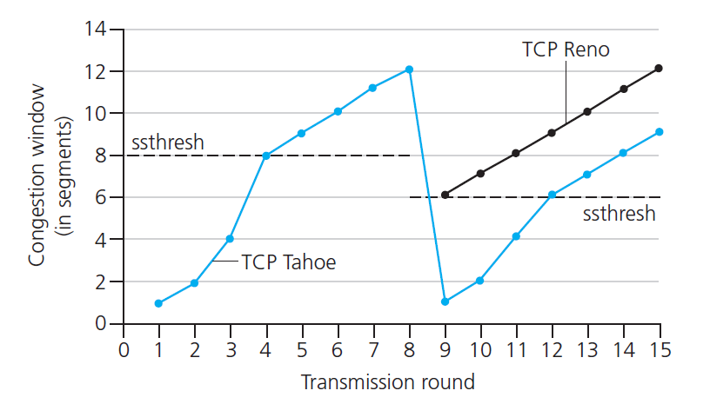
TCP: switching from slow start to CA
Q: when should the exponential increase switch to linear?
A: when cwnd gets to 1/2 of its value before timeout.
Implementation:
variable ssthresh
on loss event, ssthresh is set to 1/2 of cwnd just before loss event
For metrics such as cwnd and ssthresh, check out the structures in /usr/include/netinet/tcp.h

Slide 21
Summary: TCP Congestion Control
New
ACK!
New
ACK!
.
duplicate ACK
new ACK
dupACKcount++
new ACK
cwnd = cwnd + MSS (MSS/cwnd)
dupACKcount = 0
transmit new segment(s), as allowed
cwnd = cwnd+MSS
dupACKcount = 0
transmit new segment(s), as allowed
Λ
cwnd = 1 MSS
ssthresh = 64 KB
dupACKcount = 0
cwnd > ssthresh
slow
start
Λ
congestion
avoidance
timeout
ssthresh = cwnd/2
cwnd = 1 MSS
dupACKcount = 0
retransmit missing segment
duplicate ACK
timeout
dupACKcount++
ssthresh = cwnd/2
cwnd = 1 MSS
dupACKcount = 0
retransmit missing segment
timeout
New
ACK!
ssthresh = cwnd/2
cwnd = 1
dupACKcount = 0
retransmit missing segment
New ACK
dupACKcount == 3
cwnd = ssthresh
dupACKcount = 0
dupACKcount == 3
ssthresh= cwnd/2
cwnd = ssthresh + 3
retransmit missing segment
ssthresh= cwnd/2
cwnd = ssthresh + 3
retransmit missing segment
fast
recovery
duplicate ACK
cwnd = cwnd + MSS
transmit new segment(s), as allowed

Slide 22
TCP throughput
avg. TCP thruput as function of window size, RTT?
ignore slow start, assume always data to send
W: window size (measured in bytes) where loss occurs
avg. window size (# in-flight bytes) is ¾ W
avg. thruput is 3/4W per RTT
avg TCP thruput =
3
W
4
RTT
bytes/sec
W
W/2

Slide 23
TCP Futures: TCP over “long, fat pipes”
example: 1500 byte segments, 100ms RTT, want 10 Gbps throughput (1500 bytes = 12,000 bits seg, 100 ms can carry 83,333 segments at 10Gbps)
requires W = 83,333 in-flight segments
throughput in terms of segment loss probability, L [Mathis 1997]:
➜ to achieve 10 Gbps throughput, need a loss rate of L = 2·10⁻¹⁰ – a very small loss rate!
these observations led to new versions of TCP for high-speed [Jin 2004; RFC 3649; Kelly 2003; Ha 2008].
1.22
.
MSS
TCP throughput =
RTT
L

Slide 24
TCP Fairness
fairness goal: if K TCP sessions share same bottleneck link of bandwidth R, each should have average rate of R/K
TCP connection 1
bottleneck
router
capacity R
TCP connection 2

Slide 25
Why is TCP fair?
two competing sessions:
additive increase gives slope of 1, as throughout increases
multiplicative decrease decreases throughput proportionally
R
equal bandwidth share
loss: decrease window by factor of 2
congestion avoidance: additive increase
Connection 2 throughput
loss: decrease window by factor of 2
congestion avoidance: additive increase
Connection 1 throughput
R

Slide 26
Fairness (more)
Fairness and UDP
multimedia apps often do not use TCP
do not want rate throttled by congestion control
instead use UDP:
send audio/video at constant rate, tolerate packet loss
Fairness, parallel TCP connections
application can open multiple parallel connections between two hosts
web browsers do this
e.g., link of rate R with 9 existing connections:
new app asks for 1 TCP, gets rate R/10
new app asks for 9 TCPs, gets R/2

Slide 27
Examine some source code
Linux 2.6 implementation of TCP congestion control:
http://lxr.free-electrons.com/source/net/ipv4/tcp_cong.c
Look for
snd_cwnd
tcp_slow_start
tcp_cong_avoid_ai
tcp_reno_cong_avoid

Slide 28
Chapter 3: summary
principles behind transport layer services:
multiplexing, demultiplexing
reliable data transfer
flow control
congestion control
instantiation, implementation in the Internet
UDP
TCP
next:
leaving the network “edge” (application, transport layers)
into the network “core”

