Slide 1
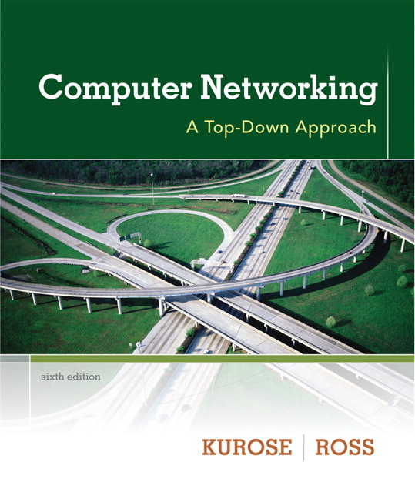
Chapter 4 Network Layer
A note on the use of these ppt slides:
We’re making these slides freely available to all (faculty, students, readers). They’re in PowerPoint form so you see the animations; and can add, modify, and delete slides (including this one) and slide content to suit your needs. They obviously represent a lot of work on our part. In return for use, we only ask the following:
Computer Networking: A Top Down Approach 6th edition Jim Kurose, Keith Ross Addison-Wesley March 2012
If you use these slides (e.g., in a class) that you mention their source (after all, we’d like people to use our book!)
If you post any slides on a www site, that you note that they are adapted from (or perhaps identical to) our slides, and note our copyright of this material.
Thanks and enjoy! JFK/KWR
All material copyright 1996-2012
J.F Kurose and K.W. Ross, All Rights Reserved
The course notes are adapted for Bucknell’s CSCI 363
Xiannong Meng
Spring 2016

Slide 2
Chapter 4: outline
4.1 introduction
4.2 virtual circuit and datagram networks
4.3 what’s inside a router
4.4 IP: Internet Protocol
datagram format
IPv4 addressing
ICMP
IPv6
4.5 routing algorithms
link state
distance vector
hierarchical routing
4.6 routing in the Internet
RIP
OSPF
BGP
4.7 broadcast and multicast routing

Slide 3
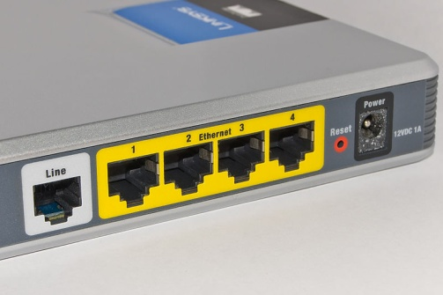
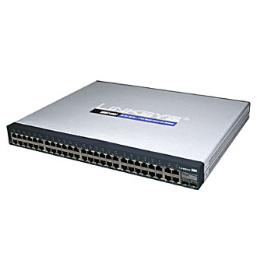
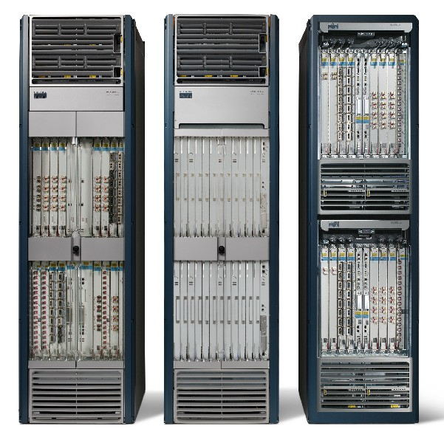
Some examples of switchers, routers, and bridge
Back of a typical home router
(Wikipedia)
Linksys 48 port switch
(Wikipedia)
Cisco CRS-1 Core Router
(Wikipedia)

Slide 4
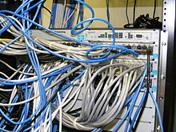
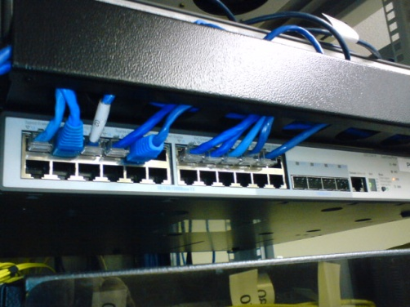
Avaya ERS 2550T-PWR 50-port network switch
(Wikipedia)
HP Procurve rack-mounted switches
mounted in a standard Telco Rack
19-inch rack with network cables
(Wikipedia)
Rack-mounted 24-port 3Com switch
(Wikipedia)

Slide 5
Router architecture overview
two key router functions:
run routing algorithms/protocol (RIP, OSPF, BGP)
forwarding datagrams from incoming to outgoing link
forwarding tables computed,
pushed to input ports
routing
processor
routing, management
control plane (software)
forwarding data plane (hardware)
high-seed
switching
fabric
router input ports
router output ports

Slide 6
Input port functions
lookup,
forwarding
queueing
line
termination
link
layer
protocol
(receive)
switch
fabric
physical layer:
bit-level reception
data link layer:
e.g., Ethernet
see chapter 5
decentralized switching:
given datagram dest., lookup output port using forwarding table in input port memory (“match plus action”)
goal: complete input port processing at ‘line speed’
queuing: if datagrams arrive faster than forwarding rate into switch fabric

Slide 7
Switching fabrics
transfer packet from input buffer to appropriate output buffer
switching rate: rate at which packets can be transfer from inputs to outputs
often measured as multiple of input/output line rate
N inputs: switching rate N times line rate desirable
three types of switching fabrics
memory
memory
bus
crossbar

Slide 8
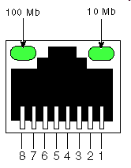
Switching via memory
first generation routers:
traditional computers with switching under direct control of CPU
packet copied to system’s memory
speed limited by memory bandwidth (2 bus crossings per datagram)
input
port
(e.g.,
Ethernet)
output
port
(e.g.,
Ethernet)
memory
system bus

Slide 9
Switching via a bus
datagram from input port memory
to output port memory via a shared bus
bus contention: switching speed limited by bus bandwidth
32 Gbps bus, Cisco 5600: sufficient speed for access and enterprise routers
bus

Slide 10
Switching via interconnection network
overcome bus bandwidth limitations
banyan networks, crossbar, other interconnection nets initially developed to connect processors in multiprocessor
advanced design: fragmenting datagram into fixed length cells, switch cells through the fabric.
Cisco 12000: switches 60 Gbps through the interconnection network
crossbar

Slide 11
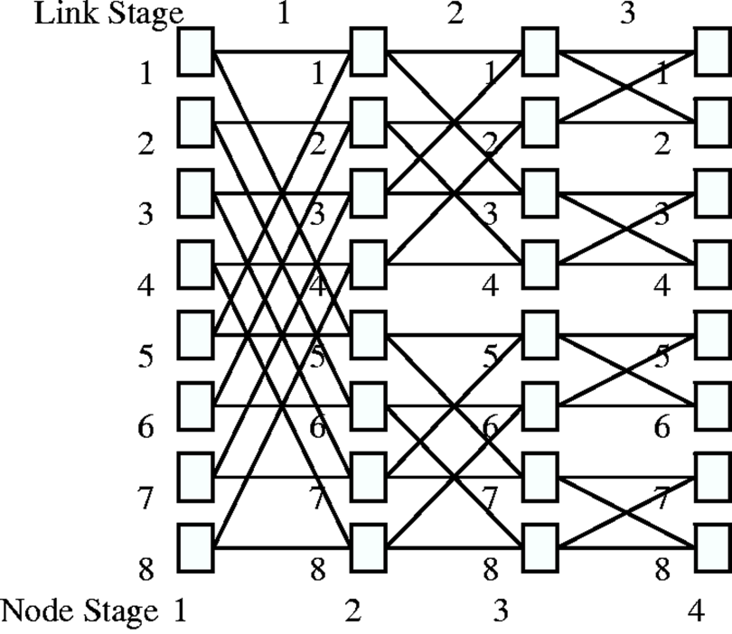
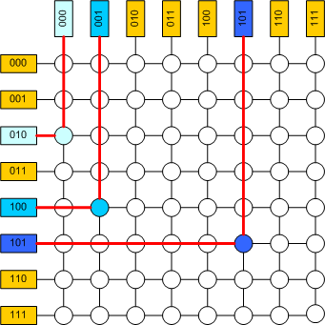
A 3-stage Banyan network switch logic
(n/2 log n) switching elements. In the
diagram, each node is a 2x2 switch. This
is a 16x16 switch (16 inputs and 16 outputs,
8 nodes, each with 2 inputs and 2 outputs.)
Images from Google
A cross-bar network switch logic
(nxn switching elements)

Slide 12
Output ports
datagram
buffer
queueing
switch
fabric
link
layer
protocol
(send)
line
termination
buffering required when datagrams arrive from fabric faster than the transmission rate
scheduling discipline chooses among queued datagrams for transmission

Slide 13
Output port queueing
switch
fabric
switch
fabric
at t, packets move
from input to output
one packet time later
buffering when arrival rate via switch exceeds output line speed
queueing (delay) and loss due to output port buffer overflow!

Slide 14
How much buffering?
RFC 3439 (December 2002) rule of thumb: average buffering equal to “typical” RTT (say 250 msec) times link capacity C (RTT * C)
e.g., C = 10 Gpbs link: 2.5 Gbit buffer
more recent (2004) recommendation: with N flows, buffering equal to
.
RTT C
N
http://yuba.stanford.edu/~nickm/papers/guido_buffer.pdf

Slide 15
Input port queuing
fabric slower than input ports combined -> queueing may occur at input queues
queueing delay and loss due to input buffer overflow!
Head-of-the-Line (HOL) blocking: queued datagram at front of queue prevents others in queue from moving forward
switch
fabric
switch
fabric
output port contention:
only one red datagram can be transferred. lower red packet is blocked
one packet time later: green packet experiences HOL blocking

Slide 16
Queues, queues, and queues
The theory of queuing has significant applications and impact on the internet.
One of the pioneers of the internet, Leonard Kleinrock, is also known for his queuing systems book
Kleinrock is a computer science professor at UCLA
http://www.lk.cs.ucla.edu/index.html
Queuing systems books
http://www.amazon.com/Queueing-Systems-Volume-1-Theory/dp/0471491101

Slide 17
Names, names, names
The naming of switchers, routers, and bridges can be confusing. In general, a switch implies that some or all ports have dedicated circuits; a router can forward traffic from input to output following certain algorithms (similar to switch) where ports may share circuits; a bridge interconnects different networks, some of which may run different protocols.
A device can be called a switch, a router, a routing switch, a bridge, or the like

Slide 18
Devices with different protocol layers
Switches can run at different protocol layers
Layer 2 switches use data link layer protocol (e.g., Ethernet)
Layer 3 switches run network protocols (e.g., IPv4)
Routers typically run at data link layer (layer 2)
More specifics to come

