Slide 1
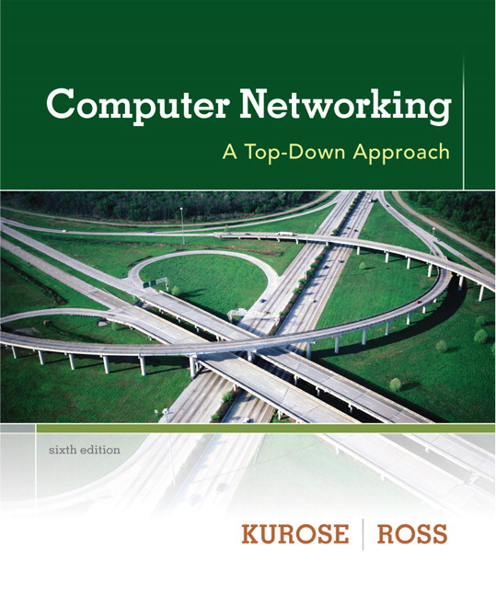
Chapter 4 Network Layer
A note on the use of these ppt slides:
We’re making these slides freely available to all (faculty, students, readers). They’re in PowerPoint form so you see the animations; and can add, modify, and delete slides (including this one) and slide content to suit your needs. They obviously represent a lot of work on our part. In return for use, we only ask the following:
Computer Networking: A Top Down Approach 6th edition Jim Kurose, Keith Ross Addison-Wesley March 2012
If you use these slides (e.g., in a class) that you mention their source (after all, we’d like people to use our book!)
If you post any slides on a www site, that you note that they are adapted from (or perhaps identical to) our slides, and note our copyright of this material.
Thanks and enjoy! JFK/KWR
All material copyright 1996-2012
J.F Kurose and K.W. Ross, All Rights Reserved
The course notes are adapted for Bucknell’s CSCI 363
Xiannong Meng
Spring 2016

Slide 2
Chapter 4: outline
4.1 introduction
4.2 virtual circuit and datagram networks
4.3 what’s inside a router
4.4 IP: Internet Protocol
datagram format
IPv4 addressing
ICMP
IPv6
4.5 routing algorithms
link state
distance vector
hierarchical routing
4.6 routing in the Internet
RIP
OSPF
BGP
4.7 broadcast and multicast routing

Slide 3
Distance vector algorithm
Bellman-Ford equation (dynamic programming)
let
d_{x}(y) := cost of least-cost path from x to y
then
d_{x}(y) = min {c(x,v) + d_{v}(y) }
v
cost from neighbor v to destination y
cost to neighbor v
min taken over all neighbors v of x

Slide 4
Bellman-Ford example
Assume we have computed,
d_{v}(z) = 5, d_{x}(z) = 3, d_{w}(z) = 3
5
v
3
w
2
5
u
z
B-F equation says:
2
1
3
1
2
d_{u}(z) = min { c(u,v) + d_{v}(z),
c(u,x) + d_{x}(z),
c(u,w) + d_{w}(z) }
= min {2 + 5,
1 + 3,
5 + 3} = 4
x
y
1
node achieving minimum (in our case, x) is next
hop in shortest path, used in forwarding table

Slide 5
Distance vector algorithm
D_{x}(y) = estimate of least cost from x to y
x maintains distance vector D_{x} = [D_{x}(y): y є N ]
node x:
knows cost to each neighbor v: c(x,v)
maintains its neighbors’ distance vectors. For each neighbor v, x maintains D_{v} = [D_{v}(y): y є N ]

Slide 6
Distance vector algorithm
key idea:
from time-to-time, each node sends its own distance vector estimate to neighbors
when x receives new DV estimate from neighbor, it updates its own DV using B-F equation:
D_{x}(y) ← min_{v}{c(x,v) + D_{v}(y)} for each node y ∊ N
under minor, natural conditions, the estimate D_{x}(y) converge to the actual least cost d_{x}(y)

Slide 7
Distance vector algorithm
iterative, asynchronous: each local iteration caused by:
local link cost change
DV update message from neighbor
distributed:
each node notifies neighbors only when its DV changes
neighbors then notify their neighbors if necessary
each node:
wait for (change in local link cost or msg from neighbor)
recompute estimates
if DV to any dest has changed, notify neighbors

Slide 8
D_{x}(z) = min{c(x,y) + D_{y}(z), c(x,z) + D_{z}(z)}
= min{2+1 , 7+0} = 3
D_{x}(y) = min{c(x,y) + D_{y}(y), c(x,z) + D_{z}(y)} = min{2+0 , 7+1} = 2
node x
table
cost to
cost to
x y z
x y z
x
0 2 7
x
0
2
3
y
y
2 0 1
from
∞
∞
∞
from
z
∞
∞
∞
z
7 1 0
node y
table
cost to
x y z
y
2
1
x
∞
∞
z
∞
2 0 1
x
from
y
7
z
∞
∞
∞
node z
table
cost to
x y z
x
∞ ∞ ∞
from
y
∞
∞
∞
z
7
1
0
time

Slide 9
D_{x}(z) = min{c(x,y) + D_{y}(z), c(x,z) + D_{z}(z)}
= min{2+1 , 7+0} = 3
D_{x}(y) = min{c(x,y) + D_{y}(y), c(x,z) + D_{z}(y)} = min{2+0 , 7+1} = 2
node x
table
cost to
cost to
cost to
x y z
x y z
x y z
x
0 2 7
x
0
2
3
x
0 2 3
y
y
2 0 1
from
∞
∞
∞
from
y
2 0 1
z
z
from
∞
∞
∞
7 1 0
z
3 1 0
node y
table
cost to
cost to
cost to
x y z
x y z
x y z
y
2
1
x
∞
∞
x
0 2 7
∞
2 0 1
x
0 2 3
x
z
from
y
y
2 0 1
y
7
from
from
2 0 1
z
∞
∞
∞
z
7 1 0
z
3 1 0
node z
table
cost to
cost to
cost to
x y z
x y z
x y z
x
∞ ∞ ∞
x
0 2 7
x
0 2 3
y
y
2 0 1
from
y
∞
∞
from
2 0 1
from
∞
z
z
3 1 0
z
3 1 0
7
1
0
time
time

Slide 10
Distance vector: link cost changes
link cost changes:
node detects local link cost change
updates routing info, recalculates distance vector
if DV changes, notify neighbors
1
y
4
1
x
z
50
“good
news
travels
fast”
t₀ : y detects link-cost change, updates its DV, informs its neighbors.
t₁ : z receives update from y, updates its table, computes new least cost to x , sends its neighbors its DV.
t₂ : y receives z’s update, updates its distance table. y’s least costs do not change, so y does not send a message to z.

Slide 11
Distance vector: link cost changes
link cost changes:
node detects local link cost change
bad news travels slow - “count to infinity” problem, e.g., c(x,y) is changed from 4 to 60
Initially, D_{y}(x) = 4, D_{z}(x) = 5, so next update leads to D_{y}(x) = 6, D_{z}(x) = 7, next, D_{y}(x) = 8, D_{z}(x) = 9, …
60
y
4
1
x
z
50
the “count-to-infinity problem”
poisoned reverse:
If Z routes through Y to get to X :
Z tells Y its (Z’s) distance to X is infinite (so Y won’t route to X via Z)
will this completely solve count to infinity problem?

Slide 12
Other means to tackle count-to-infinity
Split-horizon: if a node X learns the route to Y through Z, the X should not be part of the advertising to node Z to reach Y.
Hold-down timer: a router starts a hold-down-timer when new routing information is available. It doesn’t update its own routing information until the timer expires.
https://www.techopedia.com/definition/14850/split-horizon
https://www.techopedia.com/definition/25073/hold-down-timer

Slide 13
Comparison of LS and DV algorithms
message complexity
LS: with n nodes, E links, O(nE) msgs sent
DV: exchange between neighbors only
convergence time varies
speed of convergence
LS: O(n²) algorithm requires O(nE) msgs
may have oscillations
DV: convergence time varies
may be routing loops
count-to-infinity problem
robustness: what happens if router malfunctions?
LS:
node can advertise incorrect link cost
each node computes only its own table
DV:
DV node can advertise incorrect path cost
each node’s table used by others
error propagate thru network

Slide 14
Chapter 4: outline
4.1 introduction
4.2 virtual circuit and datagram networks
4.3 what’s inside a router
4.4 IP: Internet Protocol
datagram format
IPv4 addressing
ICMP
IPv6
4.5 routing algorithms
link state
distance vector
hierarchical routing
4.6 routing in the Internet
RIP
OSPF
BGP
4.7 broadcast and multicast routing

Slide 15
Hierarchical routing
our routing study thus far - idealization
all routers identical
network “flat”
… not true in practice
scale: with 600 million destinations:
can’t store all dest’s in routing tables!
routing table exchange would swamp links!
administrative autonomy
internet = network of networks
each network admin may want to control routing in its own network

Slide 16
Hierarchical routing
aggregate routers into regions, “autonomous systems” (AS)
routers in same AS run same routing protocol
“intra-AS” routing protocol
routers in different AS can run different intra-AS routing protocol
gateway router:
at “edge” of its own AS
has link to router in another AS

Slide 17
Interconnected ASes
3c
3a
2c
3b
AS3
2a
1c
2b
AS2
1a
1b
1d
AS1
forwarding table configured by both intra- and inter-AS routing algorithm
intra-AS sets entries for internal dests
inter-AS & intra-AS sets entries for external dests
Intra-AS
Routing
algorithm
Inter-AS
Routing
algorithm
Forwarding
table

Slide 18
Inter-AS tasks
suppose router in AS1 receives datagram destined outside of AS1:
router should forward packet to gateway router, but which one?
AS1 must:
learn which dests are reachable through AS2, which through AS3
propagate this reachability info to all routers in AS1
job of inter-AS routing!
3c
3a
3b
AS3
2c
other
networks
1c
2a
other
networks
1a
2b
1b
AS2
AS1
1d

Slide 19
Example: setting forwarding table in router 1d
suppose AS1 learns (via inter-AS protocol) that subnet x reachable via AS3 (gateway 1c), but not via AS2
inter-AS protocol propagates reachability info to all internal routers
router 1d, which has three out-going links (1 for c, 2 for a,3 for b), determines from intra-AS routing info that its interface I is on the least cost path to 1c
installs forwarding table entry (x,I)
…
x
3c
3a
3b
AS3
2c
other
networks
1c
2a
other
networks
1a
2b
1b
AS2
AS1
1d

Slide 20
Example: choosing among multiple ASes
now suppose AS1 learns from inter-AS protocol that subnet x is reachable from AS3 and from AS2.
it is the job of inter-AS routing protocol to determine which gateway it should forward packets towards for dest x
…
x
3c
……
3a
3b
AS3
2c
other
networks
1c
2a
other
networks
1a
2b
1b
AS2
AS1
1d
?

Slide 21
Example: choosing among multiple ASes
in the presence of multiple ASes to reach a destination, to configure forwarding table, router 1d must determine towards which gateway it should forward packets for dest x
hot potato routing: send packet towards closest of two routers. (closest → smallest cost)
use routing info
from intra-AS
protocol to determine
costs of least-cost
paths to each
of the gateways
determine from
forwarding table the
interface I that leads
to least-cost gateway.
Enter (x,I) in
forwarding table
learn from inter-AS
protocol that subnet
x is reachable via
multiple gateways
hot potato routing:
choose the gateway
that has the least cost

