Slide 1
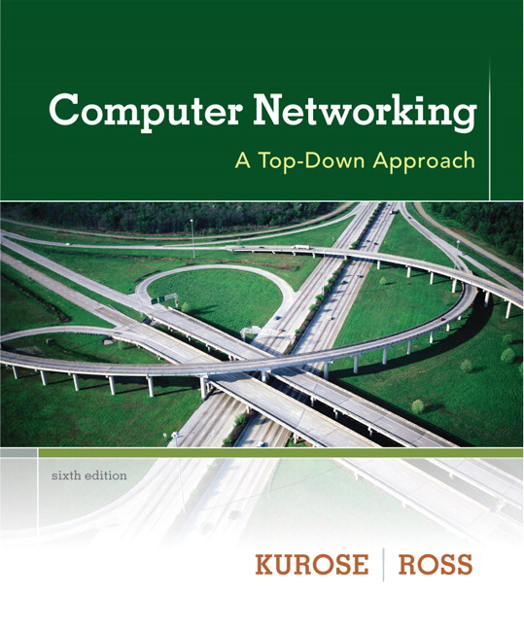
Chapter 4 Network Layer
A note on the use of these ppt slides:
We’re making these slides freely available to all (faculty, students, readers). They’re in PowerPoint form so you see the animations; and can add, modify, and delete slides (including this one) and slide content to suit your needs. They obviously represent a lot of work on our part. In return for use, we only ask the following:
Computer Networking: A Top Down Approach 6th edition Jim Kurose, Keith Ross Addison-Wesley March 2012
If you use these slides (e.g., in a class) that you mention their source (after all, we’d like people to use our book!)
If you post any slides on a www site, that you note that they are adapted from (or perhaps identical to) our slides, and note our copyright of this material.
Thanks and enjoy! JFK/KWR
All material copyright 1996-2012
J.F Kurose and K.W. Ross, All Rights Reserved
The course notes are adapted for Bucknell’s CSCI 363
Xiannong Meng
Spring 2016

Slide 2
Chapter 4: outline
4.1 introduction
4.2 virtual circuit and datagram networks
4.3 what’s inside a router
4.4 IP: Internet Protocol
datagram format
IPv4 addressing
ICMP
IPv6
4.5 routing algorithms
link state
distance vector
hierarchical routing
4.6 routing in the Internet
RIP
OSPF
BGP
4.7 broadcast and multicast routing

Slide 3
Broadcast routing
deliver packets from source to all other nodes
source duplication is inefficient:
duplicate
duplicate
creation/transmission
R1
R1
duplicate
R2
R2
R3
R4
R3
R4
source duplication
in-network
duplication
source duplication: how does source determine recipient addresses?

Slide 4
In-network duplication
flooding: when node receives broadcast packet, sends copy to all neighbors
problems: cycles & broadcast storm
controlled flooding: node only broadcasts pkt if it hasn’t broadcast same packet before
node keeps track of packet ids already broadacsted
or reverse path forwarding (RPF): only forward packet if it arrived on shortest path between node and source
spanning tree:
no redundant packets received by any node

Slide 5
Spanning tree
first construct a spanning tree
nodes then forward/make copies only along spanning tree
A
A
B
B
c
c
D
D
F
E
F
E
G
G
(a) broadcast initiated at A
(b) broadcast initiated at D

Slide 6
Spanning tree: creation
center node
each node sends unicast join message to center node
message forwarded until it arrives at a node already belonging to spanning tree
A
A
3
B
B
c
c
4
2
D
D
F
E
F
E
1
5
G
G
stepwise construction of spanning tree (center: E)
(b) constructed spanning tree

Slide 7
Multicast routing: problem statement
goal: find a tree (or trees) connecting routers having local mcast group members
tree: not all paths between routers used
shared-tree: same tree used by all group members
legend
group
member
source-based: different tree from each sender to rcvrs
not group
member
router
with a
group
member
router
without
group
member
shared tree
source-based trees
Notes:
Notes:
3.3 Network Layer: Multicast Routing Algorithms 3-9

Slide 8
Approaches for building mcast trees
approaches:
source-based tree: one tree per source
shortest path trees
reverse path forwarding
group-shared tree: group uses one tree
minimal spanning (Steiner)
center-based trees
…we first look at basic approaches, then specific protocols adopting these approaches
Notes:
Notes:
3.3 Network Layer: Multicast Routing Algorithms 3-11

Slide 9
Shortest path tree
mcast forwarding tree: tree of shortest path routes from source to all receivers
Dijkstra’s algorithm
s: source
LEGEND
R1
2
router with attached
group member
1
R4
R2
5
router with no attached
group member
3
4
R5
6
i
link used for forwarding,
i indicates order link
added by algorithm
R3
R6
R7
Notes:
Notes:
3.3 Network Layer: Multicast Routing Algorithms 3-12

Slide 10
Reverse path forwarding
rely on router’s knowledge of unicast shortest path from it to sender
each router has simple forwarding behavior:
if (mcast datagram received on incoming link on shortest path back to center)
then flood datagram onto all outgoing links of the spanning tree
else ignore datagram
Notes:
Notes:
3.3 Network Layer: Multicast Routing Algorithms 3-13

Slide 11
Reverse path forwarding: example
s: source
LEGEND
R1
R4
router with attached
group member
R2
router with no attached
group member
R5
R3
datagram will be forwarded
R6
R7
datagram will not be
forwarded
result is a source-specific reverse SPT
may be a bad choice with asymmetric links
Notes:
Notes:
3.3 Network Layer: Multicast Routing Algorithms 3-14

Slide 12
Reverse path forwarding: pruning
forwarding tree contains subtrees with no mcast group members
no need to forward datagrams down subtree
“prune” msgs sent upstream by router with no downstream group members
s: source
R1
LEGEND
R4
router with attached
group member
R2
P
router with no attached
group member
R5
P
R3
P
prune message
R6
links with multicast
forwarding
R7
Notes:
Notes:
3.3 Network Layer: Multicast Routing Algorithms 3-15

Slide 13
Center-based trees
single delivery tree shared by all
one router identified as “center” of tree
to join:
edge router sends unicast join-msg addressed to center router
join-msg “processed” by intermediate routers and forwarded towards center
join-msg either hits existing tree branch for this center, or arrives at center
path taken by join-msg becomes new branch of tree for this router
Notes:
Notes:
1. It’s always nice to see a PhD dissertation with impact. The earliest discussion of center-based trees for multicast appears to be D. Wall, “Mechanisms for Broadcast and Selective Broadcast,” PhD dissertation, Stanford U., June 1980.
3.3 Network Layer: Multicast Routing Algorithms 3-17

Slide 14
Center-based trees: example
suppose R6 chosen as center:
LEGEND
R1
router with attached
group member
R4
3
R2
router with no attached
group member
2
R5
1
path order in which join messages generated
R3
1
R6
R7
Notes:
Notes:
3.3 Network Layer: Multicast Routing Algorithms 3-18

Slide 15
Internet Multicasting Routing: DVMRP
DVMRP: distance vector multicast routing protocol, RFC1075
flood and prune: reverse path forwarding, source-based tree
RPF tree based on DVMRP’s own routing tables constructed by communicating DVMRP routers
no assumptions about underlying unicast
initial datagram to mcast group flooded everywhere via RPF
routers not wanting group: send upstream prune msgs
Notes:
Notes:
D. Waitzman, S. Deering, C. Partridge, “Distance Vector Multicast Routing Protocol,” RFC 1075, Nov. 1988. The version of DVMRP in use today is considerably enhanced over the RFC1075 spec.
A more up-to-date “work-in-progress” defines a version 3 of DVMRP: T. Pusateri, “Distance Vector Multicast Routing Protocol,” work-in-progress, draft-ietf-idmr-v3-05.ps
3.4 Network Layer: Internet Multicast Routing Algorithms 3-20

Slide 16
DVMRP: continued…
soft state: DVMRP router periodically (1 min.) “forgets” branches are pruned:
mcast data again flows down unpruned branch
downstream router: reprune or else continue to receive data
routers can quickly regraft to tree
following IGMP join at leaf
commonly implemented in commercial router
Notes:
Notes:
1. See www.mbone.com/mbone/routers.html for a (slightly outdatet) list of multicast capable routers (supporting DVMPR as well as other protocols) from various vendors.
2. ftp://parcftp.xerox.com/pub/net-research/ipmulti for circa 1996 public copy “mrouted” v3.8 of DVMRP routing software for various workstation routing platforms.
3.4 Network Layer: Internet Multicast Routing Algorithms 3-21

Slide 17
Tunneling
Q: how to connect “islands” of multicast routers in a “sea” of unicast routers?
physical topology
logical topology
mcast datagram encapsulated inside “normal” (non-multicast-addressed) datagram
normal IP datagram sent thru “tunnel” via regular IP unicast to receiving mcast router (recall IPv6 inside IPv4 tunneling)
receiving mcast router unencapsulates to get mcast datagram
Notes:
Notes:
For a general discussion of IP encapsulation, see C. Perkins, “IP Encapsulation within IP,” RFC 2003, Oct. 1996.
The book S. Bradner, A Mankin, “Ipng: Internet protocol next generation,” Addison Wesley, 1995 has a very nice discussion of tunneling
Tunneling can also be used to connect islands of IPv6 capable routers in a sea IPv4 capable routers. The long term hope is that the sea evaporates leaving only lands of IPv6!
3.4 Network Layer: Internet Multicast Routing Algorithms 3-22

