Slide 1
Chapter 5 Link Layer
A note on the use of these ppt slides:
We’re making these slides freely available to all (faculty, students, readers). They’re in PowerPoint form so you see the animations; and can add, modify, and delete slides (including this one) and slide content to suit your needs. They obviously represent a lot of work on our part. In return for use, we only ask the following:
Computer Networking: A Top Down Approach 6th edition Jim Kurose, Keith Ross Addison-Wesley March 2012
If you use these slides (e.g., in a class) that you mention their source (after all, we’d like people to use our book!)
If you post any slides on a www site, that you note that they are adapted from (or perhaps identical to) our slides, and note our copyright of this material.
Thanks and enjoy! JFK/KWR
All material copyright 1996-2012
J.F Kurose and K.W. Ross, All Rights Reserved
The course notes are adapted for Bucknell’s CSCI 363
Xiannong Meng
Spring 2016

Slide 2
Chapter 5: Link layer
our goals:
understand principles behind link layer services:
error detection, correction
sharing a broadcast channel: multiple access
link layer addressing
local area networks: Ethernet, VLANs
instantiation, implementation of various link layer technologies

Slide 3
Link layer, LANs: outline
5.1 introduction, services
5.2 error detection, correction
5.3 multiple access protocols
5.4 LANs
addressing, ARP
Ethernet
switches
VLANS
5.5 link virtualization: MPLS
5.6 data center networking
5.7 a day in the life of a web request

Slide 4
Link layer: introduction
terminology:
hosts and routers: nodes
communication channels that connect adjacent nodes along communication path: links
wired links
wireless links
LANs and WANs
layer-2 packet: frame, encapsulates datagram
global ISP
data-link layer has responsibility of
transferring datagram from one node
to physically adjacent node over a link

Slide 5
Internet protocol stack
application: supporting network applications
FTP, SMTP, HTTP
transport: process-process data transfer
TCP, UDP
network: routing of datagrams from source to destination
IP, routing protocols
link: data transfer between neighboring network elements
Ethernet, 802.11 (WiFi), PPP
physical: bits “on the wire”
application
transport
network
link
physical

Slide 6
Link layer: context
datagram transferred by different link protocols over different links:
e.g., Ethernet (802.3) on first link, frame relay on intermediate links, 802.11 on last link
each link protocol provides different services
e.g., may or may not provide rdt over link
transportation analogy:
trip from Princeton to Lausanne
limo: Princeton to JFK
plane: JFK to Geneva
train: Geneva to Lausanne
tourist = datagram
transport vehicle = communication link
transportation procedure = link layer protocol
travel agent = routing algorithm

Slide 7
Link layer services
framing, link access:
encapsulate datagram into frame, adding header, trailer
channel access if shared medium
“MAC” addresses used in frame headers to identify source, dest
different from IP address!
reliable delivery between adjacent nodes
we learned how to do this already (chapter 3)!
seldom used on low bit-error link (fiber, some twisted pair)
wireless links: high error rates
Q: why both link-level and end-to-end reliability?

Slide 8
Link layer services (more)
flow control:
pacing between adjacent sending and receiving nodes
error detection:
errors caused by signal attenuation, noise.
receiver detects presence of errors:
signals sender for retransmission or drops frame
error correction:
receiver identifies and corrects bit error(s) without resorting to retransmission
half-duplex and full-duplex
with half duplex, nodes at both ends of link can transmit, but not at same time

Slide 9
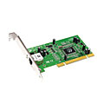
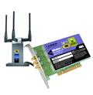
Where is the link layer implemented?
in each and every host
link layer implemented in “adaptor” (a.k.a. network interface card NIC) or on a chip
Ethernet card, 802.11 card; Ethernet chipset
implements link, physical layer
attaches into host’s system buses
combination of hardware, software, firmware
application
transport
network
link
cpu
memory
link
physical
host
bus
(e.g., PCI)
controller
physical
transmission
network adapter
card

Slide 10
Adaptors communicating
datagram
datagram
controller
controller
sending host
receiving host
datagram
frame
sending side:
encapsulates datagram in frame
adds error checking bits, rdt, flow control, etc.
receiving side
looks for errors, rdt, flow control, etc
extracts datagram, passes to upper layer at receiving side

Slide 11
Link layer, LANs: outline
5.1 introduction, services
5.2 error detection, correction
5.3 multiple access protocols
5.4 LANs
addressing, ARP
Ethernet
switches
VLANS
5.5 link virtualization: MPLS
5.6 data center networking
5.7 a day in the life of a web request

Slide 12
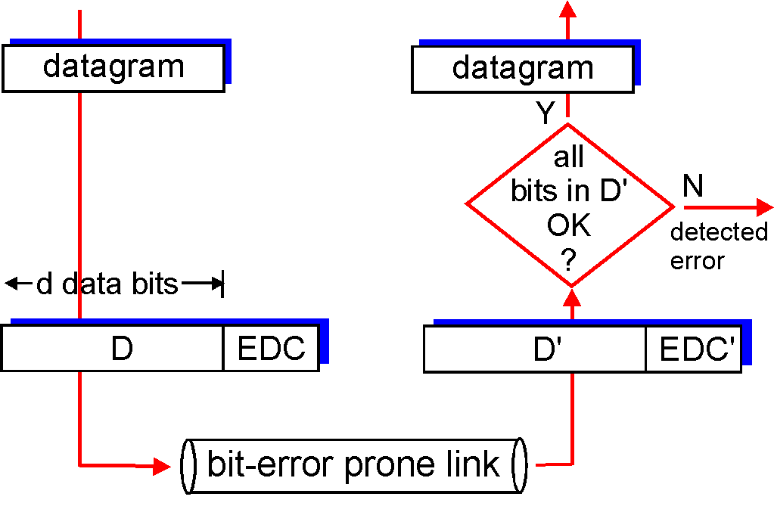
Error detection
EDC= Error Detection and Correction bits (redundancy)
D = Data protected by error checking, may include header fields
Error detection not 100% reliable!
protocol may miss some errors, but rarely
larger EDC field yields better detection and correction
otherwise

Slide 13
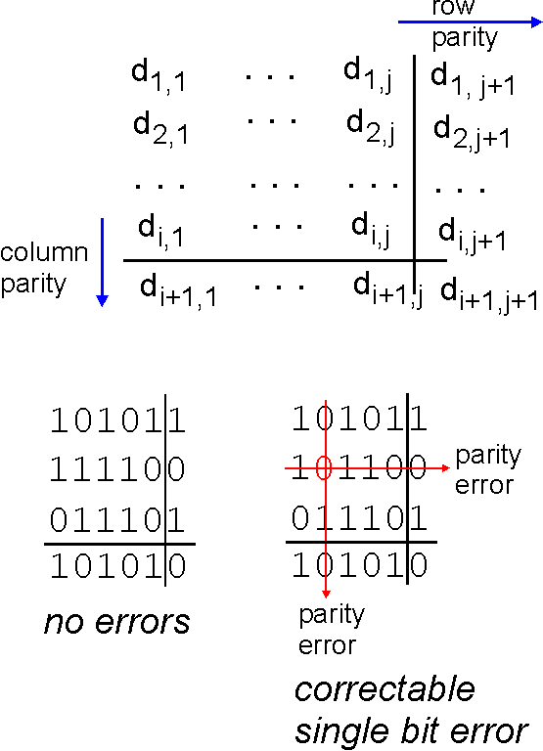
Parity checking
single bit parity:
detect single bit errors
two-dimensional bit parity:
detect and correct single bit errors
The above is an odd-parity
The example to the right
is an even-parity check
0

Slide 14
What can 2-D parity check do? (1)
Correct all 1-bit errors (we already saw it);
Detect all 2-bit errors;
An even parity example with two bit errors
0110100 1
1011010 0
0000111 0
1110101 1
1001011 0
1000110 1
data
row parities
Odd number of 1’s in 3rd
and 7th columns indicate
errors! We know the
errors are in these two
columns, not sure which row.
column parities
http://www.ccs.neu.edu/home/amislove/teaching/cs4700/spring11/lectures/lecture13.pdf

Slide 15
What can 2-D parity check do? (2)
Detect all 3-bit errors;
An even parity example with three bit errors
0110100 1
1011010 0
0000111 0
1100101 1
1001011 0
1000110 1
data
row parities
Odd number of 1’s in 7th
column indicates
errors! We can’t tell where
the errors are.
column parities

Slide 16
What can 2-D parity check do? (3)
Detect most 4-bit errors;
An even parity example with four bit errors that won’t be detected
0110100 1
1011010 0
0000111 0
1100100 1
1001011 0
1000110 1
data
row parities
All row and column parity
checks remain valid.
column parities

Slide 17
Internet checksum (review)
goal: detect “errors” (e.g., flipped bits) in transmitted packet (note: used at transport layer only)
sender:
treat segment contents as sequence of 16-bit integers
checksum: addition (1’s complement sum) of segment contents
sender puts checksum value into UDP checksum field
receiver:
compute checksum of received segment
check if computed checksum equals checksum field value:
NO - error detected
YES - no error detected. But maybe errors nonetheless?

Slide 18
Cyclic redundancy check
more powerful error-detection coding
view data bits, D, as a binary number
choose r+1 bit pattern (generator), G
goal: choose r CRC bits, R, such that
<D,R> exactly divisible by G (modulo 2)
receiver knows G, divides <D,R> by G. If non-zero remainder: error detected!
can detect all burst errors less than r+1 bits
widely used in practice (Ethernet, 802.11 WiFi, ATM)

Slide 19
CRC basics
data
CRC
G
want:
D.2^{r} XOR R = nG
equivalently:
D.2^{r} = nG XOR R
Are we convinced that the above are equivalent?
Because A XOR A = 0, A XOR 0 = A,
and (A XOR B) XOR B = A XOR (B XOR B),
we have (D.2^{r} XOR R) XOR R = nG XOR R

Slide 20
CRC example
D*2^{r}
want:
D.2^{r} XOR R = nG
equivalently:
D.2^{r} = nG XOR R
equivalently:
if we divide D.2^{r} by G, want remainder R to satisfy: (remember 1 XOR A = A)
G
D
r = 3
1
01011
1001
101110000
1001
101
000
1010
1001
110
000
1100
D.2^{r}
G
1001
R = remainder of [ ]
R
1010
1001
0011

Slide 21
Good generating polynomials (IEEE Standards)
G_{CRC-32} = x³²+x²⁶+x²³+x²²+x¹⁶+x¹²+x¹¹+x¹⁰+x⁸+x⁷+x⁵+x⁴+x²+x¹+1
or
G_{CRC-32} = 1 0000 0100 1100 0001 0001 1101 1011 0111
G_{CRC-16} = x¹⁶+x¹²+x⁵+1
or
G_{CRC-16} = 1 0001 0000 0010 0001

Slide 22
How many bit errors can be detected with CRC? (1)
Consider message received as T(x)+E(x), where T(x) is the original, correct message, E(x) is the error. Take [T(x)+E(x)]/G(x), because T(x)/G(x) is zero, we only need to focus on E(x)/G(x)
If a single bit error, E(x) = x^{i}, if G(x) has two or more terms, G(x) will never divide E(x), all single bit errors can be detected;
If two isolated single bit errors, E(x) = x^{i} + x^{j}, i > j, we can rewrite E(x) = x^{j}(x^{i-j} + 1). Assume G(x) is not divisible by x, we can choose G(x) to contain a term not divisible by (x^{i-j} + 1), then all double errors can be detected (e.g., choose k to be the length of the frame);

Slide 23
How many bit errors can be detected with CRC? (2)
If there are odd number of bits in error, E(x) contains an odd number of terms, (e.g., x⁵ + x² + 1, but not x³+1). No polynomial with an odd number of terms has x+1 as a factor in the modulo 2 system. By making x+1 a factor of G(x), we can detect all errors with odd number of error bits!
Polynomial code with r check bits will detect all burst errors of length <= r! A burst error of length k can be written as x^{i}(x^{k-i} + … + 1). If G(x) contains an x⁰ term, it will not have x^{i} as a factor, thus will not divide E(x) evenly. For example a 16-bit polynomial can detect all burst errors of 16 bits or less.
Computer Networks by A.S. Tanenbaum, 4th edition, Prentice Hall 2003

Slide 24
Why various different types of error checking and correction?
CRC is effective in detecting and correcting errors and can be easily implemented in hardware (shift registers).
Internet checksum implementation is in software, mostly at the network and transport layer.

