Slide 1
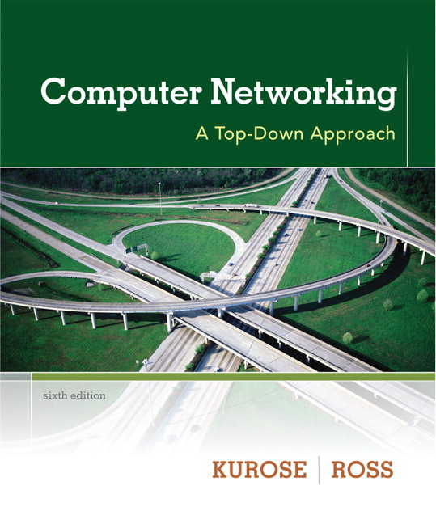
Chapter 5 Link Layer
A note on the use of these ppt slides:
We’re making these slides freely available to all (faculty, students, readers). They’re in PowerPoint form so you see the animations; and can add, modify, and delete slides (including this one) and slide content to suit your needs. They obviously represent a lot of work on our part. In return for use, we only ask the following:
Computer Networking: A Top Down Approach 6th edition Jim Kurose, Keith Ross Addison-Wesley March 2012
If you use these slides (e.g., in a class) that you mention their source (after all, we’d like people to use our book!)
If you post any slides on a www site, that you note that they are adapted from (or perhaps identical to) our slides, and note our copyright of this material.
Thanks and enjoy! JFK/KWR
All material copyright 1996-2012
J.F Kurose and K.W. Ross, All Rights Reserved
The course notes are adapted for Bucknell’s CSCI 363
Xiannong Meng
Spring 2016

Slide 2
Link layer, LANs: outline
5.1 introduction, services
5.2 error detection, correction
5.3 multiple access protocols
5.4 LANs
addressing, ARP
Ethernet
switches
VLANS
5.5 link virtualization: MPLS
5.6 data center networking
5.7 a day in the life of a web request

Slide 3
Multiple access links, protocols
two types of “links”:
point-to-point
PPP for dial-up access
point-to-point link between Ethernet switch, host
broadcast (shared wire or medium)
old-fashioned Ethernet
upstream HFC (Hybrid Fiber-Coaxial)
802.11 wireless LAN
shared wire (e.g.,
cabled Ethernet)
shared RF
(e.g., 802.11 WiFi)
shared RF
(satellite)
humans at a
cocktail party
(shared air, acoustical)

Slide 4
Multiple access protocols
single shared broadcast channel
two or more simultaneous transmissions by nodes: interference
collision if node receives two or more signals at the same time
multiple access protocol
distributed algorithm that determines how nodes share channel, i.e., determine when node can transmit
communication about channel sharing must use channel itself!
no out-of-band channel for coordination

Slide 5
An ideal multiple access protocol
given: broadcast channel of rate R bps
desiderata:
1. when one node wants to transmit, it can send at rate R.
2. when M nodes want to transmit, each can send at average rate R/M
3. fully decentralized:
no special node to coordinate transmissions
no synchronization of clocks, slots
4. simple

Slide 6
MAC protocols: taxonomy
three broad classes:
channel partitioning
divide channel into smaller “pieces” (time slots, frequency, code)
allocate piece to node for exclusive use
random access
channel not divided, allow collisions
“recover” from collisions
“taking turns”
nodes take turns, but nodes with more to send can take longer turns

Slide 7
Channel partitioning MAC protocols: TDMA
TDMA: time division multiple access
access to channel in "rounds"
each station gets fixed length slot (length = pkt trans time) in each round
unused slots go idle
example: 6-station LAN, 1,3,4 have pkt, slots 2,5,6 idle
6-slot
frame
6-slot
frame
1
3
4
1
3
4

Slide 8
Channel partitioning MAC protocols: FDMA
FDMA: frequency division multiple access
channel spectrum divided into frequency bands
each station assigned fixed frequency band
unused transmission time in frequency bands go idle
example: 6-station LAN, 1,3,4 have pkt, frequency bands 2,5,6 idle
time
frequency bands
FDM cable

Slide 9
Random access protocols
when node has packet to send
transmit at full channel data rate R.
no a priori coordination among nodes
two or more transmitting nodes ➜ “collision”,
random access MAC protocol specifies:
how to detect collisions
how to recover from collisions (e.g., via delayed retransmissions)
examples of random access MAC protocols:
slotted ALOHA
ALOHA
CSMA, CSMA/CD, CSMA/CA

Slide 10
“Taking turns” MAC protocols
channel partitioning MAC protocols:
share channel efficiently and fairly at high load
inefficient at low load: delay in channel access, 1/N bandwidth allocated even if only 1 active node!
random access MAC protocols
efficient at low load: single node can fully utilize channel
high load: collision overhead
examples include token ring and token passing
“taking turns” protocols
look for best of both worlds!

Slide 11
Random access protocols
when node has packet to send
transmit at full channel data rate R.
no a priori coordination among nodes
two or more transmitting nodes ➜ “collision”,
random access MAC protocol specifies:
how to detect collisions
how to recover from collisions (e.g., via delayed retransmissions)
examples of random access MAC protocols:
slotted ALOHA
ALOHA
CSMA, CSMA/CD, CSMA/CA

Slide 12
Slotted ALOHA
assumptions:
all frames same size
time divided into equal size slots (time to transmit 1 frame)
nodes start to transmit only slot beginning
nodes are synchronized
if 2 or more nodes transmit in slot, all nodes detect collision
operation:
when node obtains fresh frame, transmits in next time slot
if no collision: node can send new frame in next slot
if collision: node retransmits frame in each subsequent slot with prob. p until success

Slide 13
Slotted ALOHA
node 1
1
1
1
1
node 2
2
2
2
node 3
3
3
3
C
E
C
S
E
C
E
S
S
Pros:
single active node can continuously transmit at full rate of channel
highly decentralized: only slots in nodes need to be in sync
simple
Cons:
collisions, wasting slots
idle slots
nodes may be able to detect collision in less than time to transmit packet
clock synchronization

Slide 14
Slotted ALOHA: efficiency
efficiency: long-run fraction of successful slots (many nodes, all with many frames to send)
max efficiency: find p* that maximizes Np(1-p)^{N-1}
for many nodes, take limit of Np*(1-p*)^{N-1} as N goes to infinity, gives:
max efficiency = 1/e = .37
suppose: N nodes with many frames to send, each transmits in slot with probability p
prob that given node has success in a slot = p(1-p)^{N-1}
prob that any node has a success = Np(1-p)^{N-1}
at best: channel
used for useful
transmissions 37%
of time!
!

Slide 15
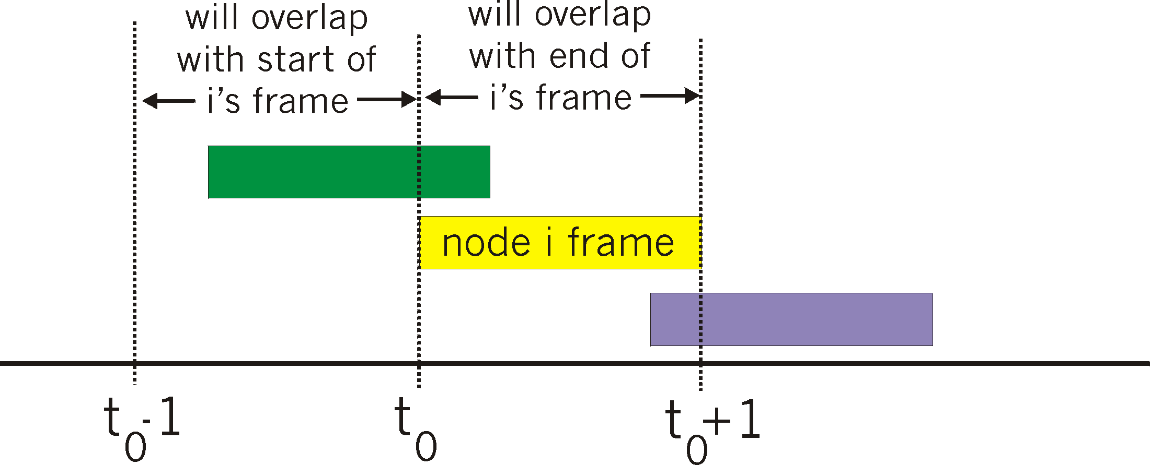
Pure (unslotted) ALOHA
unslotted Aloha: simpler, no synchronization
when frame first arrives
transmit immediately
collision probability increases:
frame sent at t₀ collides with other frames sent in [t₀-1,t₀+1]

Slide 16
Pure ALOHA efficiency
P(success by given node) = P(node transmits) .
P(no other node transmits in [t₀-1,t₀] .
P(no other node transmits in [t₀,t₀₊₁]
= p . (1-p)^{N-1 .} (1-p)^{N-1}
= p . (1-p)^{2(N-1)}
… choosing optimum p and then letting N
= 1/(2e) = .18
as expected, even worse than slotted Aloha!

