Slide 1
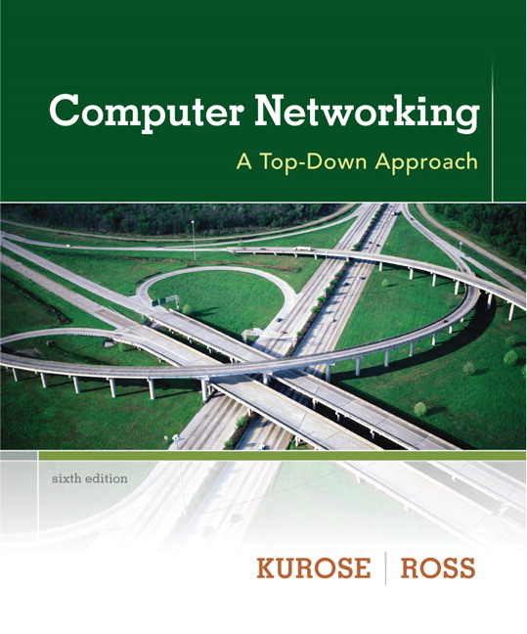

Chapter 5
Link Layer
A note on the use of these ppt slides:
We’re making these slides freely available to all (faculty, students, readers). They’re in PowerPoint form so you see the animations; and can add, modify, and delete slides (including this one) and slide content to suit your needs. They obviously represent a lot of work on our part. In return for use, we only ask the following:
Computer Networking: A Top Down Approach
6th edition
Jim Kurose, Keith Ross
Addison-Wesley
March 2012
If you use these slides (e.g., in a class) that you mention their source (after all, we’d like people to use our book!)
If you post any slides on a www site, that you note that they are adapted from (or perhaps identical to) our slides, and note our copyright of this material.
Thanks and enjoy! JFK/KWR
All material copyright 1996-2012
J.F Kurose and K.W. Ross, All Rights Reserved
The course notes are adapted for Bucknell’s CSCI 363
Xiannong Meng
Spring 2016

Slide 2
CSMA (carrier sense multiple access)
CSMA: listen before transmit:
if channel sensed idle: transmit entire frame
if channel sensed busy, defer transmission
human analogy: don’t interrupt others!

Slide 3
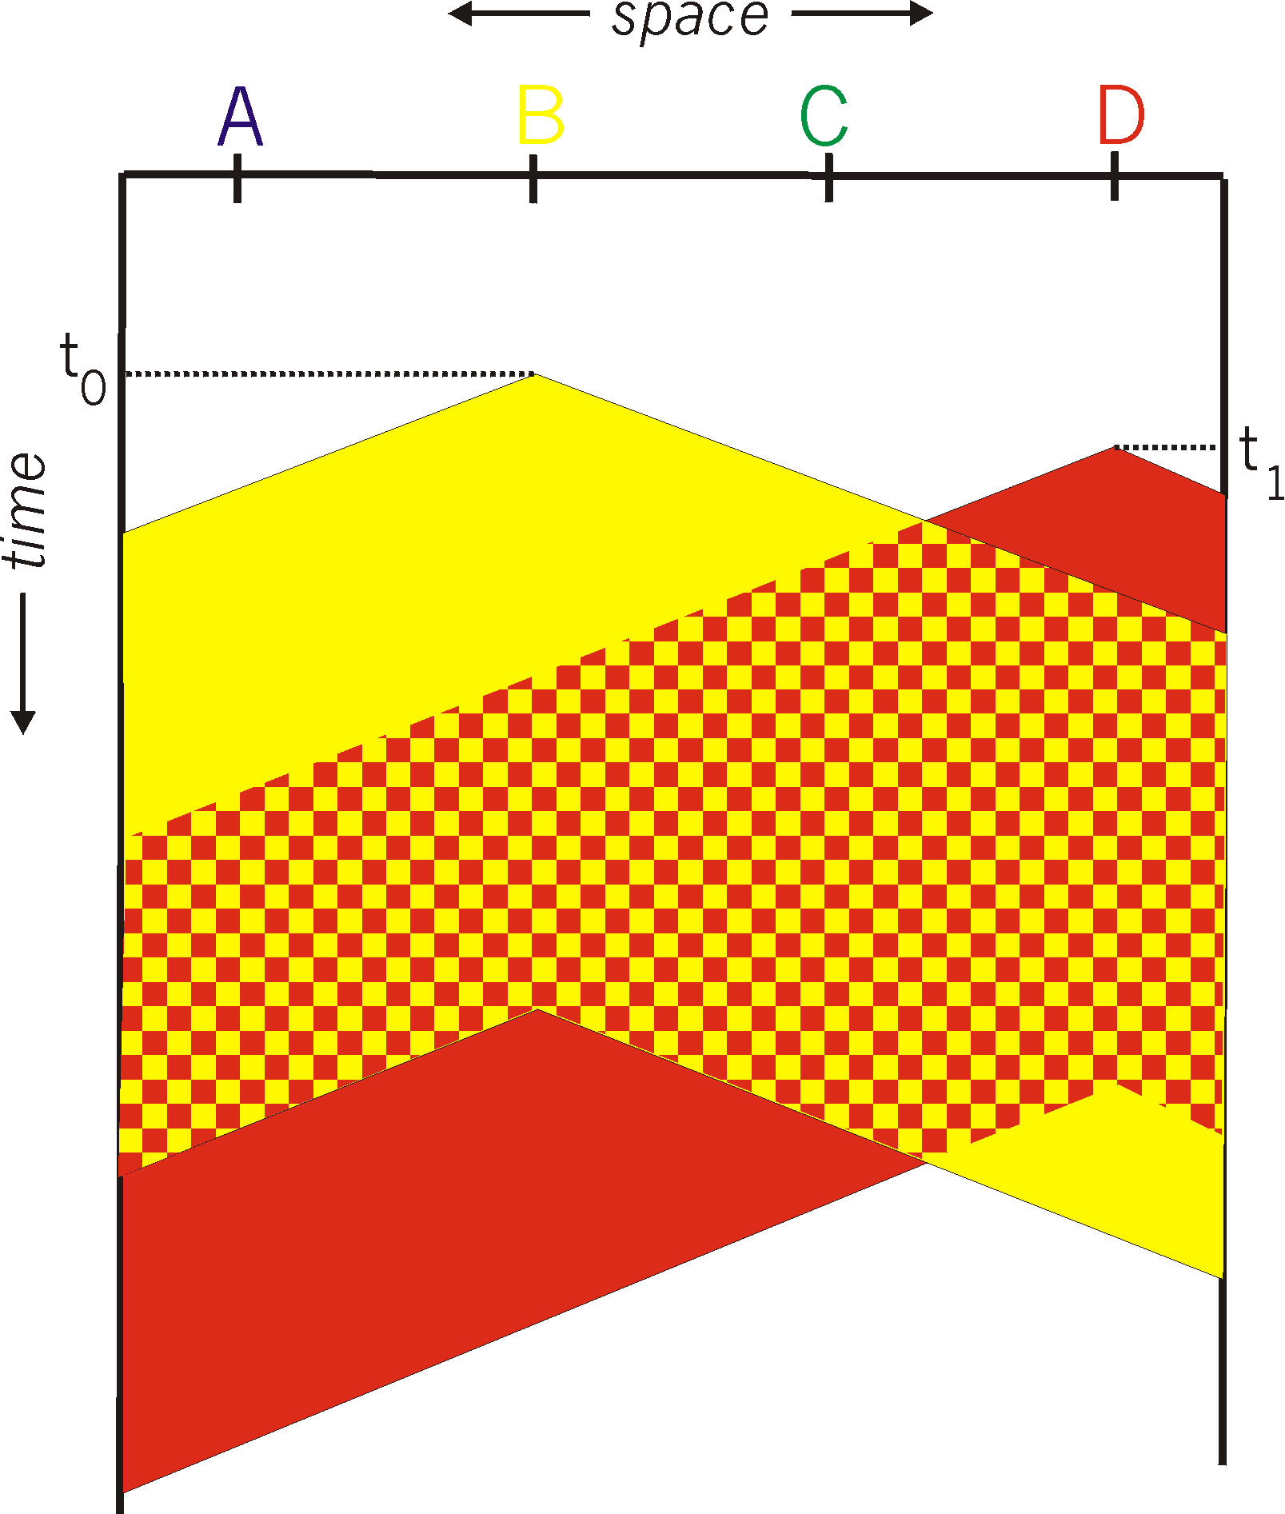

CSMA collisions
spatial layout of nodes
collisions can still occur: propagation delay means two nodes may not hear each other’s transmission
collision: entire packet transmission time wasted
  distance & propagation delay play role in in determining collision probability

Slide 4
CSMA/CD (collision detection)
CSMA/CD: carrier sensing, deferral as in CSMA
  collisions detected within short time
  colliding transmissions aborted, reducing channel wastage
collision detection:
  easy in wired LANs: measure signal strengths, compare transmitted, received signals
  difficult in wireless LANs: received signal strength overwhelmed by local transmission strength
human analogy: the polite conversationalist

Slide 5
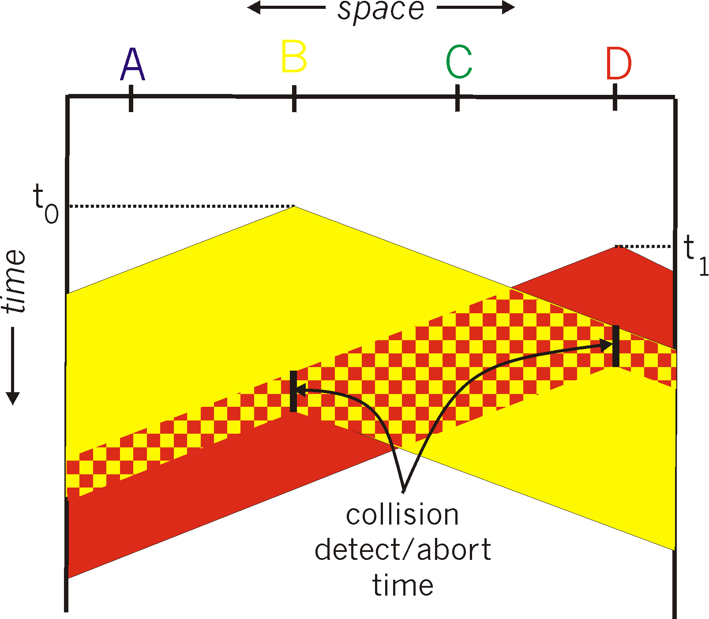
CSMA/CD (collision detection)
spatial layout of nodes

Slide 6
Ethernet CSMA/CD algorithm
1. NIC receives datagram from network layer, creates frame
2. If NIC senses channel idle, starts frame transmission. If NIC senses channel busy, waits until channel idle, then transmits.
3. If NIC transmits entire frame without detecting another transmission, NIC is done with frame !
4. If NIC detects another transmission while transmitting, aborts and sends jam signal
5. After aborting, NIC enters binary (exponential) backoff:
  after mth collision, NIC chooses K at random from {0,1,2, …, 2^{m}-1}. NIC waits K·512 bit times, returns to Step 2
  longer backoff interval if more collisions

Slide 7
CSMA/CD efficiency (1)
t_{prop} = max prop delay between 2 nodes in LAN
t_{trans} = time to transmit max-size frame
efficiency goes to 1
  as t_{prop} goes to 0, or
  as t_{trans} goes to infinity
better performance than ALOHA: and simple, cheap, decentralized!
Schwartz (1987), page 445 says e = 1/(1+6.44 a), derivation from probability.

Slide 8
CSMA/CD efficiency (2)
Performance of the CSMA/CD can be determined by one single number!
Let a = t_{pro} / t_{trans}
Some examples:
  a = 0.1, efficiency = 0.667
  a = 0.01, efficiency = 0.952
How to make a small, thus higher efficiency?
  Shorter cables → smaller t_{pro}
  Slower(!!!) network → large t_{rans}
  Larger packets → large t_{rans}
By Simon Lam of UT Austin (1979):
http://www.cs.utexas.edu/ftp/techreports/tr79-113.pdf

Slide 9
“Taking turns” MAC protocols
channel partitioning MAC protocols:
  share channel efficiently and fairly at high load
  inefficient at low load: delay in channel access, 1/N bandwidth allocated even if only 1 active node!
random access MAC protocols
  efficient at low load: single node can fully utilize channel
  high load: collision overhead
“taking turns” protocols
  look for best of both worlds!

Slide 10

“Taking turns” MAC protocols
polling:
master node “invites” slave nodes to transmit in turn
typically used with “dumb” slave devices
concerns:
  polling overhead
  latency
  single point of failure (master)
data
poll
master
data
slaves

Slide 11
“Taking turns” MAC protocols
token passing:
control token passed from one node to next sequentially.
token message
concerns:
  token overhead
  latency
  single point of failure (token)
T
(nothing
to send)
T
data

Slide 12
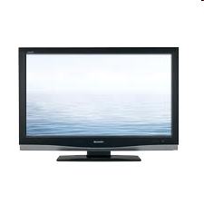


Cable access network
Internet frames,TV channels, control transmitted
downstream at different frequencies
cable headend
…
CMTS
…
splitter
cable
modem
cable modem
termination system
ISP
upstream Internet frames, TV control, transmitted
upstream at different frequencies in time slots
multiple 40Mbps downstream (broadcast) channels
  single CMTS transmits into channels
multiple 30 Mbps upstream channels
  multiple access: all users contend for certain upstream channel time slots (request slots), once granted, requesting data can be sent.
Combination of random access (request slots), time division (request data slots), and frequency division (separate channels for signal and data)!

Slide 13
Cable access network
cable headend
MAP frame for
Interval [t1, t2]
CMTS
Downstream channel i
Upstream channel j
t₁
t₂
Residences with cable modems
Minislots containing
minislots request frames
Assigned minislots containing cable modem
upstream data frames
DOCSIS: data over cable service interface spec
FDM over upstream, downstream frequency channels
TDM upstream: some slots assigned, some have contention
  downstream MAP frame: assigns upstream slots
  request for upstream slots (and data) transmitted random access (binary backoff) in selected slots

Slide 14
Summary of MAC protocols
channel partitioning, by time, frequency or code
  Time Division, Frequency Division
random access (dynamic),
  ALOHA, S-ALOHA, CSMA, CSMA/CD
  carrier sensing: easy in some technologies (wire), hard in others (wireless)
  CSMA/CD used in Ethernet
  CSMA/CA used in 802.11
taking turns
  polling from central site, token passing
  bluetooth, FDDI, token ring
hybrid DOCSIS combines random access, TDMA, and FDMA

