Slide 1
Chapter 5 Link Layer
A note on the use of these ppt slides:
We’re making these slides freely available to all (faculty, students, readers). They’re in PowerPoint form so you see the animations; and can add, modify, and delete slides (including this one) and slide content to suit your needs. They obviously represent a lot of work on our part. In return for use, we only ask the following:
Computer Networking: A Top Down Approach 6th edition Jim Kurose, Keith Ross Addison-Wesley March 2012
If you use these slides (e.g., in a class) that you mention their source (after all, we’d like people to use our book!)
If you post any slides on a www site, that you note that they are adapted from (or perhaps identical to) our slides, and note our copyright of this material.
Thanks and enjoy! JFK/KWR
All material copyright 1996-2012
J.F Kurose and K.W. Ross, All Rights Reserved
The course notes are adapted for Bucknell’s CSCI 363
Xiannong Meng
Spring 2016

Slide 2
Link layer, LANs: outline
5.1 introduction, services
5.2 error detection, correction
5.3 multiple access protocols
5.4 LANs
addressing, ARP
Ethernet
switches
VLANS
5.5 link virtualization: MPLS
5.6 data center networking
5.7 a day in the life of a web request

Slide 3
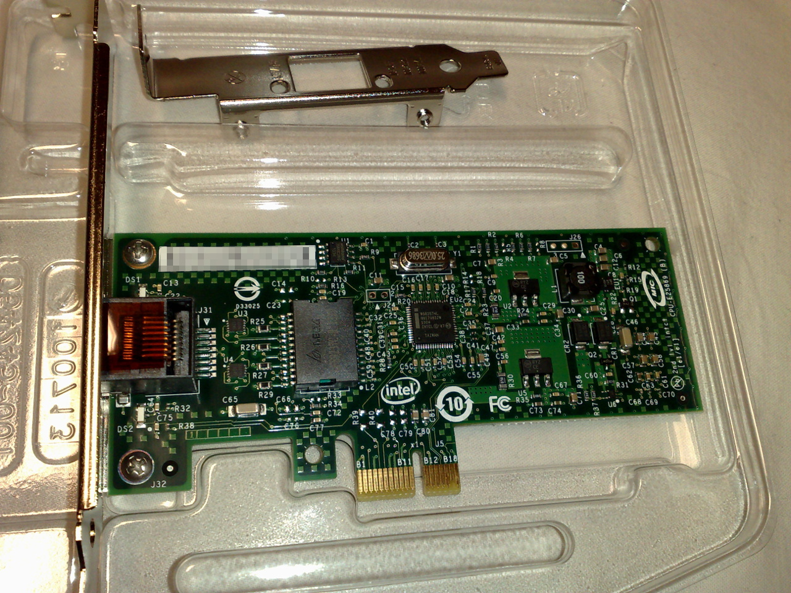
Ethernet card example: Intel 82574L Gigabit Ethernet NIC
Wikipedia: https://upload.wikimedia.org/wikipedia/commons/2/24/
An_Intel_82574L_Gigabit_Ethernet_NIC%2C_PCI_Express_x1_card.jpg

Slide 4
Network Interface Controller (NIC) information from Wikipedia
https://en.wikipedia.org/wiki/
Network_interface_controller

Slide 5
MAC addresses and ARP
32-bit IP address:
network-layer address for interface
used for layer 3 (network layer) forwarding
MAC (or LAN or physical or Ethernet) address:
function: used ‘locally” to get frame from one interface to another physically-connected interface (same network, in IP-addressing sense)
48 bit MAC address (for most LANs) burned in NIC ROM, also sometimes software settable
e.g.: 1A-2F-BB-76-09-AD
hexadecimal (base 16) notation
(each “number” represents 4 bits)

Slide 6
Some historical perspective
Ethernet history: first Ethernet spec 1973
http://timeline.ethernethistory.com/
Technical history of ARPANET: first IMP 1969
1969: RFC 1: specifies host to host communication protocol
http://www.ietf.org/rfc/rfc0001
TCP/IP history:
http://www.history-computer.com/Internet/Maturing/TCPIP.html

Slide 7
LAN addresses and ARP
each adapter on LAN has unique LAN address
1A-2F-BB-76-09-AD
LAN
(wired or
wireless)
adapter
71-65-F7-2B-08-53
58-23-D7-FA-20-B0
0C-C4-11-6F-E3-98

Slide 8
LAN addresses (more)
MAC address allocation administered by IEEE
manufacturer buys portion of MAC address space (to assure uniqueness)
analogy:
MAC address: like Social Security Number
IP address: like postal address
MAC flat address ➜ portability
can move LAN card from one LAN to another
IP hierarchical address not portable
address depends on IP subnet to which node is attached

Slide 9
Question: how to map between
interface’s MAC address, and its IP address?

Slide 10
ARP: Address Resolution Protocol
ARP table: each IP node (host, router) on LAN has table
IP/MAC address mappings for some LAN nodes:
< IP address; MAC address; TTL>
TTL (Time To Live): time after which address mapping will be forgotten (typically 20 min)
137.196.7.78
1A-2F-BB-76-09-AD
137.196.7.23
137.196.7.14
LAN
71-65-F7-2B-08-53
58-23-D7-FA-20-B0
0C-C4-11-6F-E3-98
137.196.7.88

Slide 11
ARP protocol: within same LAN
A wants to send datagram to B
B’s MAC address not in A’s ARP table.
A broadcasts ARP query packet, containing B's IP address
dest MAC address = FF-FF-FF-FF-FF-FF
all nodes on LAN receive ARP query
B receives ARP packet, replies to A with its (B's) MAC address
frame sent to A’s MAC address (unicast)
A caches (saves) IP-to-MAC address pair in its ARP table until information becomes old (times out)
soft state: information that times out (goes away) unless refreshed
ARP is “plug-and-play”:
nodes create their ARP tables without intervention from net administrator

Slide 12
Addressing: routing to another LAN
Walk-through: send datagram from A to B via R
focus on addressing – at IP (datagram) and MAC layer (frame)
assume A knows B’s IP address
assume A knows IP address of first hop router, R (how?)
assume A knows R’s MAC address (how?)
A
B
R
111.111.111.111
222.222.222.222
74-29-9C-E8-FF-55
49-BD-D2-C7-56-2A
222.222.222.220
1A-23-F9-CD-06-9B
111.111.111.112
111.111.111.110
222.222.222.221
CC-49-DE-D0-AB-7D
E6-E9-00-17-BB-4B
88-B2-2F-54-1A-0F

Slide 13
Addressing: routing to another LAN
A creates IP datagram with IP source A, destination B
A creates link-layer frame with R's MAC address as dest, frame contains A-to-B IP datagram
MAC src: 74-29-9C-E8-FF-55
MAC dest: E6-E9-00-17-BB-4B
IP
Eth
Phy
IP src: 111.111.111.111
IP dest: 222.222.222.222
A
B
R
111.111.111.111
222.222.222.222
74-29-9C-E8-FF-55
49-BD-D2-C7-56-2A
222.222.222.220
1A-23-F9-CD-06-9B
111.111.111.112
111.111.111.110
222.222.222.221
CC-49-DE-D0-AB-7D
E6-E9-00-17-BB-4B
88-B2-2F-54-1A-0F

Slide 14
Addressing: routing to another LAN
frame sent from A to R
frame received at R, datagram removed, passed up to IP
MAC src: 74-29-9C-E8-FF-55
MAC dest: E6-E9-00-17-BB-4B
IP src: 111.111.111.111
IP dest: 222.222.222.222
IP
Eth
Phy
IP src: 111.111.111.111
IP dest: 222.222.222.222
IP
Eth
Phy
A
B
R
111.111.111.111
222.222.222.222
74-29-9C-E8-FF-55
49-BD-D2-C7-56-2A
222.222.222.220
1A-23-F9-CD-06-9B
111.111.111.112
111.111.111.110
222.222.222.221
CC-49-DE-D0-AB-7D
E6-E9-00-17-BB-4B
88-B2-2F-54-1A-0F

Slide 15
Addressing: routing to another LAN
R forwards datagram with IP source A, destination B
R creates link-layer frame with B's MAC address as dest, frame contains A-to-B IP datagram
MAC src: 1A-23-F9-CD-06-9B
MAC dest: 49-BD-D2-C7-56-2A
IP
Eth
Phy
IP
Eth
Phy
IP src: 111.111.111.111
IP dest: 222.222.222.222
A
B
R
111.111.111.111
222.222.222.222
74-29-9C-E8-FF-55
49-BD-D2-C7-56-2A
222.222.222.220
1A-23-F9-CD-06-9B
111.111.111.112
111.111.111.110
222.222.222.221
CC-49-DE-D0-AB-7D
E6-E9-00-17-BB-4B
88-B2-2F-54-1A-0F

Slide 16
Addressing: routing to another LAN
R forwards datagram with IP source A, destination B
R creates link-layer frame with B's MAC address as dest, frame contains A-to-B IP datagram
MAC src: 1A-23-F9-CD-06-9B
MAC dest: 49-BD-D2-C7-56-2A
IP
Eth
Phy
IP
Eth
Phy
IP src: 111.111.111.111
IP dest: 222.222.222.222
A
B
R
111.111.111.111
222.222.222.222
74-29-9C-E8-FF-55
49-BD-D2-C7-56-2A
222.222.222.220
1A-23-F9-CD-06-9B
111.111.111.112
111.111.111.110
222.222.222.221
CC-49-DE-D0-AB-7D
E6-E9-00-17-BB-4B
88-B2-2F-54-1A-0F

Slide 17
Addressing: routing to another LAN
R forwards datagram with IP source A, destination B
R creates link-layer frame with B's MAC address as dest, frame contains A-to-B IP datagram
MAC src: 1A-23-F9-CD-06-9B
MAC dest: 49-BD-D2-C7-56-2A
IP src: 111.111.111.111
IP dest: 222.222.222.222
IP
Eth
Phy
A
B
R
111.111.111.111
222.222.222.222
74-29-9C-E8-FF-55
49-BD-D2-C7-56-2A
222.222.222.220
1A-23-F9-CD-06-9B
111.111.111.112
111.111.111.110
222.222.222.221
CC-49-DE-D0-AB-7D
E6-E9-00-17-BB-4B
88-B2-2F-54-1A-0F

Slide 18
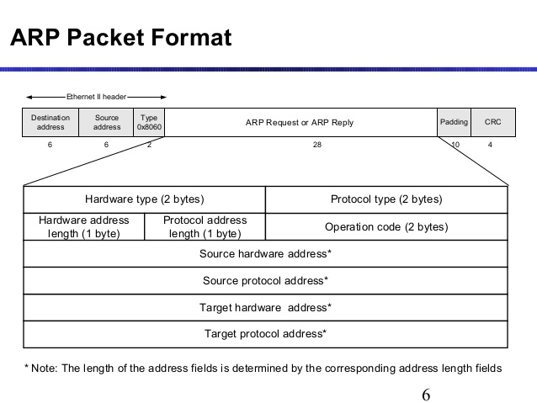
http://www.slideshare.net/naveenarvinth/arp-36193303

Slide 19
IPv6 uses NDP, not ARP
Due to security reasons, IPv6 no longer uses ARP. Rather it uses a protocol called Neighbor Discover Protocol (NDP), or Secure Neighbor Discover Protocol (SEND).
See discussion at this site:
http://superuser.com/questions/969831/why-is-arp-replaced-by-ndp-in-ipv6

Slide 20
Link layer, LANs: outline
5.1 introduction, services
5.2 error detection, correction
5.3 multiple access protocols
5.4 LANs
addressing, ARP
Ethernet
switches
VLANS
5.5 link virtualization: MPLS
5.6 data center networking
5.7 a day in the life of a web request

Slide 21
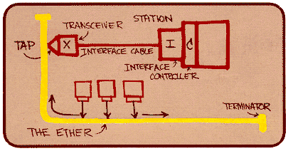
Ethernet
“dominant” wired LAN technology:
cheap $20 for NIC
first widely used LAN technology
simpler, cheaper than token LANs and ATM
kept up with speed race: 10 Mbps – 10 Gbps
Metcalfe’s Ethernet sketch

Slide 22
Ethernet cabling
10Base5 cable (thick cable)
http://en.wikipedia.org/wiki/10BASE5
Two types of transceiver connectors
http://www.erg.abdn.ac.uk/~gorry/eg3567/lan-pages/10b5.html
10Base2 cable (thin cable)
http://en.wikipedia.org/wiki/10BASE2
10Base T (twist-pair Ethernet cable)
http://en.wikipedia.org/wiki/Ethernet_over_twisted_pair

Slide 23
Ethernet: physical topology
bus: popular through mid 90s
all nodes in same collision domain (can collide with each other)
star: prevails today
active switch in center
each “spoke” runs a (separate) Ethernet protocol (nodes do not collide with each other)
switch
star
bus: coaxial cable

Slide 24
Ethernet frame structure
sending adapter encapsulates IP datagram (or other network layer protocol packet) in Ethernet frame
preamble:
7 bytes with pattern 10101010 followed by one byte with pattern 10101011
used to synchronize receiver, sender clock rates
type
preamble
dest.
address
source
address
data (payload)
CRC

Slide 25
Ethernet frame structure (more)
addresses: 6 byte source, destination MAC addresses
if adapter receives frame with matching destination address, or with broadcast address (e.g. ARP packet), it passes data in frame to network layer protocol
otherwise, adapter discards frame
type: indicates higher layer protocol (mostly IP but others possible, e.g., Novell IPX, AppleTalk)
CRC: cyclic redundancy check at receiver
error detected: frame is dropped
type
preamble
dest.
address
source
address
data (payload)
CRC

Slide 26
Ethernet: unreliable, connectionless
connectionless: no handshaking between sending and receiving NICs
unreliable: receiving NIC doesnt send acks or nacks to sending NIC
data in dropped frames recovered only if initial sender uses higher layer rdt (e.g., TCP), otherwise dropped data lost
Ethernet’s MAC protocol: unslotted CSMA/CD wth binary backoff

Slide 27
802.3 Ethernet standards: link & physical layers
many different Ethernet standards
common MAC protocol and frame format
different speeds: 2 Mbps, 10 Mbps, 100 Mbps, 1Gbps, 10G bps
different physical layer media: fiber, cable
application
transport
network
link
physical
MAC protocol
and frame format
100BASE-TX
100BASE-T2
100BASE-FX
100BASE-T4
100BASE-SX
100BASE-BX
copper (twister
pair) physical layer
fiber physical layer

Slide 28
Link layer, LANs: outline
5.1 introduction, services
5.2 error detection, correction
5.3 multiple access protocols
5.4 LANs
addressing, ARP
Ethernet
switches
VLANS
5.5 link virtualization: MPLS
5.6 data center networking
5.7 a day in the life of a web request

Slide 29
Ethernet switch
link-layer device: takes an active role
store, forward Ethernet frames
examine incoming frame’s MAC address, selectively forward frame to one-or-more outgoing links when frame is to be forwarded on segment, uses CSMA/CD to access segment
transparent
hosts are unaware of presence of switches
plug-and-play, self-learning
switches do not need to be configured

