Slide 1


Chapter 6 Wireless and Mobile Networks
A note on the use of these ppt slides:
We’re making these slides freely available to all (faculty, students, readers). They’re in PowerPoint form so you see the animations; and can add, modify, and delete slides (including this one) and slide content to suit your needs. They obviously represent a lot of work on our part. In return for use, we only ask the following:
Computer Networking: A Top Down Approach 6th edition Jim Kurose, Keith Ross Addison-Wesley March 2012
If you use these slides (e.g., in a class) that you mention their source (after all, we’d like people to use our book!)
If you post any slides on a www site, that you note that they are adapted from (or perhaps identical to) our slides, and note our copyright of this material.
Thanks and enjoy! JFK/KWR
All material copyright 1996-2012
J.F Kurose and K.W. Ross, All Rights Reserved
The course notes are adapted for Bucknell’s CSCI 363
Xiannong Meng
Spring 2016

Slide 2
802.11: advanced capabilities
power management
node-to-AP: “I am going to sleep until next beacon frame”
AP knows not to transmit frames to this node
node wakes up before next beacon frame
beacon frame: contains list of mobiles with AP-to-mobile frames waiting to be sent
node will stay awake if AP-to-mobile frames to be sent; otherwise sleep again until next beacon frame

Slide 3
802.15: personal area network
less than 10 m diameter
replacement for cables (mouse, keyboard, headphones)
ad hoc: no infrastructure
master/slaves:
slaves request permission to send (to master)
master grants requests
802.15: evolved from Bluetooth specification
2.4-2.5 GHz radio band
up to 721 kbps
S
P
P
radius of
coverage
M
S
S
P
P
M
Master device
Slave device
Parked device (inactive)
S
P

Slide 4
PAN: Bluetooth and Zigbee
Bluetooth:
Operating up to 4 M bps
Small area (a few meters)
Small number of devices (up to eight)
Master/slave mode: the master node can transmit every odd-numbered time slot, and the slave node can transmit only when polled by the master
Zigbee:
Low power, low duty cycle, low cost devices
Channel rates 20, 40, 100, and 250 K bps
Work with devices such as temperature sensors, security devices, and other wall-mounted devices

Slide 5
Chapter 6 outline
6.1 Introduction
Wireless
6.2 Wireless links, characteristics
CDMA
6.3 IEEE 802.11 wireless LANs (“Wi-Fi”)
6.4 Cellular Internet access
architecture
standards (e.g., GSM)
Mobility
6.5 Principles: addressing and routing to mobile users
6.6 Mobile IP
6.7 Handling mobility in cellular networks
6.8 Mobility and higher-layer protocols
6.9 Summary

Slide 6

Components of cellular network architecture
MSC
connects cells to wired tel. net.
manages call setup (more later!)
handles mobility (more later!)
cell (BSS)
covers geographical region
base station (BS) analogous to 802.11 AP
mobile users attach to network through BS
air-interface: physical and link layer protocol between mobile and BS
Mobile
Switching
Center
Public telephone
network
Mobile
Switching
Center
wired network

Slide 7
Cellular networks: the first hop
Two techniques for sharing mobile-to-BS radio spectrum
combined FDMA/TDMA: divide spectrum in frequency channels, divide each channel into time slots
CDMA: code division multiple access
time slots
frequency
bands

Slide 8
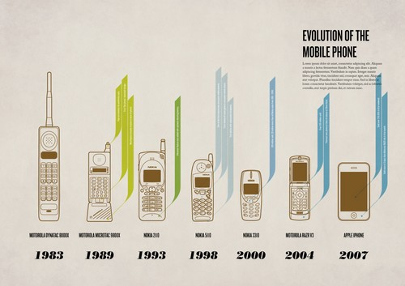
Wireless phones at different time
http://www.design-laorosa.com/2012_04_22_archive.html

Slide 9
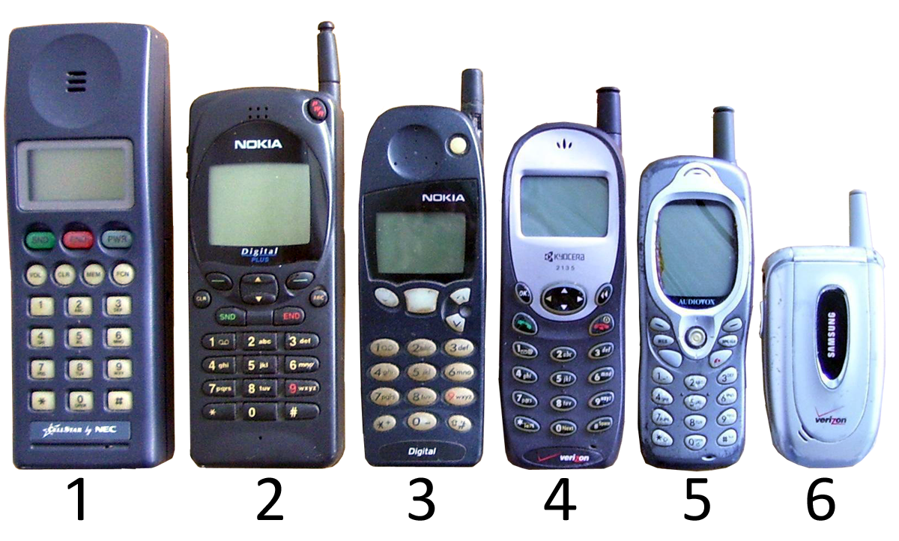
http://commons.wikimedia.org/wiki/File:Celulares.JPG

Slide 10
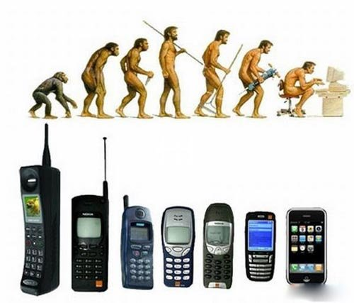
http://blogs.uoregon.edu/terryzone/files/2012/12/cell-phone-urxr5m.jpg

Slide 11
1G mobile network (wikipedia)
Wireless telephone and mobile communication technology.
Digital signaling to communicate with towers, the phone signals after establishing the connection is analog.
The first commercially automated cellular network (the 1G generation) was launched in Japan by NTT (Nippon Telegraph and Telephone) in 1979.
In 1981, this was followed by the simultaneous launch of the Nordic Mobile Telephone (NMT) system in Denmark, Finland, Norway and Sweden. NMT was the first mobile phone network featuring international roaming.
The first 1G network launched in the USA was Chicago-based Ameritech in 1983 using the Motorola DynaTAC mobile phone. Several countries then followed in the early-to-mid 1980s including the UK, Mexico and Canada.

Slide 12
2G (voice) network architecture
Base station system (BSS)
MSC
BTS
BSC
G
Public
telephone
network
Gateway
MSC
Legend
Base transceiver station (BTS)
Base station controller (BSC)
Mobile Switching Center (MSC)
Mobile subscribers

Slide 13
2G mobile network (wikipedia)
2G cellular telecom networks were commercially launched on the GSM standard in Finland (1991)
Conversation digitally encrypted
Significantly more efficient in spectrum use
Mobile data service (SMS, text message)
2G network can be divided into two categories: TDMA and CDMA
GSM: Global Systems for Mobile communication (TDMA based)
Digital, circuit switched network system supporting both voice and digital data (900 MHz or 1800 MHz)

Slide 14
2.5G mobile network (wikipedia)
Evolving from circuit switching in 2G to packet switching
The first major step in the evolution of GSM networks to 3G occurred with the introduction of General Packet Radio Service (GPRS).
CDMA2000 networks similarly evolved through the introduction of 1xRTT (1 Times Radio Transmission Technology).
The combination of the two (GPRS and CDMA) is called 2.5G mobile network.

Slide 15
3G (voice+data) network architecture
MSC(mobile switching center)
G
Public
telephone
network
radio
network
controller
Gateway
MSC
G
Public
Internet
SGSN
Key insight: new cellular data
network operates in parallel
(except at edge) with existing
cellular voice network
voice network unchanged in core
data network operates in parallel
GGSN
Serving GPRS Support Node (SGSN)
Gateway GPRS Support Node (GGSN)

Slide 16
3G (voice+data) network architecture
MSC
G
Public
telephone
network
radio
network
controller
Gateway
MSC
G
Public
Internet
SGSN
GGSN
radio interface
(WCDMA, HSPA)
radio access network
Universal Terrestrial Radio
Access Network (UTRAN)
core network
General Packet Radio Service
(GPRS) Core Network
public
Internet

Slide 17
4G network
4G network: 4th generation mobile communication technology that provides high speed access to phone and data services
Two competing standards
4G LTE (Long Term Evolution)
WiMAX (IEEE 802.16)

Slide 18
4G LTE General
4G LTE is a mobile communications standard that provides access for mobile devices to core network.
It is an evolution of the GSM/UMTS standards (from phones to Internet).
The goal of LTE was to increase the capacity and speed of wireless data networks using new DSP techniques and modulations that were developed around the turn of the millennium.
A further goal was the redesign and simplification of the network architecture to an IP-based system.
The LTE wireless interface is incompatible with 2G and 3G networks.
http://en.wikipedia.org/wiki/LTE_(telecommunication)

Slide 19
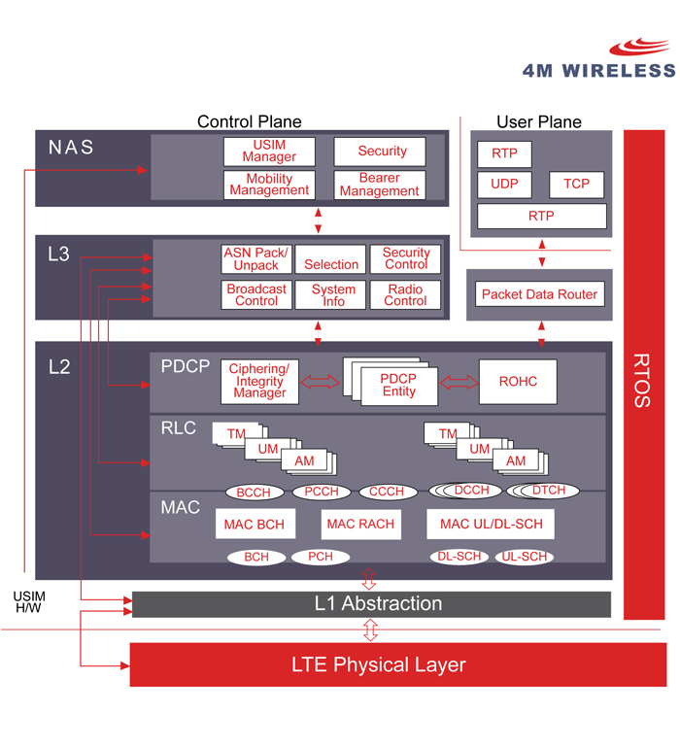
Sample protocol stack from 4M
http://www.4mwireless.com/products_lte_protocol_stack.php

Slide 20
WiMAX: (IEEE 802.16) Overview
An 802.16 wireless service provides a communications path between a subscriber site and a core network (the network to which 802.16 is providing access).
Examples of a core network are the public telephone network and the Internet.
IEEE 802.16 standards are concerned with the air interface between a subscriber's transceiver station and a base transceiver station.
Time line: ~2001 first version, 2009 wide deployment of IEEE 802.16e-2005, current 802.16m-2011
http://www.networkworld.com/news/tech/2001/0903tech.html
http://en.wikipedia.org/wiki/IEEE_802.16

Slide 21
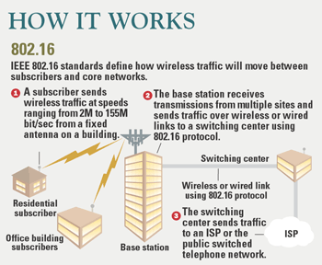
WiMAX: How it works
http://www.networkworld.com/news/tech/2001/0903tech.html

Slide 22
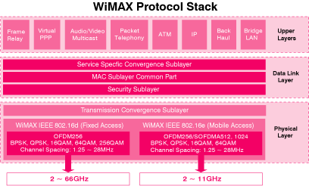
WiMAX Protocol stack
http://www.javvin.com/protocolWiMAX.html

Slide 23
IEEE 802.11, 15, 16 compared
Parameters | EEE802.16d (802.16-2004 Fixed WiMAX) | IEEE802.16e (802.16-2005 Mobile WiMAX) | 802.11 (WLAN, aka WiFi) | 802.15.1 (Bluetooth)
Frequency Band: | 2-66 GHz | 2-11 GHz | 2.4-5.8 GHz | 2.4GHz
Range: | ~31 miles | ~31 miles | ~100 meters | ~10 meters
Maximum Data rate: | ~134 Mbps | ~15 Mbps | ~55 Mbps | ~3Mbps
Number of users: | Thousands | Thousands | Dozens | Dozens
http://www.javvin.com/protocolWiMAX.html

Slide 24
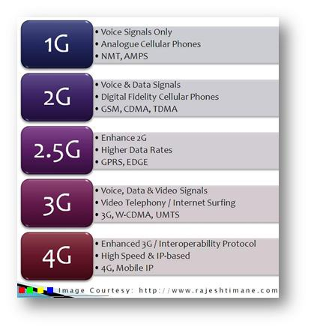
A brief comparison of different G’s
http://techtectology.blogspot.com/2011/11/4g-vs-3g-vs-25g-vs-2g-vs-1g.html

