Slide 1
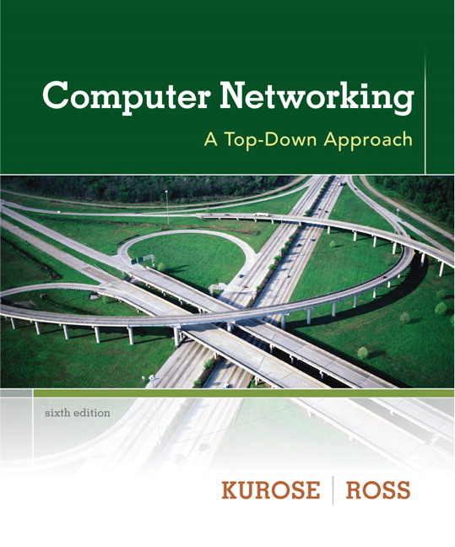

Chapter 6
Wireless and Mobile Networks
A note on the use of these ppt slides:
We’re making these slides freely available to all (faculty, students, readers). They’re in PowerPoint form so you see the animations; and can add, modify, and delete slides (including this one) and slide content to suit your needs. They obviously represent a lot of work on our part. In return for use, we only ask the following:
Computer Networking: A Top Down Approach
6th edition
Jim Kurose, Keith Ross
Addison-Wesley
March 2012
If you use these slides (e.g., in a class) that you mention their source (after all, we’d like people to use our book!)
If you post any slides on a www site, that you note that they are adapted from (or perhaps identical to) our slides, and note our copyright of this material.
Thanks and enjoy! JFK/KWR
All material copyright 1996-2012
J.F Kurose and K.W. Ross, All Rights Reserved
The course notes are adapted for Bucknell’s CSCI 363
Xiannong Meng
Spring 2016

Slide 2
Chapter 6 outline
6.1 Introduction
Wireless
6.2 Wireless links, characteristics
  CDMA
6.3 IEEE 802.11 wireless LANs (“Wi-Fi”)
6.4 Cellular Internet Access
  architecture
  standards (e.g., GSM)
Mobility
6.5 Principles: addressing and routing to mobile users
6.6 Mobile IP
6.7 Handling mobility in cellular networks
6.8 Mobility and higher-layer protocols
6.9 Summary

Slide 3
What is mobility?
spectrum of mobility, from the network perspective:
no mobility
high mobility
mobile wireless user,
using same access
point
mobile user, connecting/ disconnecting from network using DHCP.
mobile user, passing through multiple access point while maintaining ongoing connections (like cell phone)

Slide 4




Mobility: vocabulary
home network: permanent “home” of mobile
(e.g., 128.119.40/24)
home agent: entity that will perform mobility functions on behalf of mobile, when mobile is remote
wide area network
permanent address: address in home network, can always be used to reach mobile
e.g., 128.119.40.186

Slide 5
Mobility: more vocabulary
permanent address: remains constant (e.g., 128.119.40.186)
visited network: network in which mobile currently resides (e.g., 79.129.13/24)
care-of-address: address in visited network.
(e.g., 79,129.13.2)
wide area network
foreign agent: entity in visited network that performs mobility functions on behalf of mobile.
correspondent: wants to communicate with mobile

Slide 6

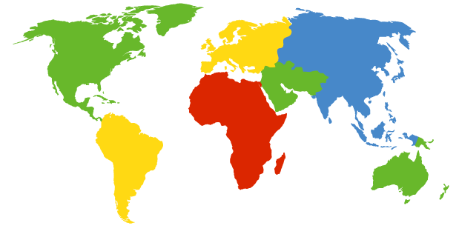

How do you contact a mobile friend:
Consider friend frequently changing addresses, how do you find her?
I wonder where Alice moved to?
search all phone books?
call her parents?
expect her to let you know where he/she is?

Slide 7
Mobility: how to handle it?
let routing handle it: routers advertise permanent address of mobile-nodes-in-residence via usual routing table exchange.
  routing tables indicate where each mobile located
  no changes to end-systems
let end-systems handle it:
  indirect routing: communication from correspondent to mobile goes through home agent, then forwarded to remote
  direct routing: correspondent gets foreign address of mobile, sends directly to mobile

Slide 8
Mobility: approaches
let routing handle it: routers advertise permanent address of mobile-nodes-in-residence via usual routing table exchange.
  routing tables indicate where each mobile located
  no changes to end-systems
let end-systems handle it:
  indirect routing: communication from correspondent to mobile goes through home agent, then forwarded to remote
  direct routing: correspondent gets foreign address of mobile, sends directly to mobile
not
scalable
to millions of
mobiles

Slide 9
Mobility: registration
visited network
home network
1
2
wide area network
mobile contacts foreign agent on entering visited network
foreign agent contacts home agent home: “this mobile is resident in my network”
end result:
foreign agent knows about mobile
home agent knows location of mobile

Slide 10
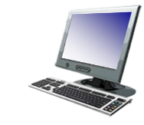
Mobility via indirect routing
foreign agent receives packets, forwards to mobile
home agent intercepts packets, forwards to foreign agent
visited
network
home
network
3
wide area network
2
1
correspondent addresses packets using home address of mobile
4
mobile replies directly to correspondent

Slide 11



Indirect Routing: comments
mobile uses two addresses:
  permanent address: used by correspondent (hence mobile location is transparent to correspondent)
  care-of-address: used by home agent to forward datagrams to mobile
foreign agent functions may be done by mobile itself
triangle routing: correspondent-home-network-mobile
  inefficient when
  correspondent, mobile
  are in same network or close
  to each other.

Slide 12
Indirect routing: moving between networks
suppose mobile user moves to another network
  registers with new foreign agent
  new foreign agent registers with home agent
  home agent update care-of-address for mobile
  packets continue to be forwarded to mobile (but with new care-of-address)
mobility, changing foreign networks transparent: on going connections can be maintained!

Slide 13


Mobility via direct routing
foreign agent receives packets, forwards to mobile
correspondent forwards to foreign agent
visited
network
home
network
3
1
2
4
correspondent requests, receives foreign address of mobile
mobile replies directly to correspondent

Slide 14




Mobility via direct routing: comments
overcome triangle routing problem
non-transparent to correspondent: correspondent must get care-of-address from home agent
  what if mobile changes visited network?
3
1
2
4

Slide 15


Accommodating mobility with direct routing
anchor foreign agent: FA in first visited network
data always routed first to anchor FA
when mobile moves: new FA arranges to have data forwarded from old FA (chaining)
foreign net visited
at session start
anchor
foreign
agent
wide area network
2
1
4
5
3
new
foreign
network
correspondent
agent
new foreign
agent
correspondent

Slide 16
Chapter 6 outline
6.1 Introduction
Wireless
6.2 Wireless links, characteristics
  CDMA
6.3 IEEE 802.11 wireless LANs (“Wi-Fi”)
6.4 Cellular Internet Access
  architecture
  standards (e.g., GSM)
Mobility
6.5 Principles: addressing and routing to mobile users
6.6 Mobile IP
6.7 Handling mobility in cellular networks
6.8 Mobility and higher-layer protocols
6.9 Summary

Slide 17
Mobile IP
Specified in RFC 3344 (2002)
has many features we’ve seen:
  home agents, foreign agents, foreign-agent registration, care-of-addresses, encapsulation (packet-within-a-packet)
three components to standard:
  indirect routing of datagrams
  agent discovery
  registration with home agent

Slide 18
Mobile IP: indirect routing
foreign-agent-to-mobile packet
packet sent by home agent to foreign agent: a packet within a packet
dest: 128.119.40.186
dest: 79.129.13.2
dest: 128.119.40.186
Permanent address: 128.119.40.186
Care-of address: 79.129.13.2
dest: 128.119.40.186
packet sent by correspondent

Slide 19
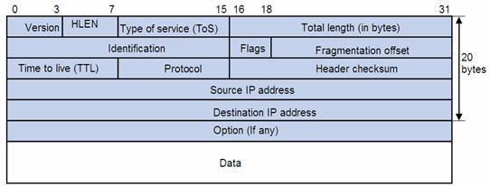
IP and ICMP
Mobile IP uses ICMP for router management (advertising home/mobile agents)
List of IP protocols:
http://en.wikipedia.org/wiki/List_of_IP_protocol_numbers
When “Protocol” equals 0x01, the IP packet carries an ICMP as
Its payload (data)

Slide 20
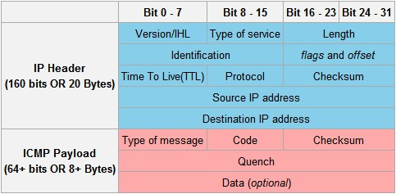
ICMP: Internet Control Message Protocol review
A combination of “type of message” and “code” specifies the meaning
of this ICMP packet. Among others
-- Type 9 is for “route advertising”
-- See a complete list from Wikipedia at
http://en.wikipedia.org/wiki/Internet_Control_Message_Protocol#Header
-- Run IP packet analysis lab solution (no-pcap) using “icmp-etherreal-trace-1”
as data to see Type 8 and Type 0 ICMP messages (Echo request and
Echo reply)

Slide 21
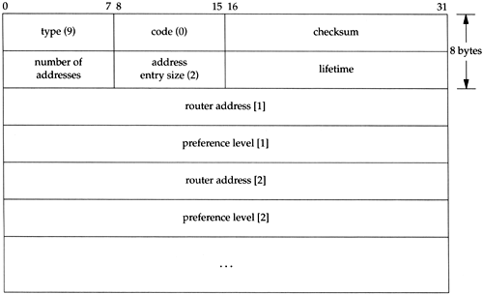
ICMP Type 9 message (route discovery)
Specification at RFC http://www.ietf.org/rfc/rfc1256.txt
http://flylib.com/books/3/223/1/html/2/files/09fig07.gif

Slide 22
Mobile IP: agent discovery
agent advertisement: foreign/home agents advertise service by broadcasting ICMP messages (typefield = 9)
H,F bits: home and/or foreign agent
R bit: registration required

Slide 23
Flags in ICMP mobile extension
H: home agent bit
F: foreign agent bit
R: registration required bit
M,G: encapsulation bits (minimal or GRE encapsulation)
B: busy
r: reserved
T: reverse tunneling

Slide 24
Other ICMP Messages Used by Mobile IP
Type 10 : agent solicitation, mobile agent is looking for COA without advertisement
Type 35 : mobile registration request
Type 36 : mobile registration reply

Slide 25


Mobile IP: registration example
visited network: 79.129.13/24
home agent
HA: 128.119.40.7
foreign agent
COA: 79.129.13.2
mobile agent
MA: 128.119.40.186
ICMP agent adv.
COA: 79.129.13.2
….
registration req.
registration req.
COA: 79.129.13.2
HA: 128.119.40.7
MA: 128.119.40.186
Lifetime: 9999
identification: 714
encapsulation format
….
COA: 79.129.13.2
HA: 128.119.40.7
MA: 128.119.40.186
Lifetime: 9999
identification:714
….
registration reply
HA: 128.119.40.7
MA: 128.119.40.186
Lifetime: 4999
Identification: 714
encapsulation format
….
registration reply
HA: 128.119.40.7
MA: 128.119.40.186
Lifetime: 4999
Identification: 714
….
time

Slide 26
Components of cellular network architecture
recall:
correspondent
wired public telephone
network
MSC
MSC
MSC
MSC
MSC
different cellular networks,
operated by different providers

Slide 27
Handling mobility in cellular networks
home network: network of cellular provider you subscribe to (e.g., Sprint PCS, Verizon)
  home location register (HLR): database in home network containing permanent cell phone #, profile information (services, preferences, billing), information about current location (could be in another network)
visited network: network in which mobile currently resides
  visitor location register (VLR): database with entry for each user currently in network
  could be home network

Slide 28

GSM: indirect routing to mobile
HLR
home
network
2
correspondent
home
Mobile
Switching
Center
home MSC consults HLR,
gets roaming number of
mobile in visited network
1
call routed
to home network
3
Public switched
telephone
network
VLR
Mobile
Switching
Center
4
home MSC sets up 2nd leg of call
to MSC in visited network
mobile
user
MSC in visited network completes
call through base station to mobile
visited
network

Slide 29
GSM: handoff with common MSC
handoff goal: route call via new base station (without interruption)
reasons for handoff:
  stronger signal to/from new BS (continuing connectivity, less battery drain)
  load balance: free up channel in current BS
  GSM doesn’t mandate why to perform handoff (policy), only how (mechanism)
handoff initiated by old BS
VLR
Mobile
Switching
Center
old
routing
new
routing
old BS
new BS

Slide 30
GSM: handoff with common MSC
1. old BS informs MSC of impending handoff, provides list of 1⁺ new BSs
2. MSC sets up path (allocates resources) to new BS
3. new BS allocates radio channel for use by mobile
4. new BS signals MSC, old BS: ready
5. old BS tells mobile: perform handoff to new BS
6. mobile, new BS signal to activate new channel
7. mobile signals via new BS to MSC: handoff complete. MSC reroutes call
8 MSC-old-BS resources released
VLR
Mobile
Switching
Center
4
2
1
8
7
3
old BS
5
6
new BS

Slide 31
GSM: handoff between MSCs
anchor MSC: first MSC visited during call
  call remains routed through anchor MSC
new MSCs add on to end of MSC chain as mobile moves to new MSC
optional path minimization step to shorten multi-MSC chain
home network
correspondent
Home MSC
anchor MSC
PSTN
MSC
MSC
MSC
(a) before handoff

Slide 32
GSM: handoff between MSCs
anchor MSC: first MSC visited during call
  call remains routed through anchor MSC
new MSCs add on to end of MSC chain as mobile moves to new MSC
optional path minimization step to shorten multi-MSC chain
home network
correspondent
Home MSC
anchor MSC
PSTN
MSC
MSC
MSC
(b) after handoff

Slide 33
Mobility: GSM versus Mobile IP
GSM element |  | Comment on GSM element | Mobile IP element
Home system | Network to which mobile user’s permanent phone number belongs |  |  | Home network
Gateway Mobile Switching Center, or “home MSC”. Home Location Register (HLR) | Home MSC: point of contact to obtain routable address of mobile user. HLR: database in home system containing permanent phone number, profile information, current location of mobile user, subscription information |  |  | Home agent
Visited System | Network other than home system where mobile user is currently residing |  |  | Visited network
Visited Mobile services Switching Center. Visitor Location Record (VLR) | Visited MSC: responsible for setting up calls to/from mobile nodes in cells associated with MSC. VLR: temporary database entry in visited system, containing subscription information for each visiting mobile user |  |  | Foreign agent
Mobile Station Roaming Number (MSRN), or “roaming number” | Routable address for telephone call segment between home MSC and visited MSC, visible to neither the mobile nor the correspondent. |  |  | Care-of-address

Slide 34
Wireless, mobility: impact on higher layer protocols
logically, impact should be minimal …
  best effort service model remains unchanged
  TCP and UDP can (and do) run over wireless, mobile
… but performance-wise:
  packet loss/delay due to bit-errors (discarded packets, delays for link-layer retransmissions), and handoff
  TCP interprets loss as congestion, will decrease congestion window un-necessarily
  delay impairments for real-time traffic
  limited bandwidth of wireless links

Slide 35
Chapter 6 summary
Wireless
wireless links:
  capacity, distance
  channel impairments
  CDMA
IEEE 802.11 (“Wi-Fi”)
  CSMA/CA reflects wireless channel characteristics
cellular access
  architecture
  standards (e.g., GSM, 3G, 4G LTE)
Mobility
principles: addressing, routing to mobile users
  home, visited networks
  direct, indirect routing
  care-of-addresses
case studies
  mobile IP
  mobility in GSM
impact on higher-layer protocols

