Slide 1
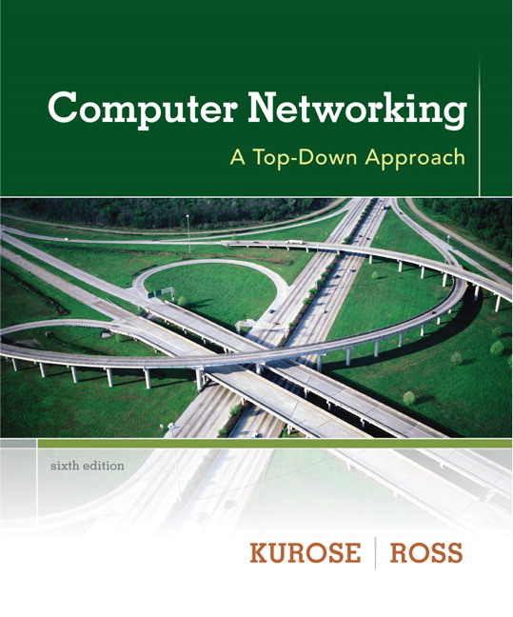

Chapter 8
Security
A note on the use of these ppt slides:
We’re making these slides freely available to all (faculty, students, readers). They’re in PowerPoint form so you see the animations; and can add, modify, and delete slides (including this one) and slide content to suit your needs. They obviously represent a lot of work on our part. In return for use, we only ask the following:
Computer Networking: A Top Down Approach
6th edition
Jim Kurose, Keith Ross
Addison-Wesley
March 2012
If you use these slides (e.g., in a class) that you mention their source (after all, we’d like people to use our book!)
If you post any slides on a www site, that you note that they are adapted from (or perhaps identical to) our slides, and note our copyright of this material.
Thanks and enjoy! JFK/KWR
All material copyright 1996-2012
J.F Kurose and K.W. Ross, All Rights Reserved
The course notes are adapted for
CSCI 363 at Bucknell
Spring 2016, Xiannong Meng

Slide 2
Chapter 8: Network Security
Chapter goals:
understand principles of network security:
  cryptography and its many uses beyond “confidentiality”
  authentication
  message integrity
security in practice:
  firewalls and intrusion detection systems
  security in application, transport, network, link layers

Slide 3
Chapter 8 roadmap
8.1 What is network security?
8.2 Principles of cryptography
8.3 Message integrity, authentication
8.4 Securing e-mail
8.5 Securing TCP connections: SSL
8.6 Network layer security: IPsec
8.7 Securing wireless LANs
8.8 Operational security: firewalls and IDS

Slide 4
What is network security?
confidentiality: only sender, intended receiver should “understand” message contents
  sender encrypts message
  receiver decrypts message
authentication: sender, receiver want to confirm identity of each other
message integrity: sender, receiver want to ensure message not altered (in transit, or afterwards) without detection
access and availability: services must be accessible and available to users

Slide 5



Friends and enemies: Alice, Bob, Trudy
well-known in network security world
Bob, Alice (lovers!) want to communicate “securely”
Trudy (intruder) may intercept, delete, add messages
Alice
Bob
channel
data, control messages
data
secure
sender
secure
receiver
data
Trudy

Slide 6
Who might Bob, Alice be?
… well, real-life Bobs and Alices!
Web browser/server for electronic transactions (e.g., on-line purchases)
on-line banking client/server
DNS servers
routers exchanging routing table updates
other examples?

Slide 7
There are bad guys (and girls) out there!
Q: What can a “bad guy” do?
A: A lot! See section 1.6
  eavesdrop: intercept messages
  actively insert messages into connection
  impersonation: can fake (spoof) source address in packet (or any field in packet)
  hijacking: “take over” ongoing connection by removing sender or receiver, inserting himself in place
  denial of service: prevent service from being used by others (e.g., by overloading resources)

Slide 8
Chapter 8 roadmap
8.1 What is network security?
8.2 Principles of cryptography
8.3 Message integrity, authentication
8.4 Securing e-mail
8.5 Securing TCP connections: SSL
8.6 Network layer security: IPsec
8.7 Securing wireless LANs
8.8 Operational security: firewalls and IDS

Slide 9
The language of cryptography
Alice’s
encryption
key
Bob’s
decryption
key
K
K
A
B
plaintext
encryption
algorithm
ciphertext
decryption
algorithm
plaintext
m plaintext message
K_{A}(m) ciphertext, encrypted with key K_{A}
m = K_{B}(K_{A}(m))

Slide 10
Breaking an encryption scheme
cipher-text only attack: Trudy has ciphertext she can analyze
two approaches:
  brute force: search through all keys
  statistical analysis
known-plaintext attack: Trudy has plaintext corresponding to ciphertext
  e.g., in monoalphabetic cipher, Trudy determines pairings for a,l,i,c,e,b,o,b
chosen-plaintext attack: Trudy can get ciphertext for chosen plaintext

Slide 11
Symmetric key cryptography
K
K
S
S
plaintext
message, m
encryption
algorithm
ciphertext
decryption
algorithm
plaintext
K (m)
m = K_{S}(K_{S}(m))
S
symmetric key crypto: Bob and Alice share same (symmetric) key: K
e.g., key is knowing substitution pattern in mono alphabetic substitution cipher
Q: how do Bob and Alice agree on key value?
S

Slide 12
Simple encryption scheme
substitution cipher: substituting one thing for another
  monoalphabetic cipher: substitute one letter for another
plaintext: abcdefghijklmnopqrstuvwxyz
ciphertext: mnbvcxzasdfghjklpoiuytrewq
e.g.:
Plaintext: bob. i love you. alice
ciphertext: nkn. s gktc wky. mgsbc
Encryption key: mapping from set of 26 letters
to set of 26 letters

Slide 13
A more sophisticated encryption approach
n substitution ciphers, M₁,M₂,…,M_{n}
cycling pattern:
  e.g., n=4: M₁,M₃,M₄,M₃,M₂; M₁,M₃,M₄,M₃,M₂; ..
for each new plaintext symbol, use subsequent substitution pattern in cyclic pattern
  bob: b using M₁, o using M₃, b using M₄
  b -> ‘k’, o -> ‘m’, b -> ‘y’
  Encryption key: n substitution ciphers, and cyclic pattern
  key need not be just n-bit pattern

Slide 14
Symmetric key crypto: DES
DES: Data Encryption Standard
US encryption standard, published 1975, originally adopted 1976, reaffirmed 1983, 1988, 1993, 1999, withdrew 2004
56-bit symmetric key, 64-bit plaintext input
block cipher with cipher block chaining
how secure is DES?
  DES Challenge: 56-bit-key-encrypted phrase decrypted (brute force) in less than a day (2008)
    http://en.wikipedia.org/wiki/Data_Encryption_Standard
  no known good analytic attack
making DES more secure:
  3DES: encrypt 3 times with 3 different keys

Slide 15
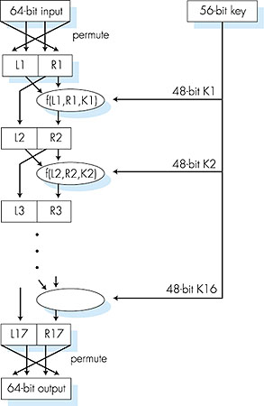
Symmetric key crypto: DES
DES operation
initial permutation
16 identical “rounds” of function application, each using different 48 bits of key
final permutation

Slide 16
AES: Advanced Encryption Standard
symmetric-key NIST standard, replaced DES (Nov 2001)
processes data in 128 bit blocks
  10 cycles for128 bit keys
  12 cycles for 192 bit keys
  14 cycles for 256 bit keys
brute force decryption (try each key) takes 1 sec on DES, would take149 trillion years for AES
See http://en.wikipedia.org/wiki/Advanced_Encryption_Standard

Slide 17
How to agree on “key(s)”?
symmetric key crypto
requires sender, receiver know shared secret key
Q: how to agree on key in first place (particularly if never “met”)?
public key crypto
radically different approach [Diffie-Hellman76, RSA78]
sender, receiver do not share secret key
public encryption key known to all
private decryption key known only to receiver

Slide 18
Public key cryptography
+
Bob’s public
key
K
B
-
Bob’s private
key
K
B
plaintext
message, m
encryption
algorithm
ciphertext
decryption
algorithm
plaintext
message
+
K (m)
-
+
B
m = K (K (m))
B
B

Slide 19
Public key encryption algorithms
requirements:
.
.
+
-
1
need K ( ) and K ( ) such that
B
B
-
+
K (K (m)) = m
B
B
2
+
given public key K , it should be impossible to compute private key K
B
-
B
RSA: Rivest, Shamir, Adelson algorithm

Slide 20
Prerequisite: modular arithmetic
x mod n = remainder of x when divide by n
facts:
  [(a mod n) + (b mod n)] mod n = (a+b) mod n
  [(a mod n) - (b mod n)] mod n = (a-b) mod n
  [(a mod n) * (b mod n)] mod n = (a*b) mod n
thus
(a mod n)^{d} mod n = a^{d} mod n
example: x=14, n=10, d=2:
(x mod n)^{d} mod n = 4² mod 10 = 6
x^{d} = 14² = 196 x^{d} mod 10 = 6

Slide 21
RSA: getting ready
message: just a bit pattern
bit pattern can be uniquely represented by an integer number
thus, encrypting a message is equivalent to encrypting a number.
example:
m= 10010001 . This message is uniquely represented by the decimal number 145.
to encrypt m, we encrypt the corresponding number, which gives a new number (the ciphertext).

Slide 22
RSA: Creating public/private key pair
1. choose two large prime numbers p, q.
(e.g., 1024 bits each)
2. compute n = pq, z = (p-1)(q-1)
3. choose e (with e<n) that has no common factors
with z (e, z are “relatively prime”).
4. choose d such that ed-1 is exactly divisible by z.
(in other words: ed mod z = 1 ).
5. public key is (n,e). private key is (n,d).
+
-
K
K
B
B

Slide 23
RSA: encryption, decryption
0. given (n,e) and (n,d) as computed above
1. to encrypt message m (<n), compute
e
c = m mod n
2. to decrypt received bit pattern, c, compute
d
m = c mod n
magic
happens!
e
d
m = (m mod n)
mod n
c
See a proof later.

Slide 24
RSA example:
Bob chooses p=5, q=7. Then n=35, z=24.
e=5 (so e, z relatively prime).
d=29 (so ed-1 exactly divisible by z).
encrypting 8-bit messages.
m
e
e
bit pattern
m
c = m mod n
encrypt
letter ‘L’
or value 12:
00001100
12
248832
17
d
d
c
c
m = c mod n
decrypt:
17
481968572106750915091411825223071697
12

Slide 25
RSA implementation in openssl
At the Linux command prompt, where openssl has been installed
  To generate private key
    openssl genrsa -out private.pem 2048
  To generate public key based on the private key
    openssl rsa -in private.pem -outform PEM -pubout -out public.pem
PEM format
  The PEM format is the most common format that Certificate Authorities issue certificates in.
  They are Base64 encoded ASCII files.

Slide 26
Why does RSA work?
must show that c^{d} mod n = m
where c = m^{e} mod n
fact: for any x and y: x^{y} mod n = x^{(y mod z)} mod n
  where n= pq and z = (p-1)(q-1)
  Fact 4 in earlier set : ed mod z = 1
thus,
c^{d} mod n = (m^{e} mod n)^{d} mod n
= m^{ed} mod n
= m^{(ed mod z)} mod n
= m¹ mod n
= m

Slide 27
RSA: another important property
The following property will be very useful later:
-
+
+
-
K (K (m)) = m
=
K (K (m))
B
B
B
B
use public key first, followed by private key
use private key first, followed by public key
result is the same!

Slide 28
Why
-
+
+
-
K (K (m)) = m
?
=
K (K (m))
B
B
B
B
follows directly from modular arithmetic:
(m^{e} mod n)^{d} mod n = m^{ed} mod n
= m^{de} mod n
= (m^{d} mod n)^{e} mod n

Slide 29
Why is RSA secure?
suppose you know Bob’s public key (n,e). How hard is it to determine d?
essentially need to find factors of n without knowing the two factors p and q
  fact: factoring a big number is hard

Slide 30
RSA in practice: session keys
exponentiation in RSA is computationally intensive
DES is at least 100 times faster than RSA
use public key cryto to establish secure connection, then establish second key – symmetric session key – for encrypting data
session key, K_{S}
Bob and Alice use RSA to exchange a symmetric key K_{S}
once both have K_{S}, they use symmetric key cryptography

