Slide 1
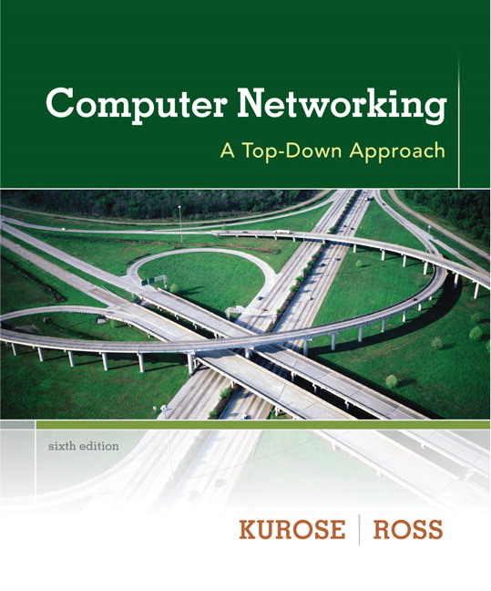

Chapter 8
Security
A note on the use of these ppt slides:
We’re making these slides freely available to all (faculty, students, readers). They’re in PowerPoint form so you see the animations; and can add, modify, and delete slides (including this one) and slide content to suit your needs. They obviously represent a lot of work on our part. In return for use, we only ask the following:
Computer Networking: A Top Down Approach
6th edition
Jim Kurose, Keith Ross
Addison-Wesley
March 2012
If you use these slides (e.g., in a class) that you mention their source (after all, we’d like people to use our book!)
If you post any slides on a www site, that you note that they are adapted from (or perhaps identical to) our slides, and note our copyright of this material.
Thanks and enjoy! JFK/KWR
All material copyright 1996-2012
J.F Kurose and K.W. Ross, All Rights Reserved
The course notes are adapted for
CSCI 363 at Bucknell
Spring 2016, Xiannong Meng

Slide 2
Chapter 8 roadmap
8.1 What is network security?
8.2 Principles of cryptography
8.3 Message integrity
8.4 Securing e-mail
8.5 Securing TCP connections: SSL
8.6 Network layer security: IPsec
8.7 Securing wireless LANs
8.8 Operational security: firewalls and IDS

Slide 3
SSL: Secure Sockets Layer
widely deployed security protocol
  supported by almost all browsers, web servers
  https
  billions $/year over SSL
mechanisms: [Woo 1994], implementation: Netscape
variation -TLS: transport layer security, RFC 2246 (1999)
provides
  confidentiality
  integrity
  authentication
original goals:
  Web e-commerce transactions
  encryption (especially credit-card numbers)
  Web-server authentication
  optional client authentication
  minimum hassle in doing business with new merchant
available to all TCP applications
  secure socket interface

Slide 4
SSL and TCP/IP
Application
Application
SSL
TCP
TCP
IP
IP
normal application
application with SSL
SSL provides application programming interface (API) to applications
C and Java SSL libraries/classes readily available

Slide 5

Could do something like PGP:
-
K_{A}
.
.
-
-
K_{A}(H(m))
K_{S}
m
H( )
K_{A}( )
.
+
K_{S}( )
m
+
Internet
.
+
K_{S}
K_{B}( )
+
K_{B}(K_{S} )
+
K_{B}
but want to send byte streams & interactive data
want set of secret keys for entire connection
want certificate exchange as part of protocol: handshake phase

Slide 6
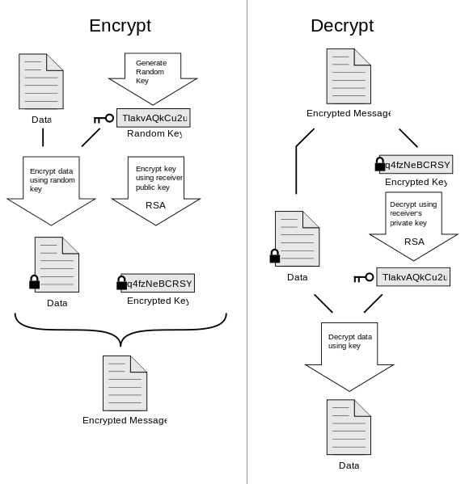
PGP: Pretty Good Privacy
https://en.wikipedia.org/wiki/File:PGP_diagram.svg

Slide 7
Toy SSL: a simple secure channel
handshake: Alice and Bob use their certificates, private keys to authenticate each other and exchange shared secret
key derivation: Alice and Bob use shared secret to derive set of keys
data transfer: data to be transferred is broken up into series of records
connection closure: special messages to securely close connection

Slide 8

Toy: a simple handshake
hello
public key certificate
K_{B}⁺(MS) = EMS
MS: master secret
EMS: encrypted master secret

Slide 9
Toy: key derivation
considered bad to use same key for more than one cryptographic operation
  use different keys for Message Authentication Code (MAC) and encryption
four keys:
  K_{c} = encryption key for data sent from client to server
  M_{c} = MAC key for data sent from client to server
  K_{s} = encryption key for data sent from server to client
  M_{s} = MAC key for data sent from server to client
keys derived from key derivation function (KDF)
  takes master secret and (possibly) some additional random data and creates the keys

Slide 10
Toy: data records
why not encrypt data in constant stream as we write it to TCP?
  where would we put the MAC? If at end, no message integrity until all data processed.
  e.g., with instant messaging, how can we do integrity check over all bytes sent before displaying?
instead, break stream in series of records
  each record carries a MAC
  receiver can act on each record as it arrives
issue: in record, receiver needs to distinguish MAC from data
  want to use variable-length records
length
data
MAC

Slide 11
Toy: sequence numbers
problem: attacker can capture and replay record or re-order records
solution: put sequence number into MAC:
  MAC = MAC(M_{x}, sequence||data)
  note: no sequence number field
problem: attacker could replay all records
solution: use nonce

Slide 12
Toy: control information
problem: truncation attack:
  attacker forges TCP connection close segment
  one or both sides thinks there is less data than there actually is.
solution: record types, with one type for closure
  type 0 for data; type 1 for closure
MAC = MAC(M_{x}, sequence||type||data)
length
type
data
MAC

Slide 13
Toy SSL: summary
hello
certificate, nonce
K_{B}⁺(MS) = EMS
type 0, seq 1, data
bob.com
type 0, seq 2, data
type 0, seq 1, data
encrypted
type 0, seq 3, data
type 1, seq 4, close
type 1, seq 2, close

Slide 14
Toy SSL isn’t complete
how long are fields?
which encryption protocols?
want negotiation?
  allow client and server to support different encryption algorithms
  allow client and server to choose together specific algorithm before data transfer

Slide 15
SSL cipher suite
cipher suite
  public-key algorithm
  symmetric encryption algorithm
  MAC algorithm
SSL supports several cipher suites
negotiation: client, server agree on cipher suite
  client offers choice
  server picks one
common SSL symmetric ciphers
  DES – Data Encryption Standard: block
  3DES – Triple strength: block
  RC2 – Rivest Cipher 2: block
  RC4 – Rivest Cipher 4: stream
SSL Public key encryption
  RSA

Slide 16
Real SSL: handshake (1)
Purpose
server authentication
negotiation: agree on crypto algorithms
establish keys
client authentication (optional)

Slide 17
Real SSL: handshake (2)
client sends list of algorithms it supports, along with client nonce
server chooses algorithms from list; sends back: choice + certificate + server nonce
client verifies certificate, extracts server’s public key, generates pre_master_secret, encrypts with server’s public key, sends to server
client and server independently compute encryption and MAC keys from pre_master_secret and nonces
client sends a MAC of all the handshake messages
server sends a MAC of all the handshake messages

Slide 18
Real SSL: handshaking (3)
last 2 steps protect handshake from tampering
client typically offers range of algorithms, some strong, some weak
person-in-the middle could delete stronger algorithms from list
last 2 steps prevent this
  last two messages are encrypted

Slide 19
Real SSL: handshaking (4)
why two random nonces (one for server and one for client) in a session?
suppose Trudy sniffs all messages between Alice & Bob
next day, Trudy sets up TCP connection with Bob, sends exact same sequence of records
  Bob (Amazon) thinks Alice made two separate orders for the same thing
  solution: Bob sends different random nonce for each connection. This causes encryption keys to be different on the two days
  Trudy’s messages will fail Bob’s integrity check

Slide 20
SSL record protocol
data
data
fragment
MAC
data
fragment
MAC
record
header
encrypted
data and MAC
record
header
encrypted
data and MAC
record header: content type; version; length
MAC: includes sequence number, MAC key M_{x}
fragment: each SSL fragment 2¹⁴ bytes (~16 Kbytes)

Slide 21
SSL record format
1 byte
2 bytes(major/minor)
2 bytes
content
type
length
SSL version
data
MAC
data and MAC encrypted (symmetric algorithm)
MAC length is variable depending on the chosen algorithm,
e.g., MD5: 128 bits MAC, SHA1: 160 bits MAC

Slide 22
Real SSL connection
handshake: ClientHello
handshake: ServerHello
handshake: Certificate
handshake: ServerHelloDone
handshake: ClientKeyExchange
ChangeCipherSpec
everything
henceforth
is encrypted
handshake: Finished
ChangeCipherSpec
handshake: Finished
application_data
application_data
Alert: warning, close_notify
TCP FIN follows

