Slide 1
Chapter 7 Multimedia Networking
A note on the use of these ppt slides:
We’re making these slides freely available to all (faculty, students, readers). They’re in PowerPoint form so you see the animations; and can add, modify, and delete slides (including this one) and slide content to suit your needs. They obviously represent a lot of work on our part. In return for use, we only ask the following:
Computer Networking: A Top Down Approach 6th edition Jim Kurose, Keith Ross Addison-Wesley March 2012
If you use these slides (e.g., in a class) that you mention their source (after all, we’d like people to use our book!)
If you post any slides on a www site, that you note that they are adapted from (or perhaps identical to) our slides, and note our copyright of this material.
Thanks and enjoy! JFK/KWR
All material copyright 1996-2012
J.F Kurose and K.W. Ross, All Rights Reserved
The course notes are adapted for
CSCI 363 at Bucknell
Spring 2016, Xiannong Meng

Slide 2
Multimedia networking: outline
7.1 multimedia networking applications
7.2 streaming stored video
7.3 voice-over-IP
7.4 protocols for real-time conversational applications
7.5 network support for multimedia

Slide 3
Multimedia: audio
analog audio signal sampled at constant rate
telephone: 8,000 samples/sec
music CD : 44,100 samples/sec
each sample quantized, i.e., rounded
e.g., 2⁸=256 possible quantized values
each quantized value represented by bits, e.g., 8 bits for 256 values
quantization error
quantized value of
analog value
analog
signal
audio signal amplitude
time
sampling rate
(N sample/sec)

Slide 4
Multimedia: audio
example: 8,000 samples/sec, 256 quantized values: 64,000 bps
receiver converts bits back to analog signal:
some quality reduction
example rates
CD: 1.411 Mbps (44,100 samples/s, 16 bit/s or 705.6 kbps for mono, 32bit/s or 1.411mbps for stereo)
MP3: 96 kbps, 128 kbps, 160 kbps
Internet telephony: 5.3 kbps and up
quantization error
quantized value of
analog value
analog
signal
audio signal amplitude
time
sampling rate
(N sample/sec)

Slide 5
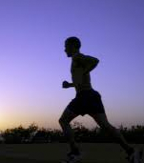
Multimedia: video
spatial coding example: instead of sending N values of same color (all purple), send only two values: color value (purple) and number of repeated values (N)
video: sequence of images displayed at constant rate
e.g., 24 images/sec
digital image: array of pixels
each pixel represented by bits
coding: use redundancy within and between images to decrease # bits used to encode image
spatial (within image)
temporal (from one image to next)
……………………...…
……………………...…
frame i
temporal coding example: instead of sending complete frame at i+1, send only differences from frame i
frame i+1

Slide 6
Multimedia: video
spatial coding example: instead of sending N values of same color (all purple), send only two values: color value (purple) and number of repeated values (N)
CBR: (constant bit rate): video encoding rate fixed
VBR: (variable bit rate): video encoding rate changes as amount of spatial, temporal coding changes
examples:
MPEG 1 (CD-ROM) 1.5 Mbps
MPEG2 (DVD) 3-6 Mbps
MPEG4 (often used in Internet, < 1 Mbps)
……………………...…
……………………...…
frame i
temporal coding example: instead of sending complete frame at i+1, send only differences from frame i
frame i+1

Slide 7
Multimedia networking: 3 application types
streaming, stored audio, video
streaming: can begin playout before downloading entire file
stored (at server): can transmit faster than audio/video, will be rendered (implies storing/buffering at client)
e.g., YouTube, Netflix, Hulu
conversational (interactive) voice/video over IP
interactive nature of human-to-human conversation limits delay tolerance
e.g., Skype
streaming live audio, video
e.g., live sporting event (futbol)

Slide 8
Multimedia networking: outline
7.1 multimedia networking applications
7.2 streaming stored video
7.3 voice-over-IP
7.4 protocols for real-time conversational applications
7.5 network support for multimedia

Slide 9
Streaming stored video:
Cumulative data
2. video
sent
video
recorded (e.g., 30 frames/sec)
3. video received,
played out at client
(30 frames/sec)
network delay
(fixed in this example)
time
streaming: at this time, client
playing out early part of video,
while server still sending later
part of video

Slide 10
Streaming stored video: challenges
continuous playout constraint: once client playout begins, playback must match original timing
… but network delays are variable (jitter), so will need client-side buffer to match playout requirements
other challenges:
client interactivity: pause, fast-forward, rewind, jump through video
video packets may be lost, retransmitted

Slide 11
Streaming stored video: revisted
constant bit
rate video
transmission
client video
reception
constant bit
rate video
playout at client
Cumulative data
variable
network
delay
buffered
video
client playout
delay
time
client-side buffering and playout delay: compensate for network-added delay, delay jitter

Slide 12
Client-side buffering, playout
buffer fill level, Q(t)
variable fill
rate, x(t)
playout rate,
e.g., CBR r
video server
client application
buffer, size B
client

Slide 13
Client-side buffering, playout
buffer fill level, Q(t)
variable fill
rate, x(t)
playout rate,
e.g., CBR r
video server
client application
buffer, size B
client
1. Initial fill of buffer until playout begins at t_{p}
2. playout begins at t_{p,}
3. buffer fill level varies over time as fill rate x(t) varies and playout rate r is constant

Slide 14
Client-side buffering, playout
buffer fill level, Q(t)
variable fill
rate, x(t)
playout rate,
e.g., CBR r
video server
client application
buffer, size B
playout buffering: average fill rate (~x), playout rate (r):
~x < r : buffer eventually empties (causing freezing of video playout until buffer again fills)
~x > r: buffer will not empty, provided initial playout delay is large enough to absorb variability in x(t)
initial playout delay tradeoff: buffer starvation less likely with larger delay, but larger delay until user begins watching

Slide 15
Streaming multimedia: UDP
server sends at rate appropriate for client
often: send rate = encoding rate = constant rate
transmission rate can be oblivious to congestion levels
short playout delay (2-5 seconds) to remove network jitter
error recovery: application-level, timeipermitting
RTSP (Real Time Streaming Protocol) [RFC 2326]: multimedia payload types
UDP may not go through firewalls

Slide 16
UDP stream example and issues
Video consumption rate: 2 Mbps (given)
Then the server would transmit one UDP packet full of data every (8000 bits)/(2 Mbps) = 4 ms, assuming each packet contains 8000 bits data
Some issues:
UDP doesn’t handle variable network bandwidth well
UDP streaming requires a media control server (e.g., RTSP server) to process client-server interaction, and to track client state
Many firewalls are designed to block UDP traffic

Slide 17
Streaming multimedia: HTTP
multimedia file retrieved via HTTP GET
send at maximum possible rate under TCP
fill rate fluctuates due to TCP congestion control, retransmissions (in-order delivery)
larger playout delay: smooth TCP delivery rate
HTTP/TCP passes more easily through firewalls
variable rate, x(t)
video
file
TCP send buffer
TCP receive buffer
application playout buffer
server
client

Slide 18
Streaming multimedia: DASH
DASH: Dynamic, Adaptive Streaming over HTTP (a.k.a. MPEG-DASH)
“intelligence” at client: client determines
when to request chunk (so that buffer starvation, or overflow does not occur)
what encoding rate to request (higher quality when more bandwidth available)
where to request chunk (can request from URL server that is “close” to client or has high available bandwidth)

Slide 19
Streaming multimedia: DASH
server:
divides video file into multiple chunks
each chunk stored, encoded at different rates
manifest file: provides URLs for different chunks
client:
periodically measures server-to-client bandwidth
consulting manifest, requests one chunk at a time
chooses maximum coding rate sustainable given current bandwidth
can choose different coding rates at different points in time (depending on available bandwidth at time)

Slide 20
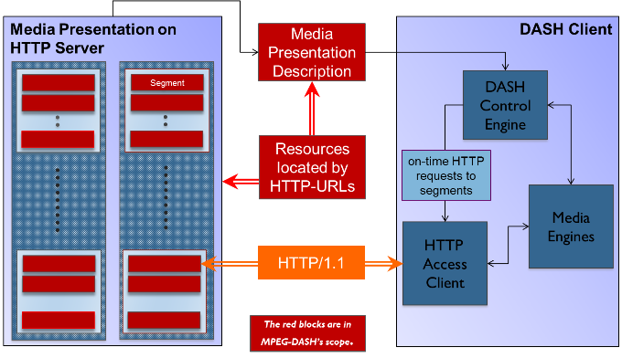
MPEG-DASH structure
http://dashif.org/mpeg-dash/

